Slide 1
21stc. Academic Presses and Online Universities: Envisioning Futures
Ray Uzwyshyn, Ph.D. MBA MLIS

Slide 2
The University Press & Academic Publishing Possibilities Are Quickly Changing
Books, Players, Markets and Models
are in a State of
Evolution & Redefinition
The Medium is the Message Marshall McLuhan
Uzwyshyn, R. “Evolving eTextbook Landscapes: Strategies, Platform, Innovation” Journal of Digital Media Management, Spring 2012.

Slide 3
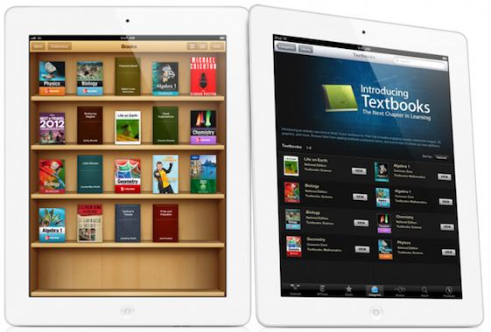
Foundational Models For Publishers and UNIversities in FLUX
Bookstore
Distribution Models
University
Apple ibooks Author: http://www.apple.com/ibooks-author/

Slide 4
Paradigm Shift New ERA of Academic/Technological/ Press Opportunities
REIMAGINING
Press
University
Classroom
Library
Relationships For 21st Century
Gutenberg II

Slide 5
online University, Academic Press Online Libraries, Technology
Rich Space for Learning. Cross-fertilization of
Projects, People and
Skillsets.
Learning Ecosystems
ePress
Learning Management System (University)
Online Library,
e-books, e- journals Resources
Faculty
Students
Librarians
Technologists
Community

Slide 6
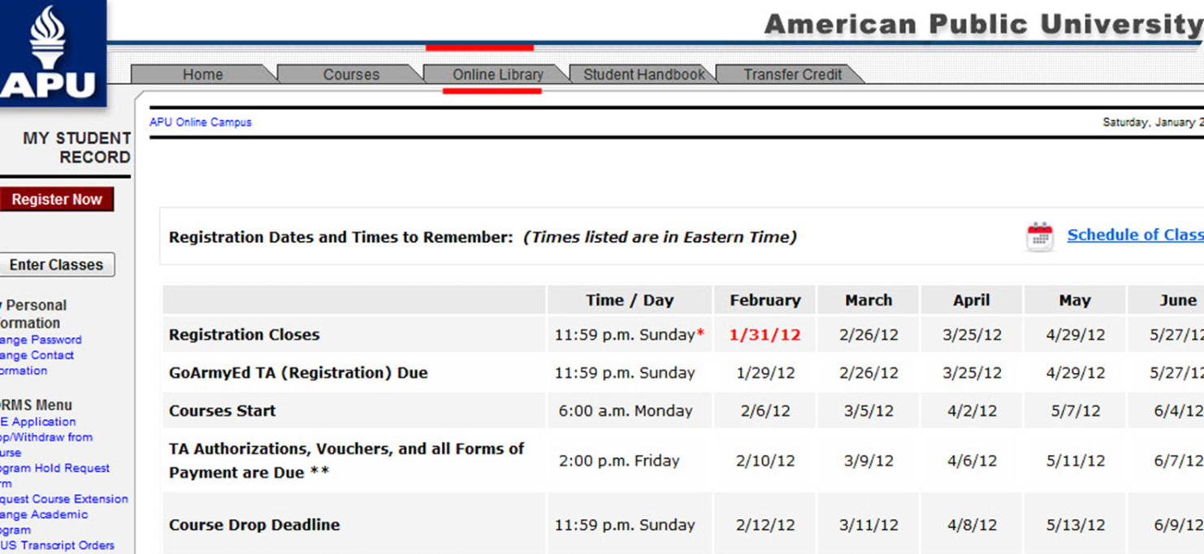
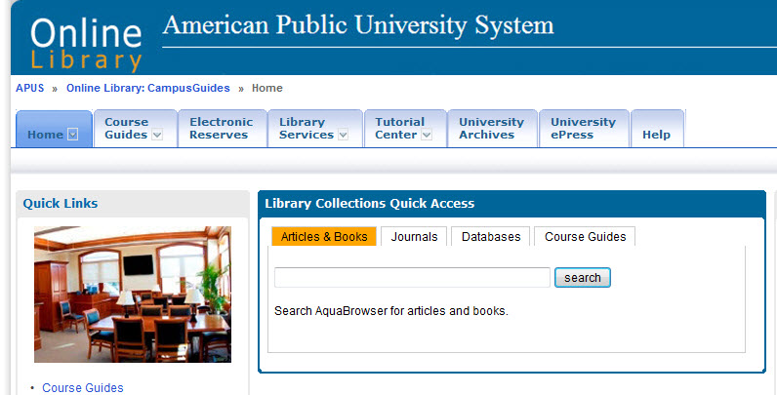
ePress/Library Integration with Online Classroom Learning Management System
Looking forward through the Rearview Mirror
Of History (Marshall McLuhan)

Slide 7
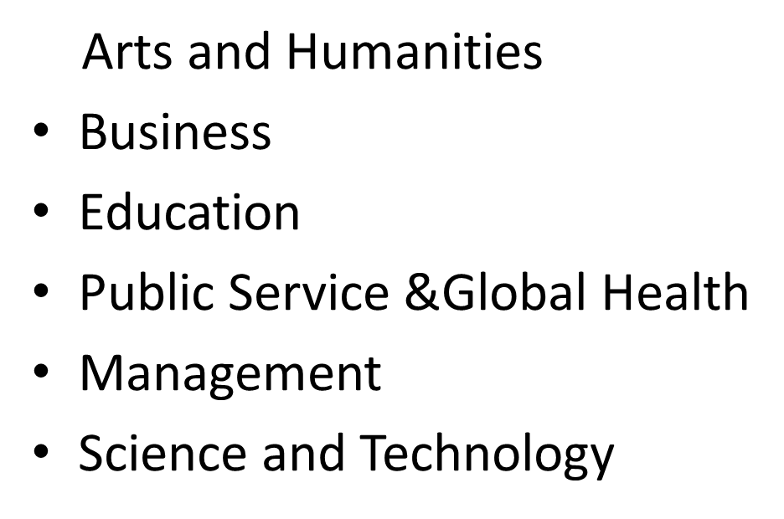
Library/Press/Online Classroom Integration
From eJournals and Monographs to Video and Database Production
Online Curricular & Classroom Needs (OER, E-Books, E-Articles, Media)

Slide 8
ePress, ScholarLy Resources & Media
Changing Publishing/Production Models From Ownership to Access to Multimedia Aggregation,
Knowledge Curation & ReSourcing Content
E-books, e-journals, article aggregrator repositories, dynamically driven interactive databases

Slide 9
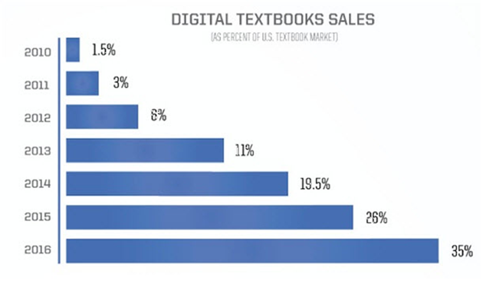
Digital Texts & Academic book Sales IN Online Education Markets
Seven Million Students Enrolled Online
Total Academic/Textbook Industry
Approx. 8.2 Billion Dollar Global Business 1.1 Billion Digital Projected by 2014 Amazon Largest eBook Distributor, Academic & Otherwise (38% of all sales)
Of Academic Presses, Oxford, Cambridge & Yale Profitable, Others ???
Source Meeker: The State of Digital Education

Slide 10
NEW Technology InFRASTRUCTUREs FOR Presses are Available
CoursePack 2.0: Tizra
http://tizra.com
Bepress: eJournals/Institutional Repositories
Academic Pub: http://academicpub.sharedbook.com/academicpub/
Course Packs Online AcademicPub
Uzwyshyn, R. “Evolving eTextbook Landscapes: Strategies, Platform, Innovation” Journal of Digital Media Management, Spring 2012.

Slide 11
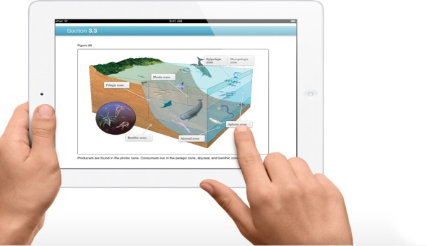
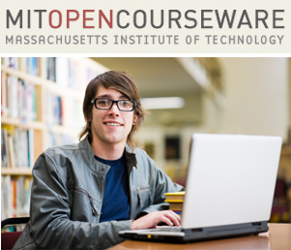
New Interactive Text/Press Production Services & Models Emerging
Aptara: http://www.aptaracorp.com/
Leap
MIT OpenCourseware: http://ocw.mit.edu , NBCLearn: http://www.nbclearn.com

Slide 12
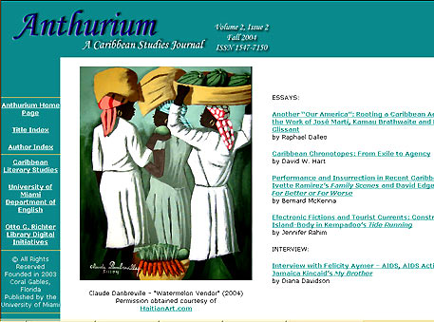
New Genres of Online Library/Press Services (Well-Established)
Scholarly Refereed E-Journals Communications ePress/Library/Faculty Scholarly Publishing Opportunities

Slide 13
e-Press/Bookstore/Library/FacultY Synthesis
Publish on Demand (POD) Foundations Text/Student/Faculty ROI
Copyright and Republishing
Possibilities

Slide 14
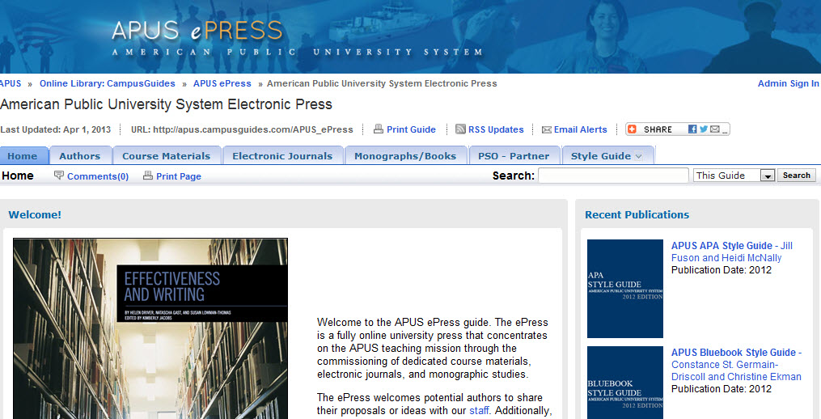
ePress/Course Materials/Library Synergies /ROI – ADDING VALUE
ePress: Style Guides, Monographs/ Course Collection Development

Slide 15
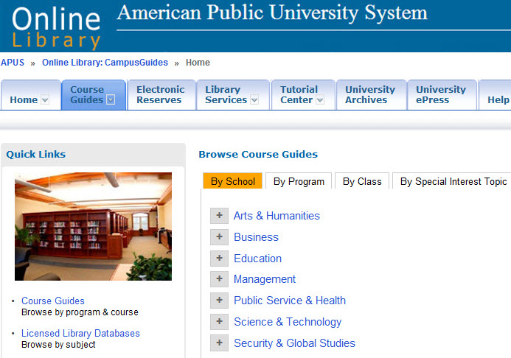
Reconfiguring Curricula APUS Online Course Guides National Award Winning Academic Technology Project
1800 Courses
7 Schools
3-5 Year Project
Massive ROI Curricular Innovation Open Source Model
National University Technology Network Award f or Distance Education Innovation (2012).
Association for Continuing Higher Education, Most Creative Use Of Technology Award (2013)
Gold Medal for IMS Global 2012
Learning Consortium’s Learning Impact competition

Slide 16
New Media Online Publishing Model
Direct Curricular
Replacement
Secondary
Multimedia Bibliographic Resource
Global
Marketing/Branding
ROI
Open Source Publishing Possibilities

Slide 17
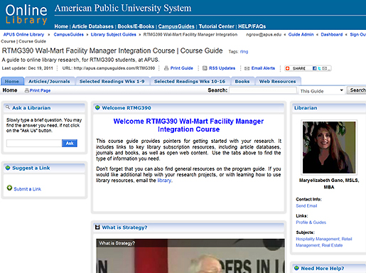
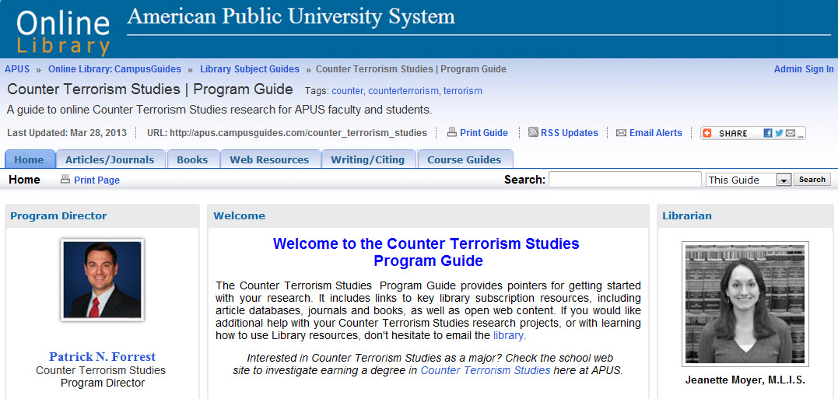
System Wide Application of Media/Curriculum Possibilities
Online ePress/Library Customization School, Program, Department or Course
New Partnerships For Course Possibility
Focused Material, Trustworthy Sources

Slide 18
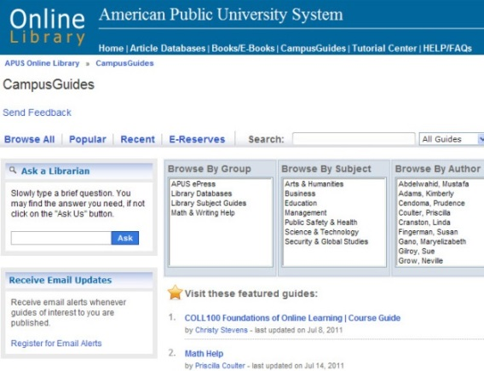
Integration of Open Source & Propietary Scholarly Resources, Curriculum & University Classroom
Secondary
Multimedia Bibliographic Resource
Direct Curricular
Replacement
Publically Available
http://apus.campusguides.com/

Slide 19
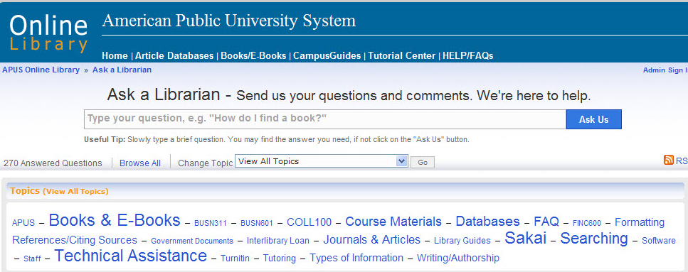
Adding Value to the University
Quality Assurance Technology Systems/Press/Library
Online Semantic Knowledge Base/High Quality Editing Necessity
Online Digital and Human Help Systems

Slide 20
Publication Pathway Synergies
Online Masters Thesis Archive/Capstone/Online Library
(Dark Archives & Repositories)

Slide 21
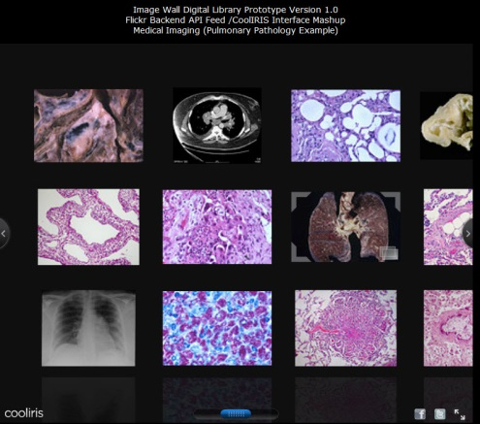
Digital Archives & Special Collections Providing Context: Metadata, Abstracts, Contextualization
Library/ePress Academic University Community Connections

Slide 22
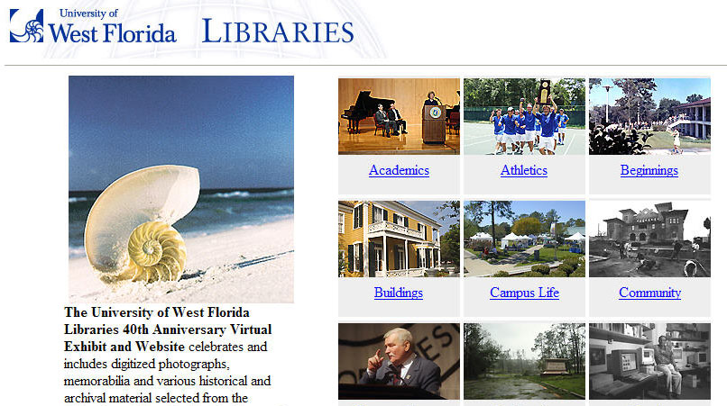
Re-sourcing Content: Digital Libraries and Books
University/Press/Library/ Special Collections/Community Bridges

Slide 23
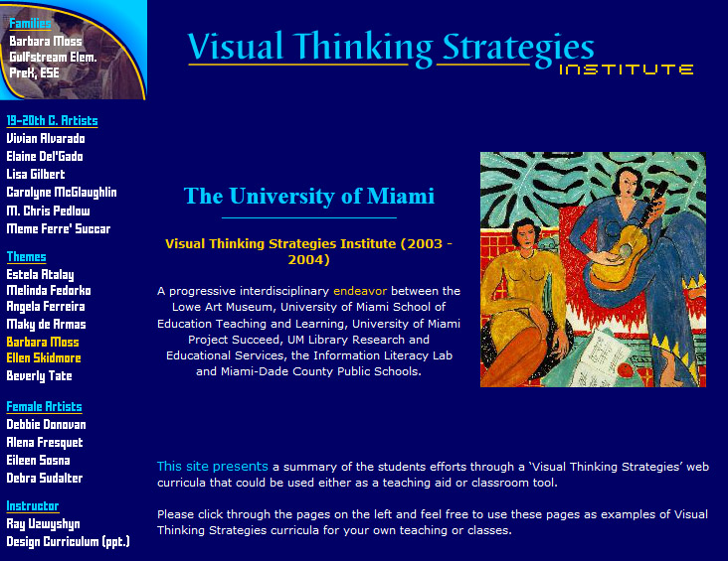
Digital Library/University/Press Connections Narrative/Editorial Function/ Interdisciplinarity
Library Technology/Information Literacy Services School of Education University Art Department/Museum
State Dept, Of Education Grant Opportunities

Slide 24
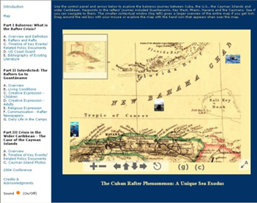
New Genres of Digital Archives Quality Assurance/Displaying Value
Library Academic Community Connections

Slide 25
Branding and Marketing the University Intellectual Riches Globally
Hybrid Digital/Paper/Audio/Video Collections

Slide 26
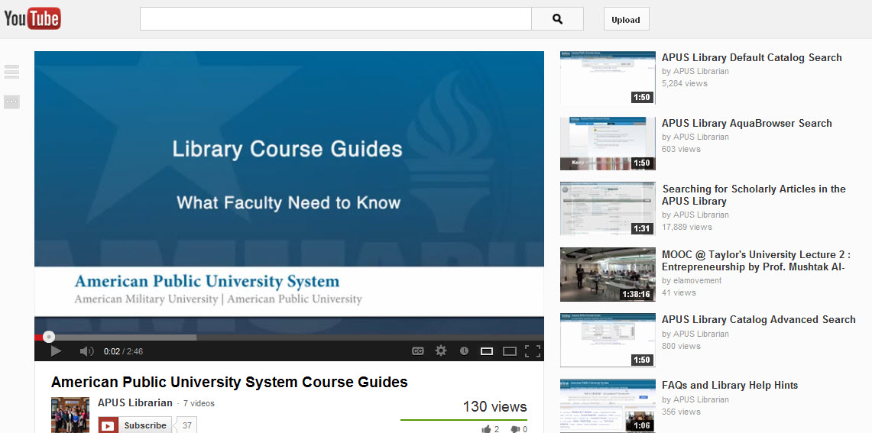
Press, Media Broadcasting , Embedding/Linking Possibilities
Video & Social Media Broadcasting

Slide 27
Opening University Synergies
ePress/faculty/Technology/ Library/ Students/
Faculty || Academic Technologists || ePress || Subject Specialists Librarians || Students

Slide 28
Ray Uzwyshyn Ph.d MBA MLIS httP://RAYUZWYSHYN.NET Ruzwyshyn@GMAIL.com
Thanks!
Questions?

