Slide 1
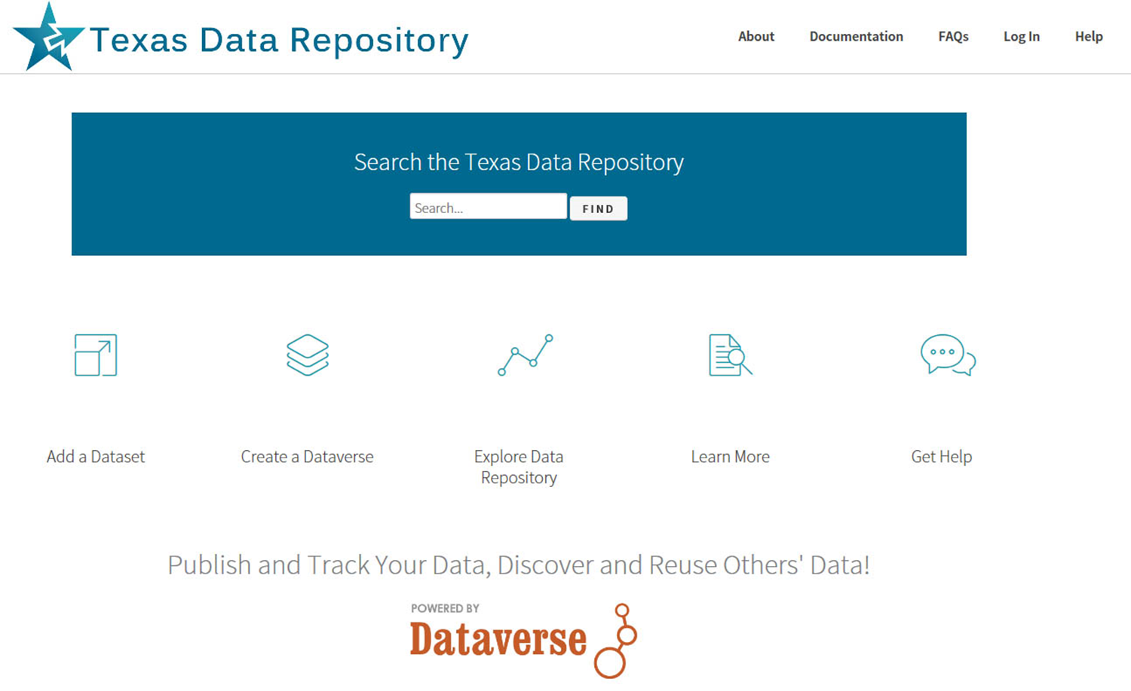
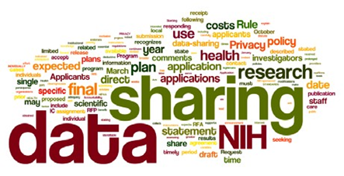
The Texas Data Repository Initiative
@ Texas State University
Ray Uzwyshyn,
Director, Collections and Digital Services,
Texas State University Libraries
ruzwyshyn@txstate.edu , 512)

Slide 2
Online Data Repositories (Background)
Way to Manage a Researcher’s Data Outputs Online
Long Term Data Archiving/Preservation Strategy
Permalinking for Online Data Citation/Access (DOI: Digital Object Identifier, UNF:University Numerical Fingerprint, Linked Data, Interoperability)
Paratextual Research Material Archiving/Sharing Possibilities (field notes, docs, data, multimedia and programs)
Ingestion of Various Data Types
(from Excel to SPSS to more esoteric forms)

Slide 3
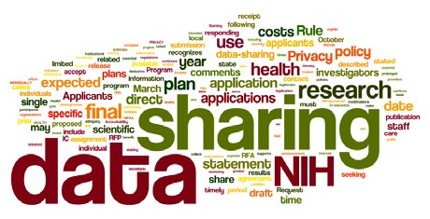
Why are Data Management Repositories Required?
Most major Federal grant agencies require data management plans as mandatory part of the grant proposal process.
(NIH 2003; NSF 2011; NEH, 2013 USDA)

Slide 4
Research Data Repository Software
Online Infrastructures to manage researchers’ data (sharing, archiving, metadata)
May be hosted or installed on a university’s server
Each software contains different ranges of management/collaborative options
Open source and proprietary options

Slide 5
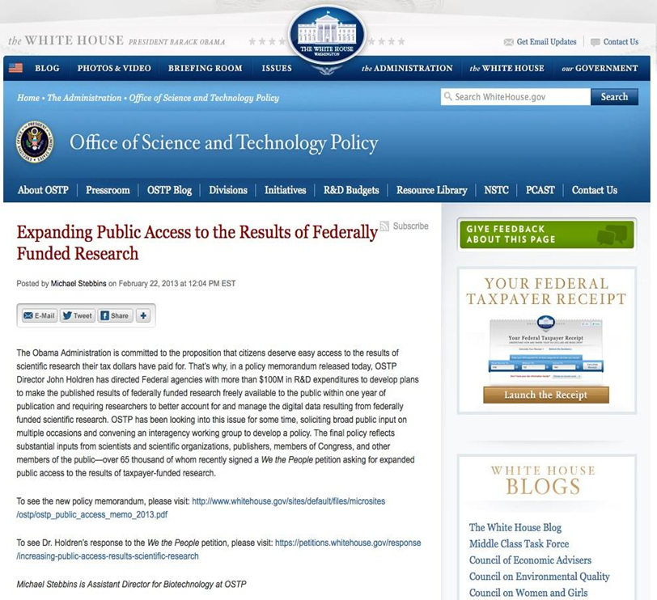
State Data Repository Group
Formed in 2014 (Texas Digital Library)
Charge: To Determine a Suitable Data repository infrastructure and management model at a consortial (State Level)
Develop Needs Assessment
Evaluate software models,
Investigate & Document findings
Make service recommendations

Slide 6
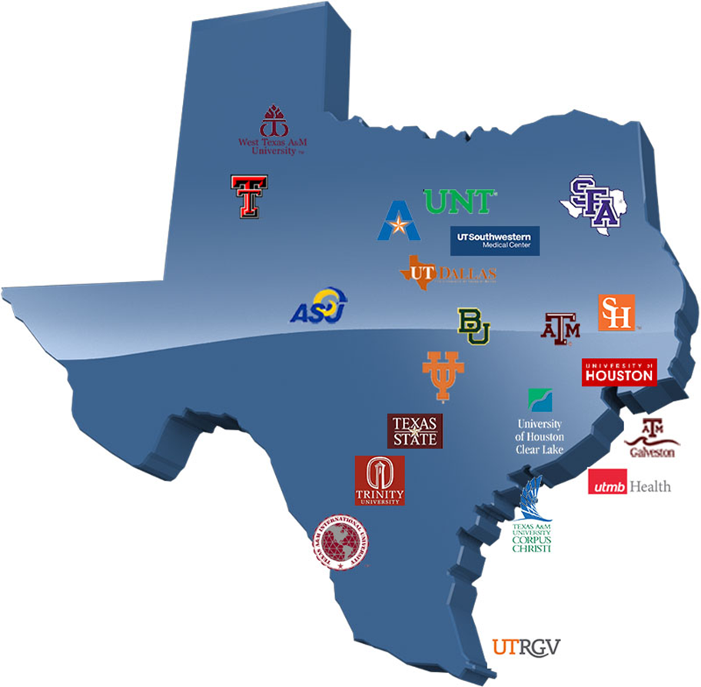
Texas Digital Library (TDL)
TDL is a Texas Consortium of
22 universities across Texas
leveraging technological
cooperation among
academic libraries
Consortium is
coordinated and facilitated
through Texas Digital Library
at UT Austin

Slide 7
Phase I: TDL Data Repository Working Group Report (August 28, 2015)
Conclusion: The group recommends that TDL adopt Dataverse to facilitate the discovery of research data.
Dataverse provides the best combination of :
system performance
Robustness
Usability
platform availability
an active open source community that responds to the evolving needs of the user community.
Working Group Report

Slide 8
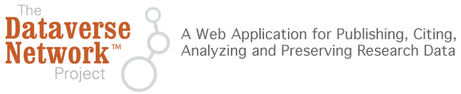

Dataverse
Harvard’s Research Data Open Source Solution
Software framework that enables institutions to host research data repositories
Preservation and archival Infrastructure: allows sharing, control, persistent data citation, data publishing and management
Social Sciences Beginnings (IQSS)

Slide 9

Dataverse Details
Relatively simple ingest for researchers
Ability to share with trusted group of researchers prior to publication
Ability to version datasets
Supports recognition & credit via data citations (e.g. DOIs)
Allows for control over branding
Helps researchers fulfill Data Management Plan requirements
Sustainable platform with growing open source community led by Harvard

Slide 10
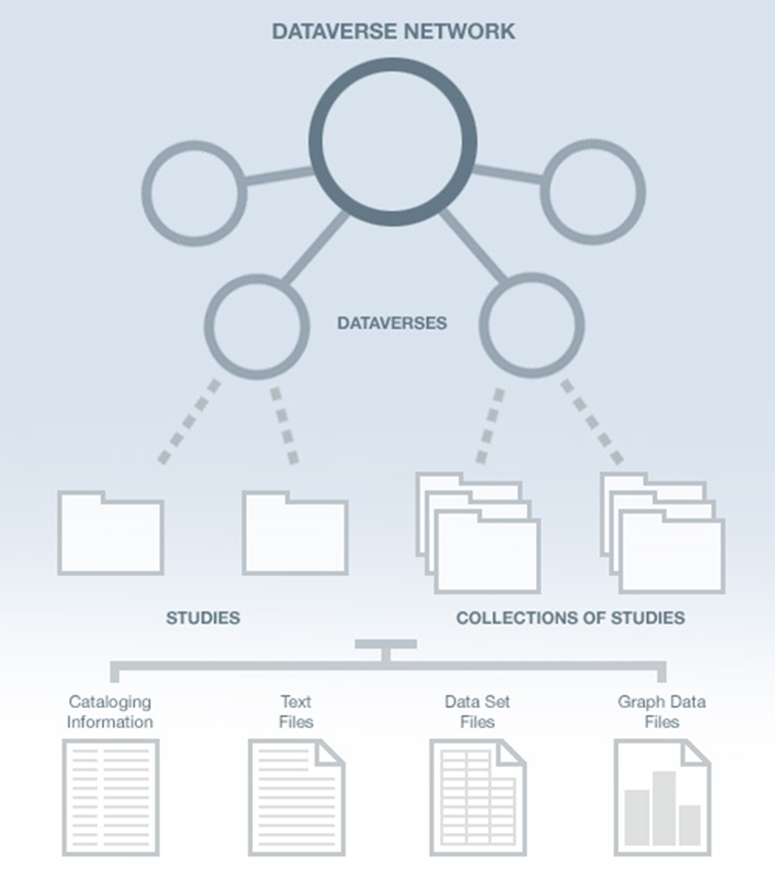
Dataverse Network Architecture
Why the Dataverse Network?
(silent video overview)
Open Journal Systems
Dataverse Integration (2014)
Research Study Data
Data Set Files
Metadata ( Data Describing the data)
Paratextual Research Material
(Methodology, Field Notes etc.)
Graph Data Files

Slide 11
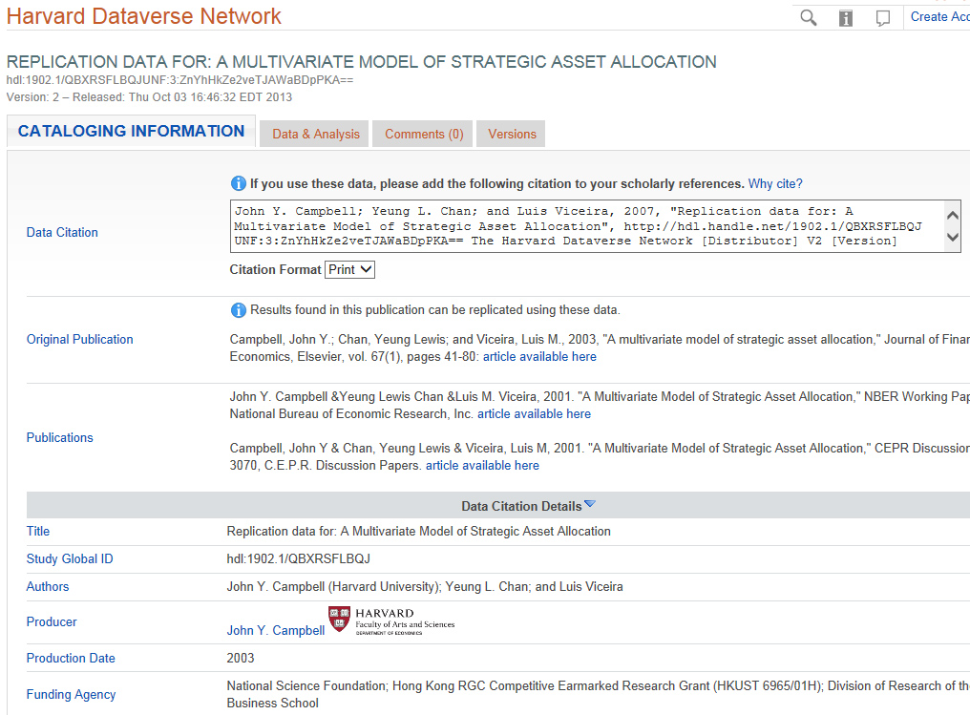
Dataverse Metadata Example

Slide 12
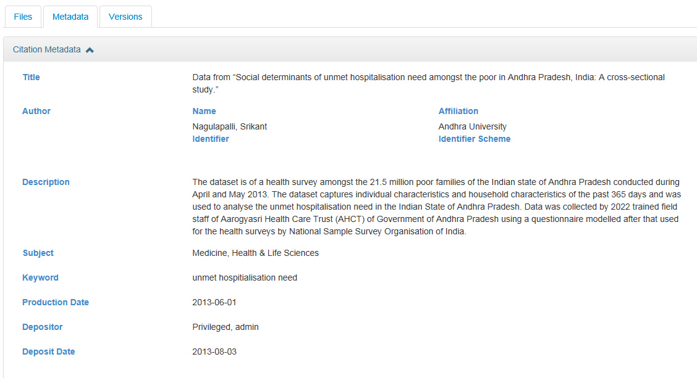
Dataverse Metadata Example

Slide 13







TDL Dataverse Implementation Working Group 2015
Charge: Pilot test, assess, and launch a consortial repository for research data archiving and management.
14
Working
Group members
Main Working Group & Subcommittees:
Policy and Governance
Workflows and Outreach
Budget/Business Models
Technology
7
Texas Universities
Texas State University Part of Main, Policy, Governance and Technology Implementation Groups (Part II, Aug 2015- December 2016)
5
Members; Denyse Rodgers (Baylor); Bruce Herbert, Sean Buckner, Wendi Kaspar, Cecilia Smith (TAMU); Ray Uzwyshyn, Todd Peters (Texas State); Christopher Starcher (Texas Tech); Jeremy Donald (Trinity); Kristi Park, Ryan Steans, Nick Lauland, Laura Waugh (TDL, UT Austin), Santi Thompson (Houston)
Committees

Slide 14
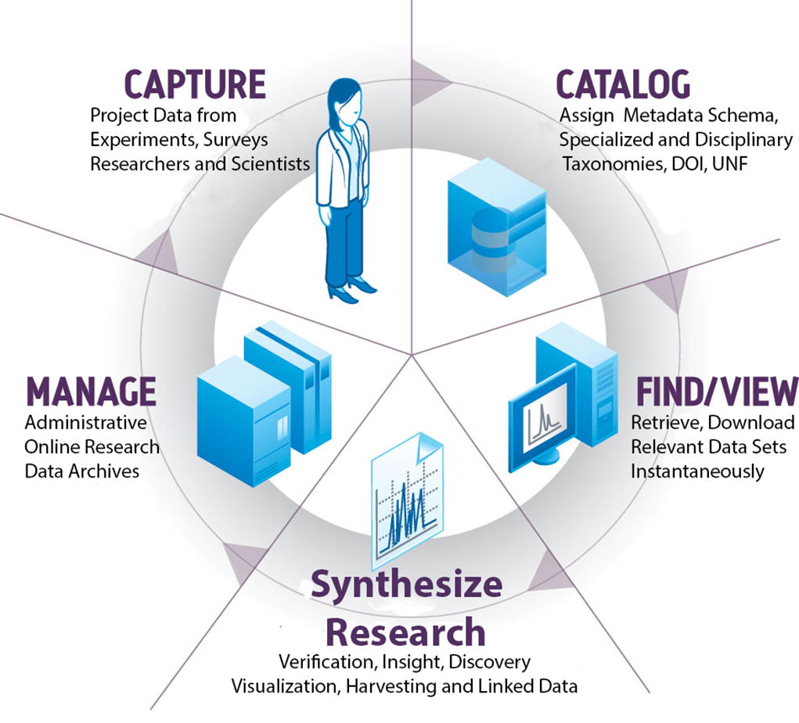
The Many Planning Aspects of Data Research Repositories
The Research Data Repository
Lifecycle

Slide 15
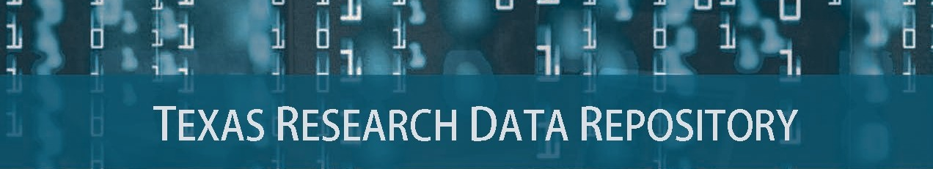
Prototype and Pilot Study, May-August 2016
Consortial Repositories, http://www.tdl.org/data-repository

Slide 16

http://data.tdl.org/

Slide 17
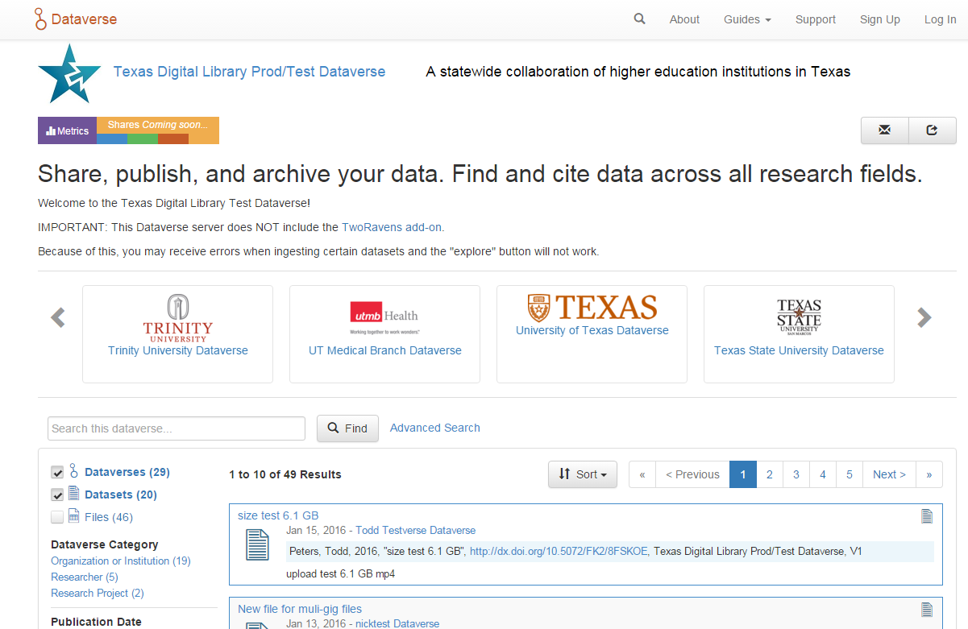
Add Data
Share, publish, and archive
Find Data
Search across disciplines
Cite Data
Obtain a citation and unique identifier

Slide 18
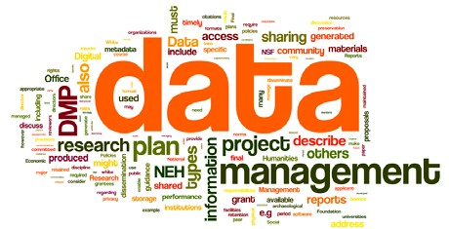
Texas Data Repository Initiative
Sept. 2016 - December 2016
NSF, NIH, NEH, USDA Grant Compliance
Key Dates: Softlaunch, September – November 2016
Online Research Data Symposium (Baylor, November 15-16)
Official Launch of Data Repository (December 1st, 2016)

Slide 19

Library Infrastructures & Federal Mandates For Public Access to Research
The Library Supports:
Publication repositories (D-Space)
Data, Texas Data Repository
Human Resource Infrastructure
Data Repository Librarian
Subject Liaisons (Outreach)
Publication Repository Librarian
Workflows, standards, & policies
http://www.whitehouse.gov/blog/2013/02/22/expanding-public-access-results-federally-funded-research

Slide 20

Types of Data Repositories
1) Institutional Repository
(institution wide and/or or consortial)
2) Project specific
(usually large single faculty/faculty team projects)
3)Discipline specific
(i.e. Academic Specialization, Purdue Nanohub, Engineering etc. )

Slide 21

Types of Data Projects (Sizes)
1) Normal range
Files/Data Fit on Server/Cloud, may be uploaded, Dataverse, 2GB File size max currently, unlimited files)
2) Large Projects
(Data may require specialized university IT Support, i.e. terabyte/petabyte tape drives, RAID, online storage)
3) Very Large
(Projects require consortial possibilities, national models, Chronopolis, Texas Advanced Computer Center, DEEPN, Duracloud)

Slide 22
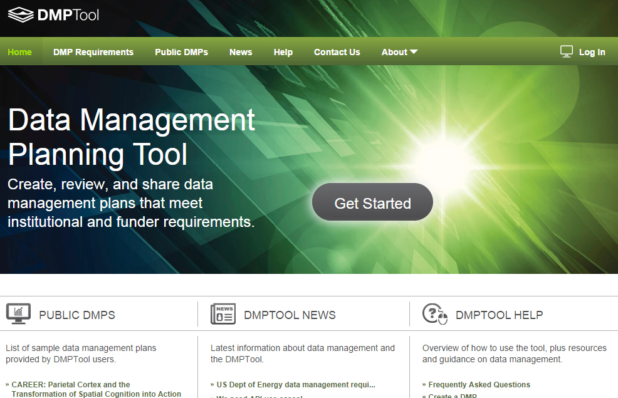
DMP Policy Tool Integration
Overview Video
Customizable
Plan Outline Tool
Resource Links
Supports All Major Funders
Texas Data Repository Template Boilerplate
https://dmptool.org/
California Digital Library

Slide 23
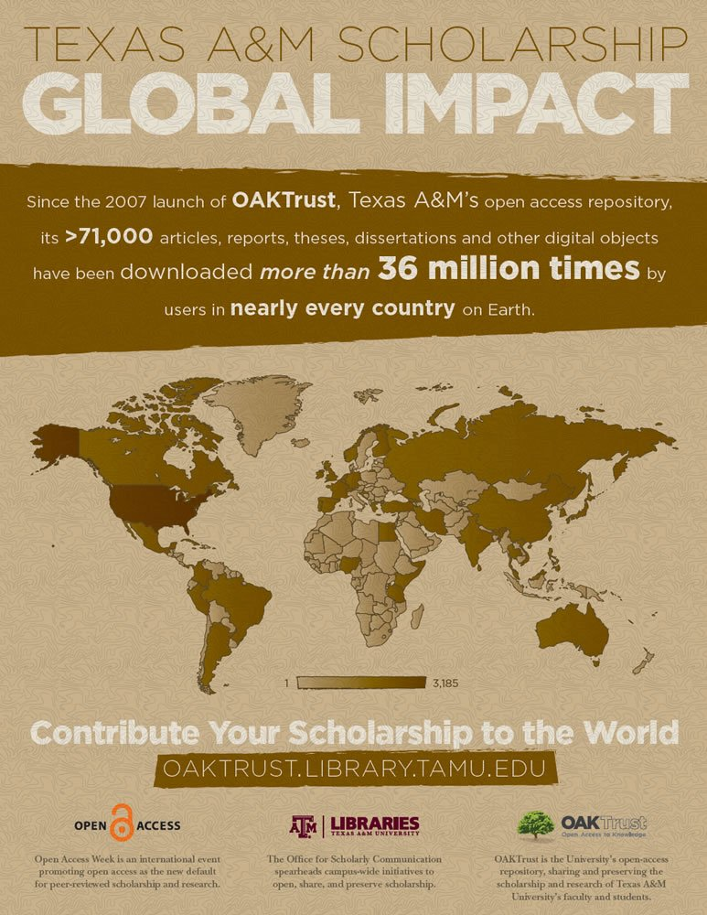
Electronic Thesis and Dissertations (ETD) Repository (D-Space) Connections
ETD (D-Space), VIREO, DATA REPOSITORY CONNECTIONS
Co-publish data sets in ETD (D-SPACE) and Data Repository
Vireo ingestion
Links in metadata in D-SPACE and DATA REPOSITORY

Slide 24
Larger Data Repository Adoption Lifecycle
(2016)

Slide 25
Comments/Questions

Slide 26
Use Cases: Make Research Data Publicly Available and/or Sharing Data
Primary Actors:
PIs of federally funded research
Researchers working on unfunded research/ funded research with no retention requirements
Graduate students working on theses, dissertations, or other data-generating projects.
Geographically Dispersed Researchers and Project Teams Wishing to Collaborate

Slide 27
Use Case: Seek Data to (Re)Use
Primary Actors:
Researcher is interested in conducting a meta study reusing data developed in earlier studies
Public using data for personal needs
Organizations seeking data for their needs.

Slide 28
Pilot Study Responses
Perceived Benefits of Data Repository
Fulfill federal mandates for sharing publications and research data
Make research data more widely available
Statistics on downloads and citations of my data
Make my data citeable through the assignment of a DOI (digital object identifier)
Saving various versions of the dataset (data lifecycle)
Collecting all my data in one place

Slide 29
Further Links/References
ARL NSF Data Sharing Policy and Resource Links, http://www.arl.org/focus-areas/e-research/data-access-management-and-sharing
ARL (White House Directives and Funded Research Data ) http://www.arl.org/focus-areas/public-access-policies#.VoaV0I-cFzo
California Digital Library DMT Tool: https://dmptool.org/
Chronopolis: http://www.digitalpreservation.gov/partners/chronopolis.html
Dataverse. http://thedata.org/
Dataverse (Data Science Site). http://datascience.iq.harvard.edu/dataverse
DPN (Digital Preservation Network) http://www.dpn.org/
Duracloud: http://www.duracloud.org/
Purr. (Purdue Institutional Data Repository). https://purr.purdue.edu/
Hubzero. https://hubzero.org/
Figshare. http://figshare.com/
ICPSR Data Management & Curation. http://www.icpsr.umich.edu/icpsrweb/content/datamanagement/
Research Data Management. Principles, Practices, and Prospects (November 2013). Council on Library and Information Resources. http://www.clir.org/pubs/reports/pub160
Cox, A. and Pinfield, S. Research Data Management and Libraries. Jounral of Librarianship and Information Science. June 2013.
Fearon, D & Sallans, A. C. (January 2014). Institutional Research Data Management: Policies, Planning, Services and Surveys. Coalition for Networked Information. https://www.youtube.com/watch?v=rvbrW7S2fes (video presentation)
Data Management for Libraries: (LITA Guide) http://www.alastore.ala.org/detail.aspx?ID=10737
NMC Horizon Report: 2014 Library Edition. http://cdn.nmc.org/media/2014-nmc-horizon-report-library-EN.pdf
“Research Data Management”. pp. 6-7 and pp 24 – 45.
Holden, J. Memorandum for Heads of Executive Departments and Agencies: Increasing Access to the Results of Federally Funded Research (2013). http://www.whitehouse.gov/sites/default/files/microsites/ostp/ostp_public_access_memo_2013.pdf
Green, A. Macdonald, S and Rice, R. Policy-making for Research Data in Repositories: A Guide. DISC-UK. http://www.disc-uk.org/docs/guide.pdf
Research Data Management in the Arts and Humanities (2013). University of Oxford. http://www.dcc.ac.uk/events/research-data-management-forum-rdmf/rdmf10-research-data-management-arts-and-humanities (Conference Presentations)

Slide 30
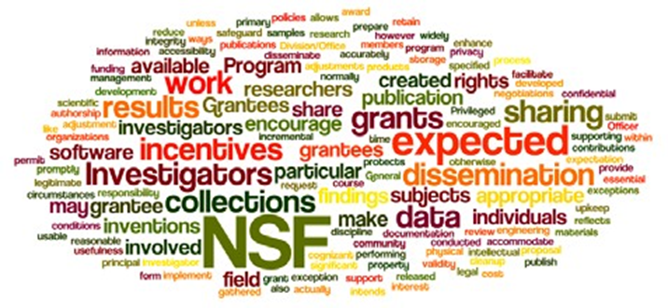
Why Are Data Management Plans Required
Leverage and make available faculty, departmental and institutional research
Allow publication of negative data (less research replication)
Wordle of the National Science Foundation’s Award and Administration Guide. Chapter VI.D.4, Mandatory 2011

Slide 31
Data Management Plans
Part of Evolving Science, Social Science and Humanities Research Process (Accuracy, efficiency, sharing)
Wordle of the data management policy of the Office of Digital Humanities, National Endowment for the Humanities, 2013

Slide 32
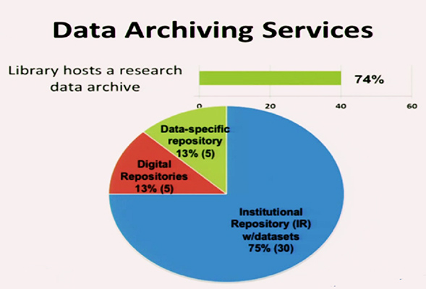
ARL Libraries 2015
Online Data Management Plan Implementation
Fearon, D & Sallans, A. C. (January 2014) Institutional Research Data Management: Policies, Planning, Services and Surveys. Coalition for Networked Information. https://www.youtube.com/watch?v=rvbrW7S2fes (54 ARL Libraries currently offer data management services_)

Slide 33
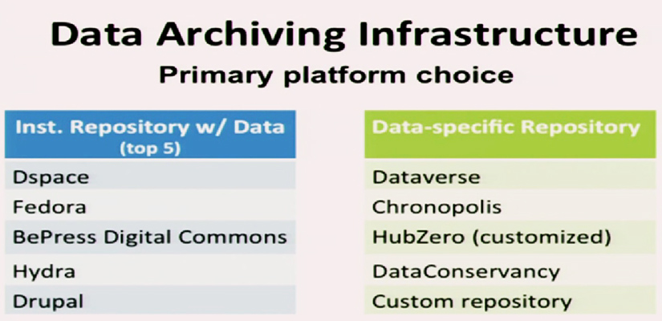
Current DMP Platforms (2015)
Fearon, D & Sallans, A. C. (January 2014) Institutional Research Data Management: Policies, Planning, Services and Surveys. Coalition for Networked Information. https://www.youtube.com/watch?v=rvbrW7S2fes (54 ARL Libraries currently offer data management services_)

Slide 34

Data Sharing
Currently, 80% of researchers do not share their data
Andreoli-Versbach, P., Mueller-Langer, F. (November 2014). Open access to data: An ideal professed but not practiced. Research Policy., http://dx.doi.org/10.1016/j.respol.2014.04.008

Slide 35
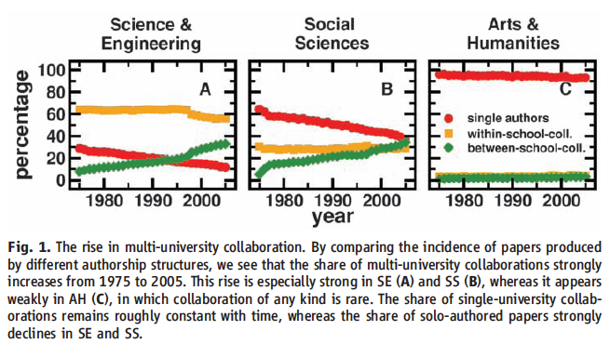
Collaboration Across Institutions
Jones et al. (2008). Science 322: 1259-1262.
Notes:
The model assumes that each lead author forms a core team through a Poisson process.
Extended teams arise from core teams by adding new members in proportion to the productivity of the team.
This process of cumulative advantage leads to the appearance of the power-law component of large teams at later times.

