Slide 1
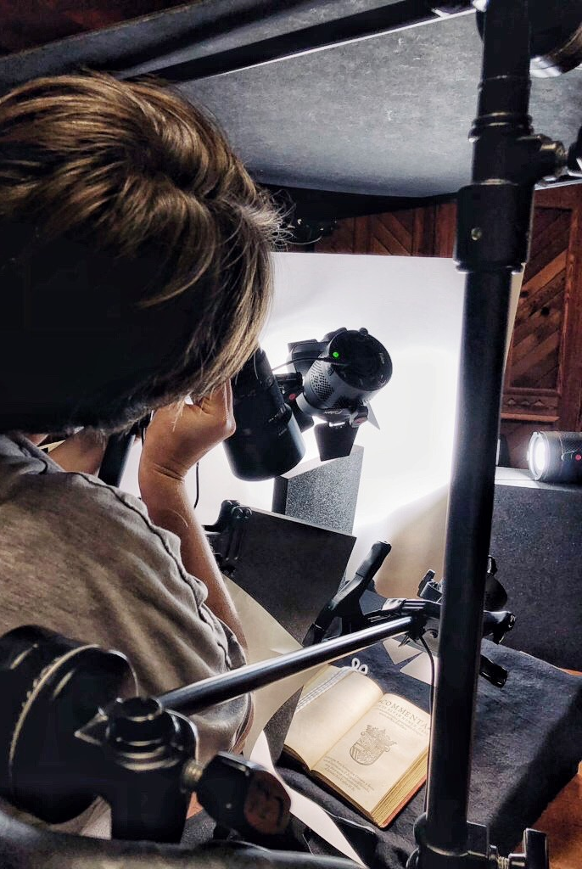
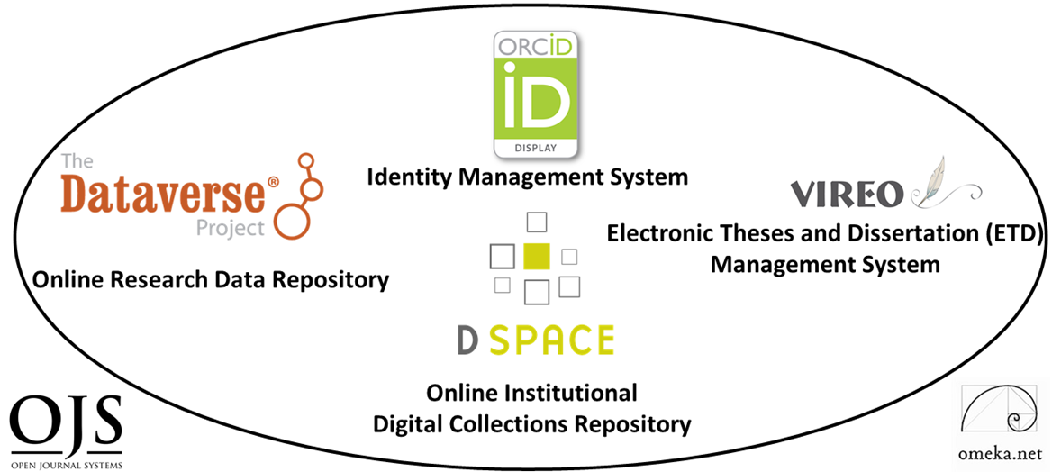
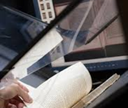
Texas State University Libraries
Digital Initiatives
Staff, Infrastructures and Accomplishments
Ray Uzwyshyn, Ph.D. MBA MLIS
Director, Collections and Digital Services,
Texas State University Libraries

Slide 2
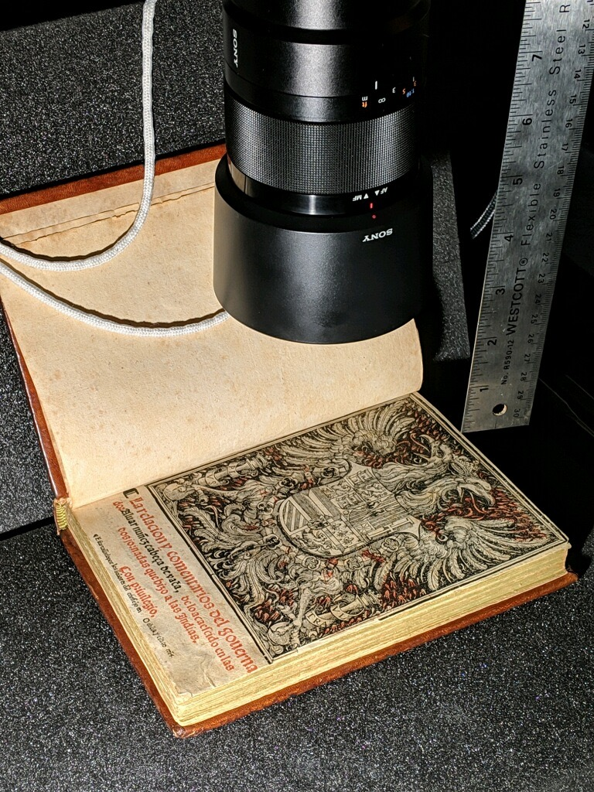

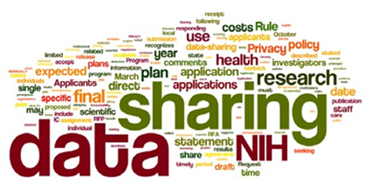
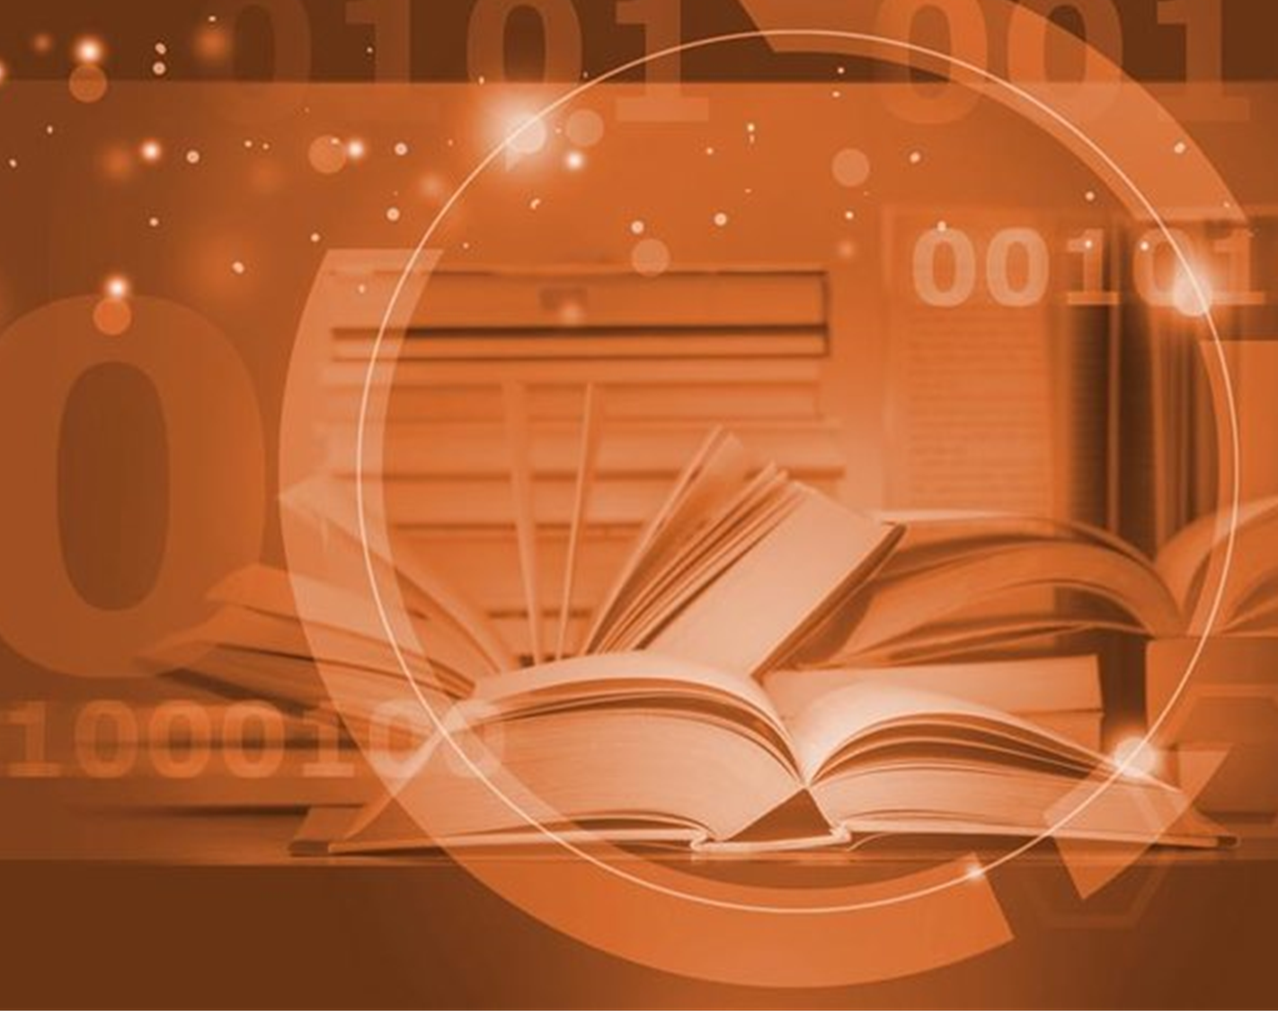
Agenda Overview
Texas State University Libraries Digital Scholarly Research Infrastructures
Texas State University Libraries Digitization Services
Texas State University Digital Preservation Storage Infrastructures.

Slide 3
Digital Research Ecosystem
Software Components and People
Digital Collections Repository (Dspace)
Research Data Repository (Dataverse)
Published and Presented Widely on our Data Research Repository. Laura Waugh, Digital Collections Librarian, Chairs the state group, Todd Peters, Ray Uzwyshyn, Presentation Nationally
Identity Management System (ORCID)
ETD Management System (VIREO)
Stephanie Larrison, Electronic Resources Librarian Chairs the state group, is the software manager for the software, has presented, nationally and internationally and the software has an international reputation
User Interface Software (OMEKA)
Open Journal Software (OJS3)
Hardware: Digitization Lab
Presented Widely Nationally and Internationally at CNI (D.C.), ASERL (Summer Series Webinar), Oxford (International Conference on Educational Technologies) and Published in ACM Conference Proceedings, ICEIT 2020

Slide 4
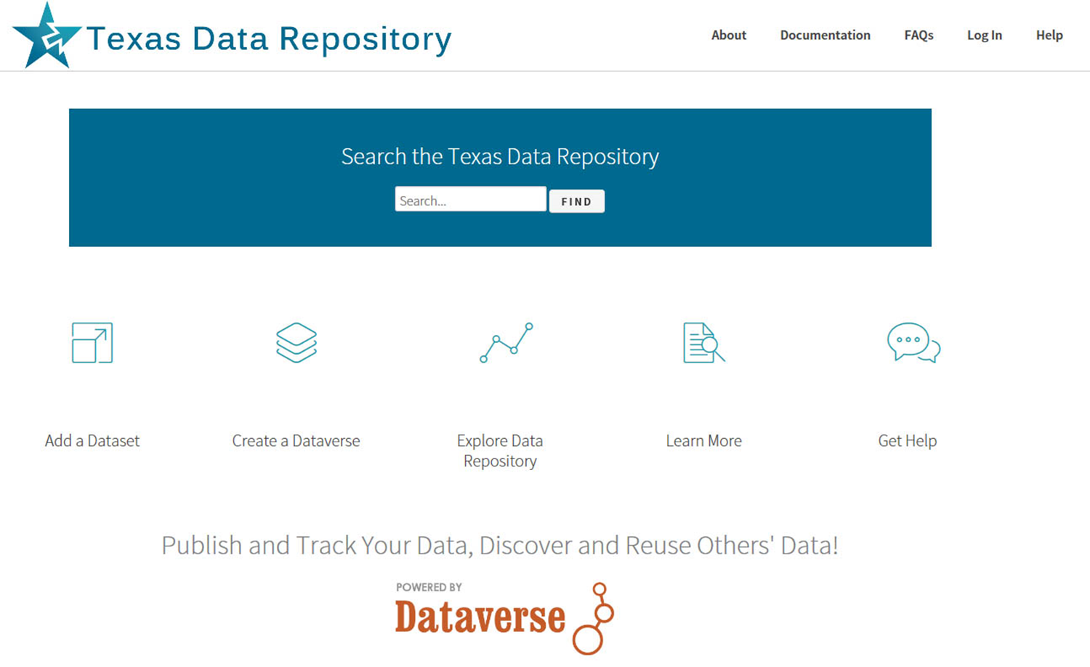




The Texas Data Repository
@ Texas State University
Launched 2017, First Global Consortial Data Repository
Main Implementation
Workflows and Outreach
Budget/Business Model
Technology
Policy and Governance
Texas State Served on Five State committees (2 Year Period) Development and
Implementation: Laura Waugh, Todd Peters, Ray Uzwyshyn
7
Texas Universities
5
Sub-Committees
https://data.tdl.org/

Slide 5
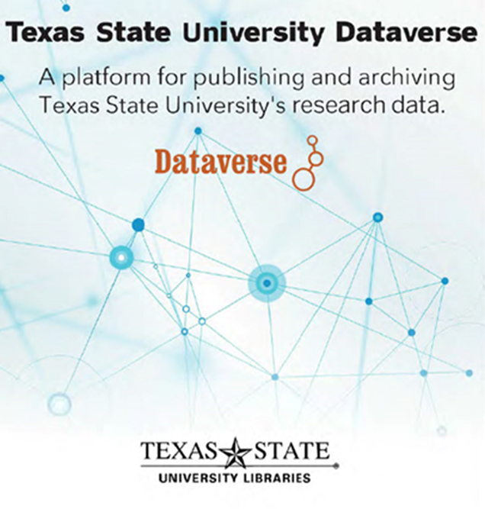
Texas State Data Repository
Widely published and presented nationally and locally on data repositories
Coalition for Network Information (DC)
Campus Technology (Boston)
Symposium on Digital Initiatives (San Diego)
Texas Conference on Digital Libraries
Computers in Libraries, Vol. 36 No. 3 — April 2016
State Data Repository Symposium Group (Baylor)

Slide 6
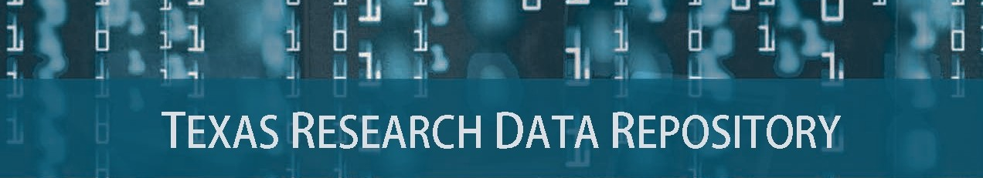
Laura Waugh, Digital Collections Library now Chairs State Data Repository Committee

Slide 7

Vireo
Electronic Thesis and Dissertation Management System
Bridges Student Thesis/Dissertation Submission with Graduate School Review, Online Publication and ETD Preservation
Our Electronic Resources Librarian is the Software Manager for Vireo and with TDL has been instrumental in the software’s development
Stephanie Larrison has presented nationally (USETDA) and statewide on Vireo and chairs the state ETD/VIREO working group and committee

Slide 8
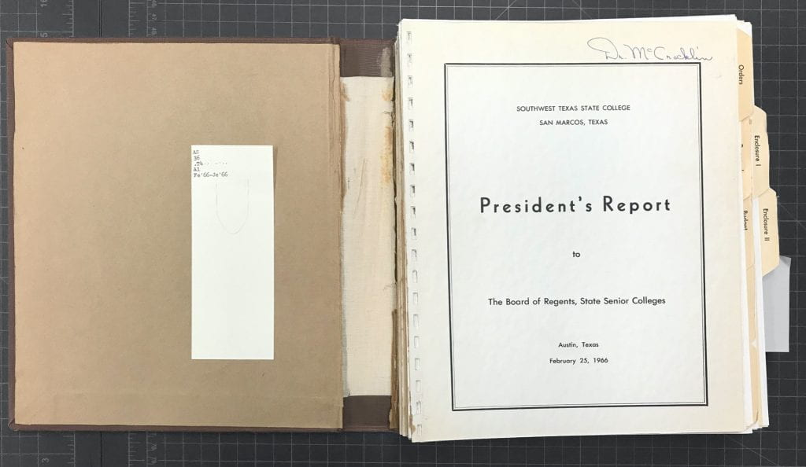
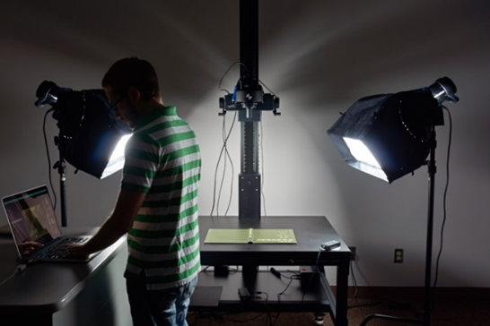
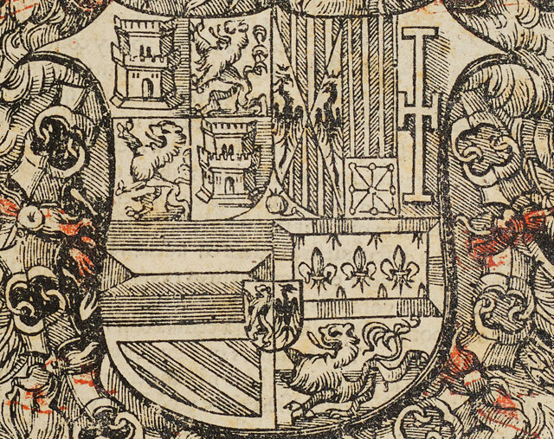
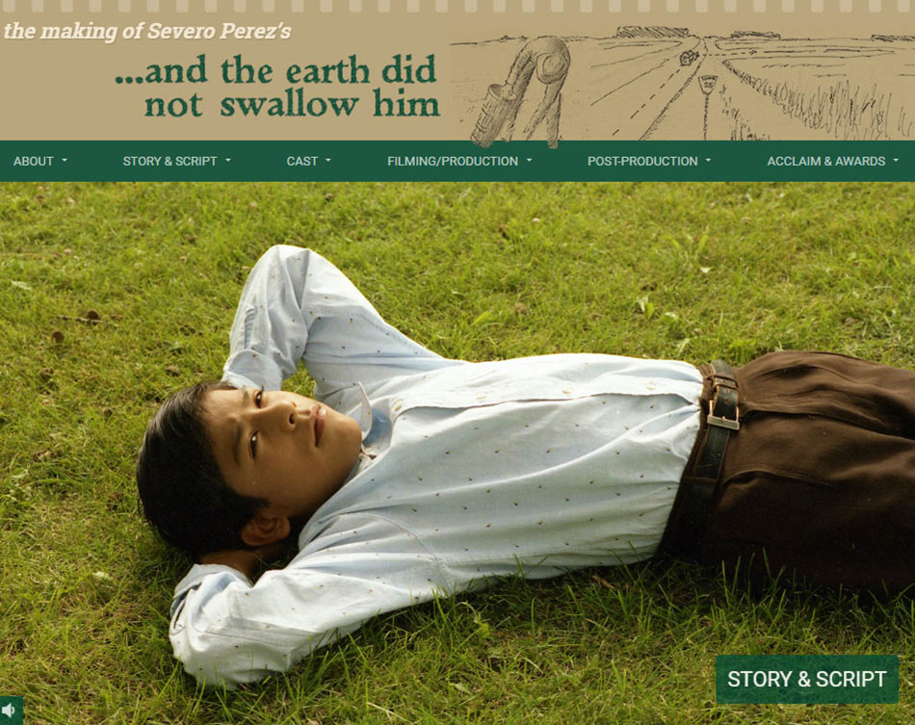
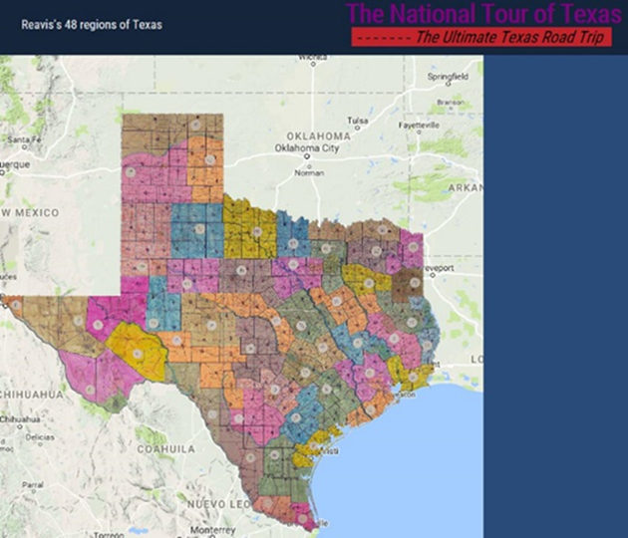
Digital Services and The Digitization Lab
Expands Possibilities for Faculty and Graduate Student Research Projects
Published and Presented Nationally on
Imaging Standards: A Camera Based Aaproach for Digitization Lage Scale Photograph Negatives (Journal of Digital Media Management)
Introduction to Image Processing with Python and Jupitor Notebooks
Robust possibilities for library archives, special collections and research faculty projects
Programming possibilities range from publication repositories and digital research ecosystems to digital libraries & online exhibits
Digital imaging possibilities range across all media.

Slide 9
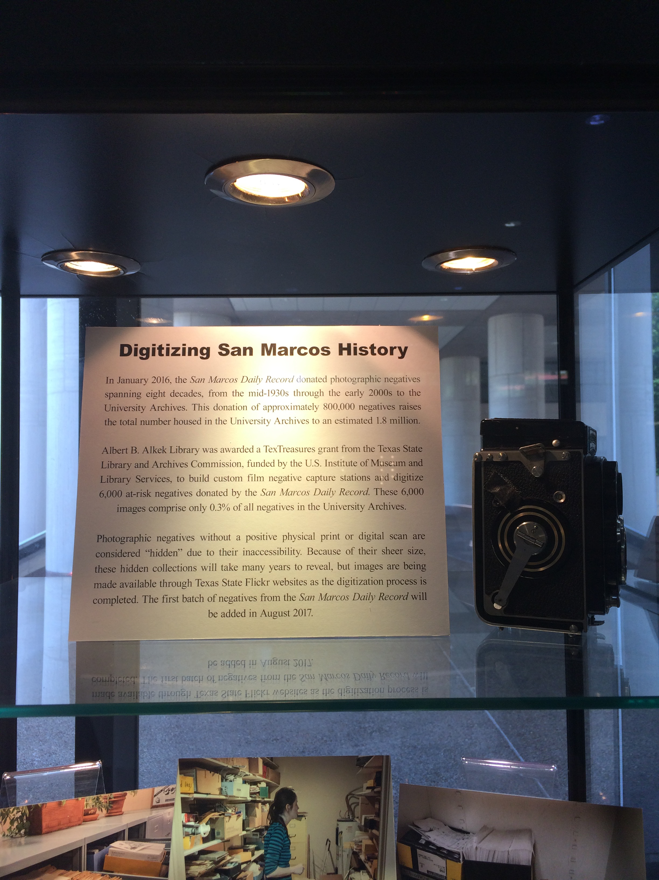
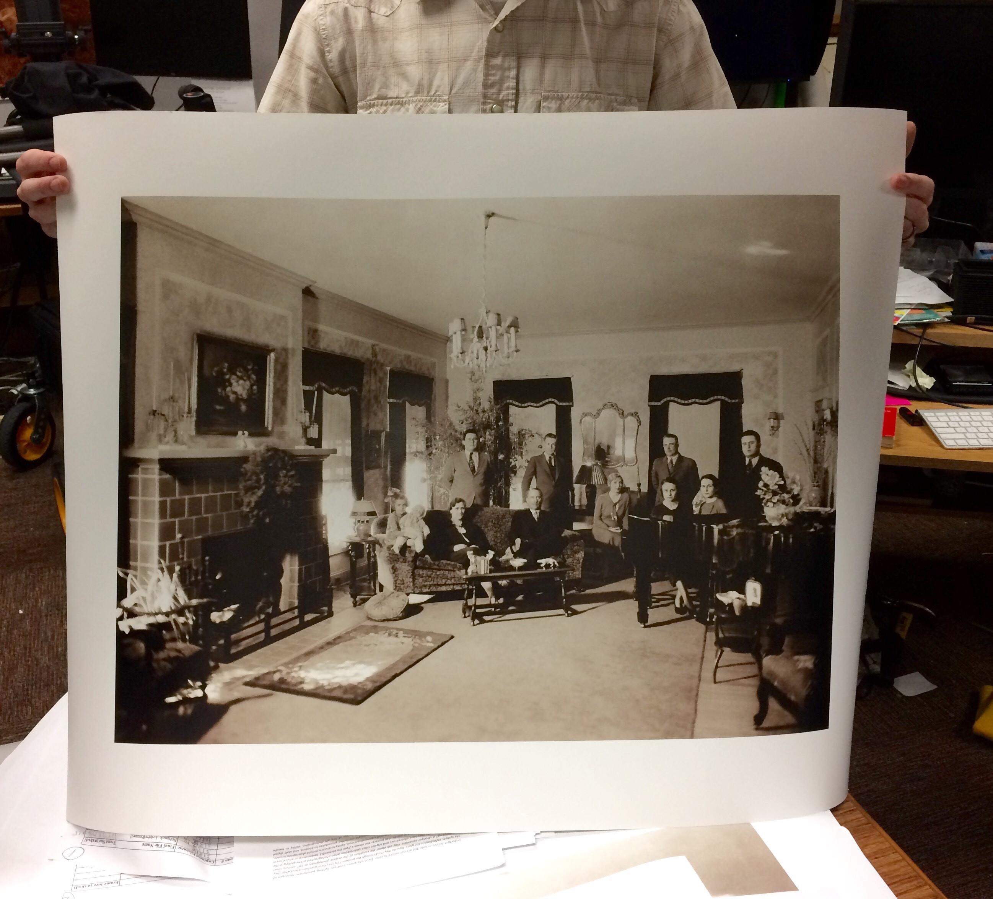
Digitization Publications and Grants
Published and Presented Nationally on Imaging Standards:
A Camera Based Approach for Digitization of Large Scale Photograph Negatives (Journal of Digital Media Management)
Introduction to Image Processing with Python and Jupitor Notebooks
TxTreasures Grant: Digitizing San Marcos Daily Negatives Texas History, Over 2 Million Images of Hays County, Texas

Slide 10
Combining These Research Ecosystem Components
Opens Amazing Possibilities For Digital Scholarship & Research Collaboration Opportunities
Cognitive Cartography/Multimedia Archives
(Video, Text, GIS, Images, Field Notes)
Dick Reavis: National Tour of Texas
Multimedia, Digital Archives/Retrospective ETD Projects
(Digital video, online exhibit images, text, digital archives)
Severo Perez: And the Earth Did not Swallow Them
Online Exhibits/Digital Archives/ Online Academic Journals
(images and text, Omeka front end/Database back end, IIIF)
Cabeza de Vaca La Relacion Digitization
Santiago Tafolla: Mexican Amer. Confederate Soldier
Interactive Image Archives/Data & Research Projects
(Image libraries, Interactive Commenting/Metadata)
Texas State Flickr Commons
Digital Libraries Archiving & Documentation Projects
(Text, Metadata, OCR, Search, Zoom ability, Page Turning)
Pedagogs University Yearbooks
Faculty Digitization Proposals/Partnerships
Complexity
Projects,Prototypes Grant Partnerships

Slide 11
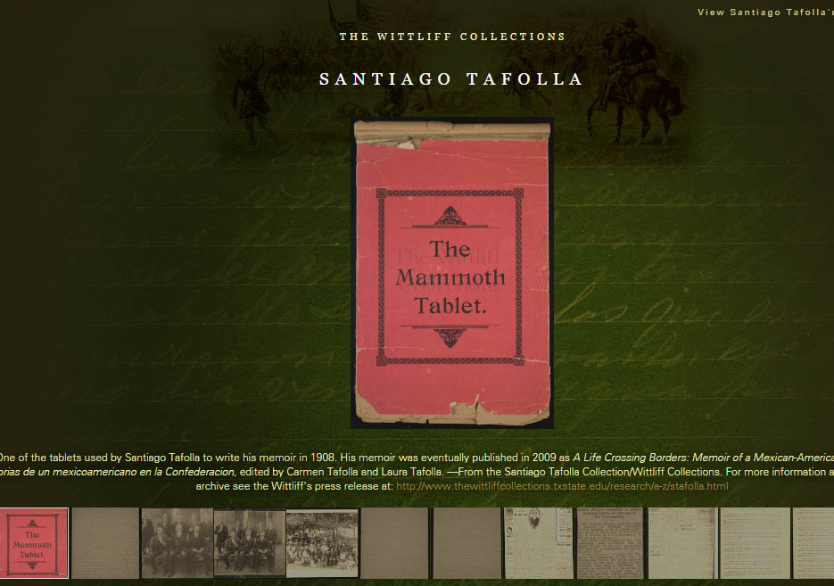
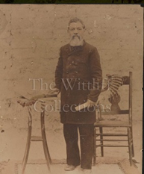
Online Exhibits/Digital Archives
Front End
Online Exhibit/Omeka
Presentation Layer
Backend
D-Space Database
(Manuscript)
Santiago Tafolla
Online Exhibit

Slide 12
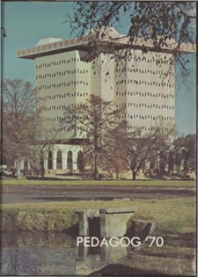
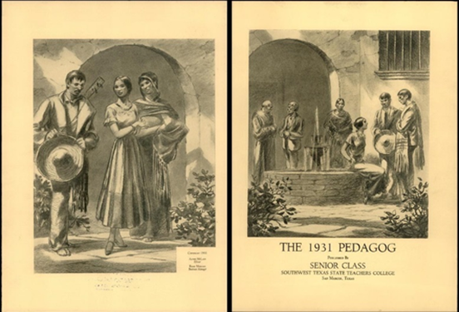
Documentation Projects
Significant Manuscripts/Books/Journals/Digital Libraries
Pedagogs Digital Archives
Pedagogs Project
90,000 pages
Documentation Project
100 Years of University Yearbooks
Page Turning,
Zoom Features
Searchability across
Decades

Slide 13

Multimedia Digital Libraries
The Making of Severo Perez’s And the Earth Did Not Swallow Him
Complex
Projects
Multimedia Presentation of Text, Images, Video
Oral Histories, Field Notes

Slide 14

Multimedia/GIS/Archives
The National Tour of Texas
Dick Reavis 1987 National Tour of Texas
GIS Physical/Cognitive
Map
Digital Library
articles
Field Notes, Paratextual Material, Images, Objects, Video

Slide 15
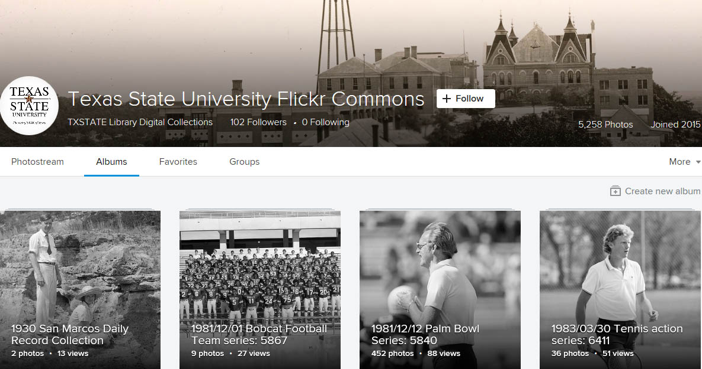
Digital Image Libraries
Interactivity/Social Tagging (Metadata)
Texas State University Flickr Commons

Slide 16
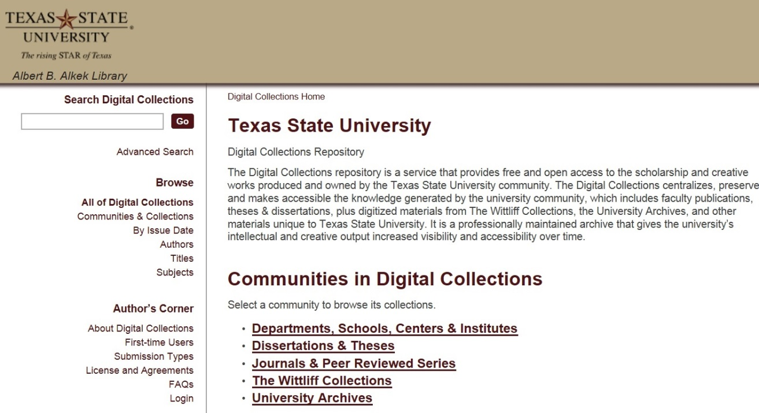
Institutional Repository (MIT, D-Space)
https://digital.library.txstate.edu/
Faculty publications, white papers, preprints, theses, dissertations, working projects
Mary Aycock
Digital Collections Librarian
Stephanie Towery, JD
Copyright Officer
Larger Idea, Grant Compliance, Enabling Faculty Research Online, Raising Research Visibility,

Slide 17
Evolution of the Scholarly Record Online
Evolution of online library tools, 1990-2020 with regards to level of interactivity and media range.

Slide 18
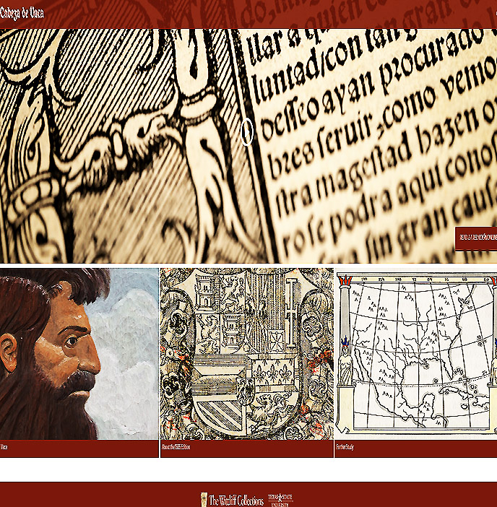
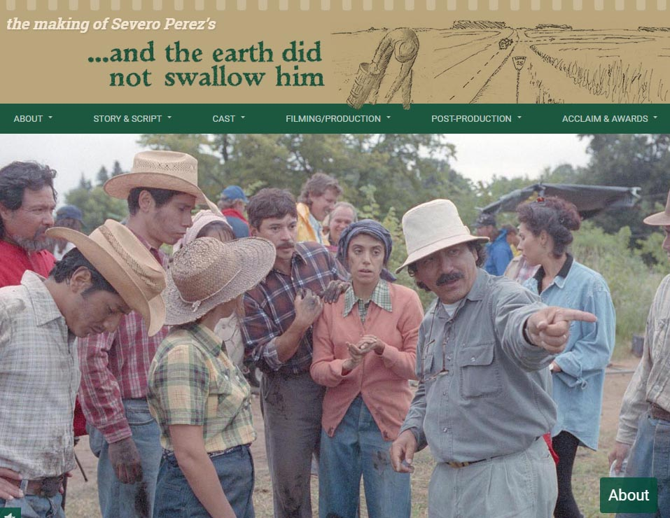
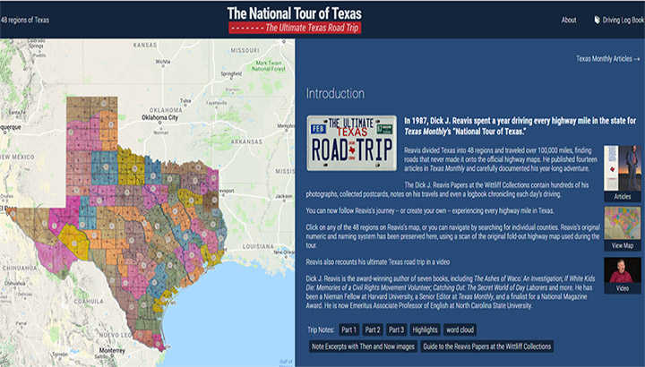
Enabling Digital Scholarship
Collaboration with Research Scholars
Special Collections, University Archives and the Community

Slide 19
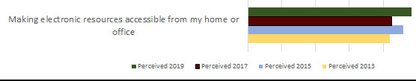
Assessment and Results
Quantitative and Qualitative Measures
Annual Usage Growth
(Downloads, Number of Items, ORCID ID’s
and Hosted Journals)
LibQual Biannual Survey 2013-2019, Faculty and Student System Perceptions, Comments
Ecosystem Implemented in Stages, 2014-2019
System | 2014 | 2015 | 2016 | 2017 | 2018 | 2019
Downloads
DSpace | 326,762 | 318,742 | 385,163 | 341,224 | 972,359 | 1,010,349
ETDs | 136,985 | 158,240 | 200,373 | 328,420 | 470,437 | 505,658
Dataverse | n/a | n/a | n/a | 455 | 3,451 | 2,043
Number of Items
DSpace | 1,340 | 1,437 | 1,546 | 1,660 | 2,135 | 2,720
ETDs | 967 | 1,174 | 1,326 | 1,581 | 1,789 | 2,218
Dataverse | n/a | n/a | n/a | 28 | 33 | 53
ORCID IDs
ORCID | 101 | 190 | 316 | 438 | 545 | 669
Hosted Journals
OJS | 1 | 1 | 2 | 2 | 3 | 4

Slide 20
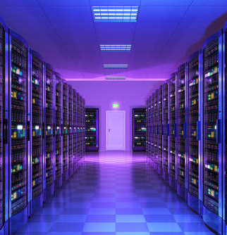


Texas State University Libraries
Digital Preservation Working Group
Background & History
Formed 2015 and consists of members of Libraries’ Digital and Web Services (Digitalization Lab, Institutional Repositories) University Archives, Wittliff Collections, Library General Collections
Authored the Libraries’ first Digital Preservation Policy Document (August 2016)
Conducted Initial Digital Storage Needs Estimate (2016)
Adopted New Digital Preservation Tools, Platforms and Resources as they Became Available
Chooses Archivematica: Middleware standard for Digital Preservation Metadata and Integrity
Conducts Storage Recommendation Solution 2019.
2020-2021 – Chronopolis Adoption and IMplementatin
Notes:
DPWG Membership:
Technology and “system administrators”
Todd Peters
Jason Long
Erin Mazzei
Collection Managers (content specialists)
Laura Waugh IR
Nicole Critchley-University Archives
Laura Kennedy-University Archives
Lauren Goodley – Wittliff Collections
Amanda Price –General Libraries
Digital Preservation Policy for the Alkek Library at Texas State University, 2016: https://www.thewittliffcollections.txstate.edu/research/visit/policies/dig-pres-policy.html, scroll down for link to PDF. *Unanimous agreement on this policy, with membership across disciplines and departments.
Another way to think about it: DPWG initially worked on 2 legs of the stool: (1) Organizational, with the DPWG and Digital Preservation Policy, which lays out definitions, roles, and goals, and (2) Technological, with the dedicated server space for preservation and use files, and associated metadata. Also investigated, identified, and implemented Archivematica, a tool that creates Archival Information Packages, suitable for archival, long term storage.
Next steps:
Continue Organizational, by continuing to meet and make collaborative and unanimous decisions on workflows, etc. Continue relationship with TR and Windows Team.
Continue Technological, by creating these AIP packages. And, in an iterative fashion, move to the next step of storage best practices, by requesting off-site, distributed preservation storage

Slide 21
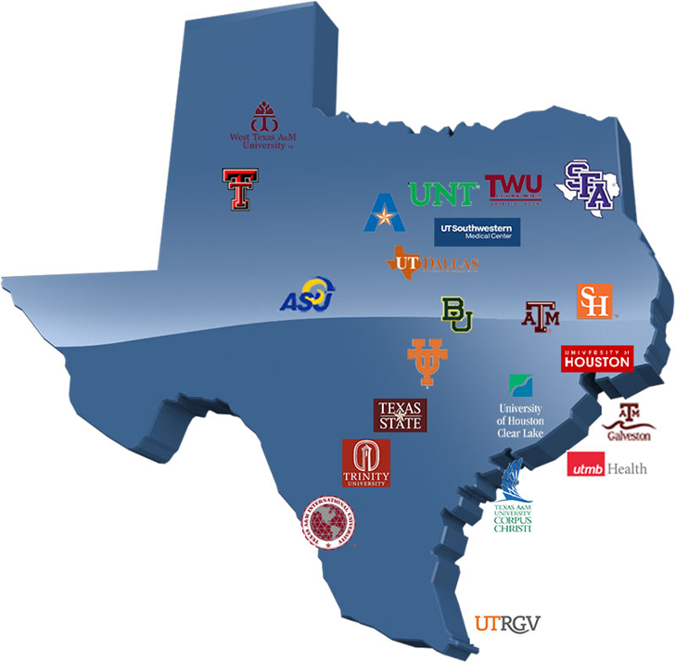
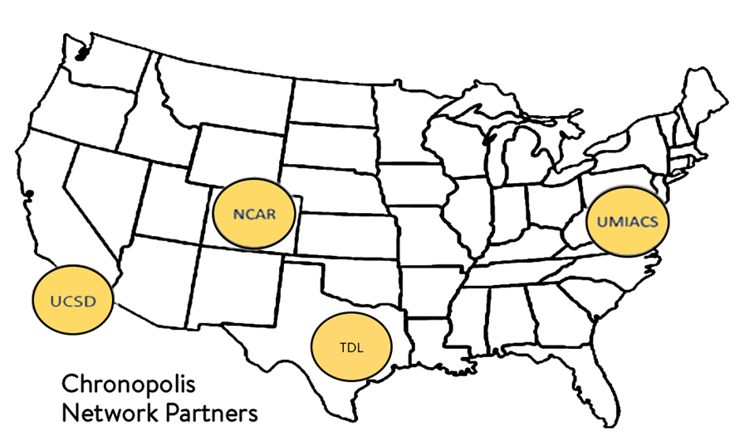
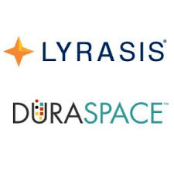

Chronopolis via DuraCloud through TDL
Provides strong library support through four academic library focused organizations (Chronopolis, Duraspace, TDL, Lyrasis) for long term viability and peer support networks
Anticipated Budgetary Request:
  Year 1: $3500.00 ($2500.00 TDL Preservation/year, $1000.00 Initial Set-up/Onboarding, Includes 2 TB Storage)
  Year 2-3: $2785.00/year (includes additional 1 TB storage/year)
Review Storage and Staff Needs Annually.

Slide 22

Deeper Rationale For Long Term Digital Preservation Storage Infrastructure
New Level of Service Expected by Donors, Researchers, Faculty and students.
Present Area of Focus for Research Libraries
Connects Library with many State and National Library Technology Organizations focused on these Issues (TDL, Texas Digital Library, CNI, Coalition of Network Information, JISC, LITA Library Information Technology Association, Chronopolis, Duraspace)
Places Texas State Libraries in Line with institutions we have joined and are aspiring towards (GWLA, Greater Western Library Association and ARL, Association of Research Libraries)

Slide 23
Texas State Research
(Data Management Plan)
Research Data
Dataverse
(Regular to Medium Size Data Sets)
Custom Data Storage Solution
(Big Data Projects)
Reports and Publications
D-Space
Publications Repository

Slide 24
Questions

Slide 25
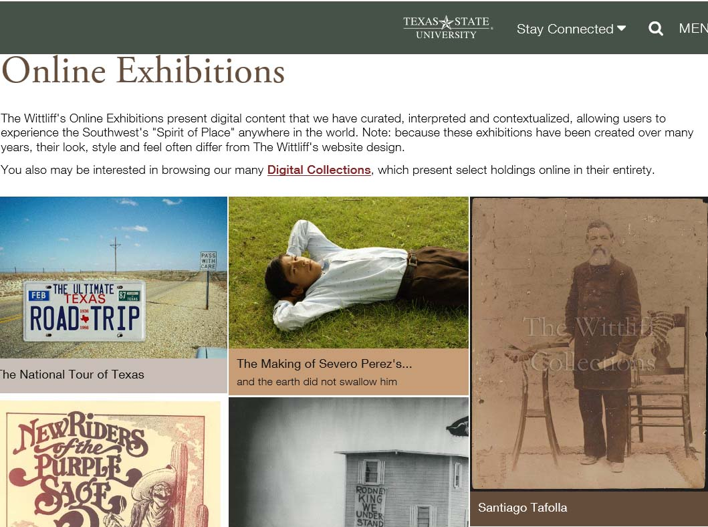
New Online Exhibition Possibilities
Close Relationships
With University Archives
And Special Collections

Slide 26
Faculty Online Research
Partnership Opportunities
Cognitive Cartography/Multimedia Archives
(Video, Text, GIS, Images, Field Notes)
Dick Reavis: National Tour of Texas
Multimedia, Digital Archives
(Digital video, online exhibit images, text, digital archives)
Severo Perez: And the Earth Did not Swallow Them
Online Exhibits/Digital Archives
(images and text, Omeka front end/Database back end)
Santiago Tafolla: Mexican Amer. Confederate Soldier
Interactive Image Archives
(Image libraries, Interactive Commenting/Metadata)
Texas State Flickr Commons
Digital Libraries Documentation Projects
(Text, Metadata, OCR, Search, Zoom ability, Page Turning)
Pedagogs University Yearbooks
Faculty Digitization Proposals/Partnerships
Todd Peters, Head, Alkek Digital and Web Services
Complexity
Projects,Prototypes Grant Partnerships

Slide 27
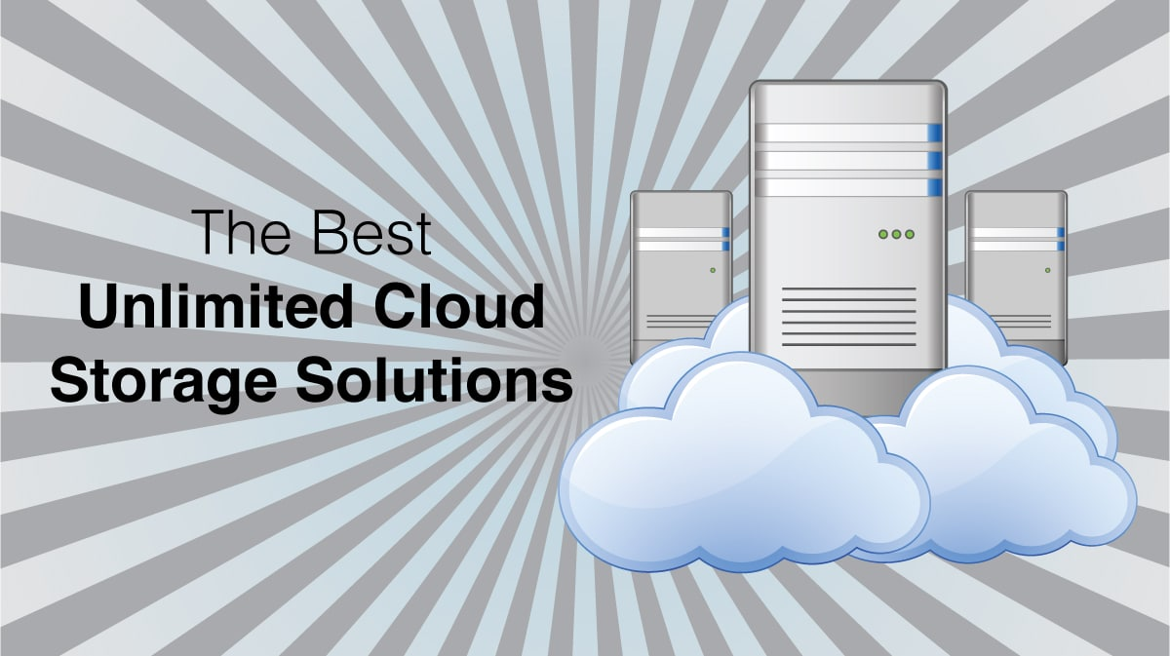
2018-2019
Digital Preservation Working Group
Storage Recommendation Charge
Charge 4 Pillar
Methodology
1) Conduct Environmental Scan: to Identify Library Digital Preservation Storage Options
2) Compare Texas Peer Groups (TDL) and National Best Practices for Research Libraries
3) Narrow The Focus to Pragmatic options suitable for University Libraries Needs
4) Forward Recommendation: for AVP and VPIT Review and Approval

Slide 28
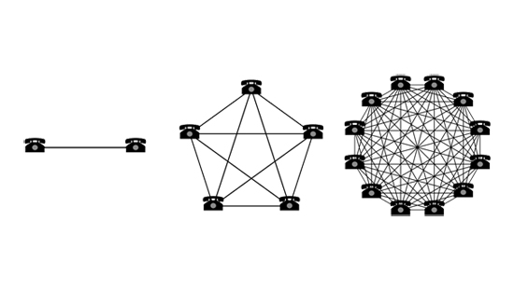
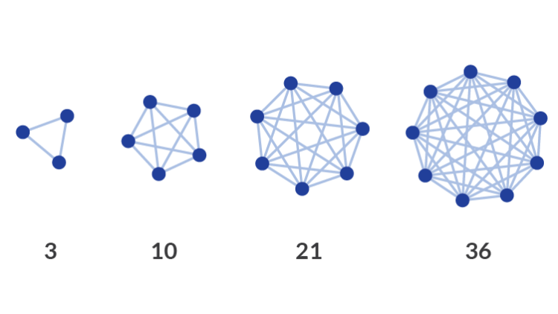
Simple Larger Idea
Digital Ecosystem Metaphor Focuses Upon Relationships
Specifically Focusing Upon the Discrete Research Component Relationships within the Networked Digital Environment

Slide 29
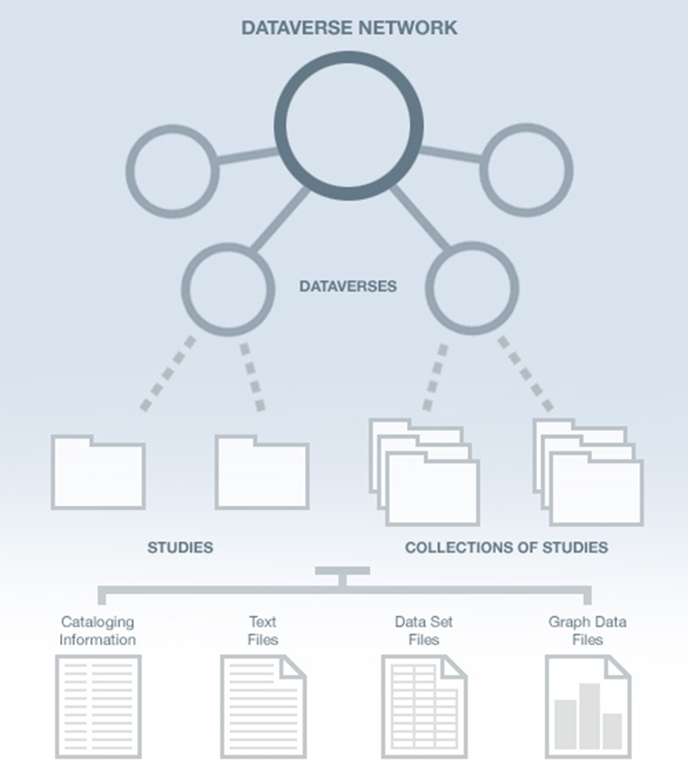
Texas Data Repository Architecture
TDL
Institutions
(i.e. Texas State)
Research Study Data
Data Set Files
Metadata ( Data Describing the data)
Paratextual Research Material
(Methodology, Field Notes , Multimedia, Graphs, Programs etc.)

Slide 30
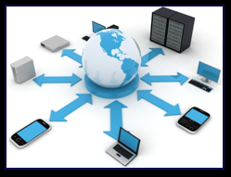
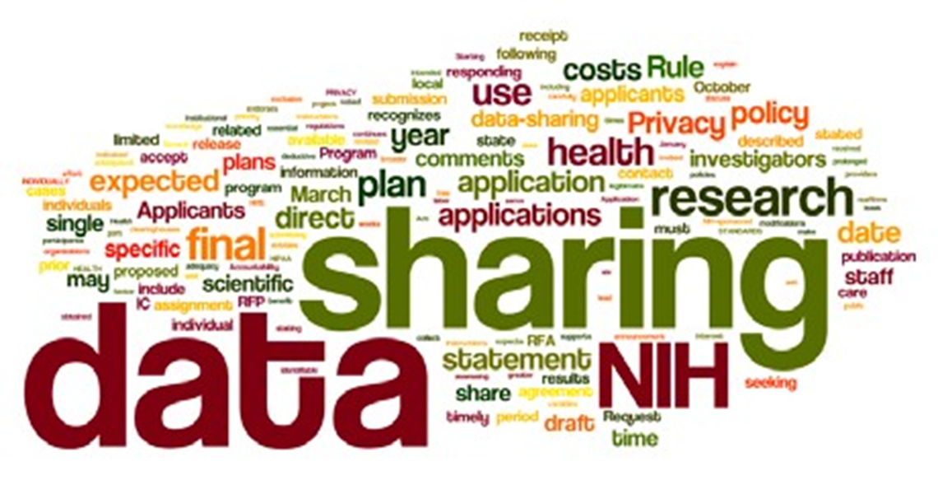
Online Data Repositories
Online Way to Manage a Researcher’s Data/Metadata
Way to Manage Federal Grant Compliance
Most major Federal grant agencies require data access as part of the grant proposal/oversite process. (NIH, NSF, NEH, 2013 USDA)
Permalinking Strategy for Online Data Citation & Access, Long Term Data Archiving, Preservation, Sharing Strategy

Slide 31

Texas Data Repository
Texas Digital Library Initiative, 2014 -2016
TDL Consortium of 22 universities across Texas
leveraging technological cooperation among academic libraries,

Slide 32
Data Literacy and Data Research Repositories
The Texas Online Data Research Repository.

Slide 33
2018-2019
Digital Preservation Working Group
Storage Recommendation Charge
Charge 4 Pillar
Methodology
1) Conduct Environmental Scan: to Identify Library Digital Preservation Storage Options
2) Compare Texas Peer Groups (TDL) and National Best Practices for Research Libraries
3) Narrow The Focus to Pragmatic options suitable for University Libraries Needs
4) Forward Recommendation: for AVP and VPIT Review and Approval

Slide 34
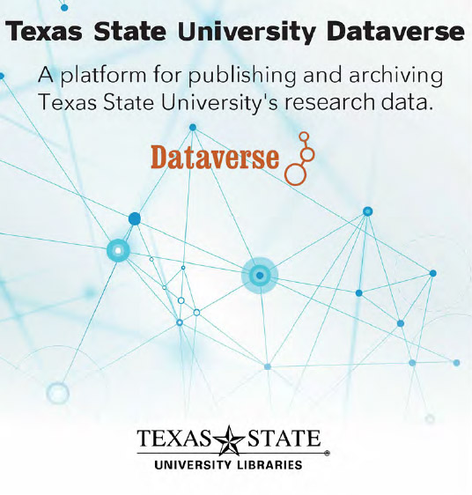
Part III: Human Resource Infrastructures (Working Teams)
Full or Part Time
Data Repository Liaison
Publication Repository Liaison
Metadata Liaison
Subject Liaisons (Outreach)
Committee for Workflows & Policies
Current Hires
Digital Collections Librarian
(Texas State Data Repository
Dataverse/Publications Repository: D-Space)
Data Visualization and Analytics
Librarian (Tableau, Bayesia)
Future Hires
Machine Learning/Neural Networks/AI Librarian (working with the data)

Slide 35

2016-2018 Texas Digital Library
Forms First State Digital Preservation
Resource Infrastructure
2016 TDL Preservation Services Initiated
(Hires Courtney Mumma from Internet Archive (Wayback Machine, Brewster Kale) to Focus on State Digital Preservation Services
2016 TDL Forms Alliance with DuraCloud
(Digital Preservation focused Non-Profit
Duracloud @ TDL )
2017 TDL Creates Digital Preservation Services Members receive “Space” in DuraCloud@TDL for ingesting content, based on membership level.
2018 Texas wide TDL Archivematica Users Group Formed

Slide 36
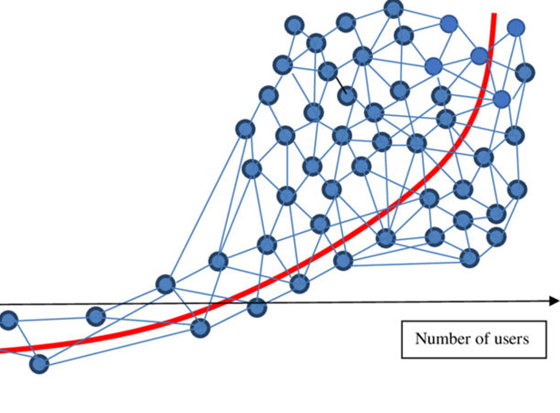

Digital Scholarship
Research Ecosystems

