Slide 1
21st Century Academic Library Collections & Digital Services
Evolution & Development Through Technology, Creativity and Best Practices
Ray Uzwyshyn, Ph.D. MBA MLIS

Slide 2
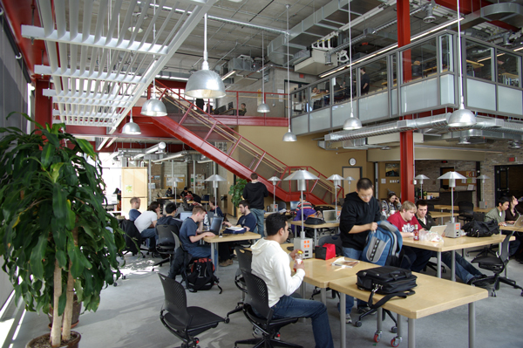
Collection Management and Digital Services are in a State of Paradigm Shift & Transformation
21st Century Library Learning Commons

Slide 3
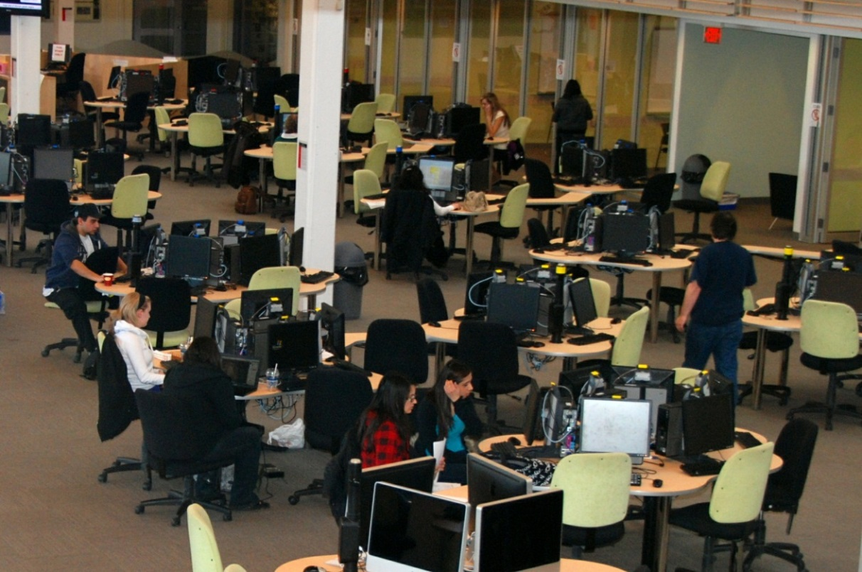
Traditional Print Warehouse Model Waning, Digital Services & Digital Collections Expanding
Student/Faculty Centered Collaborative Learning Spaces, Digital Literacy Labs, Multimedia Studios

Slide 4
Opportunity To Reimagine Digital and Collection Services For 21st Century
Reimagining University/ Classroom/Library – Relationships (Relevancy)
Faculty/Student/Curriculum & Research Relationships

Slide 5
Collection Development Priorities Transforming Through Digital Resources & Media
Collection Development Priorities Shifting
Changing Models From Ownership to Access to Aggregation and Distribution

Slide 6
Learning, Spaces, Technology
New Possibilities for Learning & Research.
Information & Digital Literacy
Classrooms
Multimedia Studios & Archival Media Conversion Labs
Technology
Traditional Study,
Books, e-books, journals
New Virtual & Physical Spaces

Slide 7
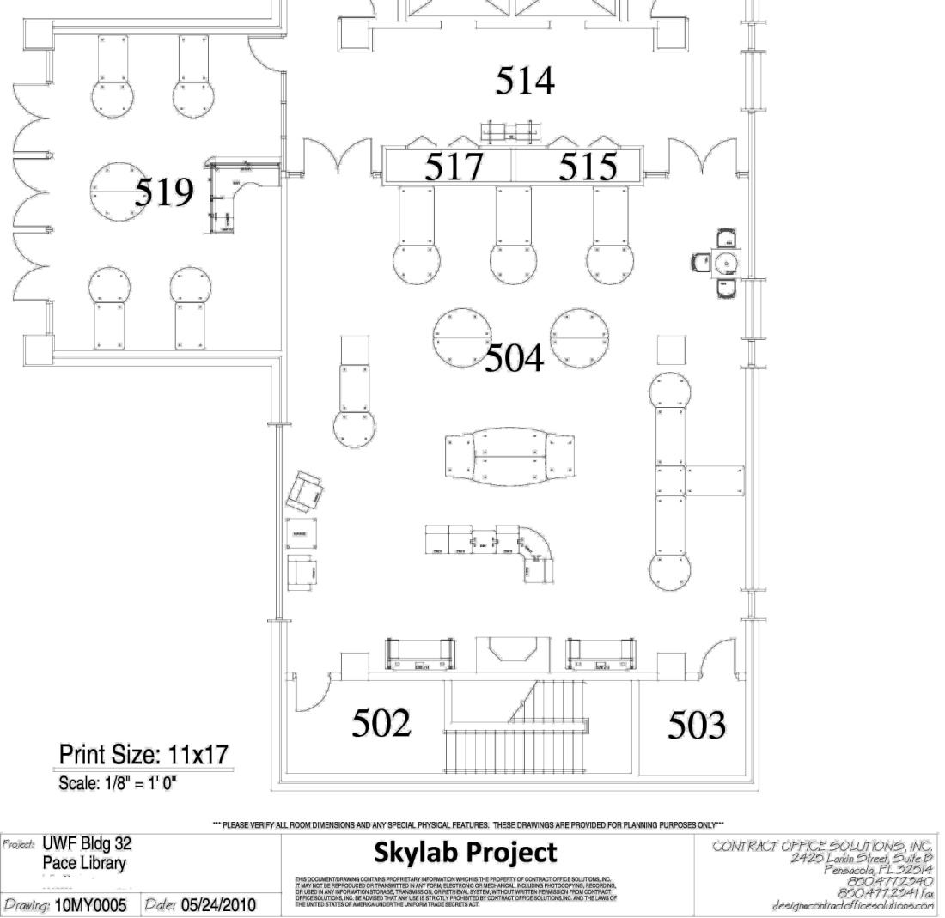
UWF Skylab
Handouts: Tech. Proposals, Schematics Skylab Conceptualization/Grant
Binders Complete Hardware, Software Tech. Specifications Budget Binders Budgetary Documents Skylab Date Log with Primary Documents
Presentations Library Stakeholders University Administration/Faculty National Awareness/Marketing

Slide 8
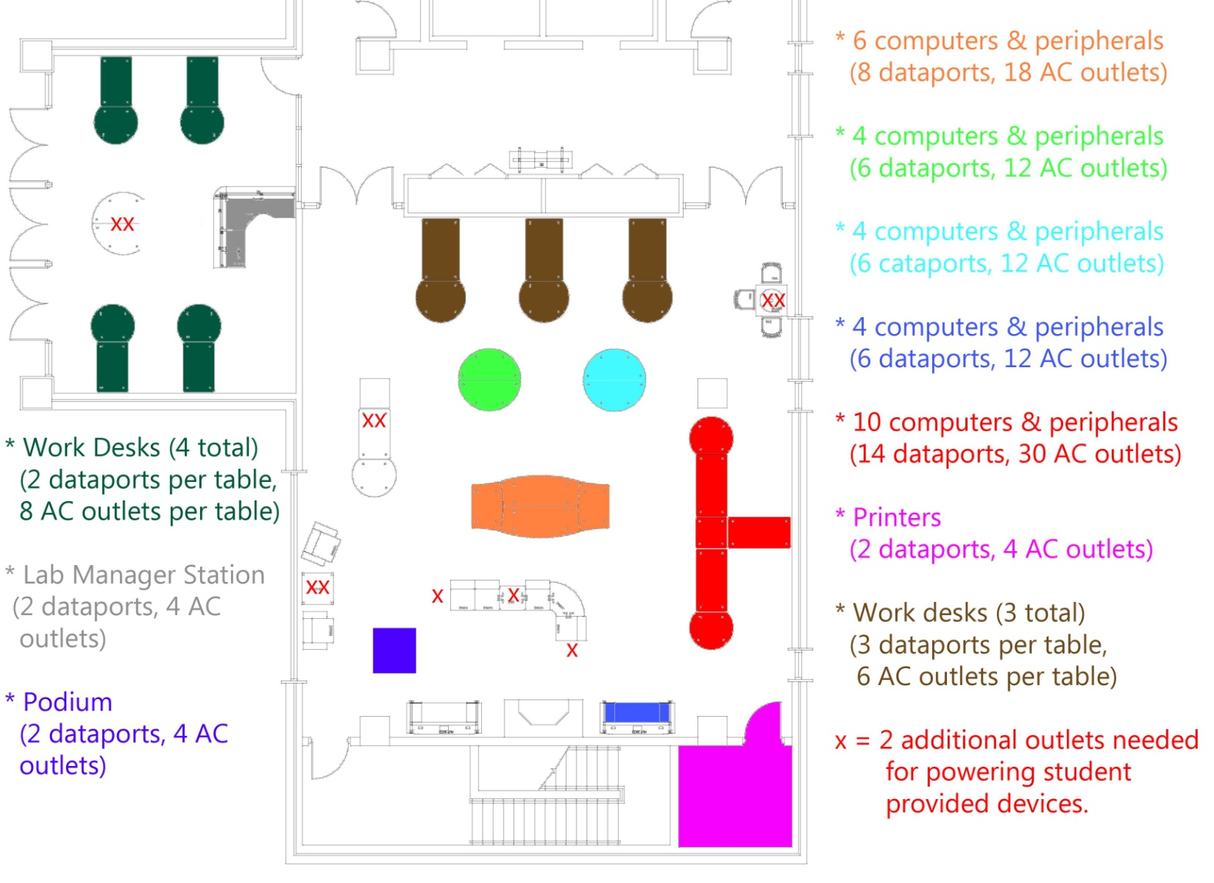
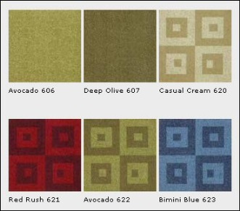
UWF Skylab Planning: Arch & Eng.: Electrical Data
Engaging and Transforming the Library through Partnership with Faculty, Students and Administrators

Slide 9
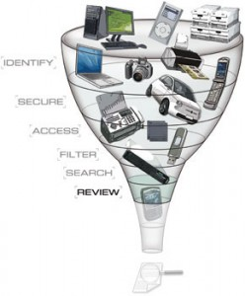
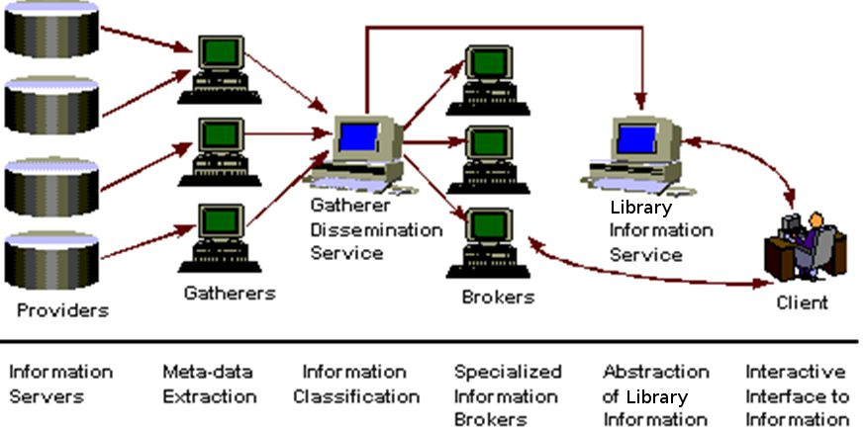
New genres of Library Web-Scale Information Discovery Tools
Engaging Faculty and Students Through New Research Discovery Possibilities (Summon, Primo, Web-Scale Discovery tools)

Slide 10
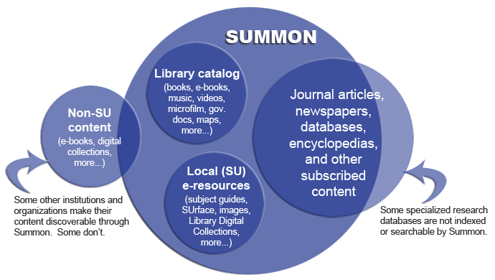
New TeXtual Aggregator Methodologies New METADATA POSsibilities (XML, RDA)
Search Engine Tuning Human Resources Shift
Search Design Logic

Slide 11
New Web Scale LMS Appearing
Entirely Cloud Based Applications: Less need to purchase hardware/software
Expanded Shared Data Possibility: Silos between applications, databases eliminated (i.e. Worldshare/Worldcat)
Expanded System/Division Integration: Ordering, Receiving, Dataloging, higher end digital library (ContentDM) and other integration

Slide 12
OCLC Worldshare Live Metadata Integration

Slide 13
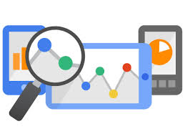
New Web-Scale LMS & Other Cloud Based Library Systems
Reduces Cost: Eliminates need for hosting multiple servers and equipment (hardware/software upgrades)
Institutional Human Resources Refocus: allows refocus on other possibilities, challenges
Better Analytics: User Trends, Click Streams,Library Database Usage. Insight, Business Intelligence (BI)

Slide 14
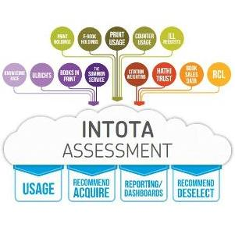
New User Focused Analytics (Collection Development)
Reconceptualizing Collection Management
Reconceptualizing Electronic Resource Management ( Integration with Serials Solutions 360)
Strong Assessment/ Analytics Reporting, (Accreditation)
Subscription Model
Strong Integration with Proquest, Summon

Slide 15
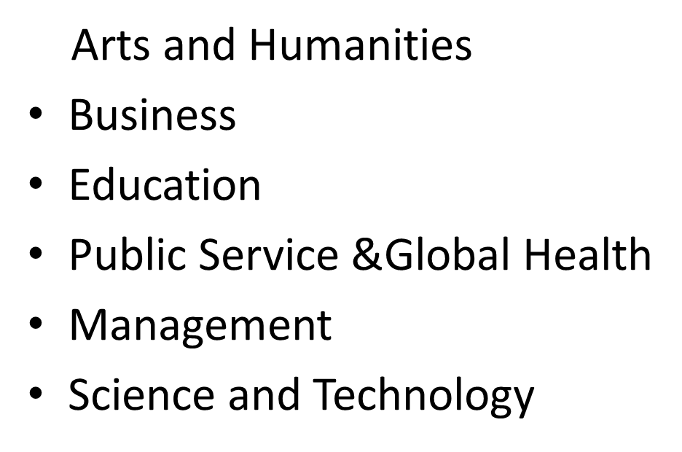
Online Library Services Expanding
From Online Research Help Systems & Knowledge bases to MOOC’s
Online Curricular Needs (OER, E-Books, E-Articles, Media)

Slide 16
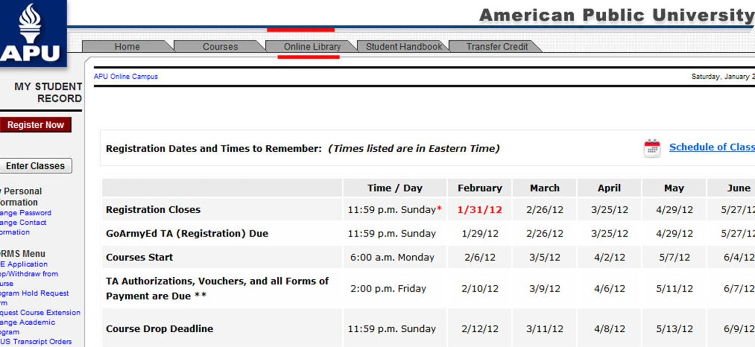
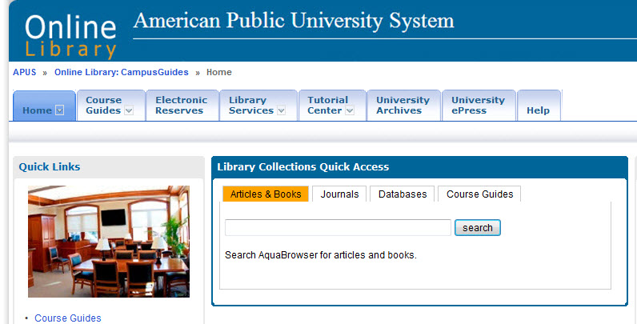
Library Integration with Online Classroom Learning Management System
Flipped Classroom/Blended Learning

Slide 17
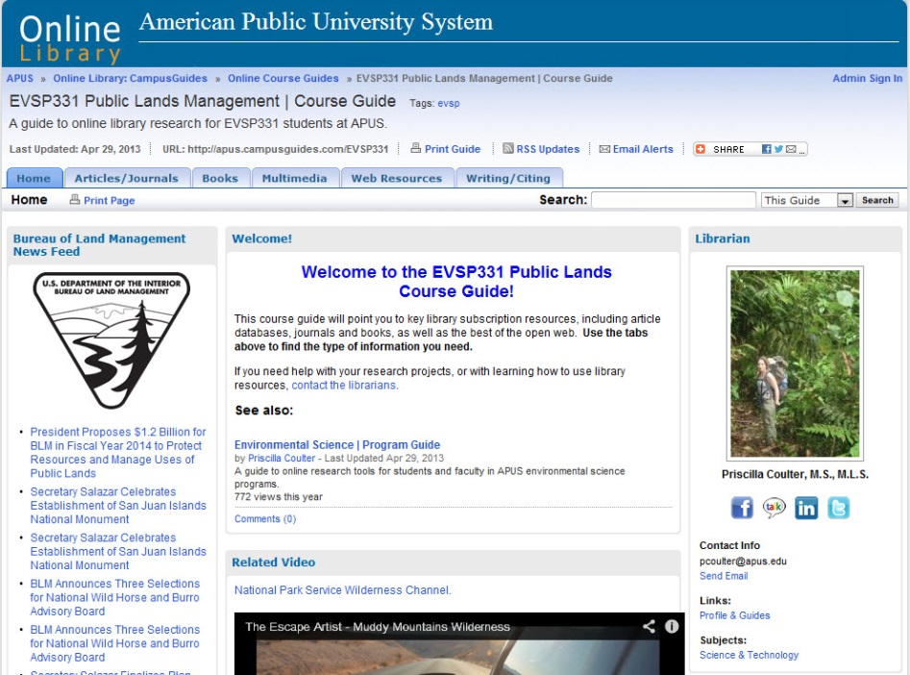
Online Course Guides powerful Research Tools
Direct Curricular
Replacement
Secondary
Multimedia Bibliographic Resource
Global
Marketing/Branding
ROI
Partnering with Faculty Online

Slide 18
Digital Help Systems Online Semantic Knowledge Base
Knowledgebase:
Semantic Knowledge Base for LMS and Libraries

Slide 19
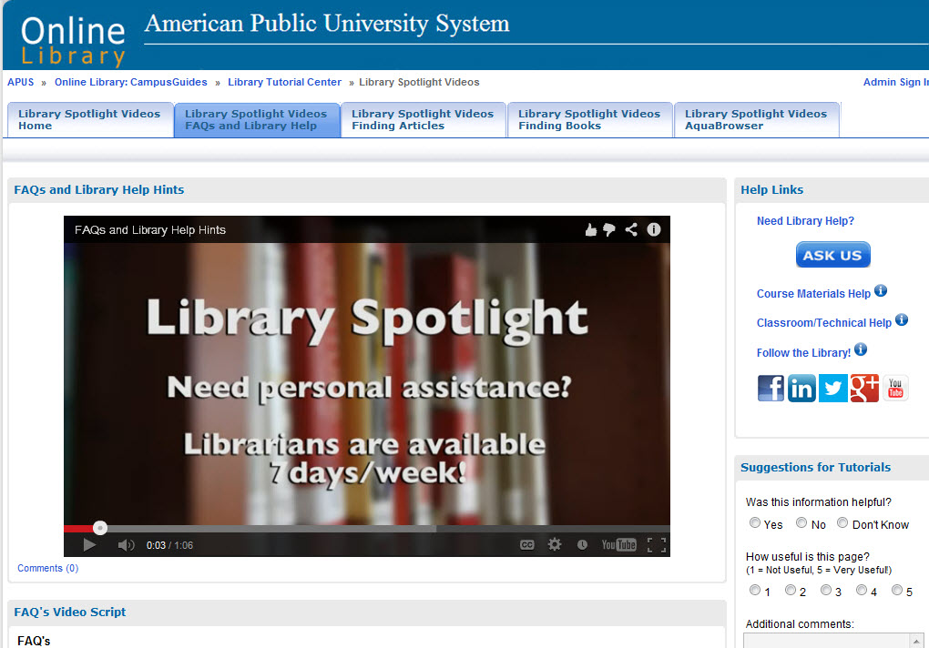
Online Video help SYstems

Slide 20
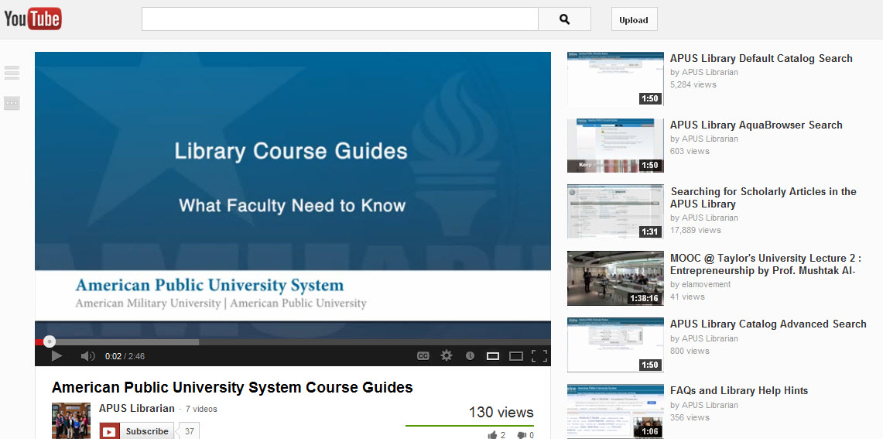
Media Channels & Social Media Network Help Systems

Slide 21
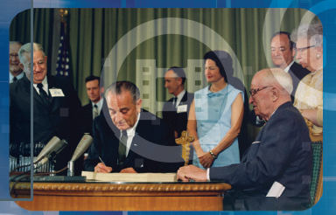
New Media Possibilities For Collection Development Academic Video Databases
Business
Psychology Counseling and therapy
Education
Economics
Public Health History Humanities Criminal Justice and Law Political Science Public Safety/Intel Literature/Philosophy Religion/theatre
Science/Technology
Security/Military
Space

Slide 22
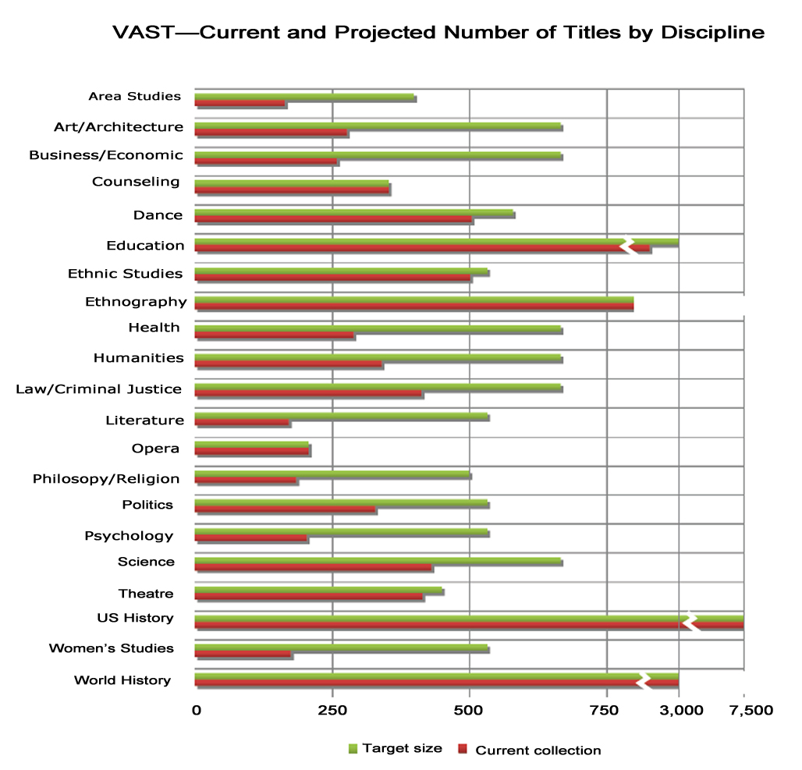
Interdisciplinarity, Interactivity,
Multi-modal Research Possibility
Alexander Street Press VAST, 20,000 videos
2013.

Slide 23
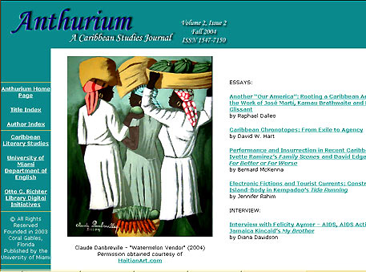
New Genres of Digital Library Services Partnering with Faculty
Scholarly Refereed E-Journals Open Source Publishing Opportunities

Slide 24
e-Press/Bookstore Partnerships with Faculty/Other Divisions
Publish on Demand (POD) Books and Faculty Publications, Revenue Generation Student/Faculty Benefits

Slide 25
Enabling Student Research
Online Masters Thesis Archive/Capstone/Online Library
(Dark Archives & Institutional Repositories)

Slide 26
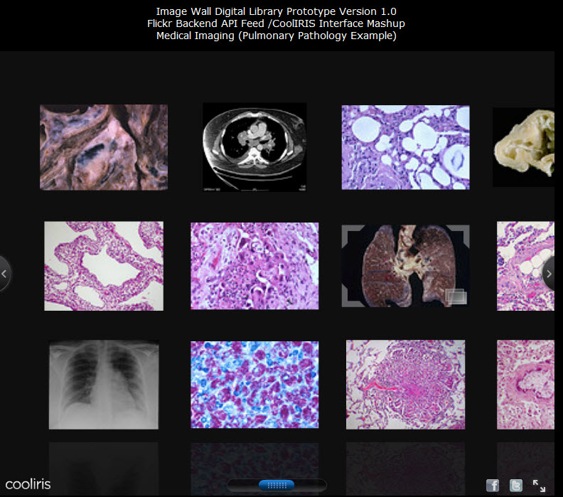
Digital Archives and Special Collections
Library Academic/University/Community Connections

Slide 27
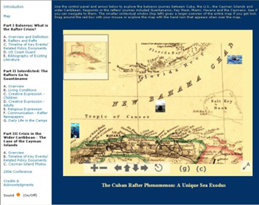
Digital Libraries Engagement With Faculty Research/ Special Collections
New Genres of Digital Archives

Slide 28
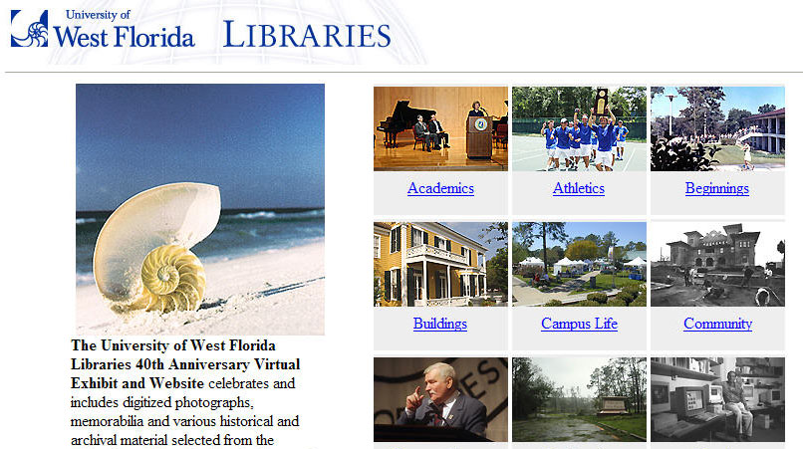
University/Library/Community Bridges
Engagement with University Administration

Slide 29
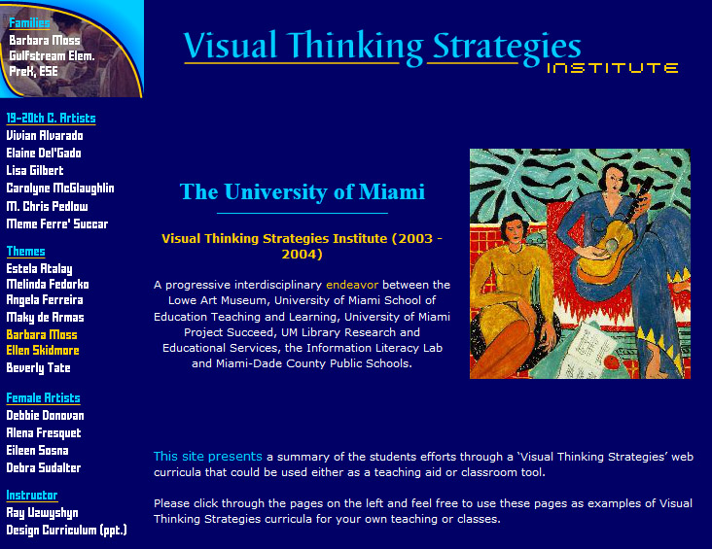
Digital Literacy/ Interdisciplinarity Partnership with Faculty Divisions and Schools
Library Technology/Information Literacy Services School of Education University Art Department/Museum
State Dept, Of Education Grant Opportunities

Slide 30
Tomorrows Collection & Digital Services Through People/Partnerships
Technology/Ideas/ People
Student/Faculty/Administration Synergies

Slide 31
thanks!
Questions?
Ray Uzwyshyn Ph.D. MBA MLIS http://rayuzwyshyn.net ruzwyshyn@gmail.com

