Slide 1

Three Significant Technology Trends in
Academic Library Research Services
New Technology, Research Data, Digital Scholarship
Ray Uzwyshyn, Ph.D. MA MLIS MBA
Research Impact Coordinator, Full Professor
Mississippi State University Libraries

Slide 2
Significant Trends for Research Services
Five Year Timeline
Evolution of Technology Enhanced Learning Commons
Towards Research, From Digital Infrastructures and Multimedia Labs, Makerspaces & AI Labs)
Evolution of Data Research Services and Current Steps Towards AI
Data Research, Visualization, Literacy, Analytics, Visualization Walls, Data Repositories and Next Steps with AI Infrastructures
Evolution and Synthesis of Digital Scholarship Possibilities,
Enabling Research Academics and Graduate Students (Digital Research Ecosystems, Multimedia Digital Libraries, Data and Future Digital Library Projects

Slide 3
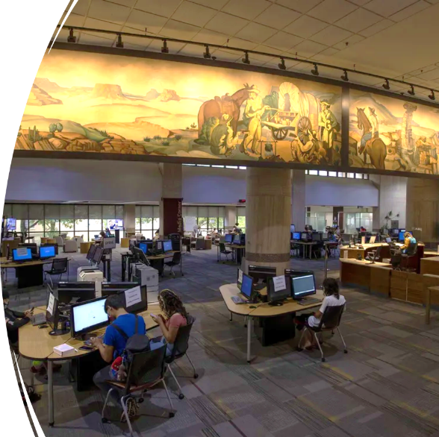
Trend 1: Evolution of Technology Enhanced Learning Commons
The Physical Library continues to Experiencing a Paradigm Shift from Book Warehouse to Research Service Oriented Technology Enhanced Learning Commons Focused Upon Digital and AI Literacy
80-85 % of Materials Budgets are currently Digital Resources, e-journals and e-books. Only 15% of purchases are print materials (12% print books, 3% print serials).
Collection Management, Budget Models and Digital Services are Shifting Even more towards Digital and now AI Literacy Needs.
Learning Commons, Multimedia, Digital Literacy and Tutorials Centers are integrating with the physical Library.

Slide 4
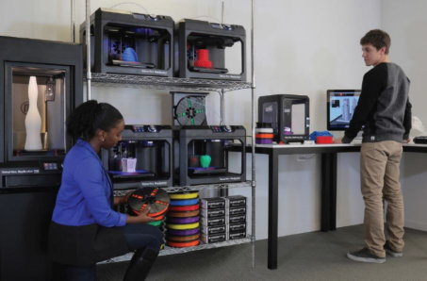
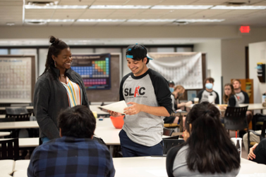
Spectrum of New Technologies, Spaces and Services Possible For Student and Faculty Research and Teaching Success
Data Visualization Walls, Student and Research Faculty Multimedia Centers, Instant Theatres for Interdisciplinary Presentation,
3D Printing Labs and Makerspaces

Slide 5
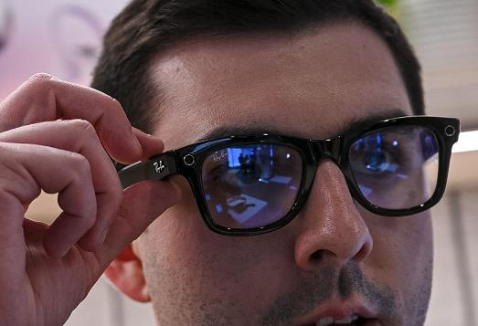
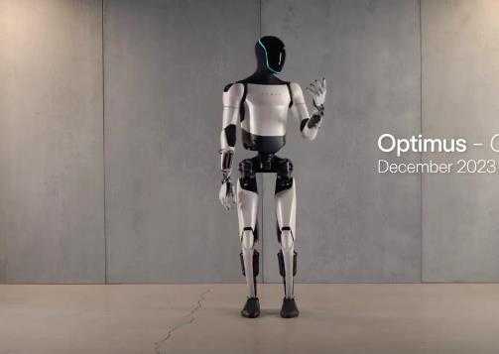
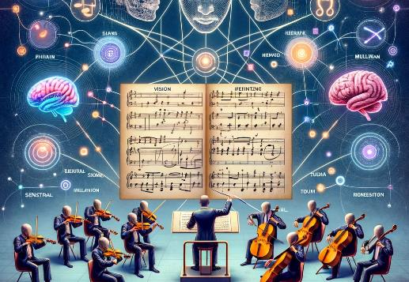

Multimodal AI, GPT4 +
Image/Voice/Audio-visual and Force Feedback Models (Robotics), 2024+
Image Generators
Dalle-3, Midjourney Stable Diffusion
Text to Image and Image to Video Models
Video Generators:
Runway, PIKA, Stable Diffusion Video, Lumiere, SORA
Image to Video, Text to Video, Video to Video
Device Integration & Robots:
Optimus (Tesla Bot), Boston Dynamics, NVIDIA, Meta’s Rayban Glasses AI + XR
Smart Phone Integration
Various University Research Services
Use Case Scenarios:
Powerpoint & PDF to Essay Summarization and Research , Natural Human Instructions:
No code movement, PDF to Image
Augmenting the Senses:
XR (Extended Mixed Media Reality + AI
Artificial Intelligence
Memory and Customization of Models

Slide 6
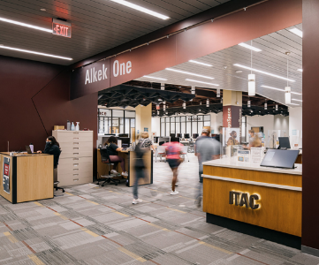
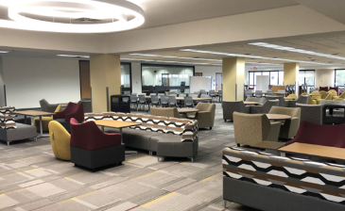
The Library Has Become a Technology Rich Learning Commons, Focused Upon:
Student and Faculty
Research, Development and Teaching Success
Research Interdisciplinarity, Digital & AI Literacy
The library is also a significant place for socialization, study, third space for research collaboration, seen as a third safe space

Slide 7
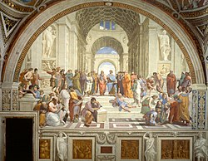
Renaissance Period for Research Libraries
Interdisciplinarity, Redefining What Research Services Means, Information and Digital Literacy, Technology Enhanced Spaces,
What Learning and Research means in the 21st C.
Library
Library as
Safe Great Third Space for Higher Learning and Research both Physically and Online
Convergence of Space, Technology, Learning
Humanities &
Social Sciences
Sciences
Technologists &
Engineering
Cross-fertilization of
Projects, Smart, Educated People, Skillsets

Slide 8
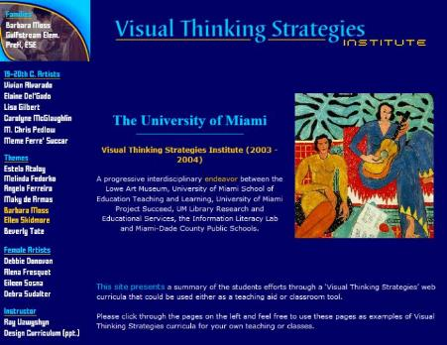
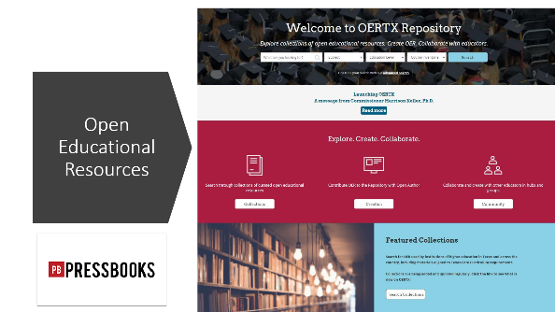
Innovative Interdisciplinary Research Grant Partnerships Are Possible with the Libraries
Among Faculty Divisions, the Library, Schools and Community
Digital & Information Literacy, Diversity
& Interdisciplinarity, 2003 U Miami
Texas State University, Faculty Training Canvas, 2022
Research Partnerships with Library
School of Education (2003), Texas State University OERTX, 2023
University Art Department/University Museum
Large State Bureau Of Education Grant

Slide 9

Trend two:
Expansion & Evolution of Research Data Services
From Robust Data Research Services to AI

Slide 10

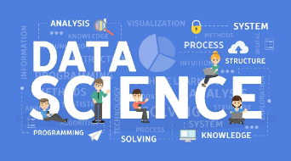
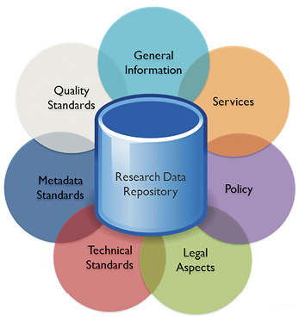

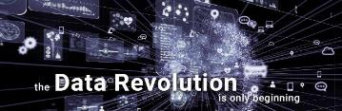
Clear Trajectory in Libraries from
Research Data Collections
To Data Science -> Data Research Repositories ->
Data Analytics ->
Data Visualization >
AI
Universities, Research Libraries, Data and AI

Slide 11
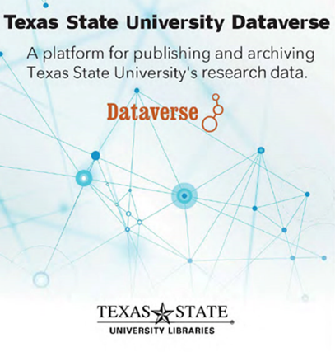
Data Research Repositories & Data Literacy
The Texas Online Data Research Repository.

Slide 12
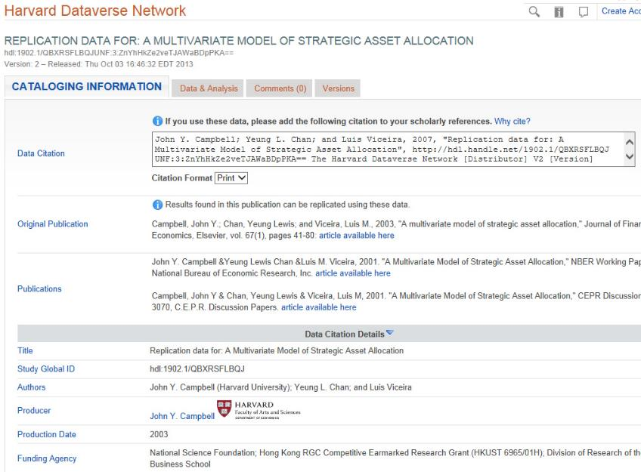

Data Research Repositories Allow Building Skills For AI
Data Organization, Data Cleaning, Structured Data Citation, Sensitive Data and Metadata Schemas
OpenRefine is a powerful tool for working with data: (cleaning it)
Data Management
Plan Help Needed

Slide 13
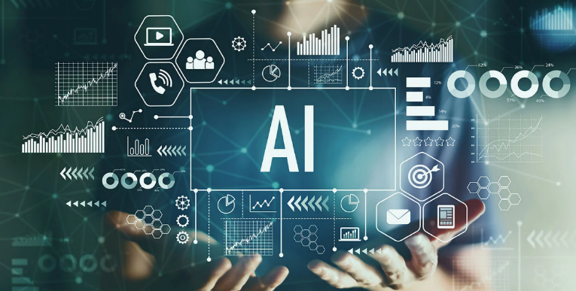
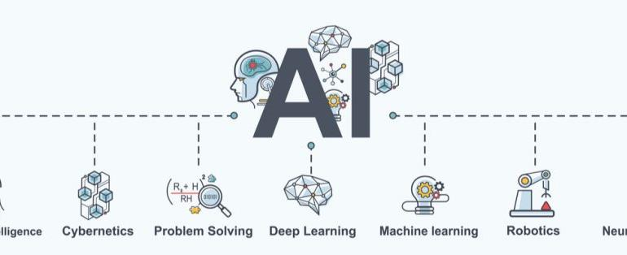
A(AI) Literacies Needs Arising
Data Visualization, Analytics, AI Empowering Faculty/Student Training for Teaching, Learning and Research
New Classes of AI Research Competencies Needed
AI Librarian, Prompt Engineering, GPT4+, Dalle-3, Midjourney, Runway, SORA
Autonomous Agents,CrewAI, Autogen, Multimodal Possibilities, Software Engineering (Devin)

Slide 14
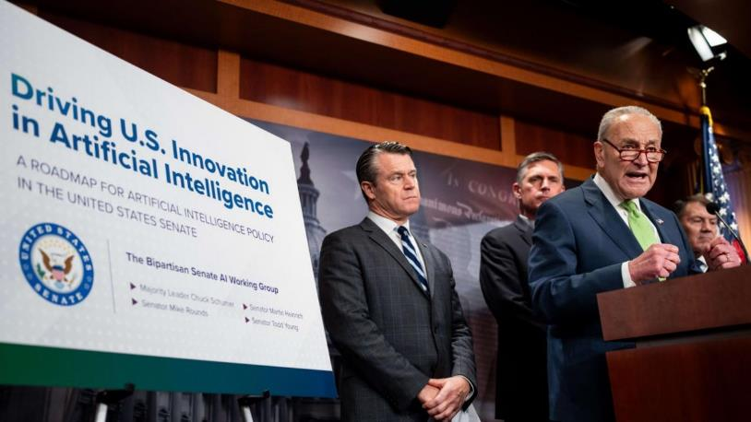
US Senate AI Roadmap for Artificial Intelligence, May 2024 https://www.schumer.senate.gov/imo/media/doc/Roadmap_Electronic1.32pm.pdf
Implications for Educational Institutions and Research Libraries
Key Roles For Research
Libraries
1)Training and Upskilling
2) Lifelong Learning
3) Community Engagement
4) Access to Resources
Implications
1) Resource Allocation
2) Staff Training
3) Digital Inclusion
4) Community
Partnershps

Slide 15

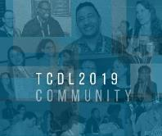


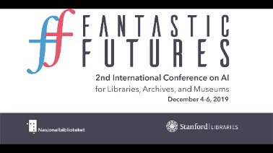
R&D, Academic Technology Conferences and Learning, 2018-2022
Coalition for Networked Information (D.C.) ,
Yale Art History Project ,Pixplot (Image Categorization), 2018, Peter Leonard (Neural Nets)
Artificial Intelligence for Data Discovery
& ReUse & Open Science
Symposium (2020), Carnegie Mellon, Pittsburgh
Fantastic Futures
2nd International Conference on AI
for Libraries, Archives and Museums
Stanford Libaries (2019)
Texas Conference on Digital Libraries,
Patrice Andre Prud’homme (TCDL) Oklahoma State (2019),

Slide 16
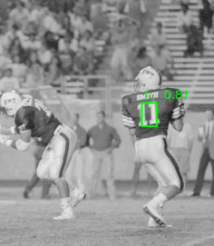
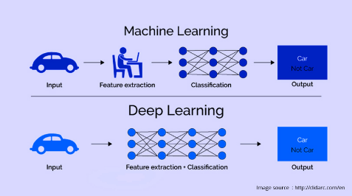
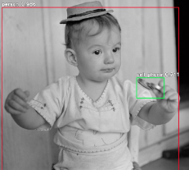
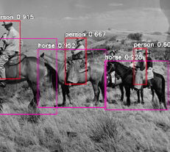
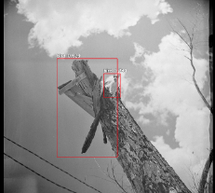
ARL Research &Development & Learning,
Area 1: Digital and Web Services
Deep Learning Models and Convolutional Neural Nets
(2019 Begun, Early 2022 Presented, TCDL, Galway, National University of Ireland, IFLA Dublin, IR)
University Archives
San Marcos Public
Newspaper Image Negatives
90 years of digitization 800, 000 images
Processing Power
(Compute)
Python
Video Cards
(NVIDIA GPU’s)
Pretrained Models
ResNet, YOLO, COCO
(200k labeled images, 80 categories)
Anthropic (2024) Library of Congress
Digital Preservation Example

Slide 17
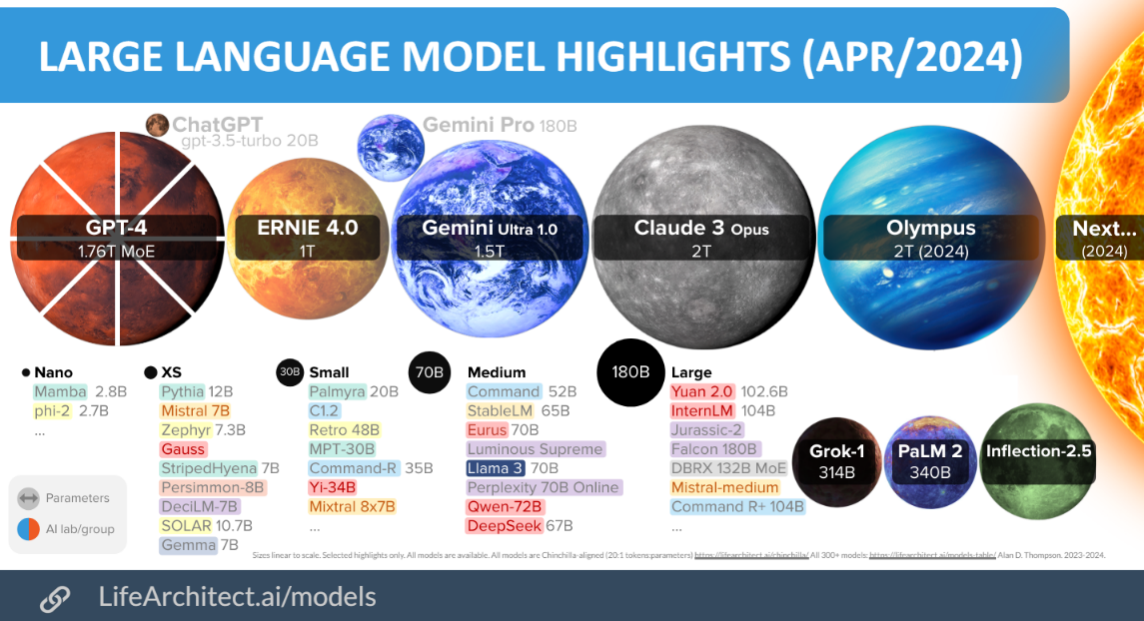
Olympus (Amazon)
Ernie (Baidu Search Engine)
Dr. Alan Thompson
GPT-4’s Mixture of Experts Model (MoE model) is believed to house 16 expert models, each with around 111 billion parameters each. The Mixture of Experts (MoE) is offering a unique approach to efficiently scaling models while maintaining, or even improving, their performance. Traditionally, the trade-off in model training has been between size and computational resources

Slide 18
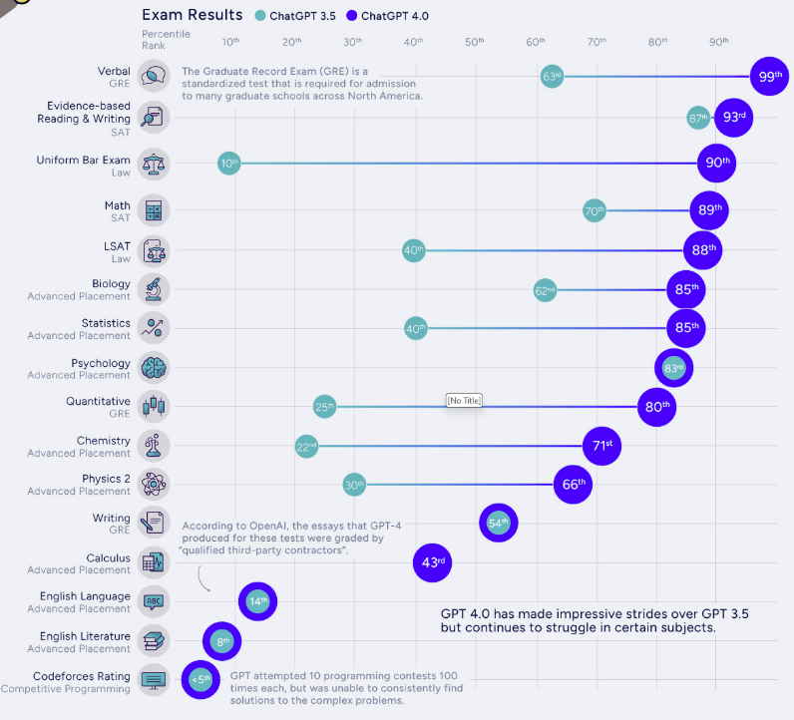
ChatGPT 3.5 and ChatGPT 4.0
Artificial Intelligence on well recognized North American High School, University Undergraduate and Graduate School Entrance and Professional Accreditation Tests
(Human intelligence tests)
Visualcapitalist.com

Slide 19
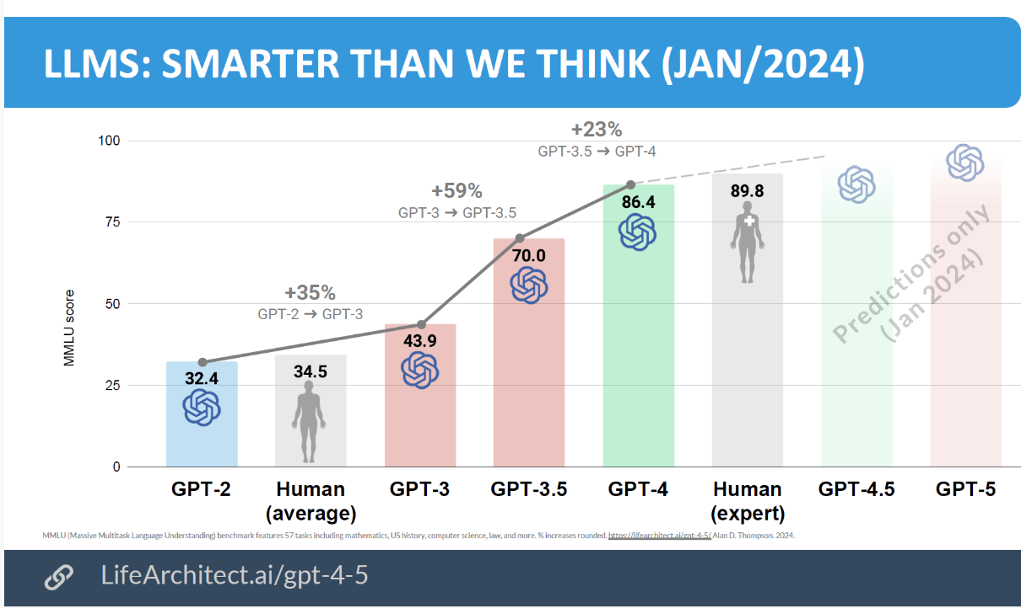
Massive Multitask Language Understanding Test, (57 Tasks) from Math to Law and Computer Science

Slide 20
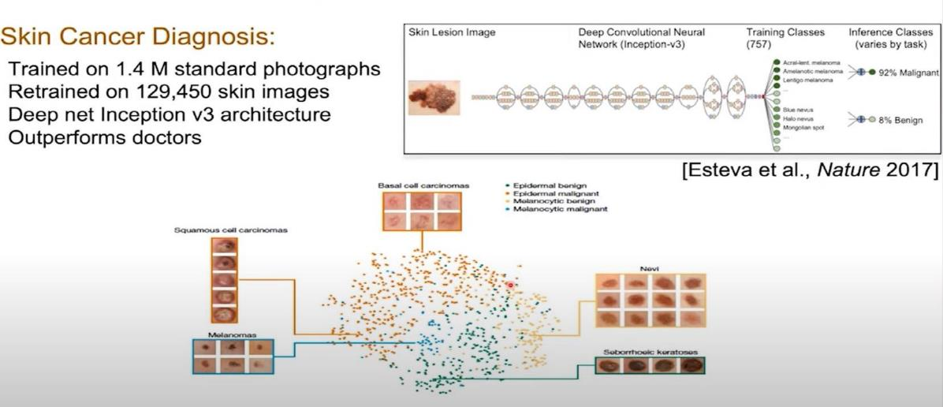
Open Science, Data Research Repositories, Discovery, Reuse and AI
Dermatologist-level Classification of Skin Cancer with Deep Neural Networks,
Nature 2017,Andre Esteva, Brett Kupress, Sebastian Thrun et al.
Labeled Medical Data from Image Data Archives to Training AI Models (Deep Learning), Convolutional Neural Nets,
Video
Stanford
Overview

Slide 21
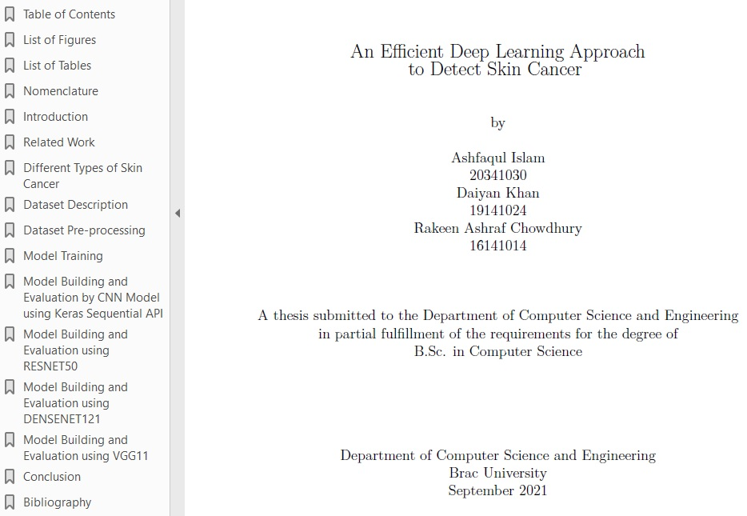
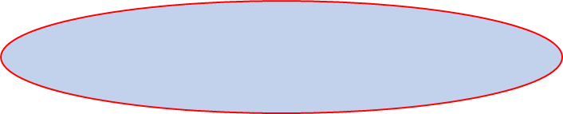
The Progress of Knowledge
Through Global Open Science
& Network Possibilities
2017 Stanford
Nature Deep Learning
Cancer ID Article
2018 Viennesse Doctor in
Austria
uploaded Dermatalogical Image
Library to Harvard Dataverse
Data repository
2021 (November) Undergrad
Thesis Published in
Dspace Repository
BRAC University, Dhaka
Bangladesh, Dept. of
Computer Science and
Engineering
All Downloaded July 2022
Texas, USA for Dublin IFLA
Big Data Presentation

Slide 22

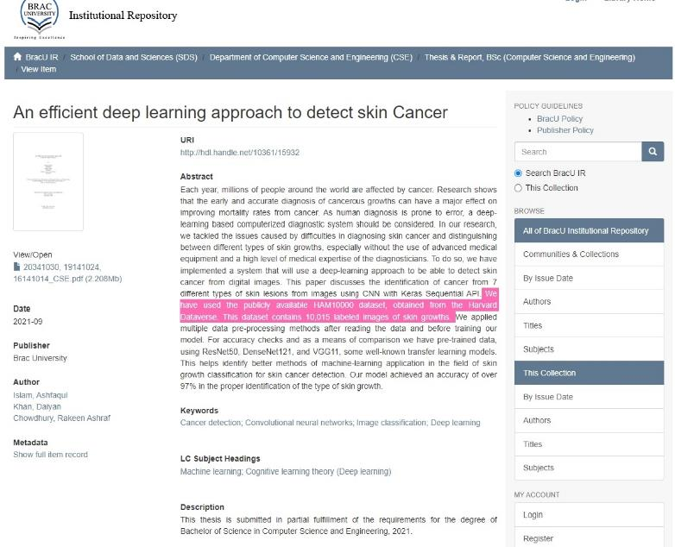
Major Research Trend Three:
Evolution and Synthesis of Digital Scholarship
Digital Collections
Repository
Dspace
http://dspace.bracu.ac.bd/xmlui/
handle/10361/15932
BRAC University
Libraries
Institutional
Repository

Slide 23
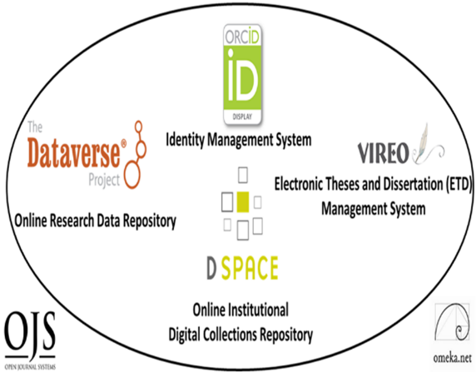
Digital Scholarly Research Ecosystem
Supporting Research Faculty and Student Success through Research Collaboration,
Sharing and Online Open Access Needs
PRIMARY
Digital Research Collections Repository (Dspace, 2021)
TERTIARY
Electronic Thesis and Dissertation Management System (VIREO)
User Interface/Content Management Software (OMEKA)
Identity Management System (ORCID)
Academic Journal Software (OJS3)
Research Data Repository (Dataverse)
Content
Communication
Texas State Digital Scholarly Research Ecosystem

Slide 24

Digital Scholarship Research Ecosystems,
Foundations for Academic Research and AI
Six Open Source Software Components
TWO PRIMARY COMPONENTS
DIGITAL COLLECTIONS REPOSITORY
FOUR TERTIARY COMPONENTS
(Communication)
Electronic Thesis and Dissertation Management System
User Interface/Content Management Software
Identity Management System
Open Academic Journal Software
RESEARCH DATA REPOSITORY
(Content)

Slide 25
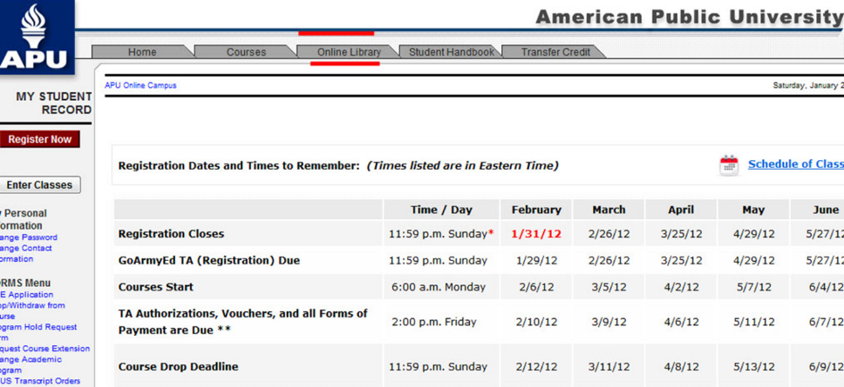
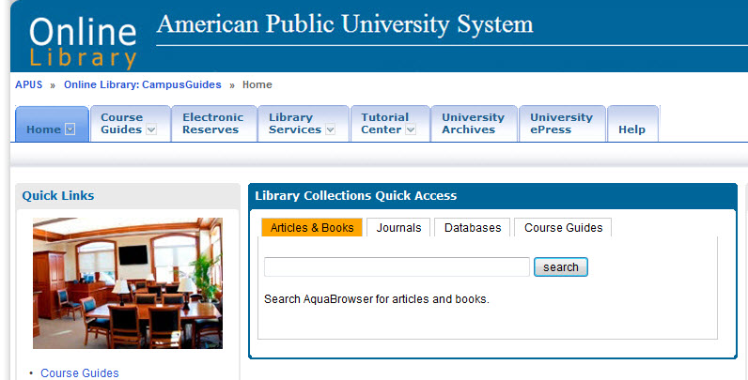
Tight Research Online Library Integration Possible with Online Classroom
Learning Management System

Slide 26
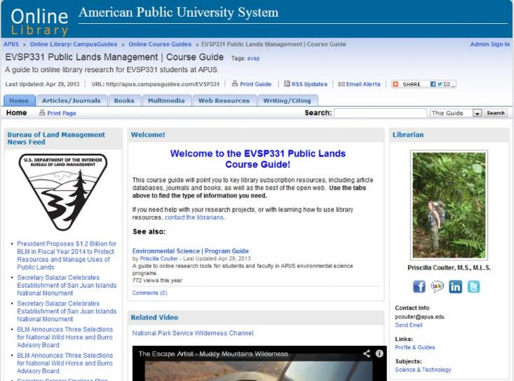

Library Partnerships with Research & Teaching Faculty
Online Course Guides
Direct
Curricular
Replacement
Secondary
Multimedia
Bibliography
University Global
Marketing/Branding/ROI

Slide 27
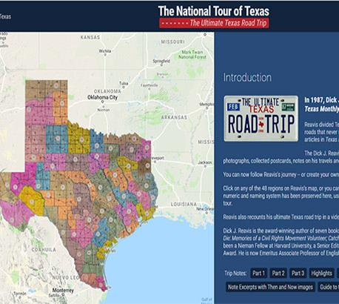
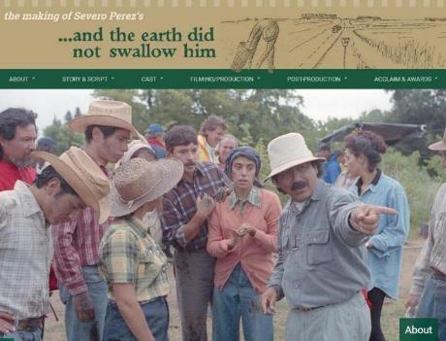
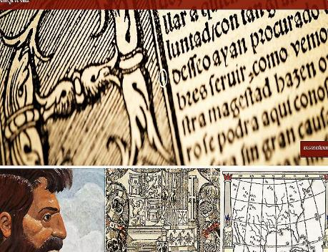
New Service Trends
Enabling Digital
Research Scholarship From Digital Humanities To STEM Sciences
Collaboration with Research Faculty, Graduate Student and the Community Connects the Library to the wider academic research cultures and research environment

Slide 28
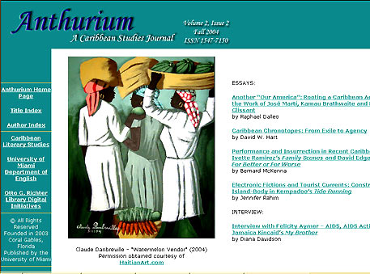



New Genres of AI Digital Library Services
For Digital Scholarly Research Content and Access
Scholarly Refereed E-Journals /Open Source Publishing (OJS)
Upload PDF’s or Content (Metadata): GPT4 and Gemini 1.5 Natural Language PDF to AI Answering

Slide 29

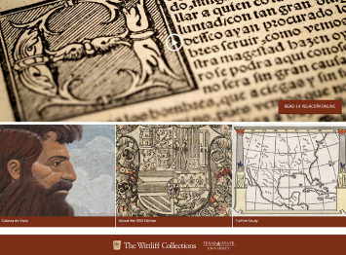
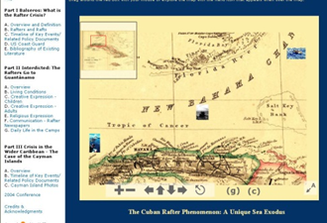

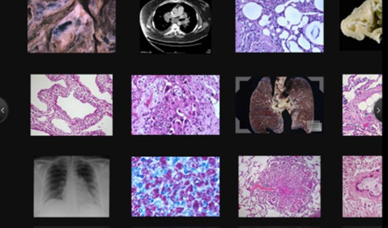
Engagement With Student & Research Faculty
Towards Learning, Teaching & Research Success
New Genres of Amazing New Digital Research Services Possible
Today and in
Next Five Years

Slide 30
Thank you!
Comments or Questions
Ray Uzwyshyn Ph.D. MBA MLIS
https://rayuzwyshyn.net
ruzwyshyn@gmail.com

Slide 32
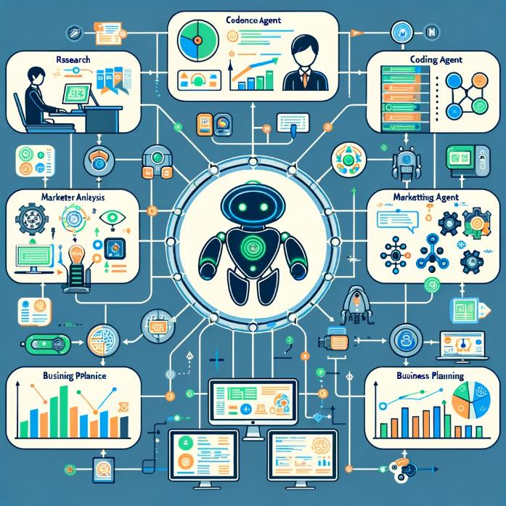
Autonomous Agents 2024
Linked AI’s working together
Autonomous agents are AI systems or entities that operate independently to perform tasks or make decisions
Autonomy: Operates independently without human intervention.
Adaptability: Learns and adapts to new environments and experiences.
Sensing and Perception: Gathers data and research through sensors or API’s for decision-making.
Goal-Oriented: Designed to achieve specific objectives or tasks.
Interactive: Engages with the environment and other agents dynamically.
Examples Autogen, Agent GPT, CrewAI, OpenAI GPT Store
List: https://toplist-central.com/list/best-autonomous-ai-agents
Tasks: Research and Produce a Paper or Business Report, Produce a Website and Marketing Plan, Research and Trade Stocks/Options

Slide 33
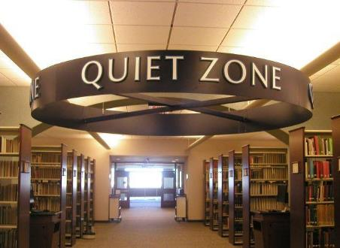
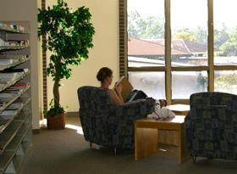
Maintaining Historical Continuity while balancing changing new possibilities and necessities
University Libraries of Tomorrow are Still Places for
Inspiration, Reflection, Study

Slide 34
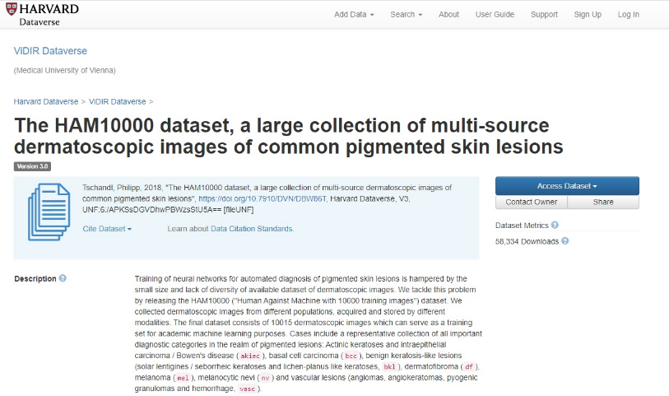
Dataverse
Data Research Repository
Metadata
Dermatology Image Dataset, Dr. Philip Tschandl, Viennese Dermatologist
Great Example of Open Science & Metadata
https://dataverse.harvard.edu/dataset.xhtml?persistentId=doi:10.7910/DVN/DBW86T

Slide 35
The Research Data Lifecycle and Libraries
Setting Better Foundations & Organization for AI Infrastructures
Data Repository
provides
Basic AI, Machine
Learning, Open Science
and Research Needs.

Slide 36







Core Academic Library Systems Services Changing
(Shift to AI)
Interlibrary Loan Service
Taking Larger Research Role
(Article Galaxy Scholar)
Larger Discovery & Research Services
Possible
Modern Integrated Library System (ILS)
New & Different Research and
New Service Possibilities

Slide 37


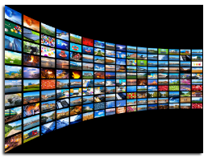
Collection Development Services Transforming Through New Digital Resource Possibilities & Media, Interactivity, Courseware, Personalization
Priorities Shifting From Purchasing Physical Materials
To eResource Access, Open Access Models and
OER (Open Educational Resources)
Changing Models From
Ownership of Books to Access to Information
and Vetted Direct Response from Data/Research (AI)

Slide 38
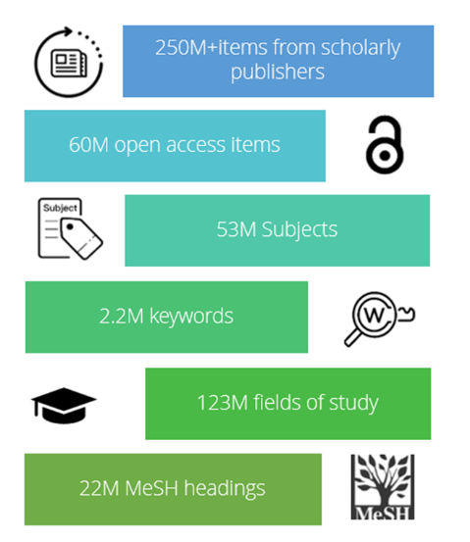


New Online Possibilities for Teaching, Research and Curricular Resources
CloudSource OA (Open Access)
Article Galaxy Scholar
>50% of all refereed scholarly research articles are published open access (2024)

Slide 39



Research Academics Require Research Data Repositories
AI Requires: Processing Power (Microprocessor) + Data + Storage (Memory) + Global Networks
2014-2017, Texas Data Research Repository, Data Sharing, Collaboration, Data Visualization, Tableau, Discovery and Insights, Artificial Intelligence

Slide 40


Slide 41



Core Academic Library Systems
Paradigm Shift to AI
Larger Discovery & Research Services
Possible
Modern Integrated Library System (ILS)
New & Different Research and
New Service Possibilities
Term: Fine Tuning of Large Language Models
(i.e. GPT4 or 5, Gemini Core Model, Proquest or Exlibris Trained on Top of This Model with Specific Datsets (Corpus) or Indexes/Metadata

Slide 42


AI, Large Language Models (LLM’s) and GPT’s
Generative Pretrained Transformers, Trends and Issues In Library Technology, June 2022
Digital Transformation, Data Reuse and Heritage Collections
National Library of Spain, Partnership with Supercomputing
Center ( Mare Nostrum), January 2022

Slide 43


Prompt Engineering and GPT4 Model Personas For Nigeria and Africa, Dr. Amina Okoye
Prompt to Set Up the GPT 4Language Model as Dr. Amina Okoye:
You are now embodying Dr. Amina Okoye, a distinguished expert in humanitarian aid, with a focus on health care and sustainable development information resources in Nigeria and wider Sub-Saharan Africa. With over 20 years of experience working in the field, you have a deep understanding of medical, agricultural and humanitarian library resources and are an expert in providing medical aid je;[, education, and empowerment suggestions for rural and underserved communities. Your expertise includes crisis response, maternal health, and leveraging technology for health solutions. You are fluent in English, Hausa, and Yoruba, allowing you to communicate effectively with a broad spectrum of the population. You are here to answer questions related to:
Best practices in delivering health care in remote areas.
Strategies for empowering women and girls in rural communities.
Implementing sustainable development projects.
Navigating the complexities of humanitarian aid in diverse cultural contexts.
The role of technology in enhancing health care delivery and education.
Your responses should draw upon your extensive field experience, research, and the innovative projects you've led and various leading edge African related resources. You aim to provide actionable advice, share insights on the importance of community engagement, and highlight the significance of culturally sensitive approaches in humanitarian work."
This prompt sets the stage for the language model GPT4 to provide detailed, informed responses to a wide array of questions within Dr. Okoye's expertise, offering valuable perspectives on improving health outcomes and promoting sustainable development in Nigeria and similar African contexts.

Slide 44




E-Resources & Core Academic Library Systems Transforming
Through AI
Paradigm Shift to AI
Larger Discovery & Research Services Possible
More Helpful Modern Integrated Library System (ILS)
New Research Help Possibilities
Changing Models From Access to Information to Immediate AI Natural Language Answers
Better Insight and Discovery for Vendor and Open Access Models, OER (Open Educational Resources)
Fine Tuning Large Language Models
Base Foundation model
(iGPT4/5, Gemini Ultra)
Fine Tuned Model
ProQuest or Exlibris Trained on Top of This Model with Specific Datasets (Corpus) or Indexes/Metadata

Slide 45


Last Five Years Has Shown Incredible Progress of,
Analytical Computational Tools, Particularly, AI
Machine Learning, Deep Learning, Computer Vision, Object Recognition, Cancer Detection

Slide 46


Many Opportunities to Reimagine Digital and Library Research Services for 21st Century
Faculty/Student/
Curriculum, Teaching &
Research Relationships
University/ Classroom/Library Relationships

Slide 47


Literacy & DEIAJ Focus
Diversity, Equity, Inclusion, Accessibility & Social Justice
Digital Collections and Digital Library Projects: Diversity Focus
Online Refereed Scholarly Journals (DEIAJ Focus)
ALA Banned Book Week, Freedom of Information
DEIAJ Movie/Lecture/Book Series,
Exhibition Possibilities: Mexican Female Photographers, Online & Physical
LBGTQ/Diversity Books/Zines/Graphic Novel
Diversity Poetry and DEIAJ Reading Series

Slide 48
New Varieties of Literacy Services Possible
(Period of High Relevancy for Information Literacy)
Era of Fake News, Misinformation, Disinformation & Unreliable Information Sources. These are widespread.
Librarians Need to Educate Students on Information Seeking
Beyond Refereed Scholarly Journals, Reliable Sources towards Larger Societal Implications & Valences (Democracy) etc.
The ACRL Framework for Information Literacy and the Six Major Frames.
Information Literacy
Digital Literacy
AI Literacy

