Slide 1
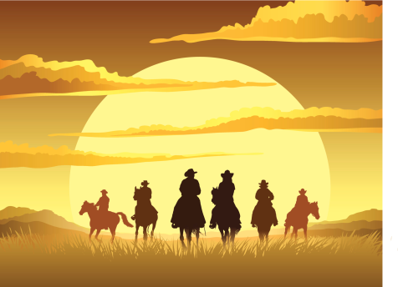
Texas Conference on Digital Libraries Round-up Full Set of Conference Presentation Slides https://conferences.tdl.org/tcdl/index.php/TCDL/TCDL2015/schedConf/presentations

Slide 2
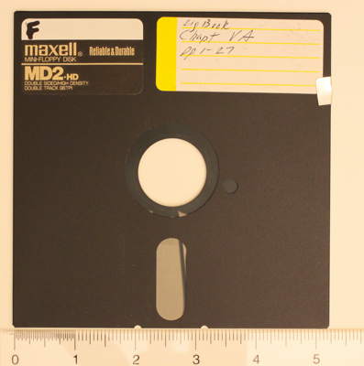
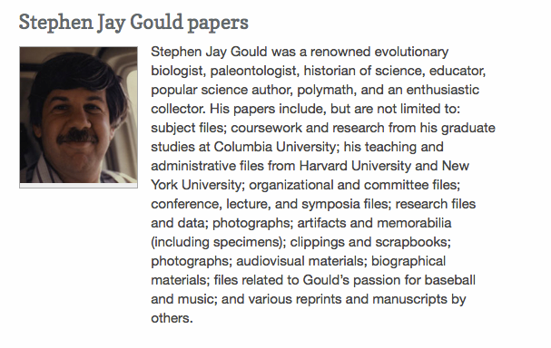
Texas Conference on Digital Libraries Overarching Theme: Digital Preservation – the Long View
Bess Sadler, Stanford

Slide 3
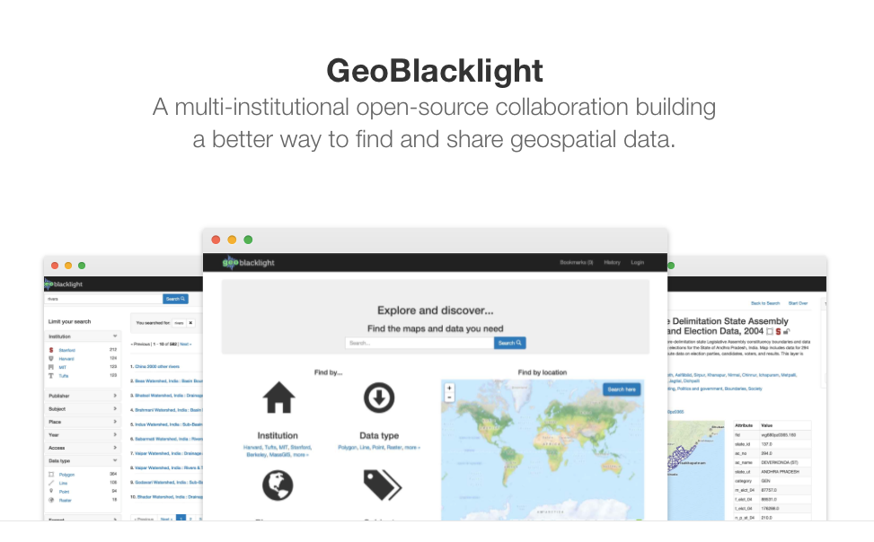
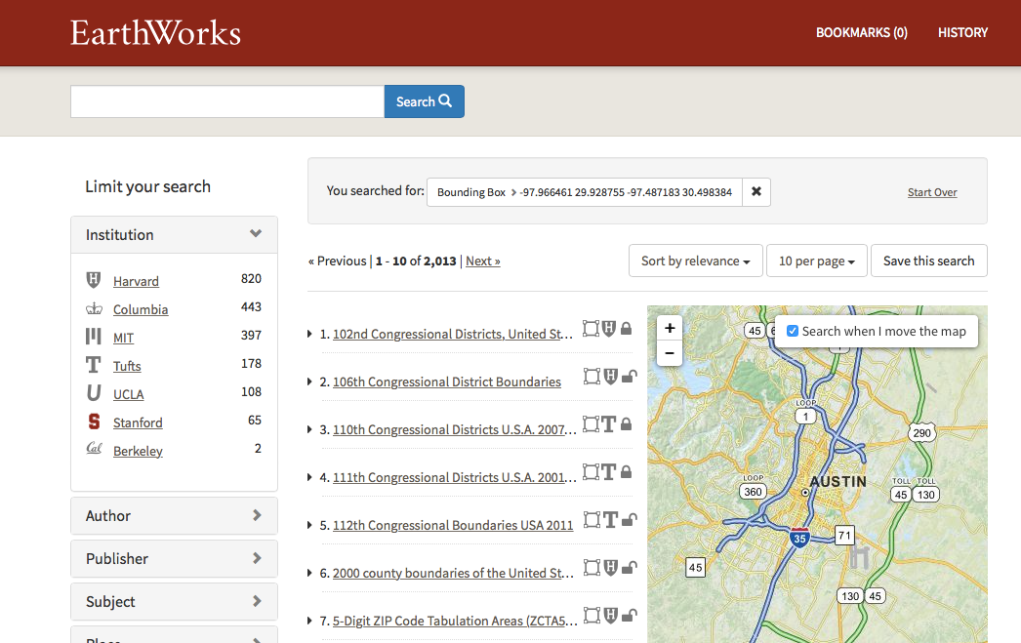
Geo-Spatial
Data Repository
http://geoblacklight.org
https://earthworks.stanford.edu
Fedora as Backend, Blacklight as Front End, Bess Sadler

Slide 4
Viewshare, Breitenbach Mexican Mask Collection James Williamson, Stephen F Austin
Viewshare is a Library of Congress Product for uploading datasets and creating customized “Views” including interactive maps and timelines
From Backend Repository Data to Visualization

Slide 5
Duracloud/DPN Debra Hanken Kurtz, Ryan Steans, Gad Krumhotz
EC2
Glacier
S3
CloudFront
Long Term Digital Preservation
Ecosystem
DPN
5 nodes UT Austin/ TPN, Stanford, Hathi, Chronopolis, AP Trust.
DuraCloud as ingestion point for
Amazon S3 – high availability
Amazon Glacier – cost efficient slow retrieval
iRODS at Texas Advanced Computing Center

Slide 6
Library Preservation Costs
Amazon S3
Storage: $360 per TB/ year
Ingestion (Data In): $0
Retrieval (Data Out): $120 per TB
Amazon Glacier
Storage: $120 per TB/ year
Ingestion (Data In): $0
Retrieval (Data Out): $120 per TB retrieved
Texas Advanced Computing Center (iRODS @TACC)
Storage: $205 per TB/ year
Ingestion (Data In): $120 per TB uploaded
Retrieval (Data Out): $120 per TB retrieved
Ex. A member institution wishes to store 5 TB at Amazon S3, Amazon Glacier and TACC. Cost $4025 – $250 member discount = $3775
Notes:
With membership comes a professionally managed installation of DuraCloud
ALlowance

Slide 7
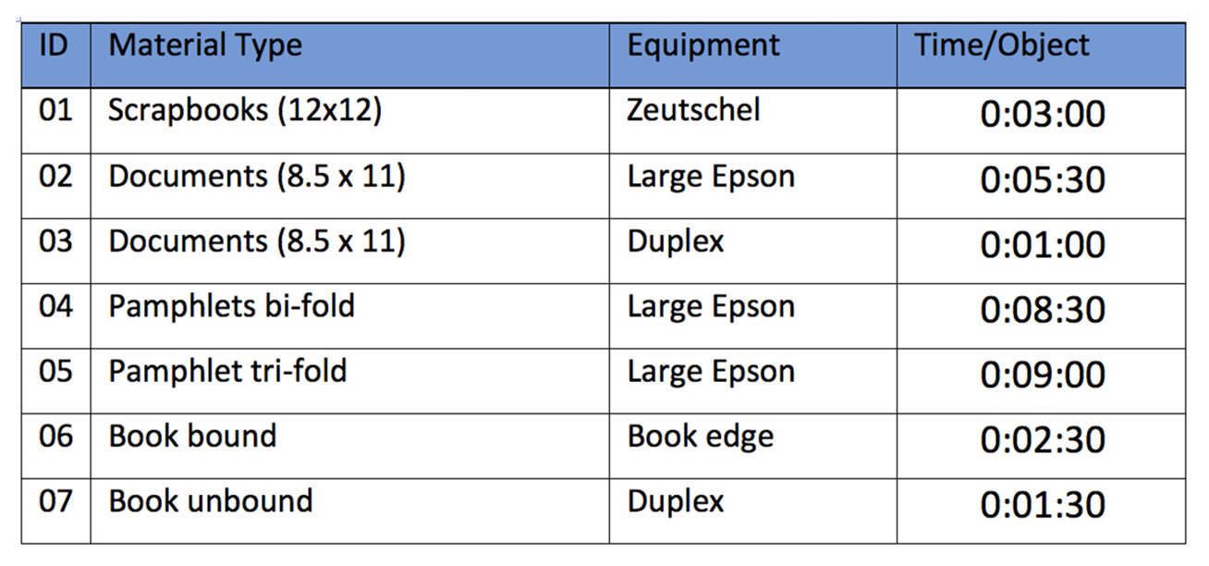
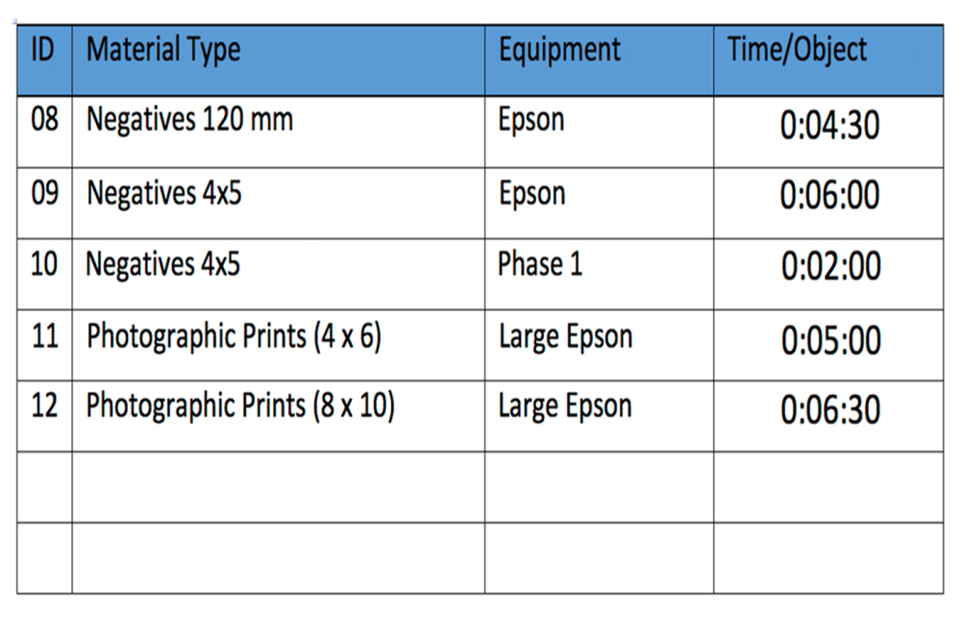
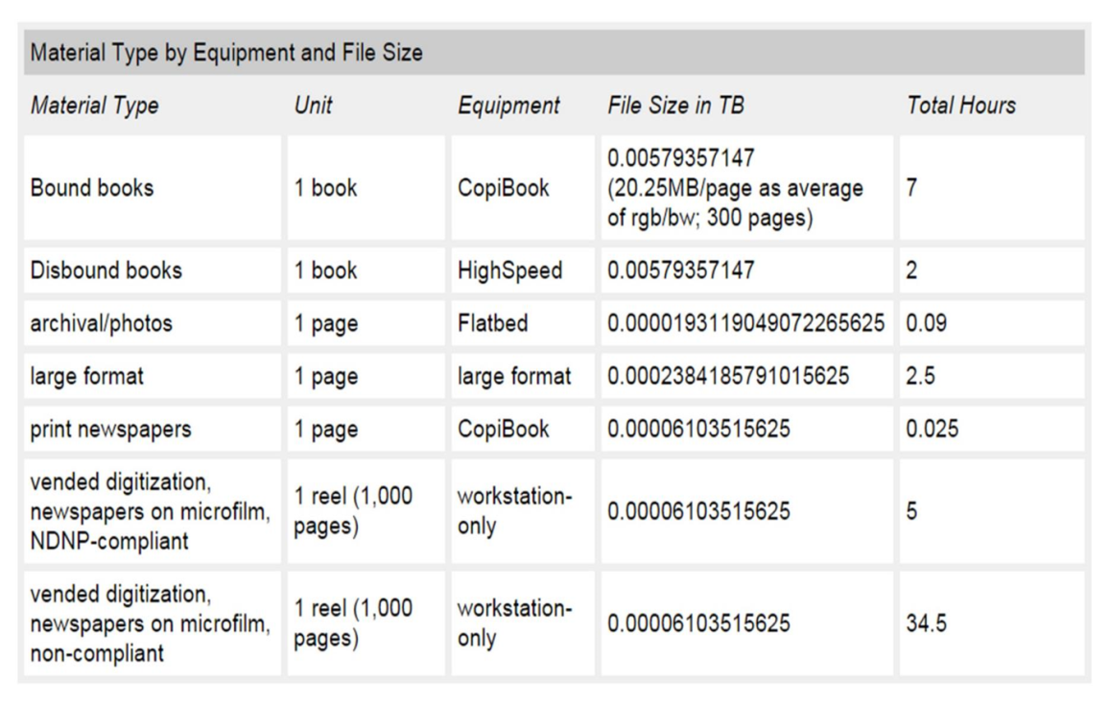
Final Estimate
University of North Texas, Digitization Rubrics
Derek Rankins, Marcia McIntosh
University of Florida Digitization Time/Object

Slide 8
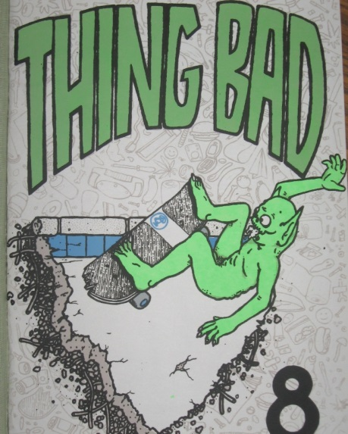
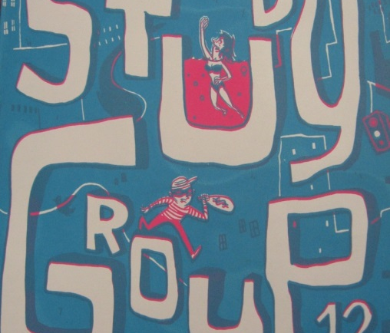
Texas Zine MetaData Cataloging Crowdsourcing Party
Collaboration Project Between Special Collections, Cataloging, Public Services and Digital Services
https://conferences.tdl.org/tcdl/index.php/TCDL/TCDL2015/paper/view/819

Slide 9
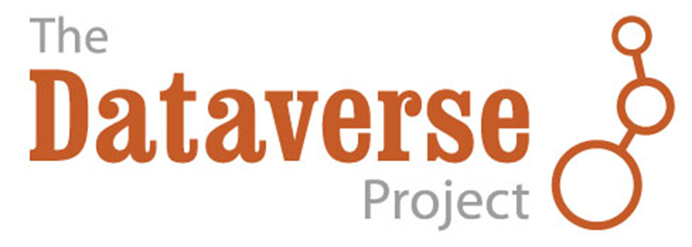
Dataverse 4.0 Elizabeth Quigley, Harvard IQSS
Data Repository & Software open source framework for publishing, citing and preserving research data
Developed by the Institute for Quantitative Social Science at Harvard University.
Provides incentives for researchers to share:
Data citations
Control over data & branding
Fulfilling Data Management Plan requirements
Default CC0 Waiver for all uploaded datasets

Slide 10
Who uses Dataverse?
Researchers
Librarians
Data Archivists
Journals (+ Open Journal Systems Connection)
Courses
Institutions and Organizations

Slide 11
Dataverse
Standard Metadata Schemas, DDI & OAI DC, DataCite 3.1, ISA-Tab (biomedical), VO Resource (astronomy)
Metadata can be exported (JSON, XML)
Datasets receive CC0 Waiver but data files in a dataset can be restricted, or terms of use added
Formal Data Citation: Persistent IDs: DOI (DataCite/EZID)

Slide 12
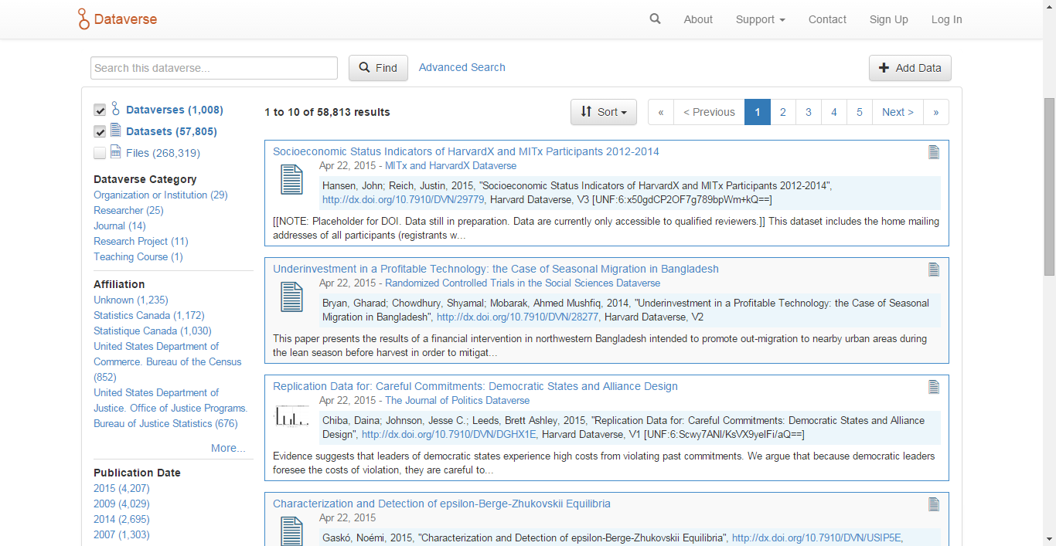
Searching & Data Discovery
Notes:
Basic search

Slide 13
Conference Website & Abstracts
https://conferences.tdl.org/tcdl/index.php/TCDL/TCDL2015
Full Set of Conference Presentation Slides https://conferences.tdl.org/tcdl/index.php/TCDL/TCDL2015/schedConf/presentations

Slide 14
TLA Sessions
Ray Uzwyshyn

Slide 15
Augmented Books
Books that take advantage of camera/computing power of mobile (Ipad/Android)
Children’s books with enhanced animation.
Translation (Written and Voice). Camera scans text and does on the fly translation / replacement (books or signs) https://www.youtube.com/watch?v=h2OfQdYrHRs

Slide 16
50 new Technologies in Fifty Minutes
Many new information science biology/medical related app (Digital Genome app, Internet of DNA, Drinkable Book)
Terabyte Flash Drives (Samsung)
Mobile Video Editing (Nutshell): http://nutshell.prezi.com/index_en.html

Slide 17
Linked Data
Three Speakers (Rice, UNT, Public Library) Currently in a State of Evolution with Linked Data.
Important to simply be in the conversation
Linked Data is a set of best practices for publishing/connecting structured data on the Web and has primarily to do with consuming, creating and publishing information
Justification: Search Engine Optimization

Slide 18
Future of Libraries
3 Panelists (Miguel Figueroa, ALA, Samantha Becker Aspen Institute, Larry Johnson, New Media Foundation)
Figueroa“21st Century is a Terrible Time to be a Control Freak in Libraries” – everything is changing
Aspen Institute: Selling Libraries to Policymakers in 21st Century, Combination of High Tech and Human help paradigms

Slide 19
Future of Libraries – New Media Consortium (2 Speakers)
Larry Johnson, Ortega y Gasset Mission of the University
Mission University/Library
A) Conserve Knowledge
B) Create Knowledge C) Pass on Knowledge
Rapid Doubling Speed of Technology
Disruptive Potential of New Technologies
Is Our Strategic Thinking Based on a World that No Longer Exists?
Be open/Take Risks/Celebrate Failures as much as successes

Slide 20
Horizon Report http://cdn.nmc.org/media/2014-nmc-horizon-report-library-EN.pdf
Trends Accelerating Technology Adoption in Academic and Research Libraries
Fast Trends - Immediate
Increasing Focus on Research Data Management for Publications
Prioritization of Mobile Content and Delivery
Mid-Range Trends -3-5 years
Evolving Nature of the Scholarly Record
Increasing Accessibility of Research Content
Long-Range Trends > 5 years
Continual Progress in Technology, Standards, and Infrastructure
Rise of New Forms of Multidisciplinary Research

Slide 21
Challenges Impeding Technology Adoption in Academic/Research Libraries
Solvable Challenges: Those that we understand and know how to solve
Embedding Academic and Research Libraries in the Curriculum
Rethinking the Roles and Skills of Librarians
Difficult Challenges: Those that we understand but for which solutions are elusive
Capturing and Archiving the Digital Outputs of Research as Collection Material
Competition from Alternative Avenues of Discovery
Wicked Challenges: Those that are complex to even define, much less address
Embracing the Need for Radical Change
Maintaining Ongoing Integration, Interoperability, and Collaborative Projects

Slide 22
Important Developments in Technology for Academic and Research Libraries
Time-to-Adoption Horizon: One Year or Less
Electronic Publishing
Mobile Apps
Time-to-Adoption Horizon: Two to Three Years
Bibliometrics and Citation Technologies (Elsevier, Thompson/Reuters)
Open Content
Time-to-Adoption Horizon: Four to Five Years
The Internet of Things
Semantic Web and Linked Data

Slide 23
Questions/Comments

