Slide 1
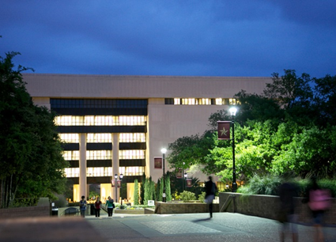
New Directions in Student Learning Spaces
Ray Uzwyshyn, Ph.D. MBA MLIS Dir. Digital and Collection Services Texas State University
March 25, 2016
10:00-10:45 am

Slide 2
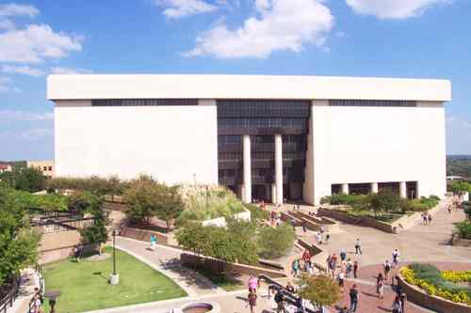
Alkek Library Learning Commons 2015-2022
Reconfiguration of Alkek Library From Book Warehouse to Learning Commons
Large Academic Library (7 Fl.)
Texas State University, 36,000 Students
Carnegie Class Doctoral University (Higher Research Activity)
Designated Emerging Research Institution (Texas)
Overview Video
Multi-Stakeholder IT Division Project
Multi-Year, 5-7, 3 Large Phases
~ 40 Million Total Budget

Slide 3
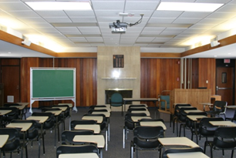
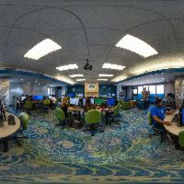
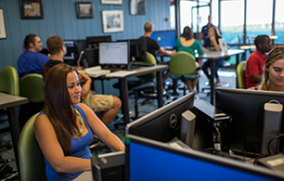
University of West Florida Skylab Reconfiguration of Library Fifth Floor
1) Information Literacy Lab/Classroom
2) Multimedia Studio
3) Digital Media Conversion Center
Unifying Theme: Digital Literacy
University of West Florida, ~12000 FTE
500K Project (2010)
Proposal, Presentation, Video
Overview White Paper

Slide 4
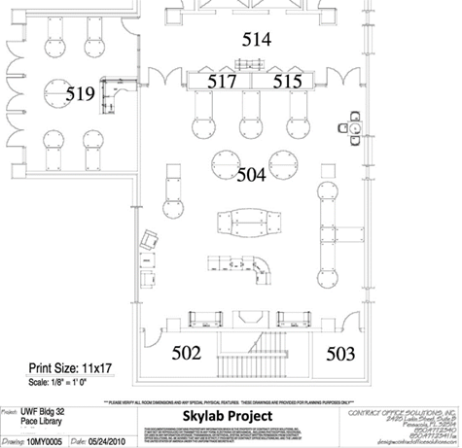
Space, Technology, Learning
Information Literacy Lab/Classroom
Multimedia Studio
1. Collaboration 2. Third Space for Learning.
3. Cross fertilization of Projects, People and Skillsets.
Technology
Media Conversion Center

Slide 5
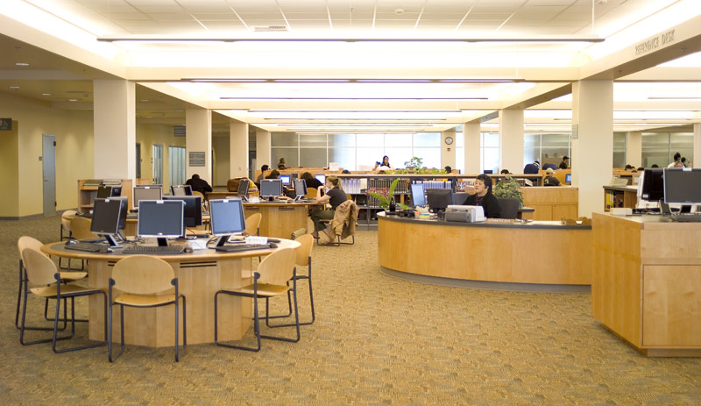
Learning Spaces
Learning Space Directions
Interdisciplinarity
Digital Literacy
Multimedia
Specialized Software/ Hardware
Technological Facilitation
Collaboration Among Divisions Academic Technology, Faculty Teaching Centre, Library, University IT Writing Center
Faculty Students, Community

Slide 6
Discussion, Questions, Comments

Slide 7
Contact Information Contact Info Ray Uzwyshyn, Ph.D. MBA MLIS TEXAS STATE UNIVERSITY ruzwyshyn@txstate.edu Further Information (Presentations and Downloads) http://rayuzwyshyn.net https://www.linkedin.com/in/rayuzwyshyn

