Slide 1

Research Library
Digital Collections
Management and Strategies
For Academic Libraries
Ray Uzwyshyn, Ph.D. MLIS MBA
Director, Collections and Digital Services
Texas State University Libraries, 2022

Slide 2

Collection Management Strategy must align with both the Mission and Goals of the University and University Libraries
Strategy is also Importantly Built on Trust

Slide 3

Collection Management Strategies Consist of Various Components
Budgets
Technology
Implementation

Slide 4




Budgets
Increasing
Decreasing
Flat
Strategic
Management
(Plan, Plan, Plan)

Slide 5

Strategy also Means Negotiation and Forming Relationships with Vendors
Strategies: Try to Keep Inflation from 2-4%
Try to Negotiate Open Access Agreements

Slide 6


Negotiating Inflation and
More Open Access Deals for Research Faculty
Cambridge University Press. Capped Inflation, 1- 2.5% 2021-24, Read and Publish Deal (No cost OA publishing in Gold OA and Hybrid Journals)
Wiley. Transformational Agreement, 2-3% inflation, 2022-25(No cost OA publishing in all hybrid journals,<60.

Slide 7
+600% (2020)
+521% (2015)

Slide 8
Texas State University History of Elsevier Contracts

Slide 9
Impact of Renewing Serials When Budget Is Flat
6% annual subscription increases consume entire
Collections Budget

Slide 10

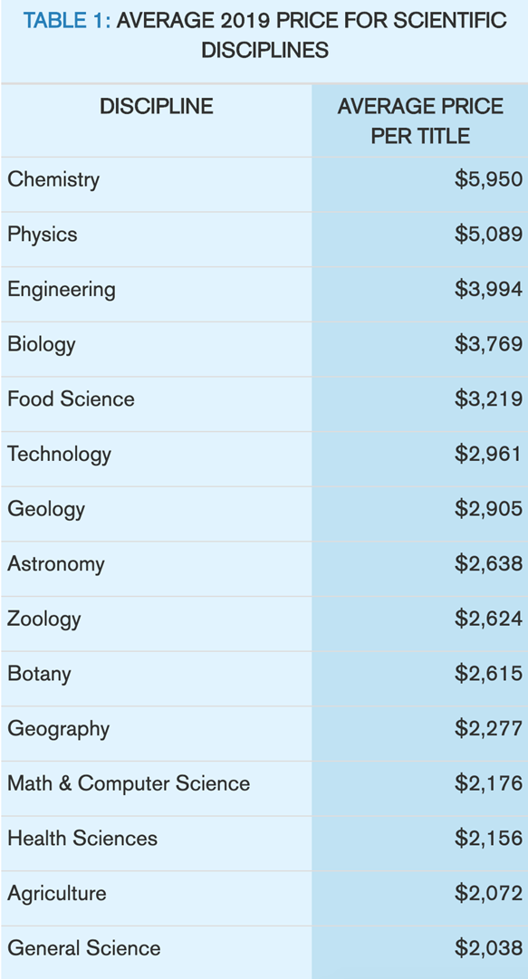
Single Title Subscriptions
are also not getting
Cheaper.
Source: “Deal or No Deal | Periodicals Price Survey 2019,”
by Stephen Bosch, Barbara Albee, & Sion Romaine .
Library Journal,
April 4, 2019: https://www.libraryjournal.com/?detailStory=Deal-or-No-Deal-Periodicals-Price-Survey-2019

Slide 11
Four multi-year subscription packages make up more than 16% of our Budget, 1.4 Million Dollars
2181 journals, some perpetual
139,484 article downloads
Wiley
1496 journals, all perpetual
57,565 article downloads
Springer
2002 journals, all perpetual
46,564 article downloads
Cost per use $4.26
Cost per use $6.99
Cost per use $4.75
Elsevier
Sage
882 journals, all perpetual
53,900 article downloads
Cost per use $4.16
7% collection budget
4.5% collection budget
2.5% collection budget
2.6% collection budget

Slide 12



How Do You Strategically Solve these types of Problems?

Slide 13
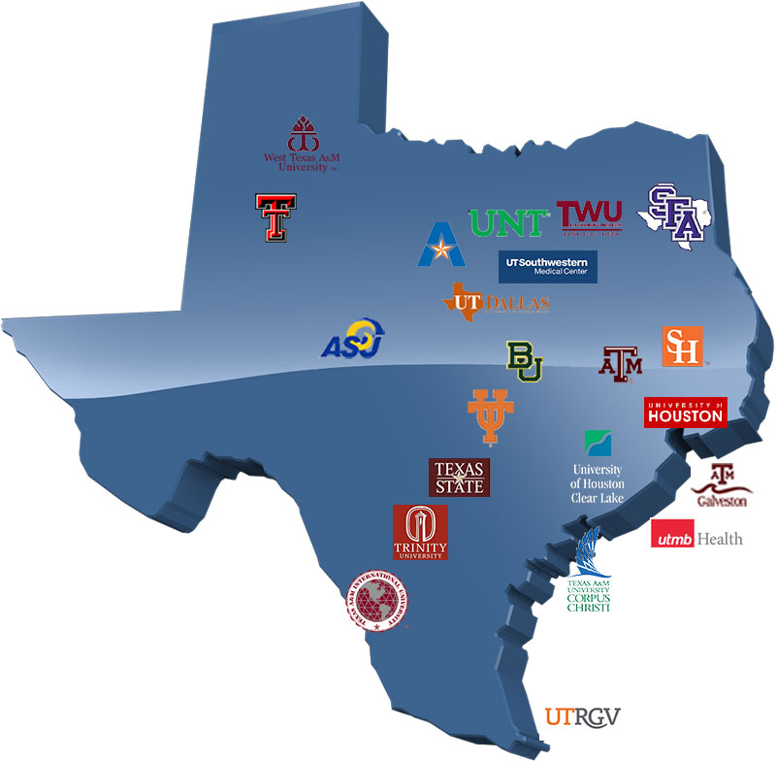

The Texas Coalition
New Texas Negotiating Group Formed
(2019-2020: 12 - 29, 2022: 44)
Angelo State University
Baylor University
Lamar University
Prairie View A&M University
Rice University
Sam Houston State University
Stephen F. Austin University
Sul Ross State University
Tarleton State University
Texas A&M International University
Texas A&M University (College Station)
Texas A&M University-Central
Texas Texas A&M University-Commerce
Texas A&M University-Corpus Christi
Texas A&M University-Kingsville
Texas A&M University-San Antonio
Texas A&M University-Texarkana
Texas State University
Texas Tech University (Lubbock)
Texas Tech University Health Sciences Center El Paso
Texas Tech University Health Sciences Center Lubbock
University of Dallas
University of Houston
University of Houston Clear Lake
University of Houston Downtown
The University of Texas
Southwestern Medical Center
West Texas A&M University

Slide 14
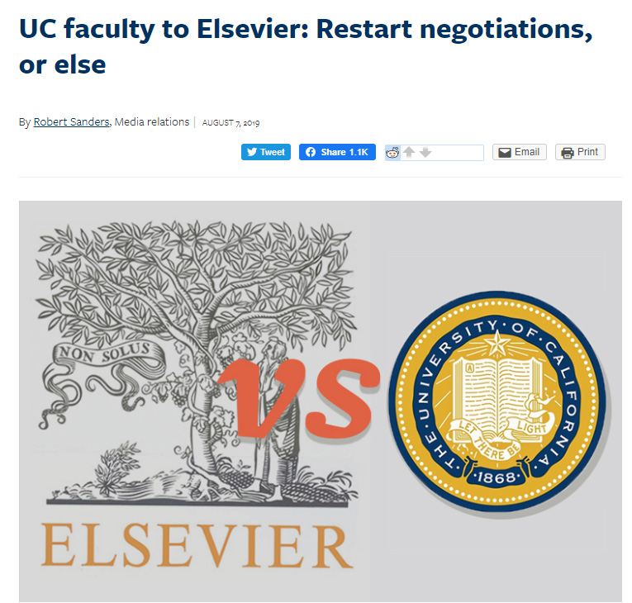
Join a Coalition
Begin to Diversify
Resources
Form Your Own
Negotiation
Committee
Lyrasis
Great Western Library Association
Hathi Trust

Slide 15
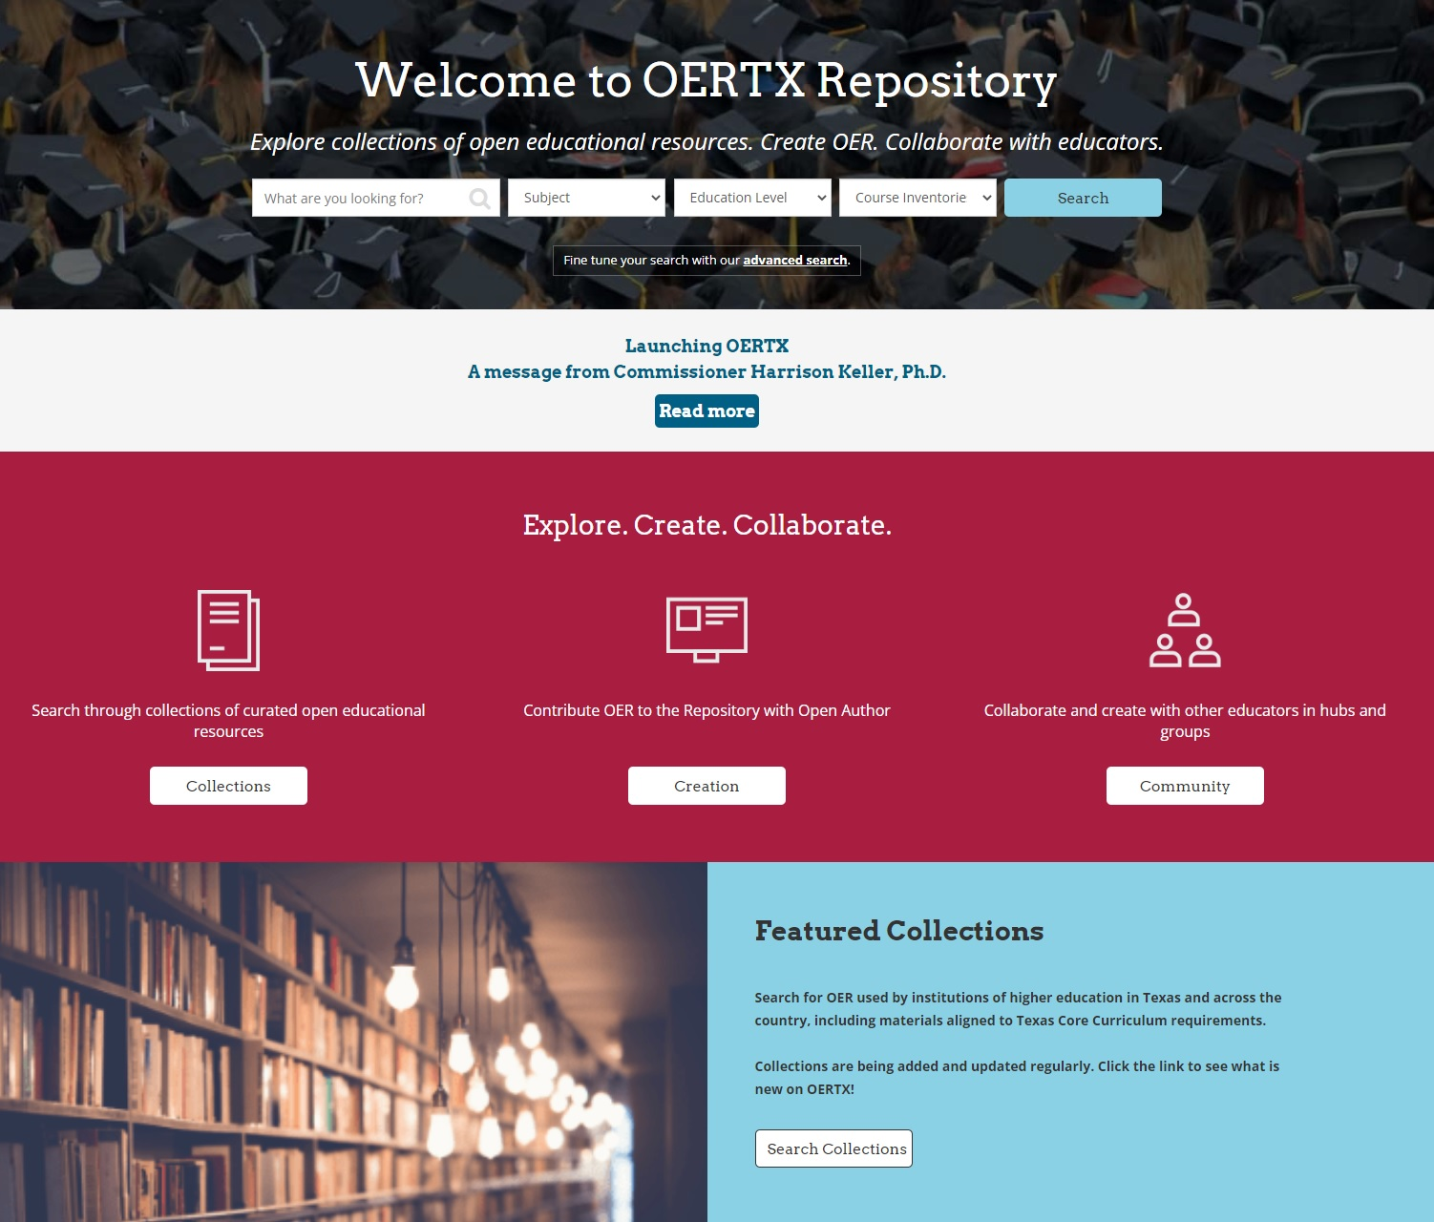

Open Educational Resources

Slide 16



Collection Management and Strategy:
Technologies

Slide 17
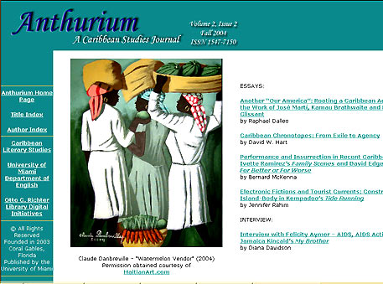

New Genres of Digital Library Services Appearing
Enabling Faculty Research/Reputation on Global Levels
Scholarly Refereed E-Journals /SEO (Metadata)
Open Source Publishing Opportunities (OJS)

Slide 18


Library/University Press Scholarly Publishing
Academic Books and Scholarly Journals
E-Press Editor & Marketing Director,
Graduate English Student
Grad MBA or Marketing Student
In House Library e-presses (Espresso Book Machine ~200K)
University Publishing Infrastructures

Slide 19

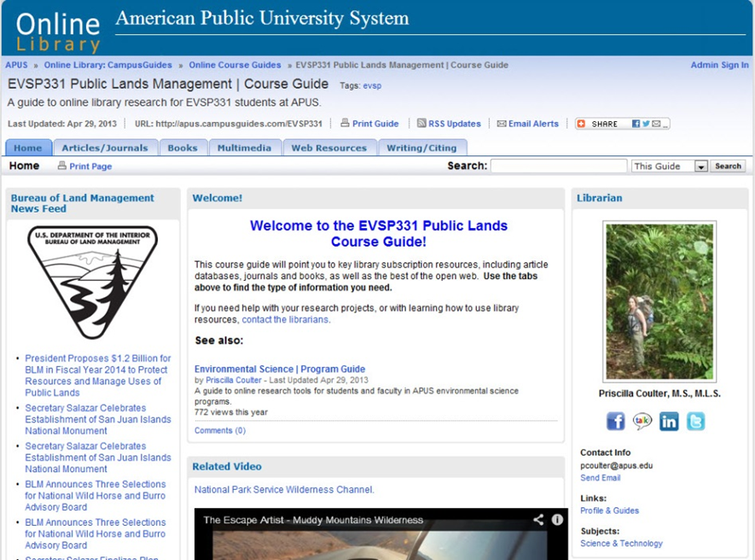

Faculty Library/
E-Press Synergies Possible
Teaching
Research
New Media Curricula & Library E-resources
Publishing on Demand (POD)
Books, Journals and Faculty Publications
University Value Added Models
(Open Access Text Books)

Slide 20

Many Great Possibilities
With Technology
Always Changing
New Paradigms
Regularly Appearing
Previous Skills Can Be Harnessed And Retooled

Slide 21








Core Academic Library Systems Changing
More Sophisticated Discovery & Research Services Possible
(Crosswalking Metadata, Semantic Web and AI)
Interlibrary Loan
Service Taking
Larger Role
(Galaxy Scholar)
Modern Integrated Library System (ILS)
New & Different Research and
Open Source Flavors

Slide 22

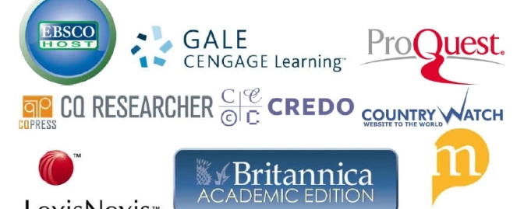
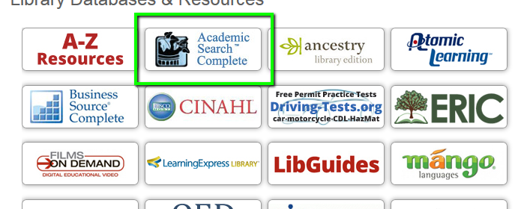
Spectrum of Academic Content Databases & eResources Appearing evolving into Software as a Service, Cloudware & Courseware

Slide 23
Evolution of Research Library Collections
Research Library
Scholarly Collections eRevolution
Online Courseware
Open Access Resources
SAAS, Cloud+Content, AI
Level
Of Access &
Interactivity
Digital Literacy Software
Interactive Personalized Content
Academic Library Scholarly Tools
Online Information Literacy Tools
Online Reference Tools
Scholarly Media Databases
1990-2022 with regards to level of interactivity and media range.
Longer Term Perspectives
Online Journal Aggregators
Interdisciplinary Journal Databases
Multidisciplinary e-Books Databases
Scholarly Online Journals
Scholarly Online Books
Scholarly Online Reference
Scholarly Print Journals
Scholarly Print Books
Scholarly Print Reference
1990 1995 2000 2005 2010 2015 2020

Slide 24
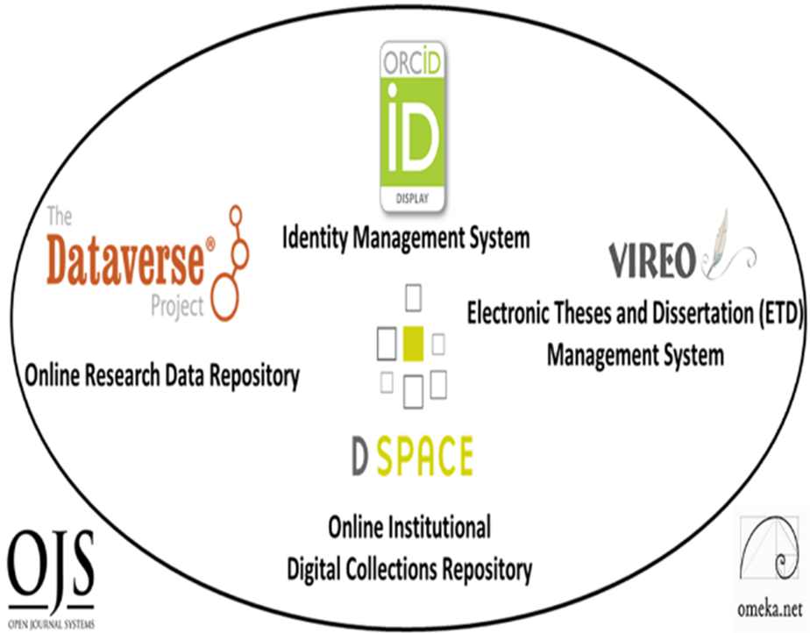
Digital Scholarly Research Ecosystem Infrastructures
Supporting Faculty and Graduate Students Research Collaboration, Sharing and Online Open Access Needs
PRIMARY
Digital Research Collections Repository (Dspace, 2021)
TERTIARY
Electronic Thesis and Dissertation Management System (VIREO)
User Interface/Content Management Software (OMEKA)
Identity Management System (ORCID)
Academic Journal Software (OJS3)
Research Data Repository (Dataverse)
Content
Communication
Texas State Digital Scholarly Research Ecosystem

Slide 25

Strategy #3: Implementation
When Nothing is Done,
nothing is left undone.
Lao Tzu, Tao Te Ching
Book of the Way

Slide 26

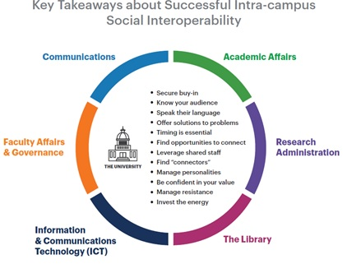


It Takes a Village
Communication and Implementation
(Many Divisions of the Library &
University Working Together)

Slide 27
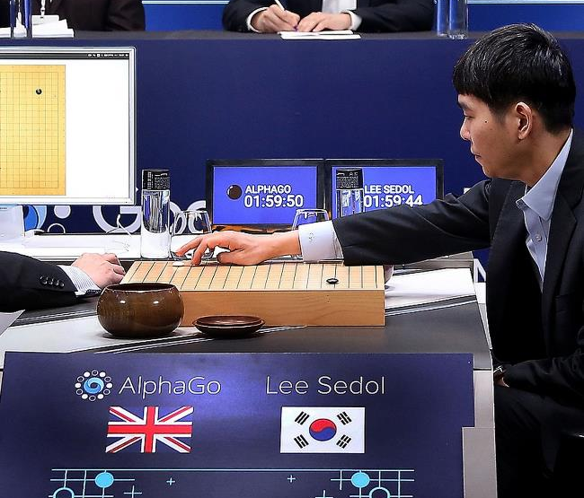
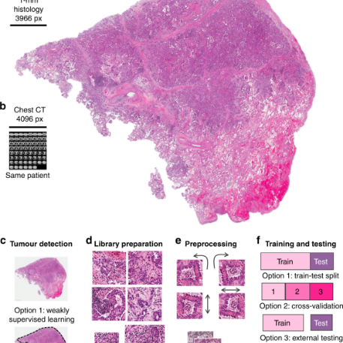
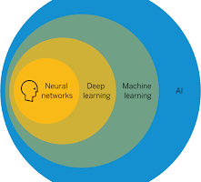
Last Ten Years Has Shown Incredible Progress of AI
AI (Machine Learning (Deep Learning)) =
Better Algorithms + Greater Computing Power + Large Data Sets + Good Metadata (Labeling)
Natural Language Processing
(Speech to Text, Translation)
Fraud Detection
& Cybersecurity
Coversational Chatbots
& Robotic Agents
Strategic Reasoning (AlphaGo)
Computer Vision
(Facial + Object Recognition
Cancer Cell Detection) )

Slide 28
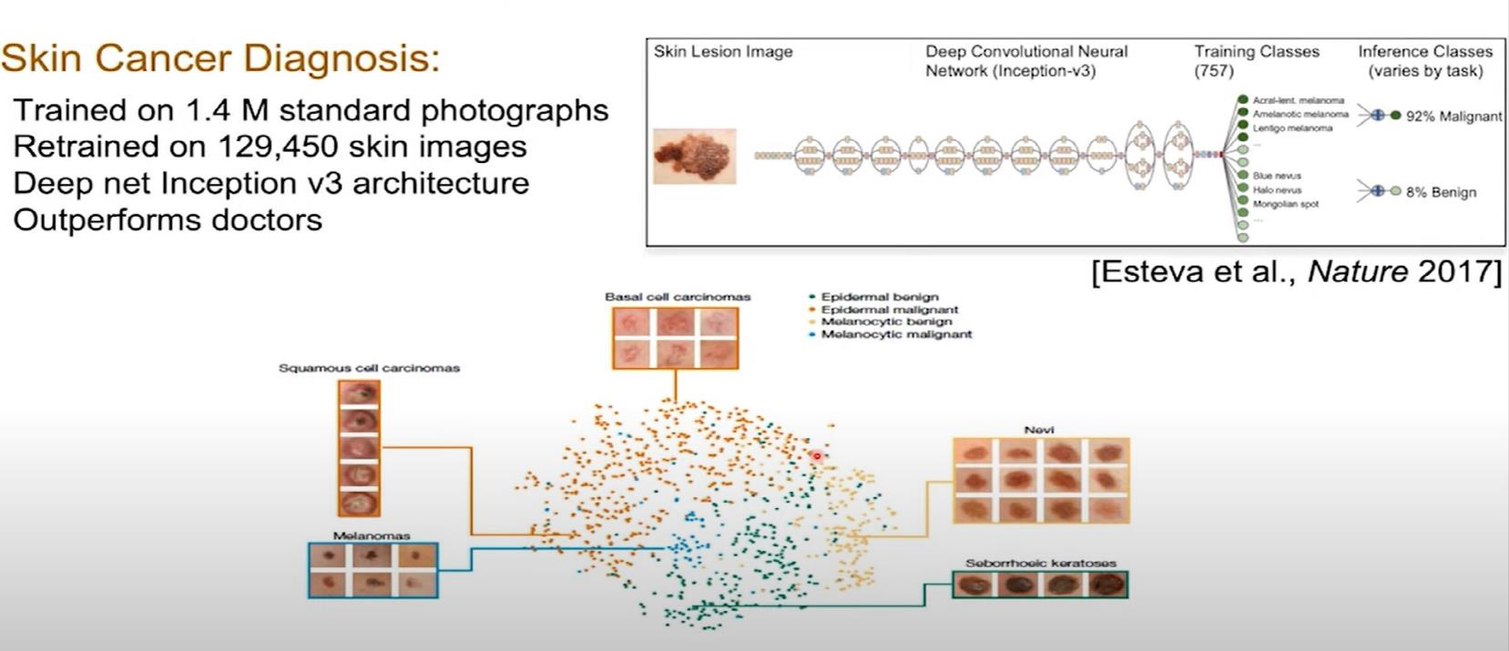
Open Science, Data Research Repositories, Discovery and AI
Dermatologist-level Classification of Skin Cancer with Deep Neural Networks,
Nature 2017,Andre Esteva, Brett Kupress, Sebastian Thrun et al.
AI Models, Deep Learning, Convolutional Neural Nets, Labeled Medical Data from Image Data Archives
Video
Stanford
Overview

Slide 29
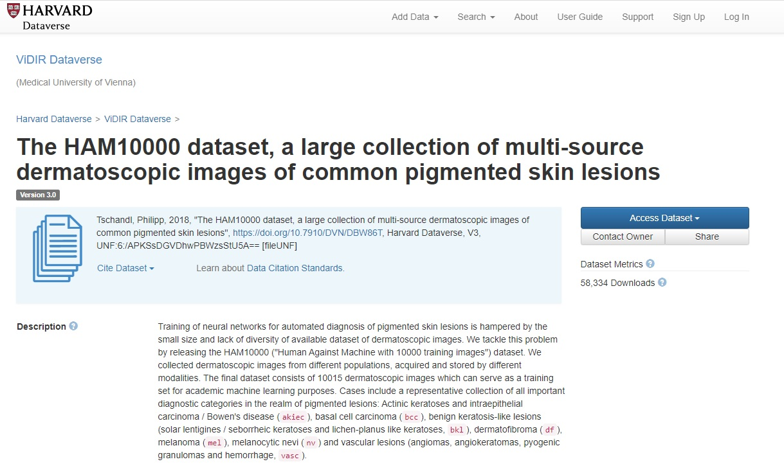
Dataverse
Data Research Repository
Dermatology Image Dataset, Dr. Philip Tschandl, Viennesse Dermatologist
Great Example of Open Science & Metadata
https://dataverse.harvard.edu/dataset.xhtml?persistentId=doi:10.7910/DVN/DBW86T

Slide 30
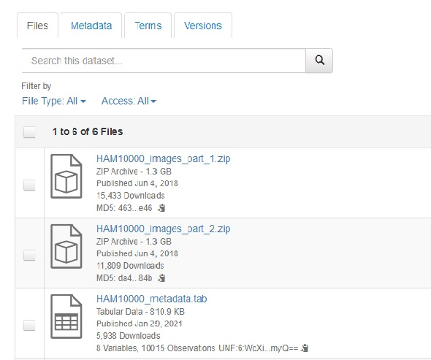
Labeled Image Metadata and Image for Download
From Data Repository

Slide 31
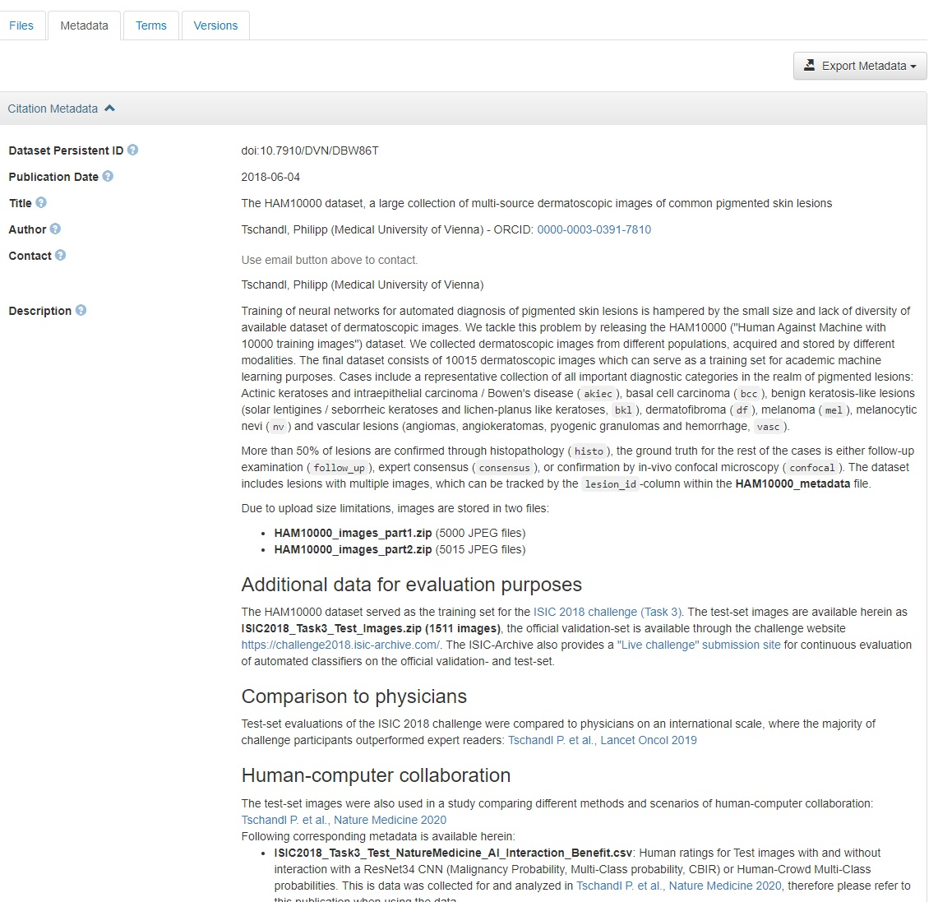
Citation Metadata
Files
Metadata
Terms
Versions
Export Metadata

Slide 32
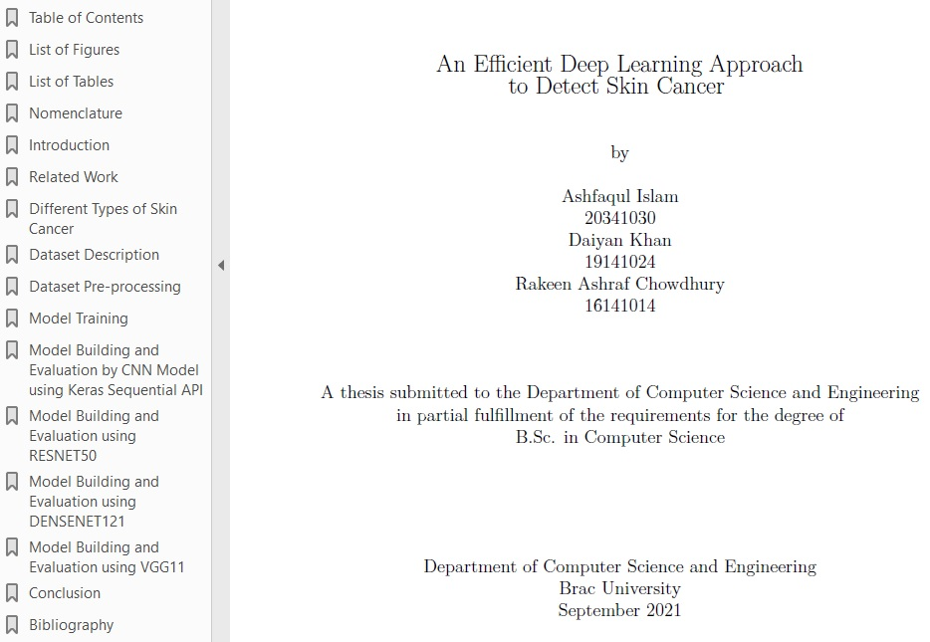

The Progress of
Knowledge
2017 Stanford
Nature Deep Learning
Cancer ID Article
2018 Harvard Libraries Dataverse
Data Repository Upload
Open Source Viennesse
Dermatalogical Image
Library
November 2021
Dspace Repository
Undergraduate Thesis
BRAC University, Dhaka
Bangladesh, Dept. of
Computer Science and
Engineering
Downloaded July 2022

Slide 33


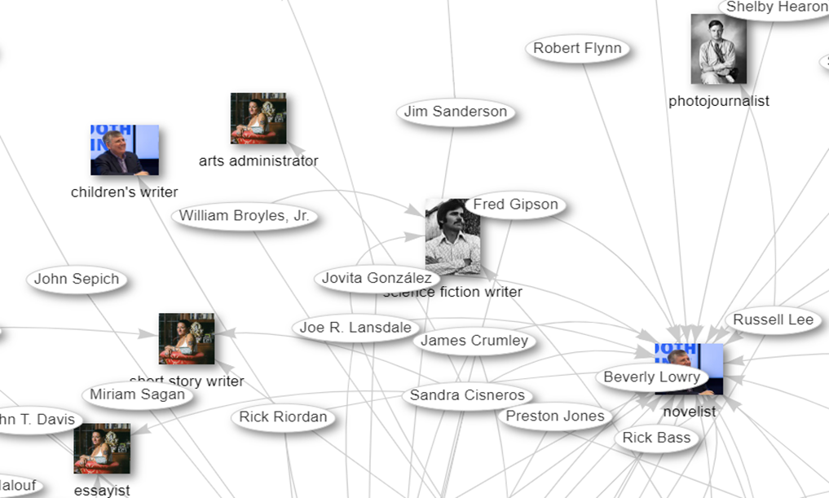
Cataloging, Metadata, Wikidata, Crosswalking and Semantic Web and AI Possibilities
Problem Solving and Motivation
Attend Cooperative Cataloging Workshop for Wikidata
Try Pilot with Music Cataloging
Expand into a Faculty Profile Project
Teach University Archives and Digital Collections Catalogers on New Methods
Present at Coalition for Networked Information
Apply for IMLS Summer AI Camp
(the Next Level)

Slide 34

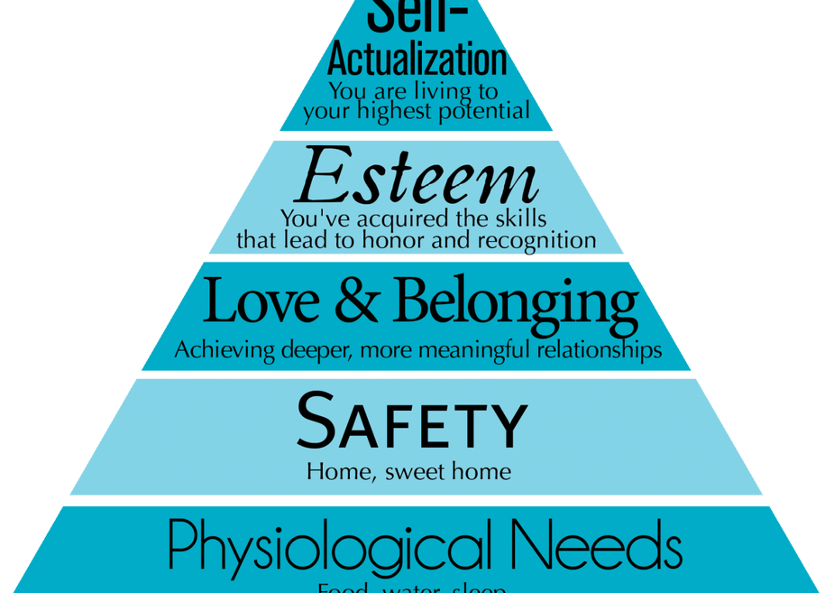

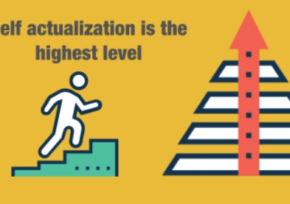
Self Actualization, Implementation and Projects
Staff are more motivated when they feel enabled and empowered to carry out projects they feel strongly or passionate about
Daily incremental steps forward for Collection Management and Discovery in Libraries are equally important.

Slide 35




Implementation Should be Win/Win for Everyone
Honoring Diversity, Equity and Inclusion
Keeping Human Values and a Positive Environments Paramount
Keeping, Learning, Research and the University and Libraries mission in mind in any Collections Management strategy

Slide 36

Thank you!
Comments or Questions
Ray Uzwyshyn Ph.D. MBA MLIS
Director, Collections and Digital Services
Texas State University Libraries
http://rayuzwyshyn.net
ruzwyshyn@gmail.com

Slide 37

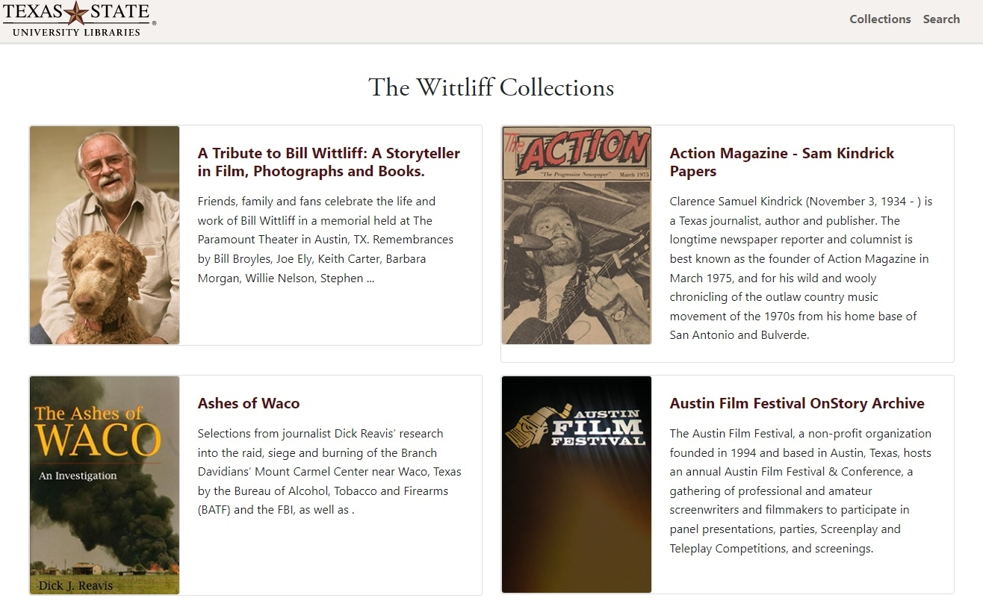


Versioning and Technology
Version 1.0, MVB, IT Project Management

Slide 38
Implementation Should be Win/Win for Everyone
Building Winning Teams is a long term process
Honoring Diversity, Equity, Inclusion
Keeping Human Values and a Positive Environments Paramount
Keeping, Learning, Research and the University and Libraries mission in mind
Keeping Students, Faculty and the University at the Center

Slide 39

Implementation, Motivation, Self Actualization
Psychological Components
Human Uniqueness

Slide 40
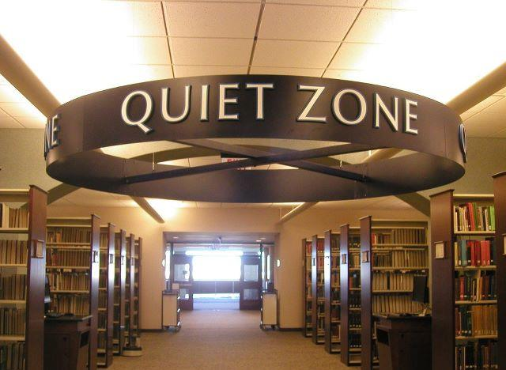

Incremental Steps forward for Collection Management and Discovery in Libraries
Also Enables, Strategy, Inspiration and Alignment
with Library and University Missions and Goals

