Slide 1

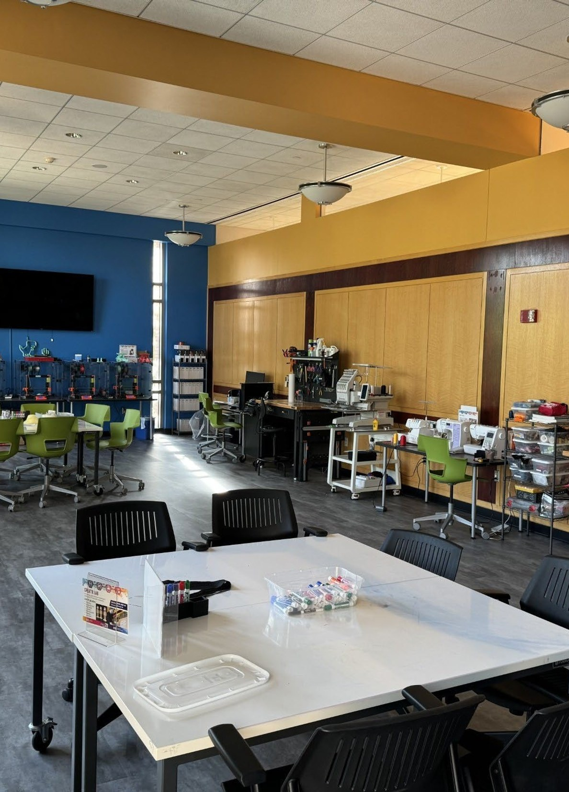
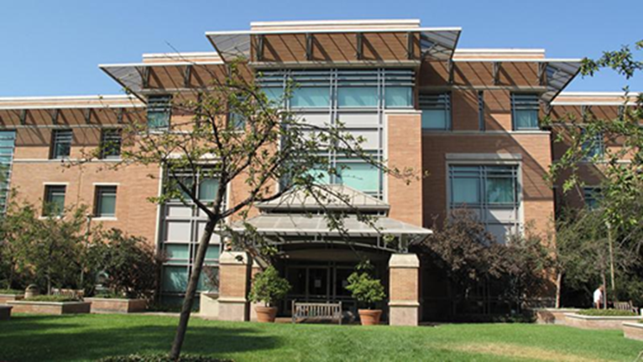
UCR Library Research and Technology Services
Research Support, Technology, Staff,
Consultations, meetups, workshops and events for engineering and Interdisciplinary policy researchers
CE-CERT SPEAKS · GRADUATE COHORT · FALL 2026
Ray Uzwyshyn, Ph.D., MBA, MLIS
Acting AUL for Research & Technology · Director of Research Services
https://rayuzwyshyn.net raymondu@ucr.edu,
Notes:
Suggested pacing: 0.85 min. Welcome and thanks to CE-CERT's SPEAKS program (Science to Policy Education: Activating Knowledge for Sustainable Transportation). This cohort bridges engineering, environmental science, social science and public policy — and so does the Library. Today is practical: where to search, whom to call, what to attend, and where to build.

Slide 2
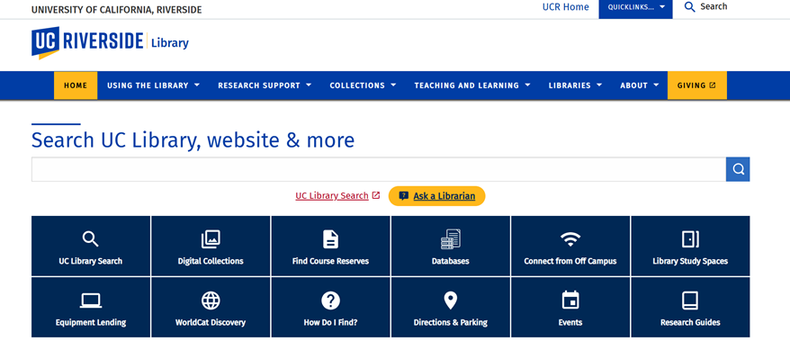
The UCR Library Website
(The Basics)
01
Foundations
One box searches UC Library Search and the website; quick tiles for databases, guides, off-campus access and events.
Homepage
Foundations for graduate research:
Find Research, Discovery, access and help when you need it
library.ucr.edu
Research & Technology Services
2
Notes:
Suggested pacing: 0.25 min. Section 1: discovery and access. The library website has a new interface this year; the key addresses below are current.

Slide 3
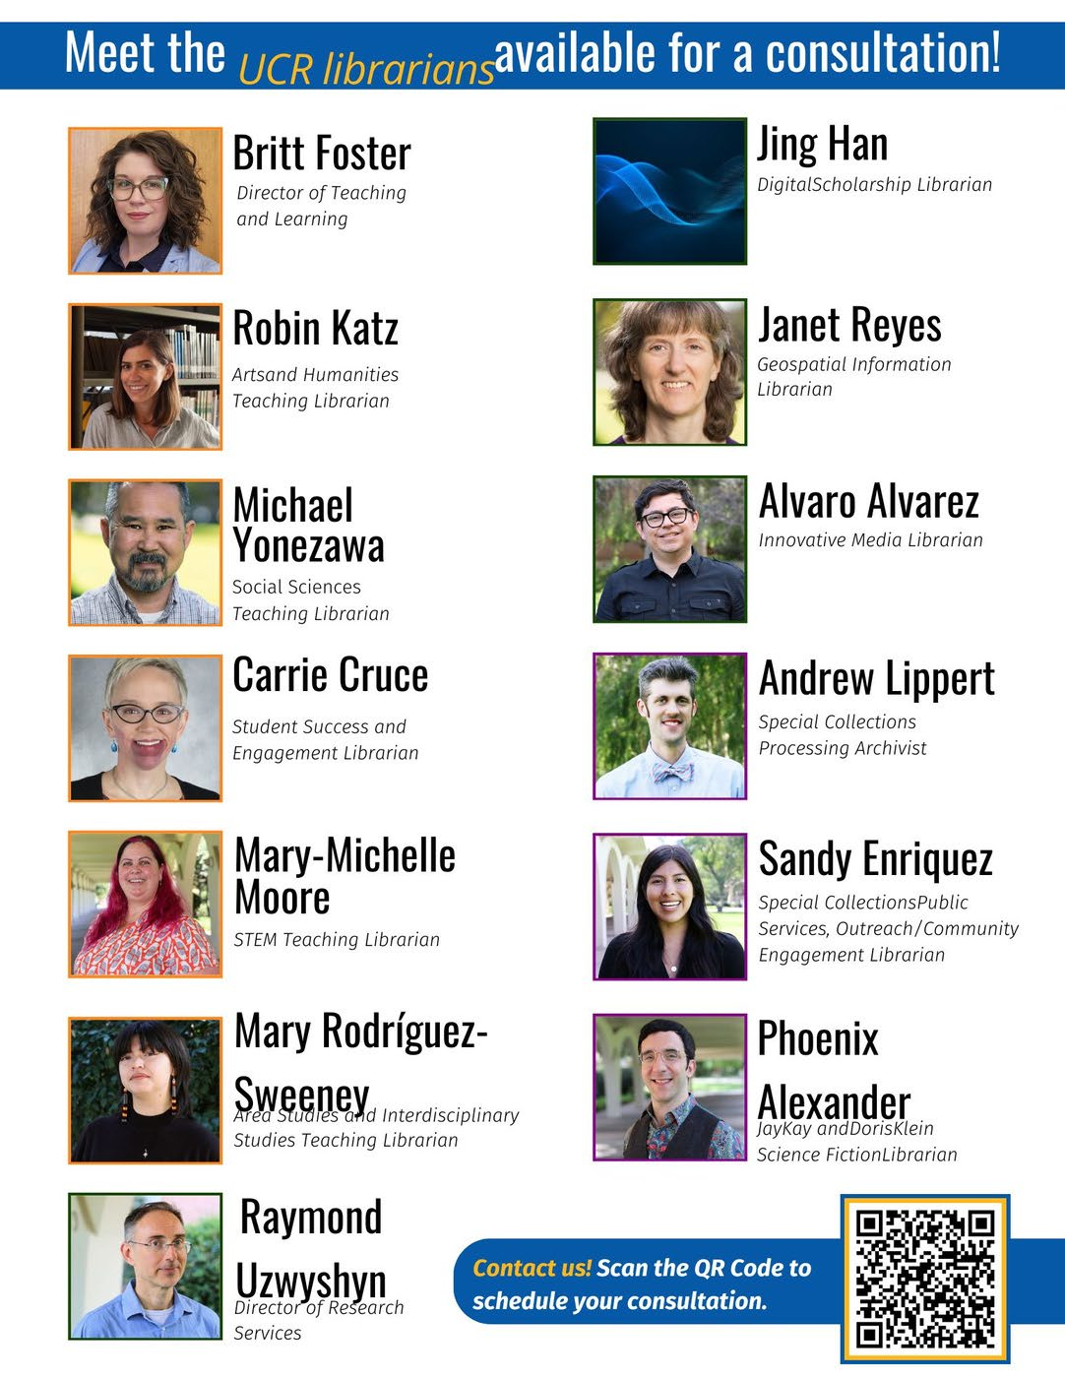

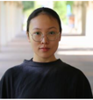


WHO WE ARE
Librarians and Technologists
Available for Consultation on Subject, Technology, Teaching and Project Levels
Beyond Research & Technology Services, subject and teaching librarians across the Library take consultations — the request form matches you with the right person.
Jing Han, Digital Scholarship Librarian
Scholarly communication and digital scholarship consultations
Scholarly Communication Services
Digital Scholarship
Book: scholarly communication consultation
Book: digital scholarship consultation
Request a consultation
Scan, or use the form on the Ask Us page
Research & Technology Services
16
Notes:
Suggested pacing: 0.85 min. The consultation roster graphic from our outreach materials (update if names have changed). Jing Han covers both scholarly communication and digital scholarship — her pages and booking links are here and in Section 02.

Slide 4
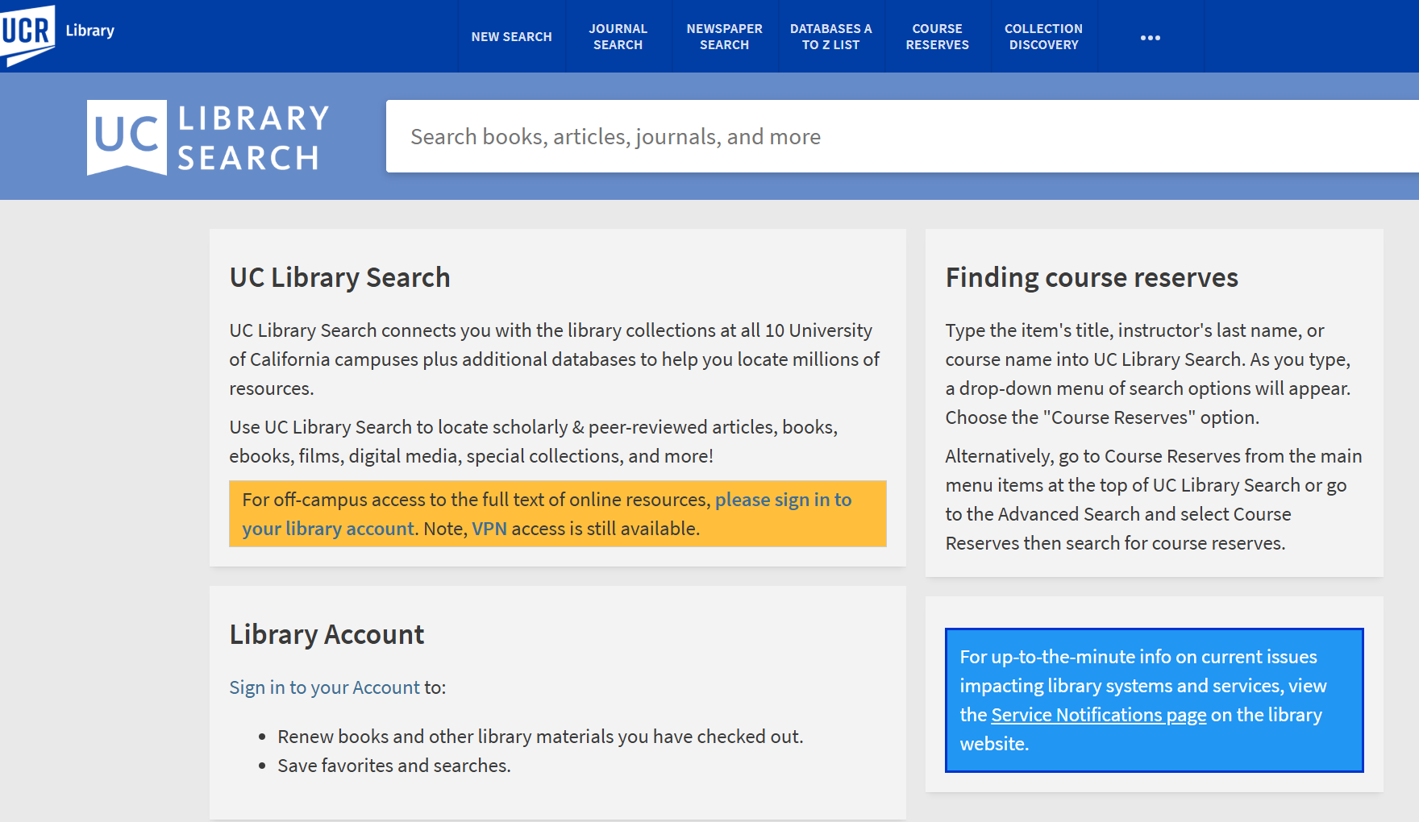
01 · FIND
UC Library System Search
HOW TO USE IT
1
Type keywords — use quotes for phrases and AND / OR to combine concepts
2
Choose a scope: Articles, books & more, or the UCR Catalog only
3
Filter by date, peer review, resource type and discipline
4
Not at UCR? Request it with Get It at UC
GO TO
search.library.ucr.edu
UC Library Search guide
Video: Get It at UC
Research & Technology Services
5
Notes:
Suggested pacing: 0.6 min. Demo the flow: a SPEAKS-type query ("zero-emission trucks" AND freight policy), switch scopes, apply the peer-reviewed filter, then show Get It at UC for items at other campuses. [Screenshot of the live page, September 2026.]

Slide 5




01 · FIND
Start Your Search
UC Library Search
Databases A–Z
Articles & Journals
One search across UCR and all UC libraries — print, e-books, articles, media. Request items from any UC campus.
Hundreds of disciplinary databases (542): Web of Science, Academic Search Complete, JSTOR, ProQuest Dissertations & Theses and more.
Browse journals with Browzine, check availability by title, and use Google Scholar with full-text links on campus or via VPN.
search.library.ucr.edu
guides.lib.ucr.edu/az.php
Articles & Journals page
Off campus? Sign in with OpenAthens (preferred) or the Cisco Secure VPN — Connect From Off-Campus
Research & Technology Services
4
Notes:
Suggested pacing: 0.85 min. Three front doors; each gets its own page on the next three slides so you don't need to switch windows. Off-campus access via the library VPN/proxy.

Slide 6
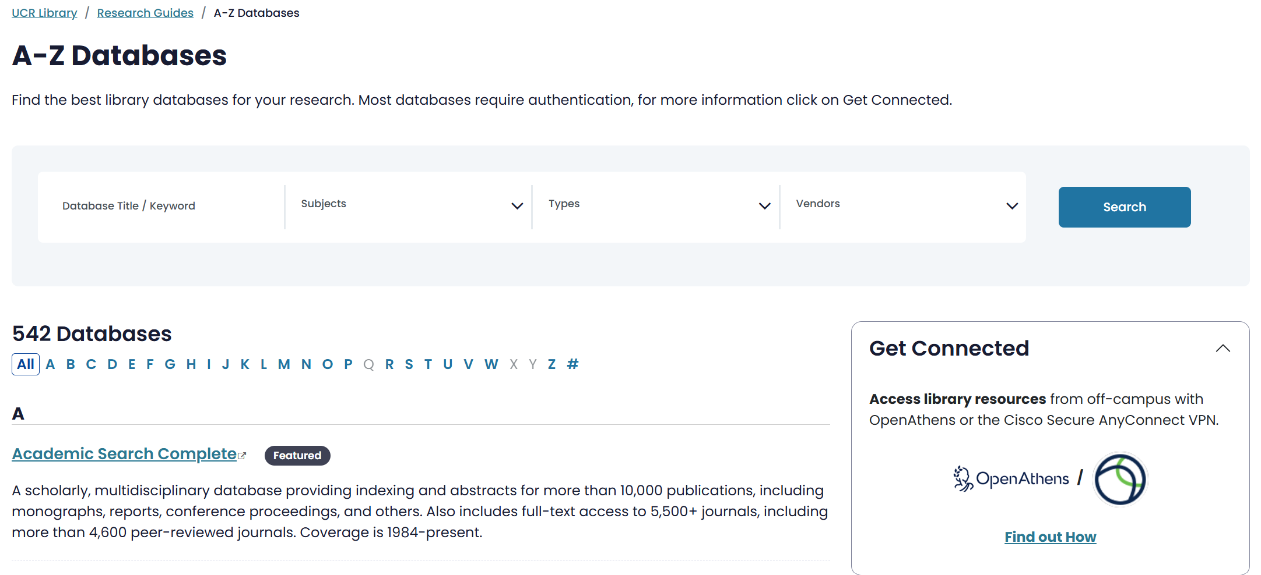
01 · FIND
Databases A–Z
HOW TO USE IT
1
542 databases — filter by subject, type or vendor
2
Use Web of Science to trace citations forward and backward
3
Search ProQuest for dissertations close to your topic
4
Off campus? Use Get Connected: OpenAthens or Cisco Secure VPN
GO TO
guides.lib.ucr.edu/az.php
Web of Science
ProQuest Dissertations & Theses
JSTOR
Research & Technology Services
6
Notes:
Suggested pacing: 0.6 min. The A–Z list moved to guides.lib.ucr.edu/az.php. For engineering-policy work: Web of Science for citation chaining, ProQuest for dissertations, JSTOR for policy and social-science literature. [Screenshot of the live page, September 2026.]

Slide 7
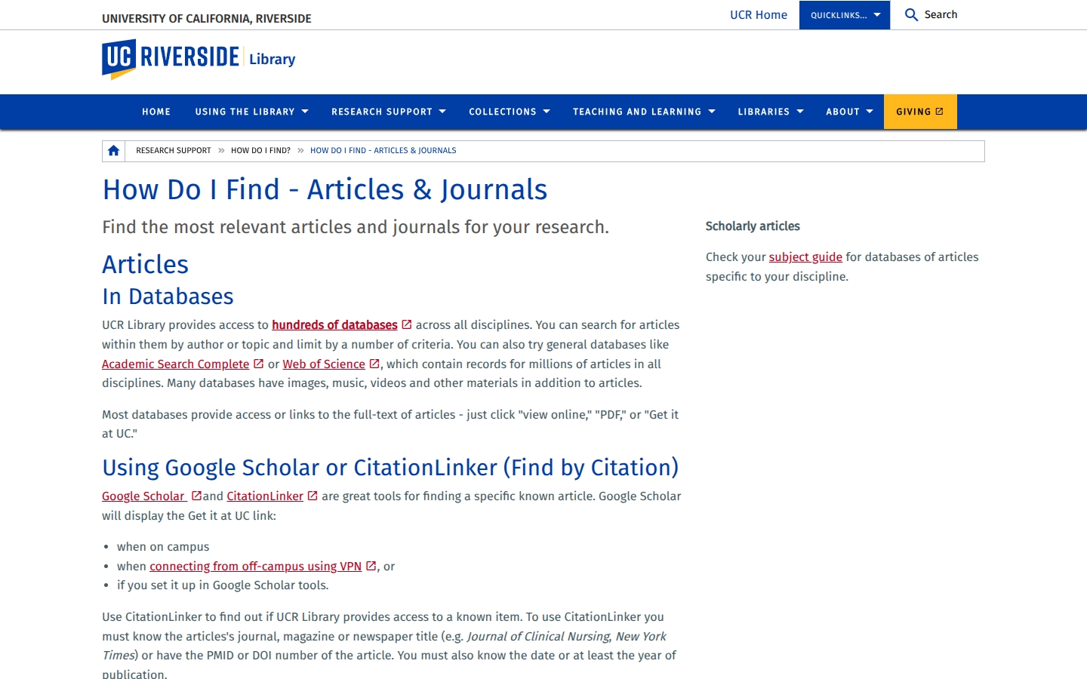
01 · FIND
Articles & Journals
HOW TO USE IT
1
Have a citation? Paste the title or DOI into UC Library Search or CitationLinker
2
Browse and follow key journals in Browzine
3
Use Google Scholar on campus or via VPN for full-text links
4
Check your subject guide for databases in your discipline
GO TO
Articles & Journals page
Browzine
Research Guides by subject
Research & Technology Services
7
Notes:
Suggested pacing: 0.6 min. Browzine is underused: set up a "bookshelf" of journals like Transportation Research Part D or Energy Policy and get new-issue alerts. [Screenshot of the live page, September 2026.]

Slide 8
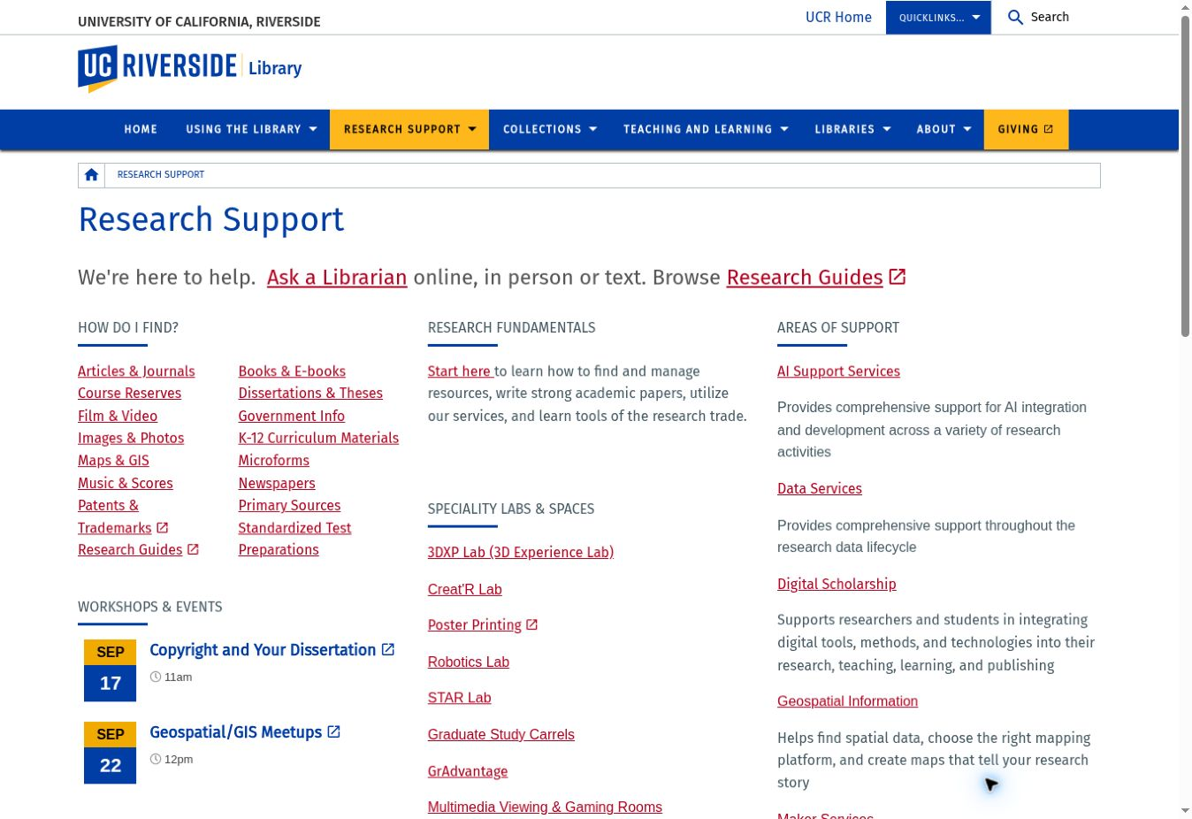
01 · FIND
Research Support hub
Enter by what you need: find evidence, find a lab, or find a specialist.
Research & Technology Services
library.ucr.edu/research-support
3
Notes:
Suggested pacing: 0.6 min. The redesigned site. Left: homepage with quick-access tiles and Ask a Librarian. Right: the Research Support hub — How Do I Find, Specialty Labs & Spaces, and Areas of Support. [Screenshots of the live pages, September 2026.]

Slide 9






01 · FIND
Beyond Journal Articles
The contribution of technology depends on the quality of the underlying evidence. Policy research draws on sources beyond a typical database search.
Government Information
Patents & Trademarks
Dissertations & Theses
Federal, state & international documents, statistics and reports
Prior art and technology landscapes for engineering innovation
Methods and literature reviews from recent doctoral work
Maps & GIS
Newspapers
Primary Sources
Includes historical aerial photos of Riverside & San Bernardino back to 1938
Current and historical coverage for policy context and public discourse
Special Collections, including the Water Resources Collections
Research & Technology Services
8
Notes:
Suggested pacing: 0.85 min. Government information, patents, dissertations, historical aerial photography (Riverside & San Bernardino since 1938 — land use and logistics corridors), newspapers, and Special Collections including the Water Resources Collections. Each tile is linked.

Slide 10

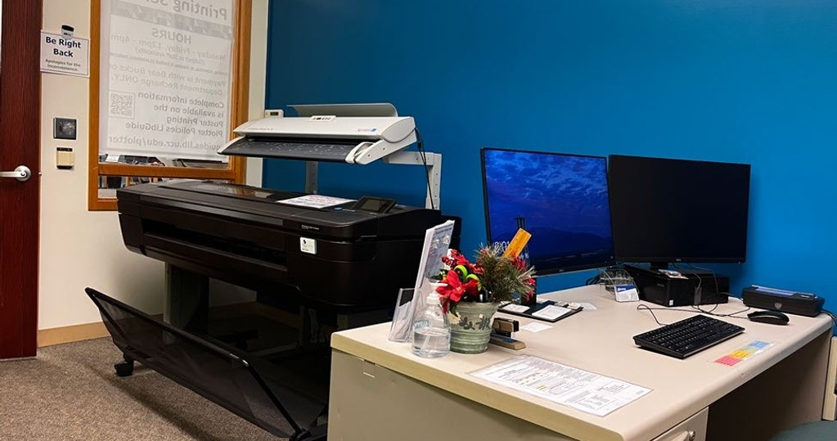

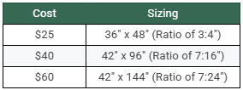

01 · FIND
Get It, Cite It, Learn the Fundamentals
Interlibrary Loan
Free. Request items not held at UCR through UC Library Search; UC loans run 90 days, non-UC loans 30 days (renewable).
Research Guides
Subject and course guides curated by librarians — start here for your discipline.
Research Fundamentals
Tutorials on searching, citing, avoiding plagiarism, literature reviews and reference managers (Zotero, Paperpile).
Research Poster Printing
Orbach Science Library, Room 121. Pay with R’Card (Bear Bucks) or department recharge.
Poster printing prices, Orbach Science Library
Research & Technology Services
9
Notes:
Suggested pacing: 0.85 min. Four everyday services. Poster printing: $25 for 36×48, $40 for 42×96, $60 for 42×144 — popular before TRB and other conferences. Pages for each follow on the next two slides.

Slide 11
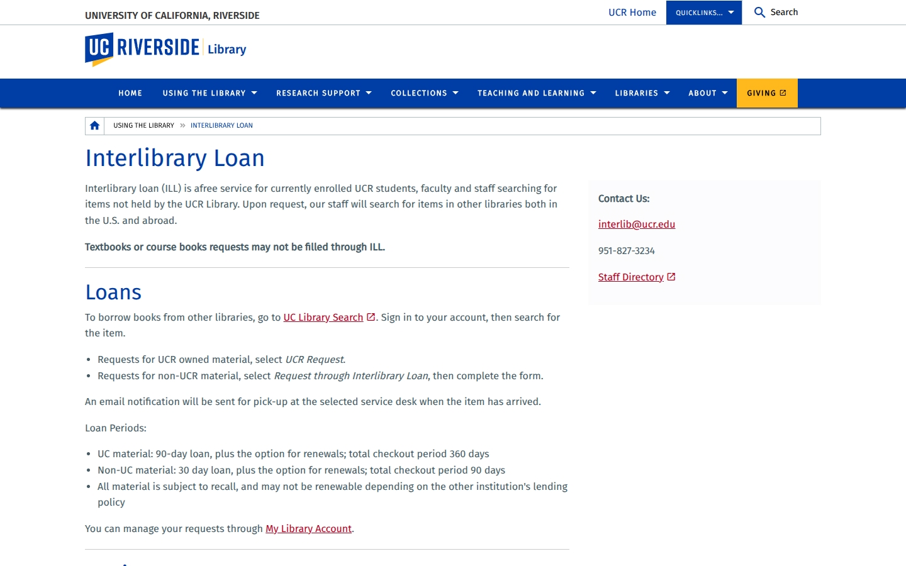
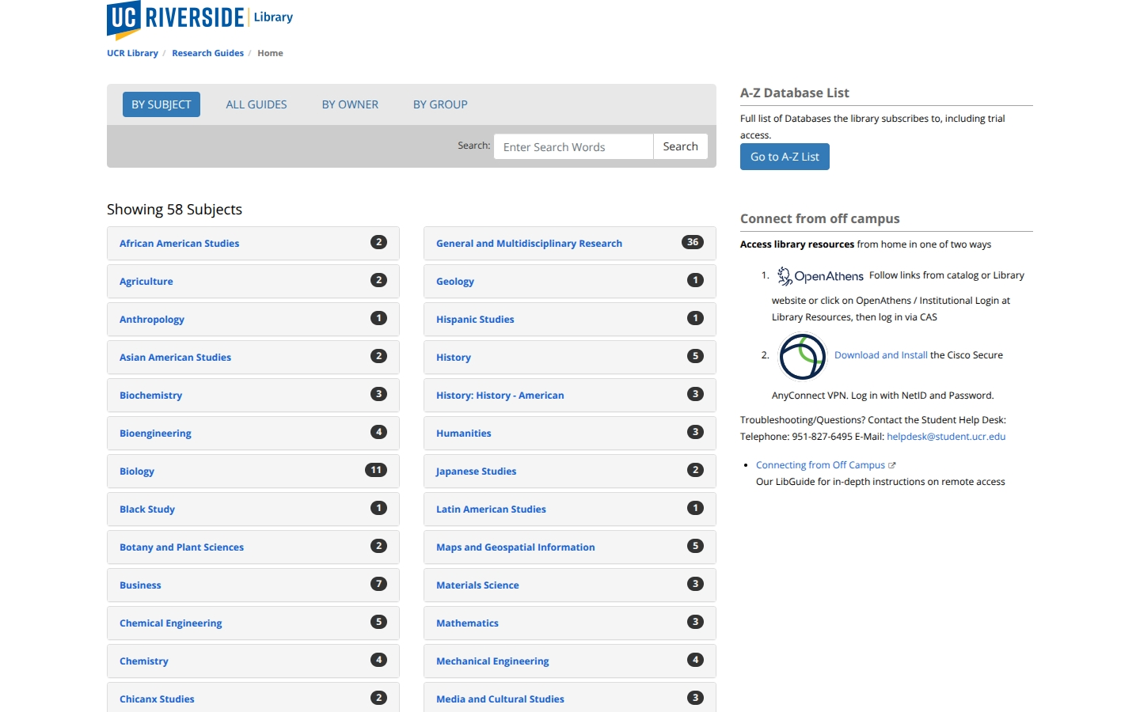
01 · FIND
Interlibrary Loan and Research Guides
Interlibrary Loan
Research Guides
Request through UC Library Search; questions to interlib@ucr.edu or 951-827-3234.
58 subject areas — engineering, environmental sciences, public policy and more — plus the A–Z list and off-campus access.
library.ucr.edu/using-the-library/interlibrary-loan
guides.lib.ucr.edu
Research & Technology Services
10
Notes:
Suggested pacing: 0.6 min. Two pages to bookmark. ILL is free; turnaround for articles is often a day or two. [Screenshots of the live pages, September 2026.]

Slide 12

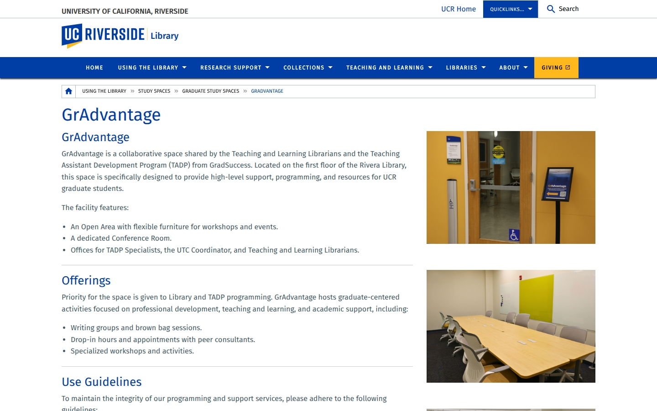



01 · FIND
Spaces for Graduate Researchers
GrAdvantage
Rivera Library, 1st floor. Graduate hub with the TA Development Program: workshops, writing groups, peer consultations and a reservable conference room.
Graduate Study Carrels
Dedicated carrels in Rivera Library for focused dissertation work.
Specialty Labs & Spaces
Makerspace, Robotics, 3DXP and STAR Lab in Orbach Science Library (Section 05).
Reserve Study Space
library.ucr.edu/…/gradvantage
Book group and individual rooms online.
Research & Technology Services
12
Notes:
Suggested pacing: 0.85 min. GrAdvantage on Rivera 1st floor is the graduate hub, co-run with Teaching & Learning and the TA Development Program. Graduate carrels in Rivera. Labs in Orbach come later.

Slide 13
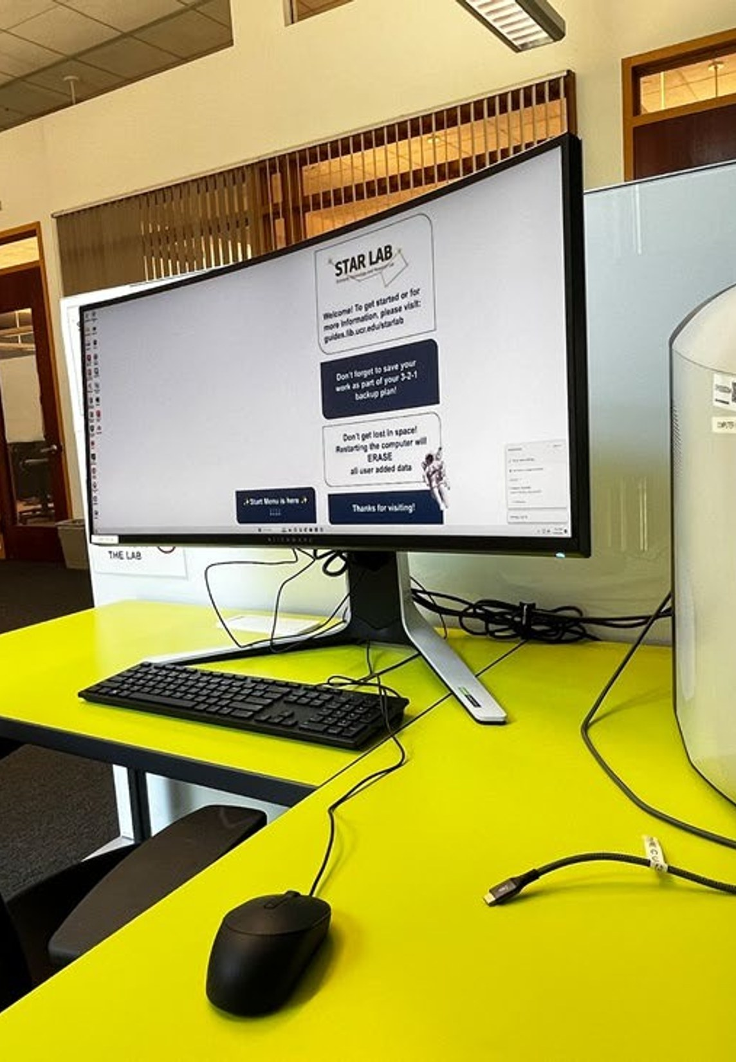
02
Research, Technology Services
One-on-one expertise in data, AI, GIS, Innovative Media, Prototyping , Digital Scholarship, Makerspaces and Entrepreneurships
Research & Technology Services
17
Notes:
Suggested pacing: 0.25 min. Section 2: consultations — the highest-value service we offer graduate researchers.

Slide 14


WHO WE ARE
Research & Technology Services at a Glance
8
4
27
2,400+
research specialists &
technologists on call
specialty labs in Orbach
Science Library
workshops, meetups & events
this fall quarter
Research Services -program participants each year
Research Services
Cyberinfrastructure
AI support · Data services · GIS · Digital scholarship · Scholarly communication · Innovative media · Makerspace & robotics · Medical & clinical outreach
Core library IT, software development and research platforms — e.g., the CooperScene data viewer built with CISL
Based in the Raymond L. Orbach Science Library, serving every college and discipline at UCR.
Research & Technology Services
14
Notes:
Suggested pacing: 0.85 min. Now that you know where to find things — who is behind them. Two halves: Research Services (specialists) and Cyberinfrastructure (systems). Confirm counts before presenting.

Slide 15




WHO WE ARE
Meet Your Research/Technology Services Team
Barbara Martinez Neda, Ph.D.
Inyoung Shin, Ph.D.
Janet Reyes
Jing Han Ph.D.
Research Data Scientist
AI Research Librarian
Geospatial Information Librarian
Digital Scholarship Librarian
Data management, Python, machine learning, Dryad
AI research workflows, APIs, responsible AI use
GIS, imagery, spatial data, StoryMaps
Digital methods, open access, certificate & badge
barbara.martinezneda@ucr.edu
inyoungs@ucr.edu
janet.reyes@ucr.edu
jingh@ucr.edu
Alvaro Alvarez
Brendon Wheeler
Dan Szilagyi
Ray Uzwyshyn, Ph.D.
Innovative Media Librarian
Maker Services Coordinator
Manager, Cyberinfrastructure
Acting AUL & Director
3D, VR/XR, AI-assisted media production
Makerspace, 3D printing, laser, prototyping
Software development & research platforms
Partnerships, collaborations, grants
alvaro.alvarez@ucr.edu
brendon.wheeler@ucr.edu
Digital Initiatives showcase
raymondu@ucr.edu
Research & Technology Services
15
Notes:
Suggested pacing: 0.85 min. Put faces to names. Barbara (data) and Inyoung (AI) are most relevant for engineering/policy; Janet for anything spatial; Jing for publishing and credentials.

Slide 16



02 · CONSULT
Four Ways to Work With Us
Consultations
Workshops
Meetups
Events
Your question, methods, data or technical obstacle — in person or on Zoom.
Guided, hands-on skill building in AI, data, GIS, making and digital methods.
Exchange approaches with a community: AI Brown Bags, GIS and Maker Meetups.
Present research, meet collaborators: ORCA, Open House, thematic weeks.
How a consultation works
1
2
3
4
Request
Match
Meet
Continue
Submit the consultation form or book a specialist directly
We pair you with the right expert, in person or Zoom
Work through your question, data or method together
Follow-up resources, workshops or a collaboration
Research & Technology Services
18
Notes:
Suggested pacing: 0.85 min. Four entry points: consultations, workshops, meetups and events. Collaborations — longer partnerships like CooperScene — can grow out of any of them.

Slide 17
02 · CONSULT
Book an Expert Directly
If you need help with… | Talk to | Book / contact
Research data: DMPs, cleaning, Python, ML, Dryad | Barbara Martinez Neda | calendly.com/barbara-martinezneda
AI in research: tools, workflows, APIs, ethics | Inyoung Shin | calendly.com/inyoungs-ucr/30min
GIS, spatial data, imagery, StoryMaps | Janet Reyes | calendly.com/janet-reyes
Digital scholarship, open access, publishing | Jing Han | calendly.com/jingh-ucr/…
3D modeling, VR/XR, innovative media | Alvaro Alvarez | calendly.com/alvaro-alvarez
Makerspace, 3D printing, prototyping | Brendon Wheeler | brendon.wheeler@ucr.edu
Medical & clinical research, biomedical databases | Elisa Cortez | elisa.cortez@ucr.edu
Not sure where to start? | Librarian match | Request a Consultation form
All consultations are free for UCR students, faculty and staff.
Research & Technology Services
19
Notes:
Suggested pacing: 0.85 min. The slide to photograph — every link is live.

Slide 18
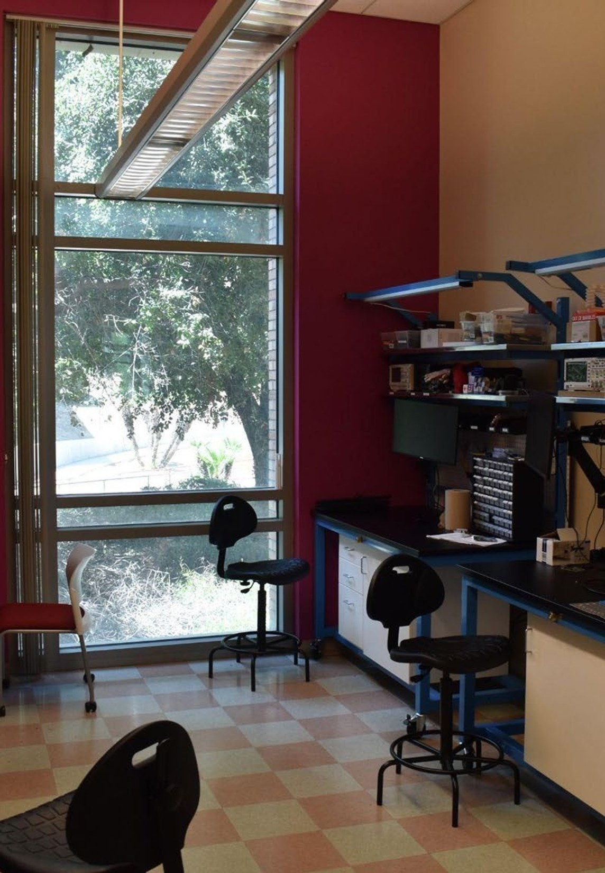
03
Research in Action
How library collaboration turns research data into discoveries and insights into public knowledge
Research & Technology Services
30
Notes:
Suggested pacing: 0.25 min. Section 3: concrete examples of collaboration.

Slide 19
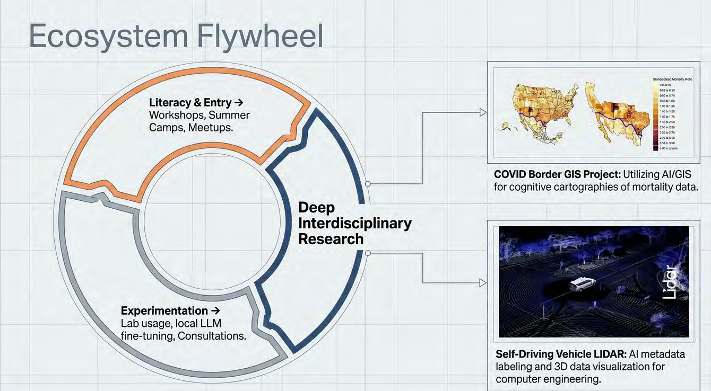
03 · RESEARCH IN ACTION
From Literacy to Deep Interdisciplinary Research
1
Literacy & entry
Workshops, summer camps, meetups
2
Experimentation
Lab usage, local LLM fine-tuning, consultations
3
Deep research
COVID Border GIS project · self-driving vehicle LiDAR
Research & Technology Services
32
Notes:
Suggested pacing: 0.85 min. The ecosystem flywheel from UC Tech 2026: entry through workshops and camps, experimentation in the labs and with local LLMs, then deep interdisciplinary research — the COVID border GIS project and self-driving vehicle LiDAR are the two outcomes shown.

Slide 20
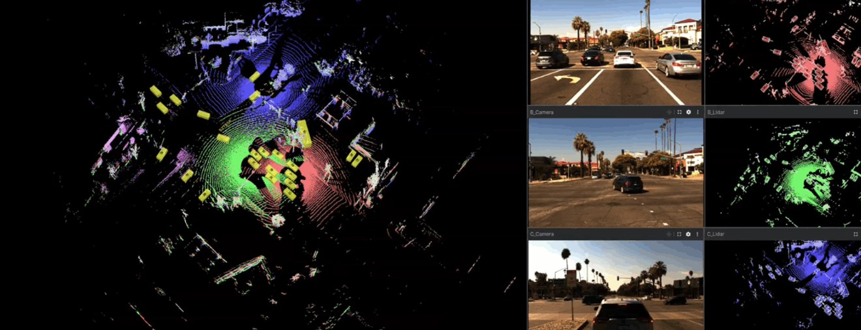
03 · RESEARCH IN ACTION
CISL × Library: Bringing Autonomous-Vehicle Data to Life
~60,000
synchronized LiDAR frames
344,000+
3D bounding-box labels
ECCV 2026
oral presentation, Malmö
CooperScene viewer: LiDAR point clouds with synchronized camera and sensor views
The research team Hang Qiu and CISL develop the autonomous-systems dataset
CooperScene is an interactive web portal for the Collaborative Intelligence Systems Lab (Dr. Hang Qiu, ECE). The Library built the data-processing pipeline and a browser-based 3D viewer so researchers can explore sensor data before downloading enormous files.
Research Services Barbara Martinez Neda identifies and builds the data solution
Cyberinfrastructure Dan Szilagyi, Joel Valdez and Scott Metoyer build pipeline and viewer
Read the story (Sept. 9, 2026) · Open the CooperScene viewer
Library team: Barbara Martinez Neda · Dan Szilagyi · Joel Valdez · Scott Metoyer
Library Overview: https://digitalinitiatives.ucr.edu/projects/cooperscene
Research & Technology Services
33
Notes:
Suggested pacing: 2.5 min. Sept 9, 2026 story. Barbara: "the goal was to allow researchers to interact with the dataset before downloading the enormous files." Prof. Qiu: "The great support and collaboration with UCR Library Research and Technology Services made this lens feasible and the dataset more accessible." Accepted as an oral at ECCV, Malmö. Connected and automated vehicles are a core sustainable-transportation topic.

Slide 21
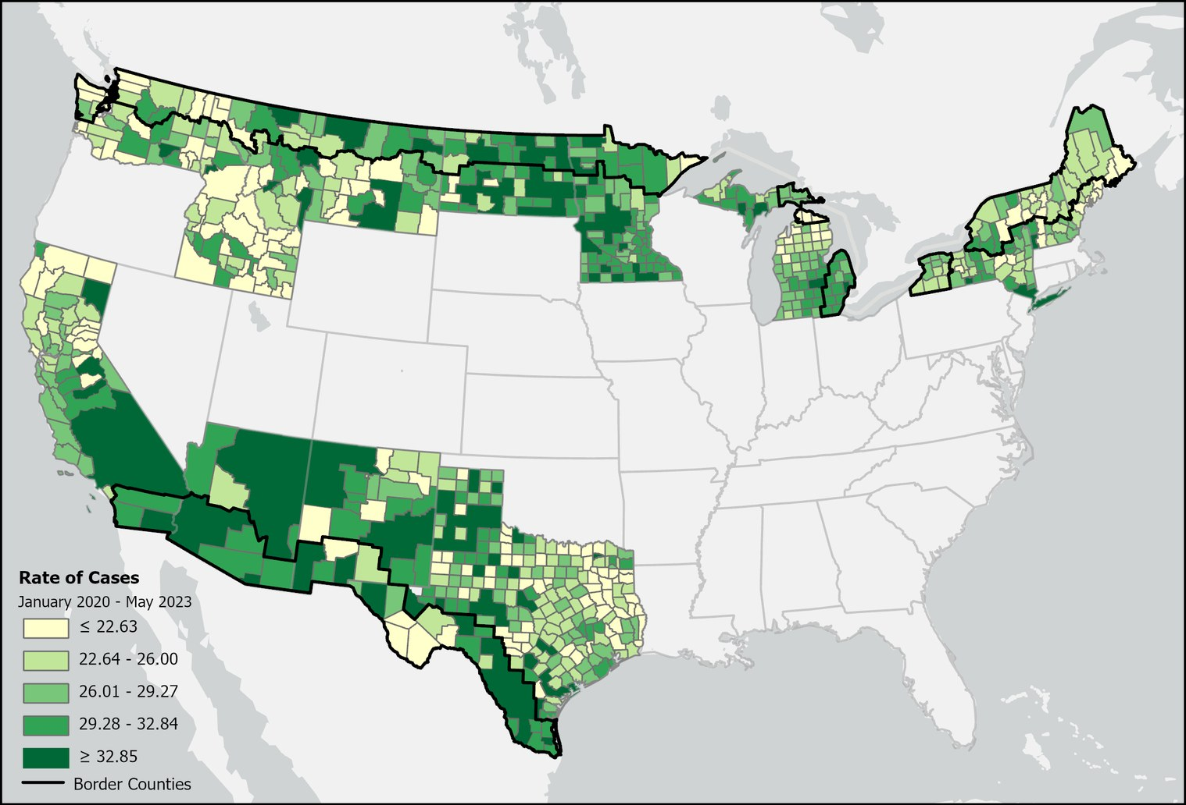


03 · RESEARCH IN ACTION
COVID Borders: A Research Question Becomes a Map
The question
Did proximity to U.S. international land borders correspond to different COVID-19 outcomes?
Library contribution
Data preparation and GIS mapping by Barbara Martinez Neda and Janet Reyes
Research value
Variance between U.S.–Mexico and U.S.–Canada border regions informs binational pandemic preparedness
Led by Dr. Robert Rodriguez, UCR School of Medicine · Explore COVID Borders
Research & Technology Services
34
Notes:
Suggested pacing: 2 min. COVID Borders (July 2025–March 2026, complete). Team: Dr. Robert Rodriguez (lead, School of Medicine), Shaokui Ge (biostatistician), Barbara Martinez Neda, Janet Reyes, medical students Leonides Catarino and Berenice Arguello. Map shows case rates, Jan 2020–May 2023, with border counties outlined. Speak from experience; do not infer causal effects from the map.

Slide 22
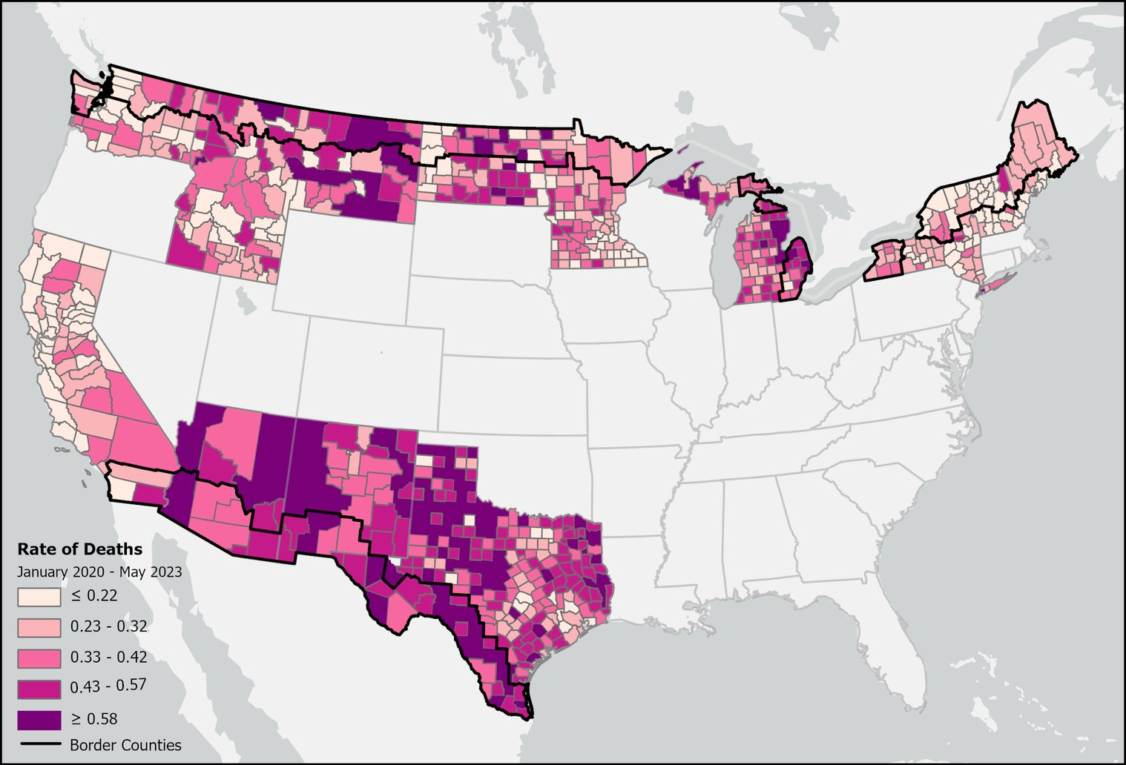
03 · RESEARCH IN ACTION
COVID Borders: The Work Behind the Visualization
1
Prepare the data
Weekly epidemiological records aggregated into quarterly totals and validated
2
Define the comparison
ArcGIS Pro Select by Location: counties within 100 km of an international land border
3
Map the measures
Case rates, death rates and case fatality rates, January 2020 – May 2023
Data: weekly COVID-19 records · U.S. county shapefiles · TIGER/Line international boundaries
Research & Technology Services
35
Notes:
Suggested pacing: 1.5 min. Death-rate map (second measure). Do not compare colors across maps — the measures and legends differ. A transportation analogue: the same workflow (clean → classify by distance → map) works for corridor, port-of-entry or emissions-exposure questions.

Slide 23
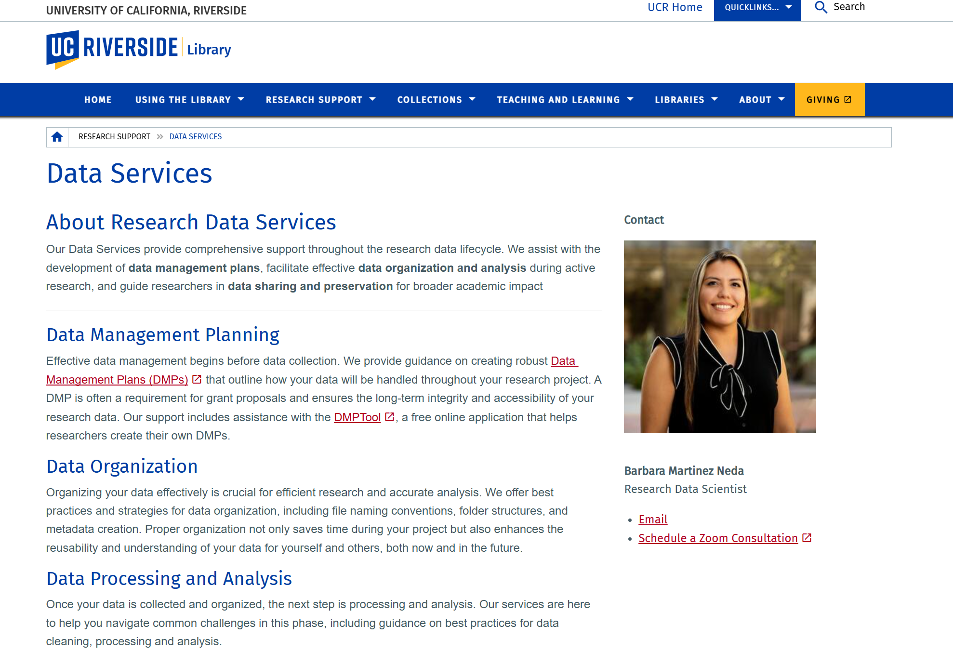
02 · CONSULT
Data Services Across the Research Lifecycle
HOW TO USE IT
1
Plan — Data Management Plans for grants, with DMPTool
2
Organize — file naming, folder structures, metadata
3
Analyze — cleaning, Python/pandas, machine learning, visualization
4
Share — deposit in Dryad; meet funder and journal requirements
GO TO
Data Services page
Book Barbara Martinez Neda
DMPTool
Dryad
Research & Technology Services
20
Notes:
Suggested pacing: 0.6 min. NSF requires DMPs — Barbara reviews them. Sensor, traffic and emissions data need cleaning and documentation. Dryad (UC-supported) publishes data with a DOI. [Screenshot of the live page, September 2026.]

Slide 24
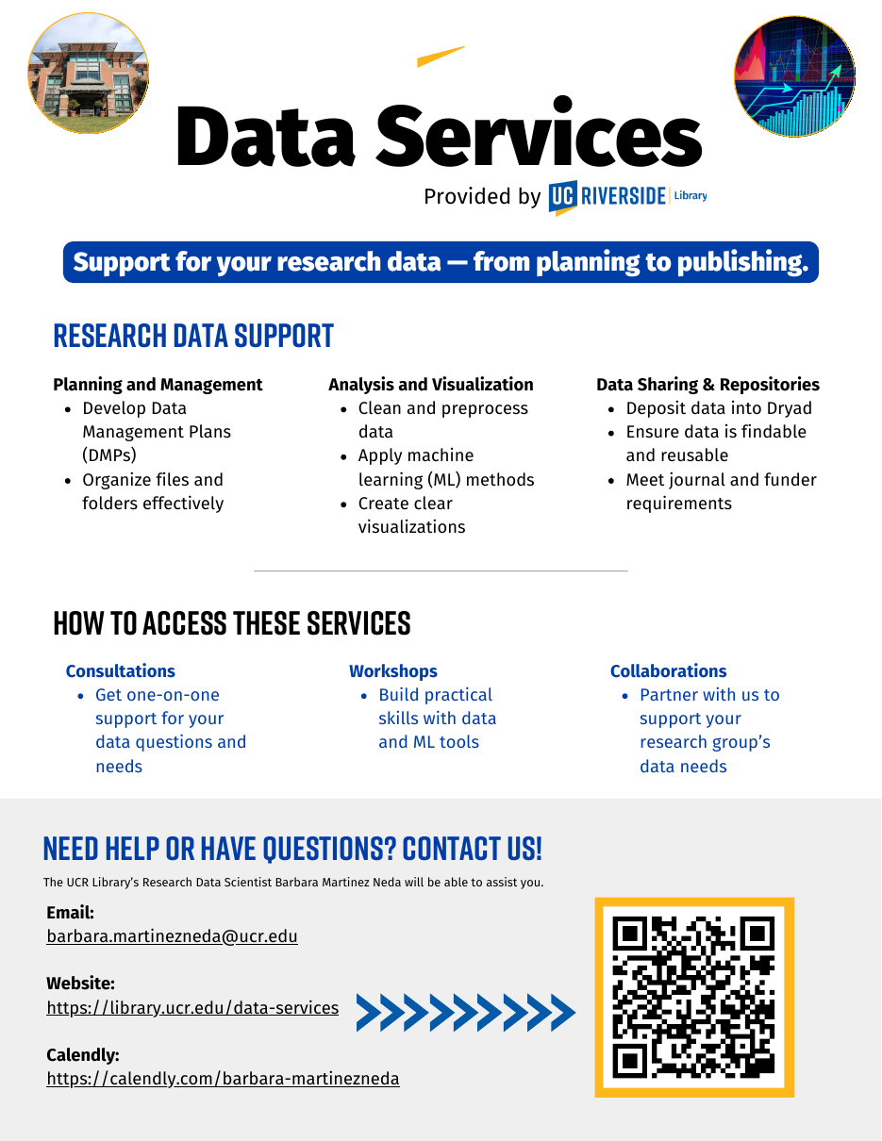
02 · CONSULT
Data Services — From Planning to Publishing
Support for your research data — from planning to publishing.
Planning & management
Analysis & visualization
DMPs, file organization
Cleaning, ML methods, clear visuals
Sharing & repositories
Collaborations
Dryad, findable & reusable data
Partner on your group’s data needs
DATA WORKSHOPS THIS FALL
Python for Beginners Using AI — Wed, Oct. 7
Data Cleaning with Python, Pandas & AI — Wed, Oct. 21
Introduction to Machine Learning — Wed, Nov. 4
Book Barbara: calendly.com/barbara-martinezneda · barbara.martinezneda@ucr.edu
Research & Technology Services
21
Notes:
Suggested pacing: 0.6 min. Barbara's Data Services flyer, with her fall workshops. The flyer QR goes to her Calendly.

Slide 25
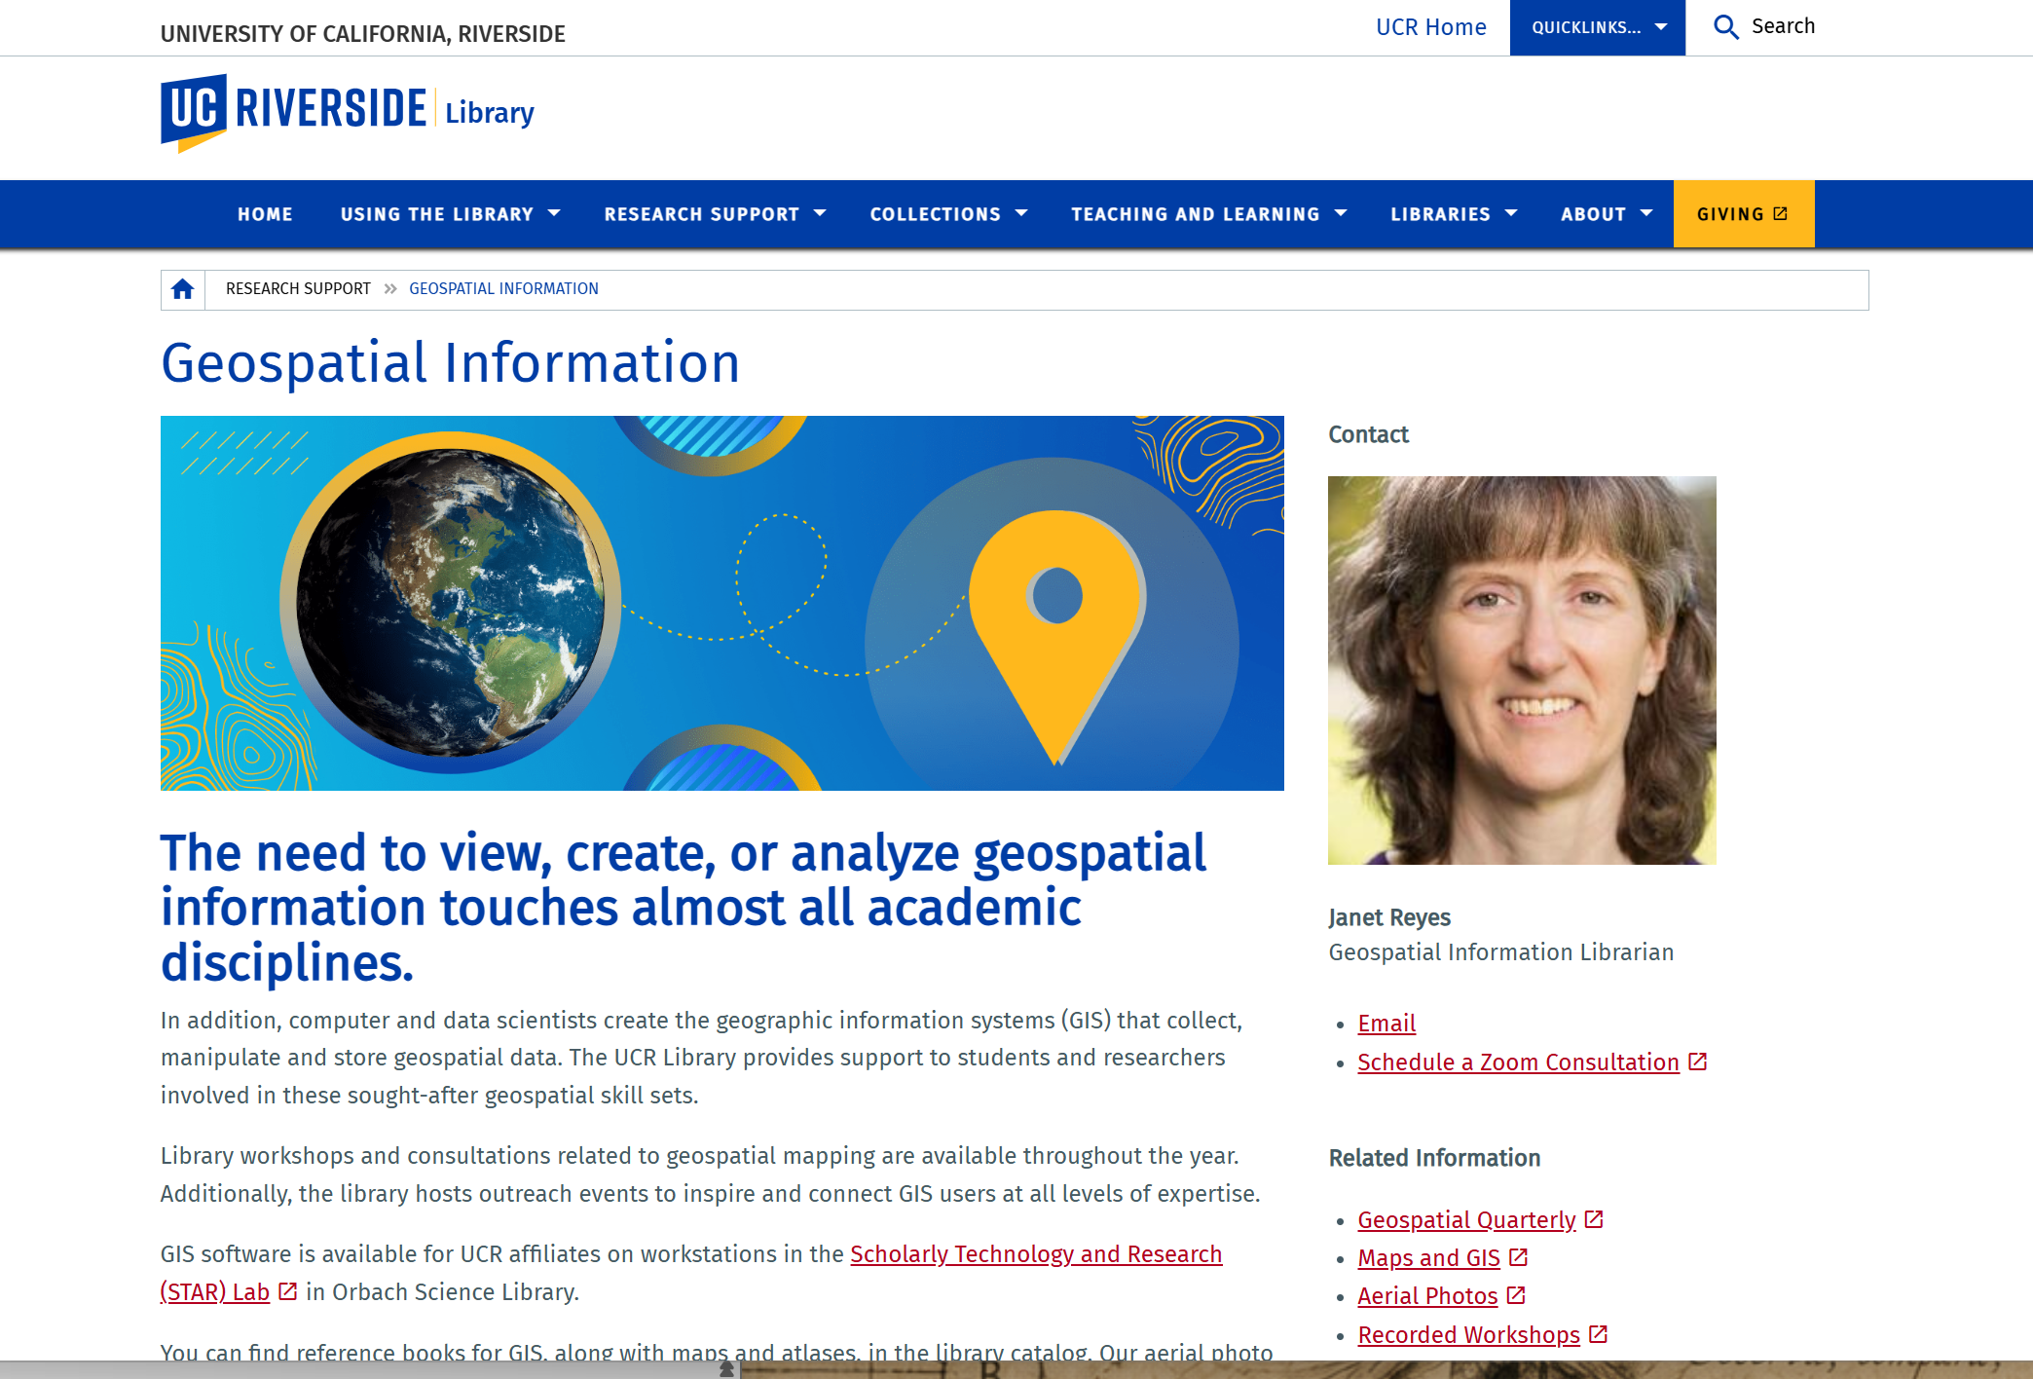
02 · CONSULT
Geospatial Information Services
HOW TO USE IT
1
Find and format spatial data and imagery — including historical aerial photos back to 1938
2
ArcGIS Pro & Online, QGIS and Google Earth Pro; GIS software in the STAR Lab
3
Workshops, consultations and GIS Meetups throughout the year
4
Follow the Geospatial Quarterly StoryMap and recorded workshops
GO TO
Geospatial Information page
Book Janet Reyes
Maps & GIS
Research & Technology Services
25
Notes:
Suggested pacing: 0.6 min. GIS is central to transportation and environmental policy — networks, emissions exposure, land use, equity. Historical aerials are a hidden gem for Inland Empire logistics corridors. [Screenshot of the live page, September 2026.]

Slide 26
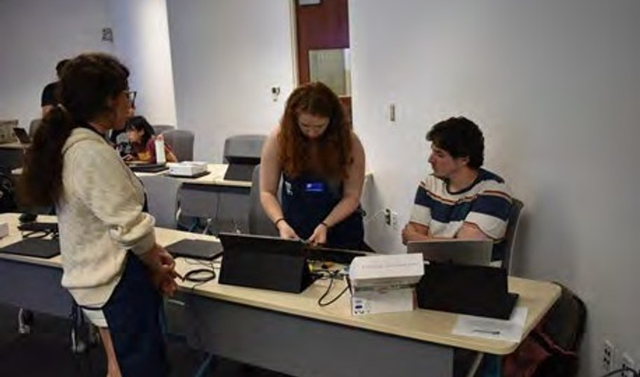
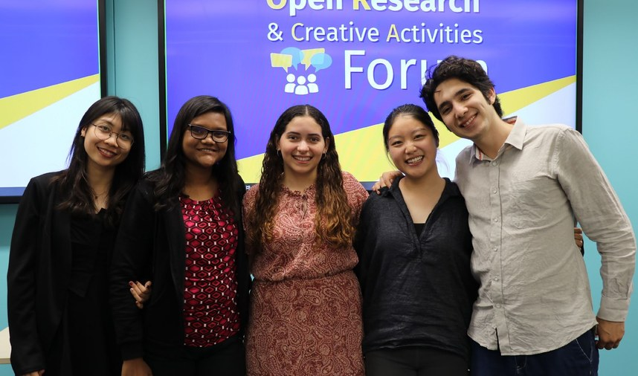

03 · RESEARCH IN ACTION
Research Service
Planet Imagery Day
AI + Robotics Summer Camp
ORCA Forum
May 2, 2025, with the AI for Sustainable Agriculture (AI4SA) project: Planet and Esri staff on satellite imagery in Google Earth Engine and ArcGIS.
Students train convolutional neural nets and deploy them on robots. Open to all disciplines; 75% of attendees were women.
Quarterly Open Research & Creative Activities showcase. Finalists present at Orbach and can publish code, data and media in eScholarship with DOIs.
Research & Technology Services
36
Notes:
Suggested pacing: 0.85 min. Planet Imagery Day (May 2, 2025) with USDA-NIFA's AI4SA; the AI Robotics Camp; ORCA — a venue for SPEAKS students to present and publish with a DOI.

Slide 27
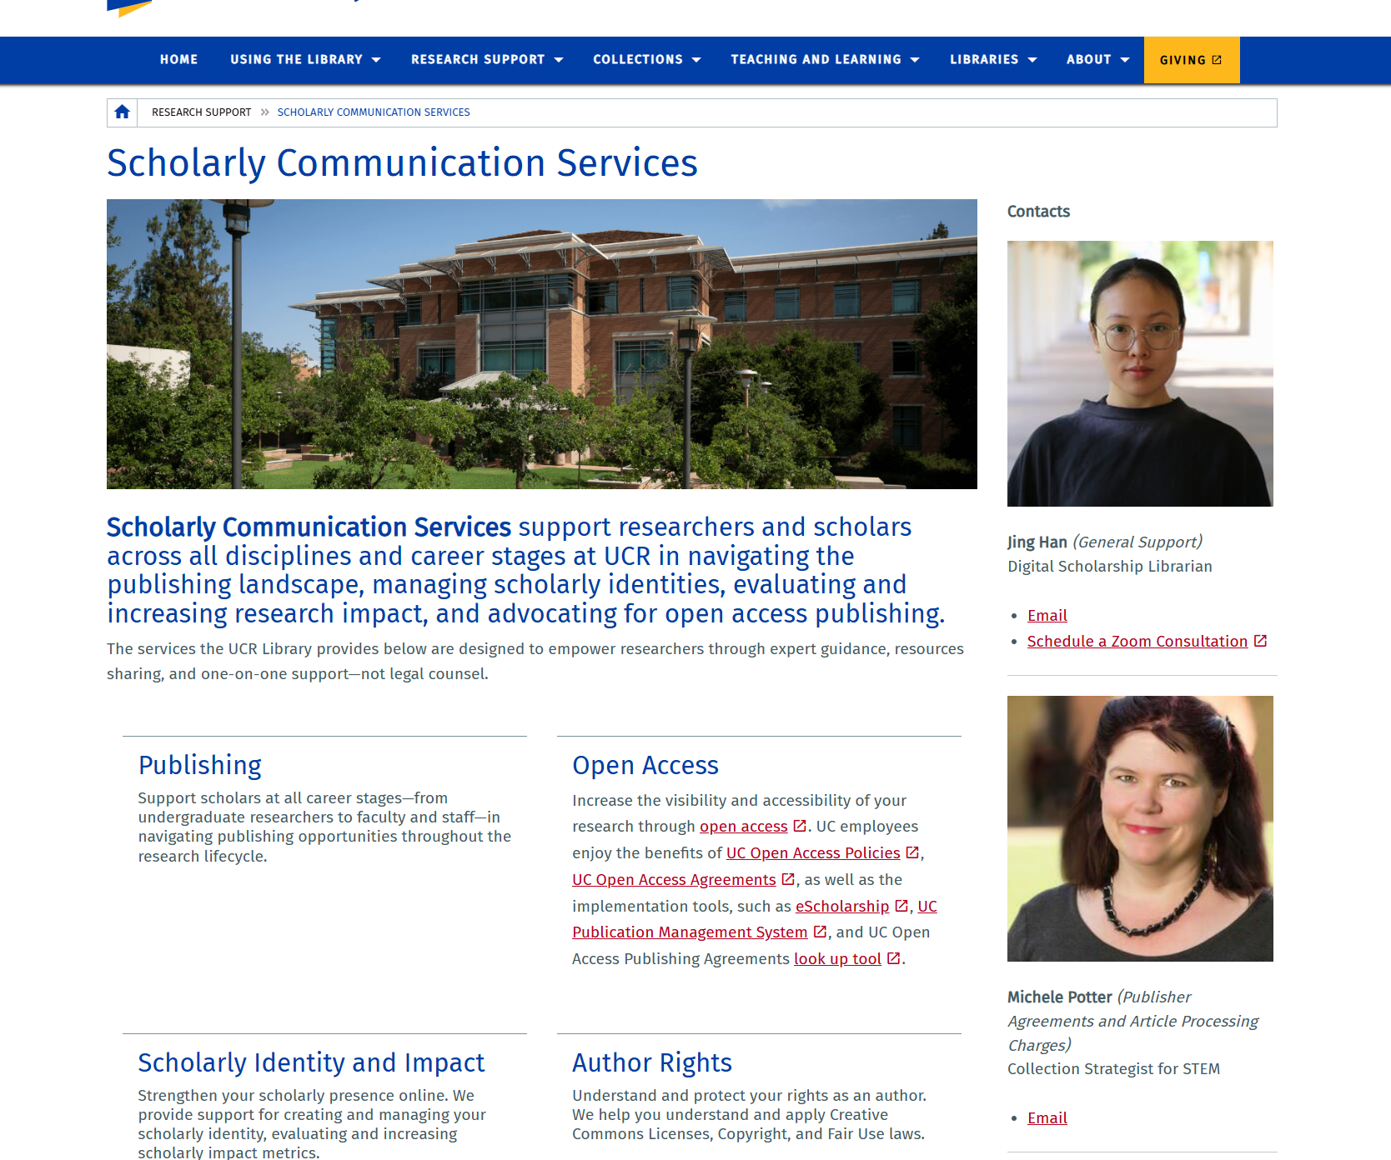
02 · CONSULT
Scholarly Communication Services
HOW TO USE IT
1
Check UC open access policies and publisher discounts before you submit
2
Deposit your work in eScholarship for a permanent, open link
3
Set up ORCID and track your research impact
4
Join the Authors Alliance fall series: Oct. 13, Nov. 17, Dec. 8 (Zoom)
GO TO
Scholarly Communication Services
Open Access guide
UC OA publishing look-up (JOLT)
Book a consultation with Jing
Research & Technology Services
27
Notes:
Suggested pacing: 0.6 min. Authors Alliance fall workshops for new academic authors: Sept 17 Copyright and Your Dissertation; Oct 13 Managing and Maximizing Scholarly Impact; Nov 17 From Dissertation to Book; Dec 8 Research & Writing in the Age of AI. Team email: libscholcomm@ucr.edu. [Screenshot of the live page, September 2026.]

Slide 28
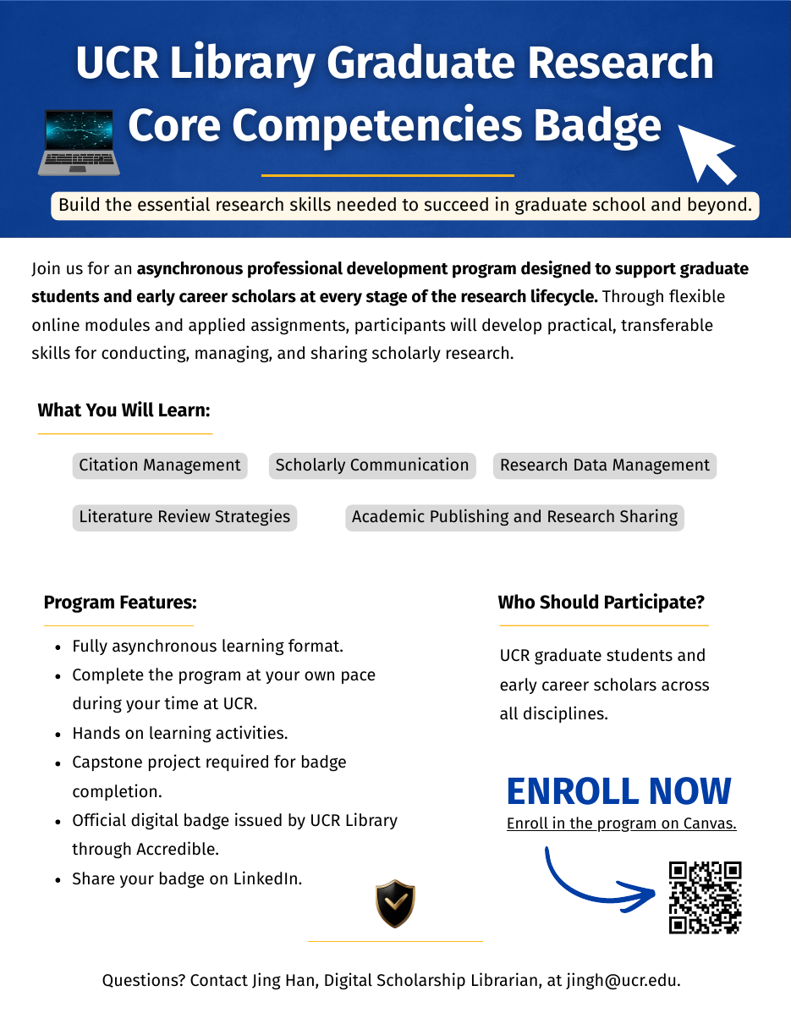

Graduate Research Core Competencies Badge
04 · LEARN
Build the essential research skills needed to succeed in graduate school and beyond.
Fully asynchronous
Hands-on
Complete at your own pace during your time at UCR
Applied assignments and a capstone project
Official digital badge
Share it
Issued by UCR Library through Accredible
Add the badge to LinkedIn and your CV
For UCR graduate students and early-career scholars in all disciplines.
Enroll on Canvas
elearn.ucr.edu/enroll/HJ8D8K · Questions: jingh@ucr.edu
Research & Technology Services
44
Notes:
Suggested pacing: 0.6 min. Fully asynchronous — ideal alongside SPEAKS requirements. Curriculum on the next slide.

Slide 29



04 · LEARN
What the Core Competencies Badge Covers
MODULE 1
MODULE 2
MODULE 3
MODULE 4
MODULE 5
Citation Management
Literature Review Strategies
Research Data Management
Scholarly Communication
Publishing & Research Sharing
Organize sources and generate citations and bibliographies with reference managers.
Search systematically, synthesize sources and map the scholarly conversation.
Plan, organize, document and preserve research data across a project.
Open access, author rights and managing your scholarly identity.
Choose venues, navigate publication and share your work openly.
1
2
3
4
5
Enroll on Canvas
Complete online modules
Hands-on assignments
Capstone project
Badge via Accredible
Research & Technology Services
45
Notes:
Suggested pacing: 0.85 min. The five competency areas named on the badge flyer; module descriptions summarize each topic — confirm details with Jing Han.

Slide 30
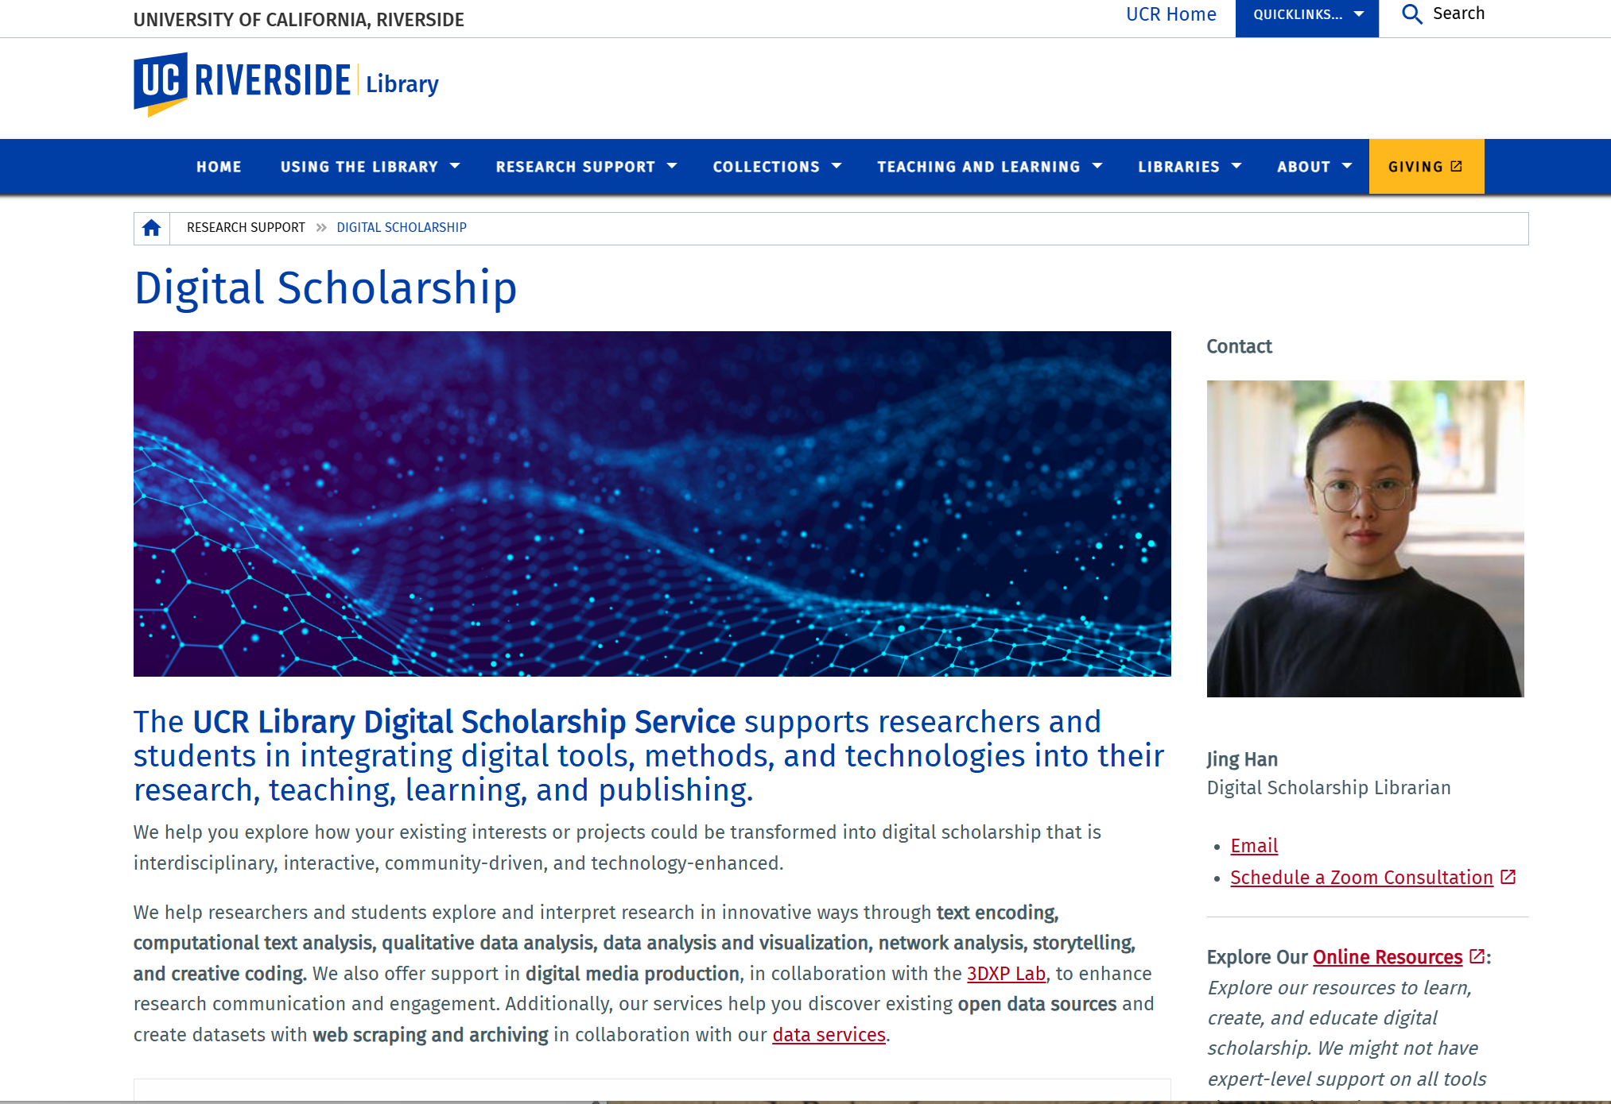
02 · CONSULT
Digital Scholarship
HOW TO USE IT
1
Book a consultation to scope tools, data and preservation for your project
2
Earn the Digital Scholarship Certificate on Canvas
3
Present at the quarterly ORCA Forum and publish with a DOI
4
Listen to The Reference Desk podcast on Spotify
GO TO
Digital Scholarship page
The Reference Desk podcast
ORCA Forum on eScholarship
Digital Scholarship newsletter
Research & Technology Services
28
Notes:
Suggested pacing: 0.6 min. Jing's Digital Scholarship page: workshops and consultations, project management, ORCA, the certificate, the podcast and the newsletter. [Screenshot of the live page, September 2026.]

Slide 31
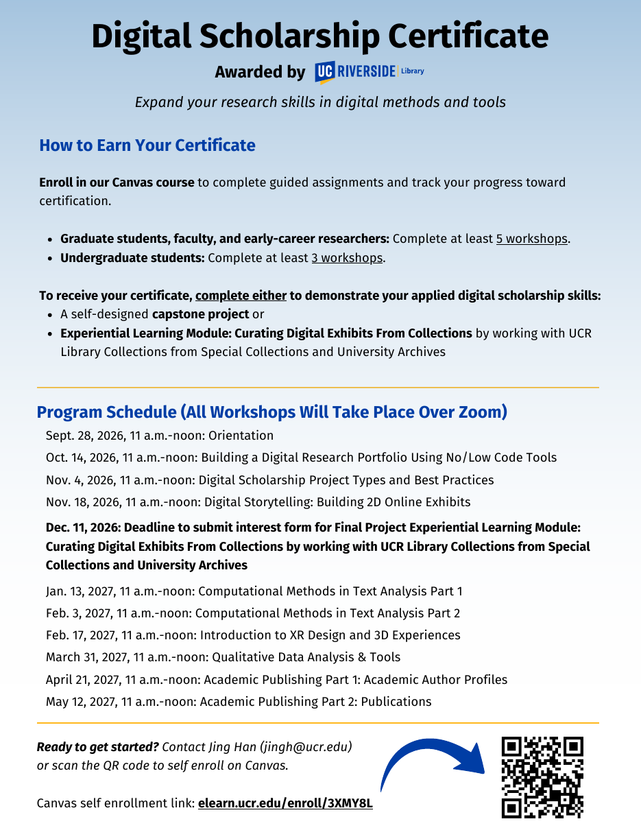

04 · LEARN
Digital Scholarship Certificate
Expand your research skills in digital methods and tools — awarded by the UCR Library.
1
Enroll
Self-enroll in the Canvas course to track progress
2
Attend
Graduate students & early-career researchers: at least 5 workshops (undergraduates: 3)
3
Apply
Complete a self-designed capstone project, or the Experiential Learning Module curating digital exhibits from Special Collections & University Archives
Enroll on Canvas
elearn.ucr.edu/enroll/3XMY8L · Jing Han, jingh@ucr.edu
Research & Technology Services
42
Notes:
Suggested pacing: 0.6 min. All 2026–27 certificate workshops are on Zoom. Full curriculum on the next slide.

Slide 32

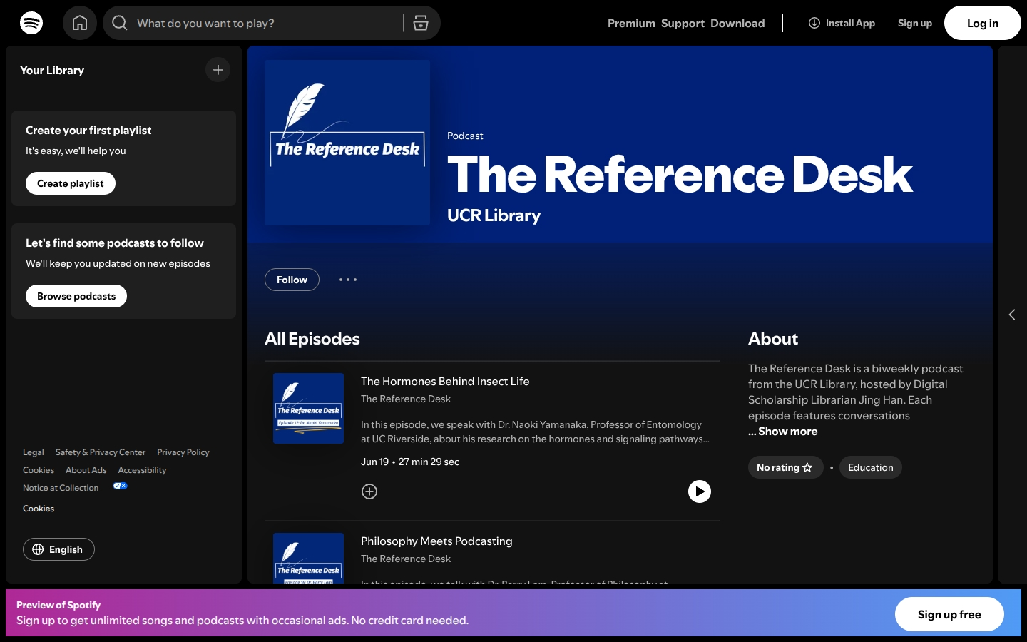

02 · CONSULT
The Reference Desk Podcast
Biweekly conversations with UCR faculty and student researchers — their projects, the library tools they use, and the books shaping their thinking.
Listen free on Spotify
open.spotify.com/show/7KuhdYsiLBZlTdaWAoIjZE · produced by Digital Scholarship (Jing Han)
Research & Technology Services
29
Notes:
Suggested pacing: 0.85 min. Produced by Digital Scholarship (Jing Han). Suggest students contact Jing if their research would make a good episode.

Slide 33
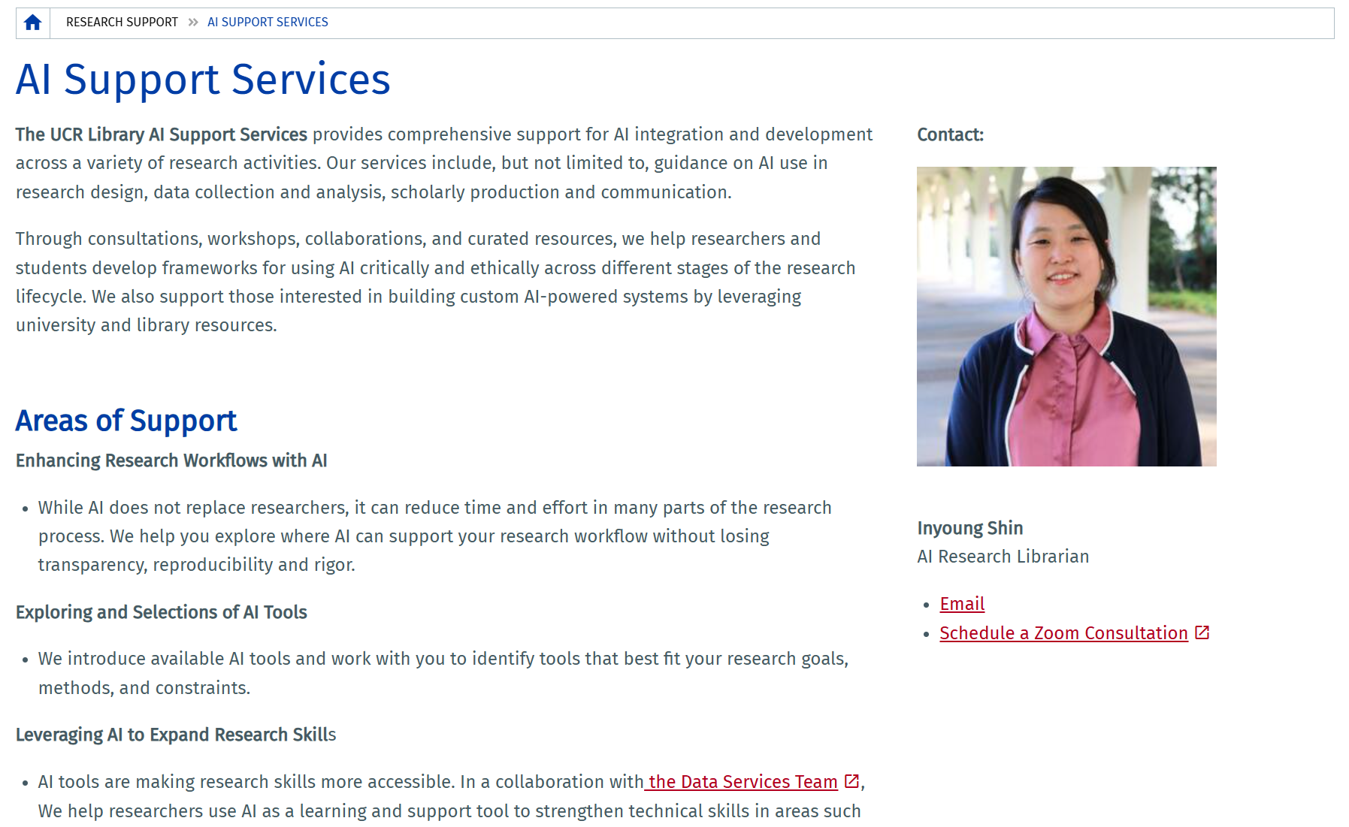
02 · CONSULT
AI Literacy Support Services
HOW TO USE IT
1
Enhance research workflows with AI — without losing transparency or rigor
2
Explore and select AI tools that fit your goals and constraints
3
Build skills with the Data Services team: coding, data processing, visualization
4
Responsible AI: privacy, bias, authorship and compliance — plus custom AI systems
GO TO
AI Support Services page
Book Inyoung Shin (30 min)
inyoungs@ucr.edu
Research & Technology Services
22
Notes:
Suggested pacing: 0.6 min. For a policy audience, stress responsible use: disclosure rules differ by publisher and funder, and interview/stakeholder data needs confidentiality. [Screenshot of the live page, September 2026.]

Slide 34
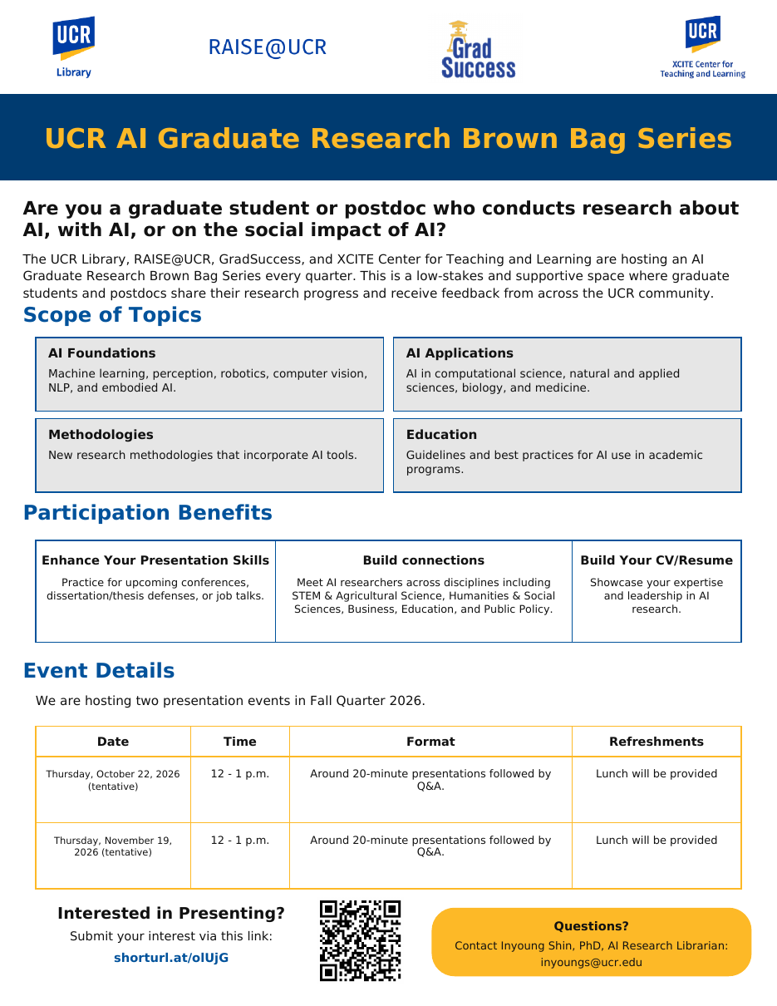

04 · LEARN
UCR AI Graduate Research Brown Bag Series
For grad students and postdocs doing research about AI, with AI, or on the social impact of AI.
AI foundations
AI applications
ML, perception, robotics, computer vision, NLP, embodied AI
Computational, natural & applied sciences, biology, medicine
Methodologies
Education
New research methods that incorporate AI tools
Guidelines and best practices for AI in programs
Thu, Oct. 22 & Thu, Nov. 19 · 12–1 pm · ~20-min talks + Q&A · lunch provided
Co-hosted by the UCR Library, RAISE@UCR, GradSuccess and XCITE Center for Teaching and Learning.
Present your work
shorturl.at/olUjG · inyoungs@ucr.edu
Research & Technology Services
41
Notes:
Suggested pacing: 0.6 min. Strong fit for SPEAKS: AI in transportation, perception, or AI policy all qualify; the audience spans STEM, social sciences and public policy. Good practice for conference talks and defenses.

Slide 35
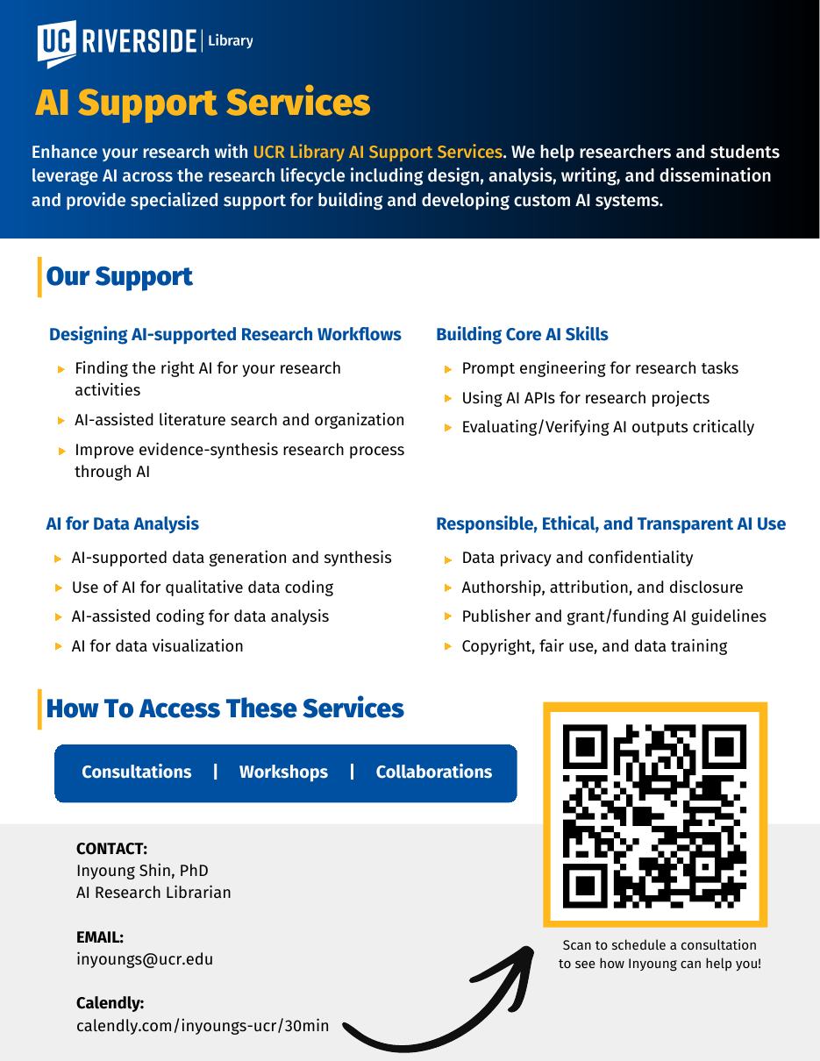
02 · CONSULT
AI Support Services — Inyoung Shin
Enhance your research with AI across design, analysis, writing and dissemination.
AI WORKSHOPS THIS FALL
Studying with Gemini Notebook
AI Literacy 101
Wed, Sept. 30 · 1–2 pm · with Amiee Zou
Generative AI through history · Wed, Oct. 28 · 12–1 pm
Web Agent: AI Agent for Data Analysis
Intro to Advanced ML: Neural Networks
Thu, Nov. 5 · 3–4 pm
Mon, Nov. 23 · 3–4 pm · PyTorch
Book Inyoung: calendly.com/inyoungs-ucr/30min · inyoungs@ucr.edu
Also co-leads Brainy Bots (Arduino & ESP32 with LLMs) with Alvaro Alvarez and hosts the AI Graduate Research Brown Bags.
Research & Technology Services
23
Notes:
Suggested pacing: 0.6 min. Inyoung's flyer and her fall AI sessions. The Web Agent session features a free, secure Gemini-powered agent built by UCR faculty for quantitative analysis.

Slide 36
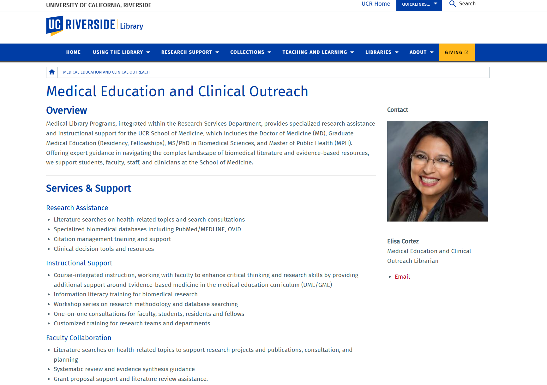
02 · CONSULT
Medical Education/Clinical Outreach, Systematic Review
and Meta-analysis
HOW TO USE IT
1
Literature searches on health topics and search consultations
2
Biomedical databases: PubMed/MEDLINE, OVID
3
Citation management training and support
4
Workshops and course-integrated instruction for health research
GO TO
Medical Education & Clinical Outreach
Elisa Cortez — elisa.cortez@ucr.edu
Research & Technology Services
26
Notes:
Suggested pacing: 0.6 min. Elisa Cortez supports the School of Medicine and biomedical graduate students — relevant for SPEAKS work on transportation, air quality and health. [Screenshot of the live page, September 2026.]

Slide 37
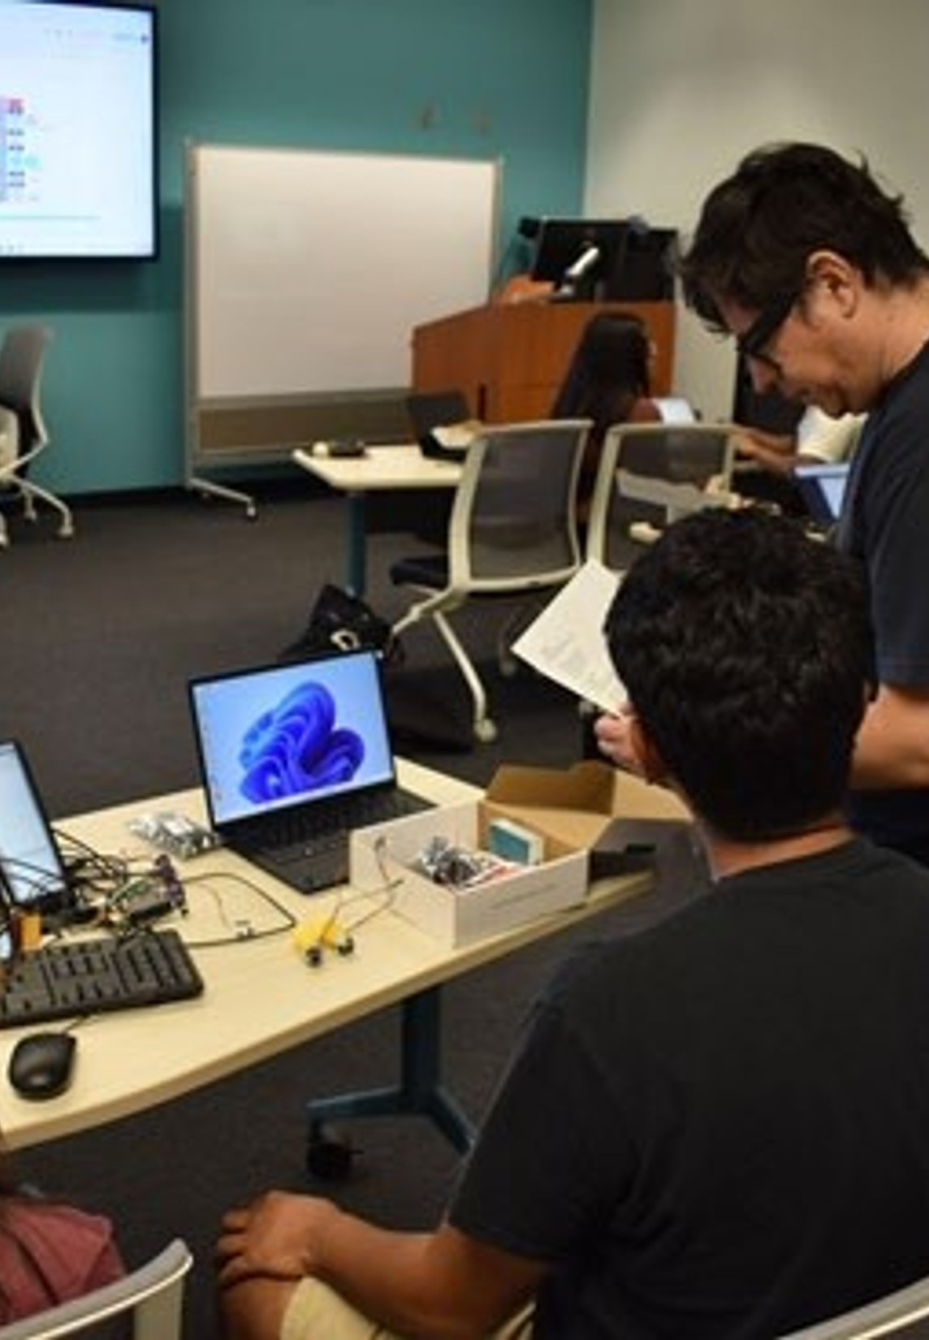
04
Learn
Fall 2026 workshops, meetups, certificates and signature events
Research & Technology Services
37
Notes:
Suggested pacing: 0.25 min. Section 4: the fall schedule, credentials and community events.

Slide 38
04 · LEARN · FALL 2026
Track 1 — AI & Data Science
From first Python program to neural networks and agentic AI
Date | Time | Session | Lead
Thu, Sept. 24 | 9:00–10:30 am | Introduction to Agentic AI: Capabilities, Personas & Possibilities | Ray Uzwyshyn
Wed, Sept. 30 | 1:00–2:00 pm | Studying with Gemini Notebook (UCR-licensed tools) | A. Zou / I. Shin
Wed, Oct. 7 | 2:00–3:00 pm | Python for Beginners Using AI | B. Martinez Neda
Wed, Oct. 21 | 3:00–4:00 pm | Introduction to Data Cleaning with Python, Pandas & AI | B. Martinez Neda
Wed, Oct. 28 | 12:00–1:00 pm | AI Literacy 101: Exploring Generative AI Through History | I. Shin
Wed, Nov. 4 | 2:00–3:30 pm | Introduction to Machine Learning | B. Martinez Neda
Thu, Nov. 5 | 3:00–4:00 pm | Web Agent: A Gemini-Powered AI Agent for Data Analysis | I. Shin
Mon, Nov. 23 | 3:00–4:00 pm | Intro to Advanced Machine Learning: Neural Networks (PyTorch) | I. Shin
Research & Technology Services
38
Notes:
Suggested pacing: 0.85 min. Recommend: Data Cleaning (Oct 21), Intro to ML (Nov 4), Web Agent (Nov 5).

Slide 39
04 · LEARN · FALL 2026
Track 2 — Prototypes, Robotics & Media: Makerspace Labs
Hands-on prototyping, physical computing and AI-assisted 3D
Date | Time | Session | Lead
Wed, Oct. 7 | 11:00 am–12:00 pm | Tinkering Research: Using the UCR Library Makerspace | B. Wheeler
Wed, Oct. 28 | 12:00–1:30 pm | Mini Maker: Pumpkin Carving — Subtractive Design & Spatial Reasoning | B. Wheeler
Wed, Nov. 4 | 11:00 am–12:00 pm | Tinkering Research: 3D Printing | B. Wheeler
Nov. 5, 19 & 23 | 2:00–3:00 pm | Brainy Bots: Powering Arduino & ESP32 Projects with LLMs | A. Alvarez / I. Shin
Wed, Nov. 11 | 2:00–3:00 pm | Maker Meetup: Fieyue Sewing & Embroidery (industry demo) | B. Wheeler
Wed, Nov. 18 | 11:00 am–12:00 pm | Tinkering Research: Laser Engraving | B. Wheeler
Wed, Nov. 18 | 2:00–3:00 pm | The AI 3D Revolution: From Prompt to Production-Ready Assets | A. Alvarez
Wed, Nov. 25 | 12:00–1:30 pm | Mini Maker: Thankful Origami — Folding & Structural Geometry | B. Wheeler
Wed, Dec. 9 | 12:00–1:30 pm | Mini Maker: Silent Painting — Composition & Color Theory | B. Wheeler
Wednesdays | 9:30 am–1:00 pm | Makerspace Tabling at the Bell Tower (drop-in, Oct. 7 – Dec. 16) | B. Wheeler
Research & Technology Services
39
Notes:
Suggested pacing: 0.85 min. Brainy Bots connects ESP32/Arduino to LLMs for natural-language control, sensor interpretation and automated debugging. Tinkering Research orientations certify you on 3D printing and laser engraving.

Slide 40
04 · LEARN · FALL 2026
Track 3 — Digital Scholarship, Meetups & Events
Credentials, community and campus-wide events (certificate sessions on Zoom)
Date | Time | Session | Lead
Tue, Sept. 22 | 12:00–12:50 pm | Geospatial/GIS Meetup (lunchtime discussion) | J. Reyes
Mon, Sept. 28 | 11:00 am–12:00 pm | Digital Scholarship Certificate: Orientation (Zoom) | J. Han
Tue–Wed, Oct. 6–7 | 10:00 am–4:00 pm | UCR Library Open House — passport tour, Rivera & Orbach | Library-wide
Wed, Oct. 14 | 11:00 am–12:00 pm | Building a Digital Research Portfolio Using No/Low-Code Tools | J. Han
Thu, Oct. 22 | 12:00–1:00 pm | UCR AI Graduate Research Brown Bag (lunch provided) | I. Shin + partners
Wed, Nov. 4 | 11:00 am–12:00 pm | Digital Scholarship Project Types & Best Practices | J. Han
Wed, Nov. 18 | 11:00 am–12:00 pm | Digital Storytelling: Building 2D Online Exhibits | J. Han
Thu, Nov. 19 | 12:00–1:00 pm | UCR AI Graduate Research Brown Bag (lunch provided) | I. Shin + partners
Fri, Dec. 11 | Deadline | Interest form: Experiential Learning Module (Special Collections) | J. Han
Research & Technology Services
40
Notes:
Suggested pacing: 0.85 min. Certificate sessions are on Zoom. Open House earns an emailed certificate some instructors accept for credit. Brown Bag dates are tentative per the flyer.

Slide 41

04 · LEARN
Meetups and Signature Events, Year-Round
Fall
Winter
Spring
Summer
Library Open House (Oct. 6–7) · Open Access Week
UC Love Data Week (February)
Maker Week (April) · hands-on prototyping
AI + Robotics Camp · free, all disciplines
ONGOING
ORCA Forum
AI Grad Brown Bags
GIS Meetups
The Reference Desk
Quarterly student research showcase
Quarterly AI research talks
Geospatial talks & Quarterly StoryMap
Biweekly podcast on Spotify
Research & Technology Services
46
Notes:
Suggested pacing: 0.85 min. The annual rhythm: Open House and Open Access Week in fall, Love Data Week in February, Maker Week in April, Robotics Camp in summer. ORCA, Brown Bags and GIS Meetups each quarter; the podcast every other week.

Slide 42
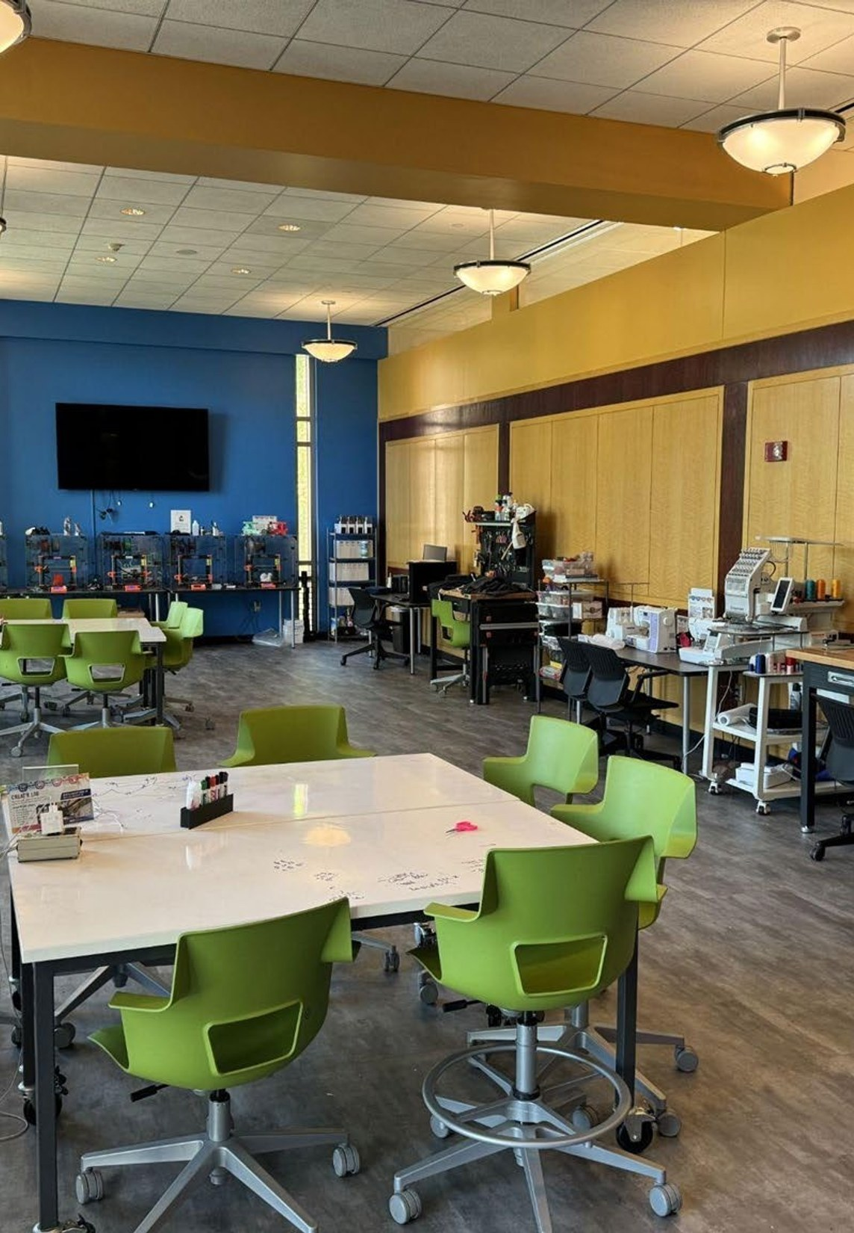
05
Create
Labs and technology for prototyping, immersive media and private, local AI
Research & Technology Services
47
Notes:
Suggested pacing: 0.25 min. Section 5: the labs in Orbach Science Library.

Slide 43
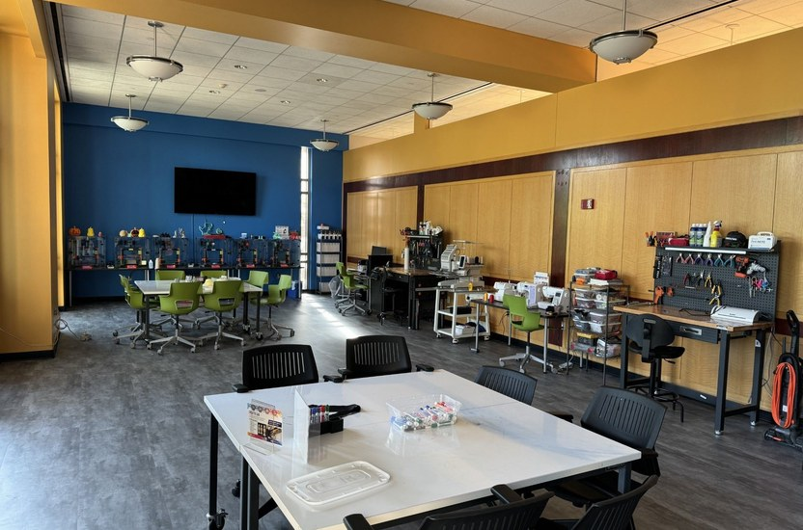
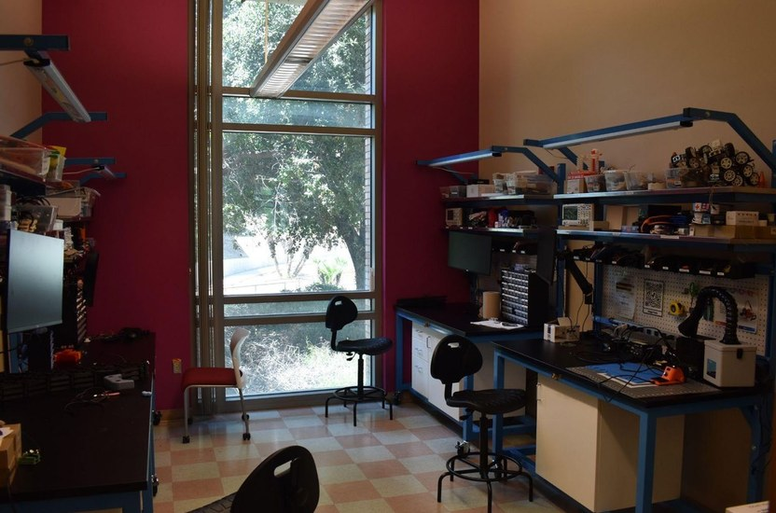
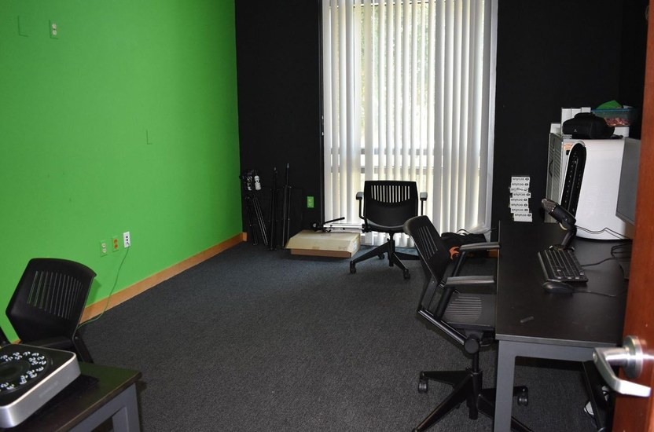
05 · CREATE
The Creat’R Lab, Orbach Science Library
Makerspace
Room 140
Robotics Lab
Room 146
3DXP Lab
Room 145
3D printers, laser engraver, sewing & embroidery, electronics, workbench and tools
Raspberry Pi, Arduino, sensors and microcontrollers; kits for AI + robotics
VR/AR, 3D scanning, green screen, high-performance computers; Unity & Meta Immersive Learning grant
Free 3D modeling & printing for research and coursework · equipment lending (GoPro, green screen, electronics kits) · staff and student assistants on hand
Research & Technology Services
49
Notes:
Suggested pacing: 0.85 min. Rapid prototyping of sensor housings, test rigs and robot chassis; VR/XR for visualizing transportation scenarios or public engagement. Labs reopened after the Sept 14–23 reflooring.

Slide 44
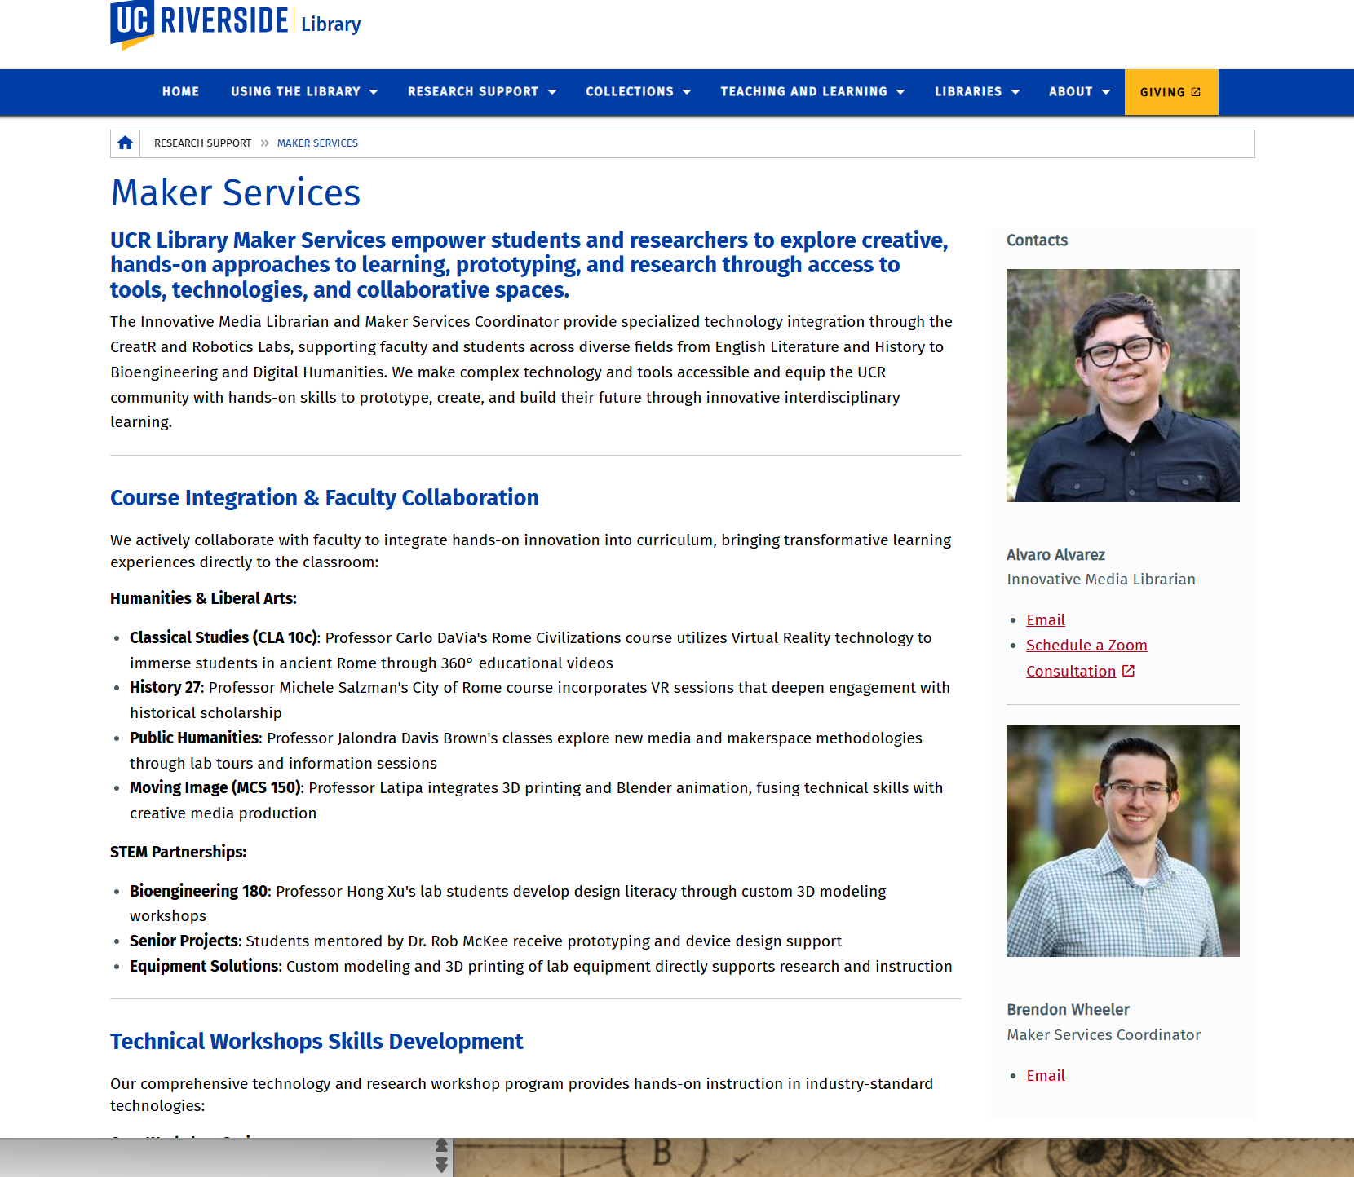
05 · CREATE
Maker Services, Prototyping, Entrepreneurship, R&D
HOW TO USE IT
1
Hands-on prototyping, creating and research across disciplines
2
Course integration: VR, 3D printing and Blender in humanities and STEM classes
3
STEM partnerships: design literacy, senior-project prototyping, custom lab equipment
4
Technical workshops in industry-standard tools
GO TO
Maker Services page
Book Alvaro Alvarez
Brendon Wheeler — brendon.wheeler@ucr.edu
3D modeling & printing guide
Research & Technology Services
48
Notes:
Suggested pacing: 0.6 min. Maker Services: Alvaro Alvarez (Innovative Media) and Brendon Wheeler (Maker Services Coordinator). Senior design projects get prototyping support — relevant for engineering students. [Screenshot of the live page, September 2026.]

Slide 45
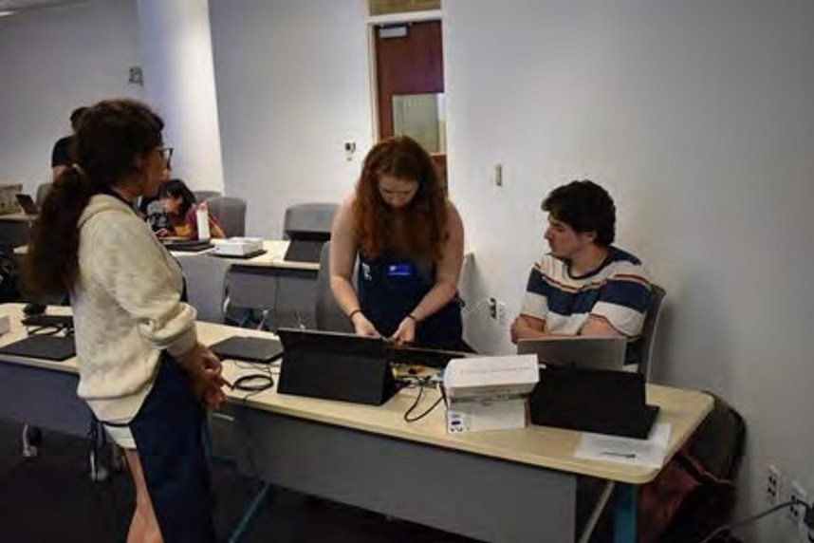
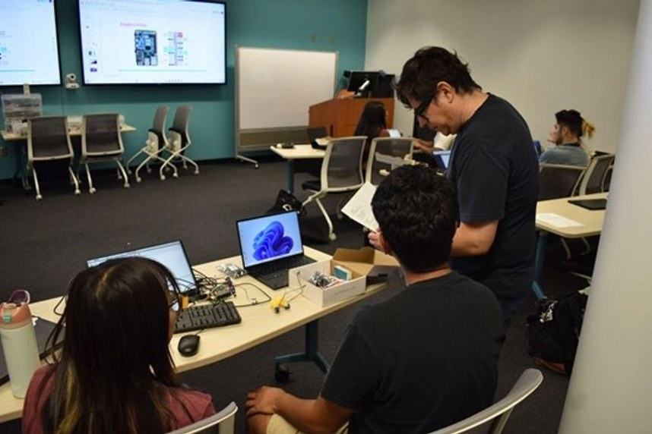
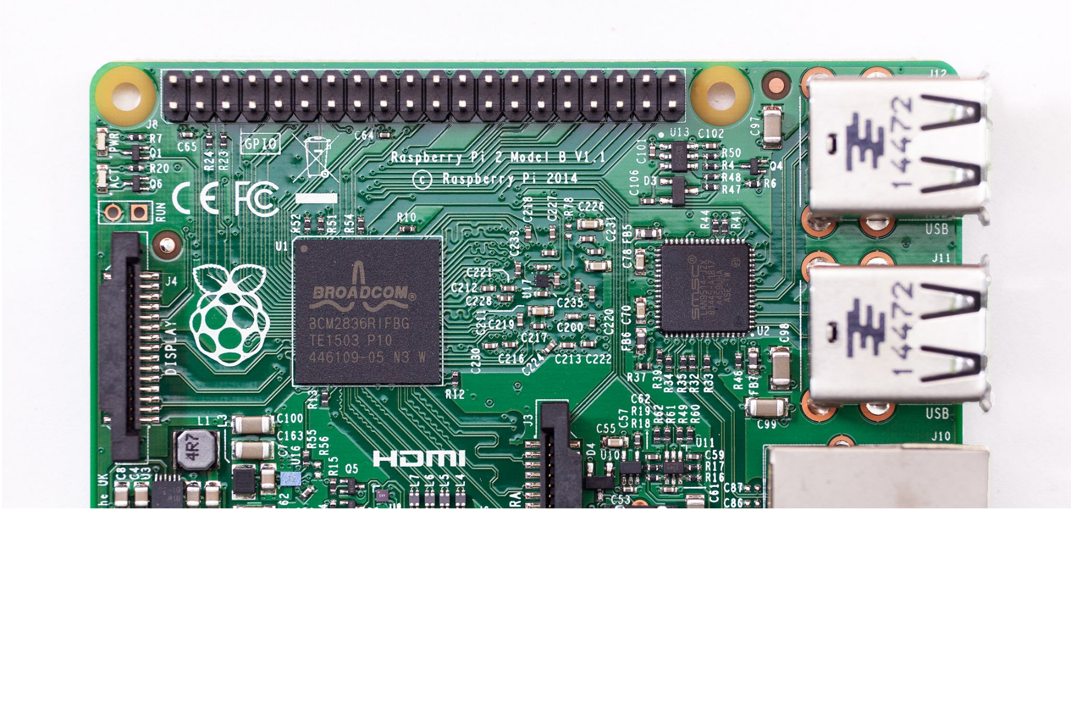
05 · CREATE
Robotics: Prototypes Connect Code with the Physical World
Sensors and microcontrollers
Coding and AI in a physical system
Raspberry Pi, Arduino and sensor kits
A prototype makes methods visible and gives researchers something to test — from convolutional neural nets that recognize objects to sensor rigs for field data.
Robotics Lab, Orbach Room 146 · AI + Robotics Camp story
Research & Technology Services
50
Notes:
Suggested pacing: 0.85 min. Robotics Lab equipment and the AI-enhanced robotics camp (CNN image recognition deployed on robots). Ground examples in actual camp projects. Senior design mentorship is available for engineering students.

Slide 46
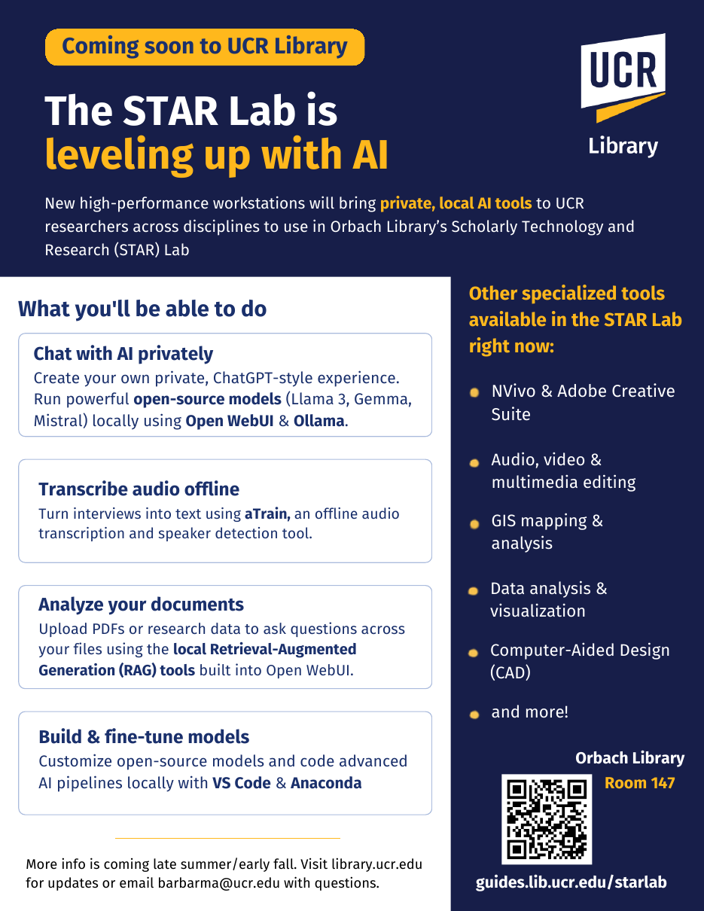



05 · CREATE
Coming Soon: The STAR Lab Is Leveling Up With AI
New high-performance workstations bring private, local AI tools to UCR researchers across disciplines.
Chat with AI privately
Open WebUI & Ollama running Llama, Gemma and Mistral locally
Transcribe audio offline
aTrain for interviews, with speaker detection
Analyze your documents
Local retrieval-augmented generation over PDFs & data
Build & fine-tune models
Custom models and AI pipelines in VS Code & Anaconda
Questions: Barbara Martinez Neda · barbarma@ucr.edu
Research & Technology Services
52
Notes:
Suggested pacing: 0.6 min. Coming this fall. Why local AI matters for policy research: no per-token costs, sensitive interview and IRB data stay on campus, and pinned open-weight model versions make methods reproducible. aTrain transcription never leaves the machine. UC-licensed cloud tools remain fine for general work.

Slide 47
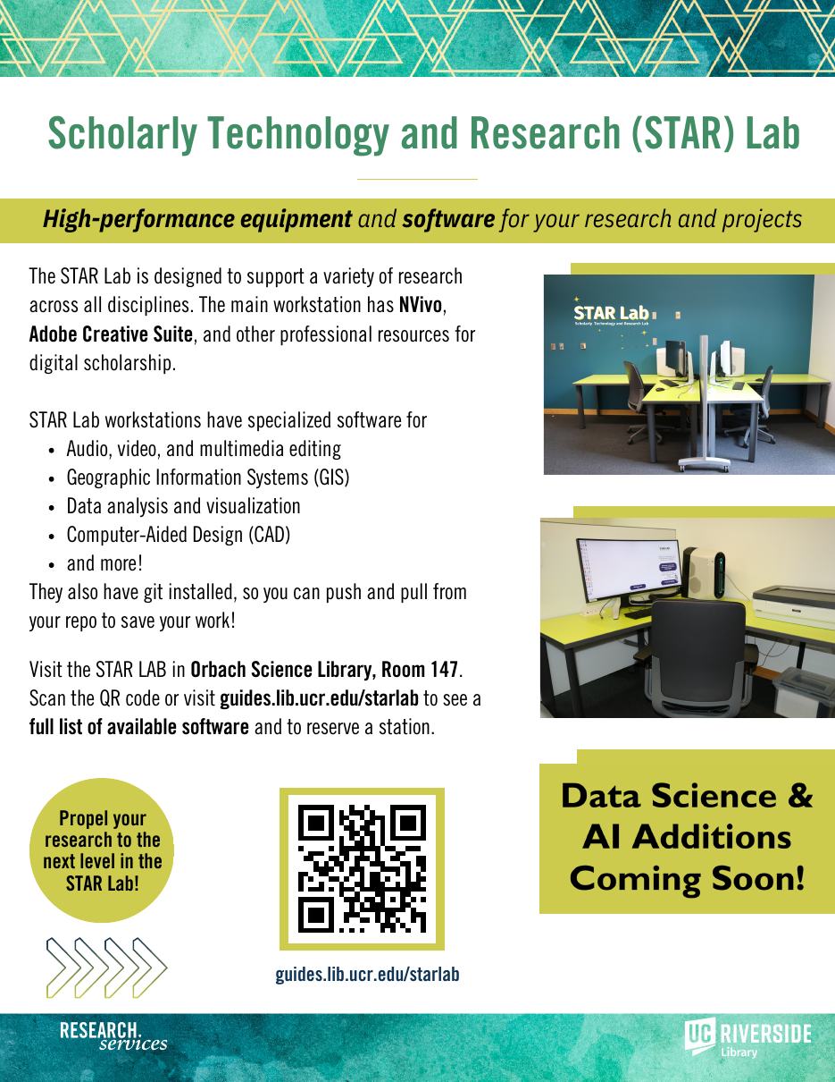
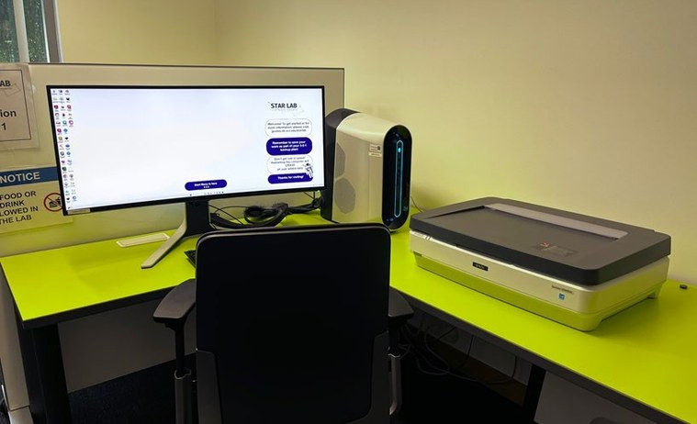
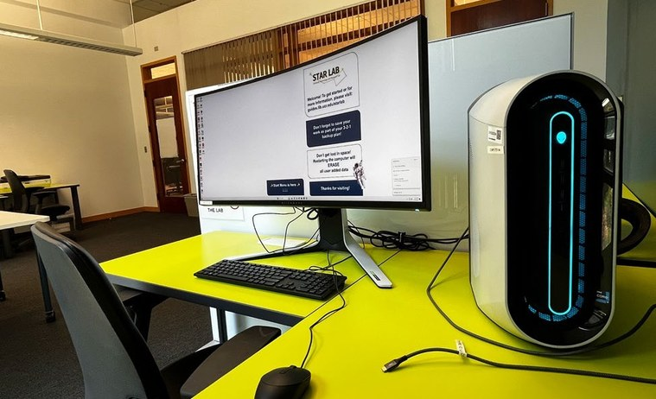
05 · CREATE
STAR Lab — Scholarly Technology & Research
High-performance equipment and software for your research and projects — Orbach Science Library, Room 147.
NVivo, Adobe Creative Cloud, GIS, CAD, data analysis & visualization — plus git
Four high-performance Windows workstations and an Epson photo scanner
Reserve a 1 hr 45 min block; pick up the key at Circulation with your R’Card
Reserve a station · guides.lib.ucr.edu/starlab
Research & Technology Services
51
Notes:
Suggested pacing: 0.6 min. STAR Lab today: four workstations with NVivo, Adobe, GIS, CAD and data tools; reservable in 1 hr 45 min blocks.

Slide 48



TAKE-AWAY
Three Links to Save Today
Research Support
Workshops & Events
Ask Us
Every service, lab and specialist
Register for fall sessions
Chat, text, desks & consultations
library.ucr.edu/research-support
library.ucr.edu/about/workshops-events
library.ucr.edu/research-support/ask-a-librarian
Research & Technology Services
54
Notes:
Suggested pacing: 0.85 min. Leave this up during questions — phones out.

Slide 49
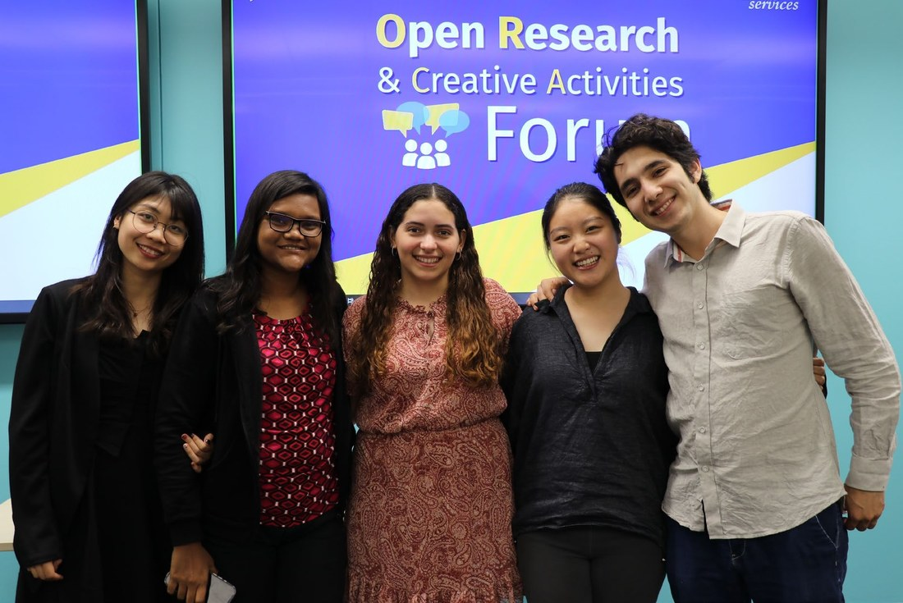
Comments & Questions
THANK YOU
Bring a question or idea
See what your research can achieve
ORCA Forum, Orbach Science Library
Ray Uzwyshyn, Ph.D., MBA, MLIS
Acting AUL for Research & Technology ·
Director of Research Services, UCR
raymondu@ucr.edu,, rayuzwyshyn.net
Notes:
Suggested pacing: 4 min. Open the floor. Ask students to name one research question, one technical obstacle and one output they want to create — then route them to the right specialist.

Slide 50
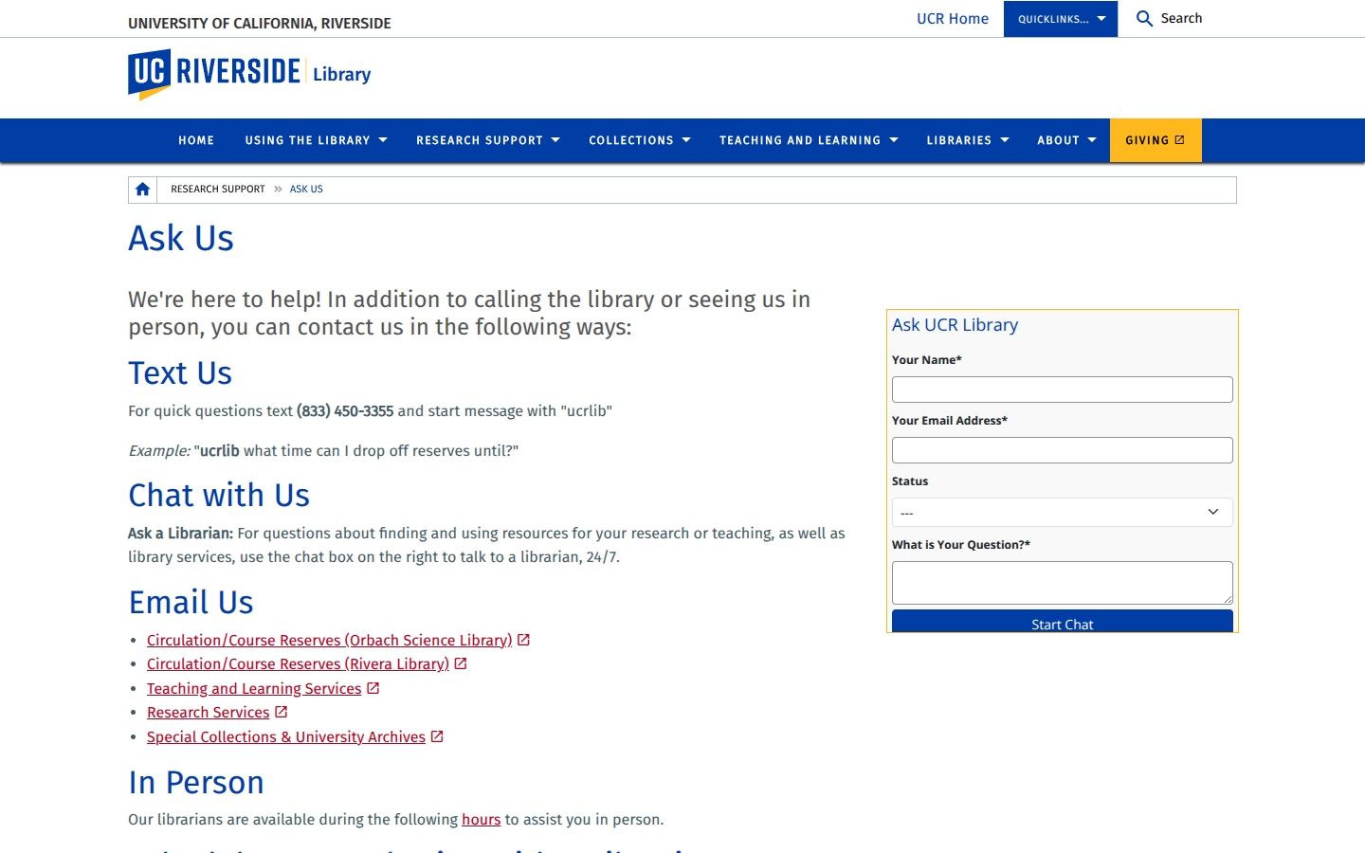



01 · FIND
Ask Us — Any Time, Any Channel
24/7 chat
Ask a Librarian chat on every library page
Text
(833) 450-3355 — start your message with “ucrlib”
Ask Us page
In person
Library Support Desks at Orbach and Rivera
Consultation
Request form — reply by the end of the next business day
Consultation form
library.ucr.edu/research-support/ask-a-librarian
Research & Technology Services
13
Notes:
Suggested pacing: 0.85 min. Chat 24/7; text (833) 450-3355 with "ucrlib"; desks at Orbach and Rivera; the consultation form matches you with a librarian, in person or Zoom.

Slide 51
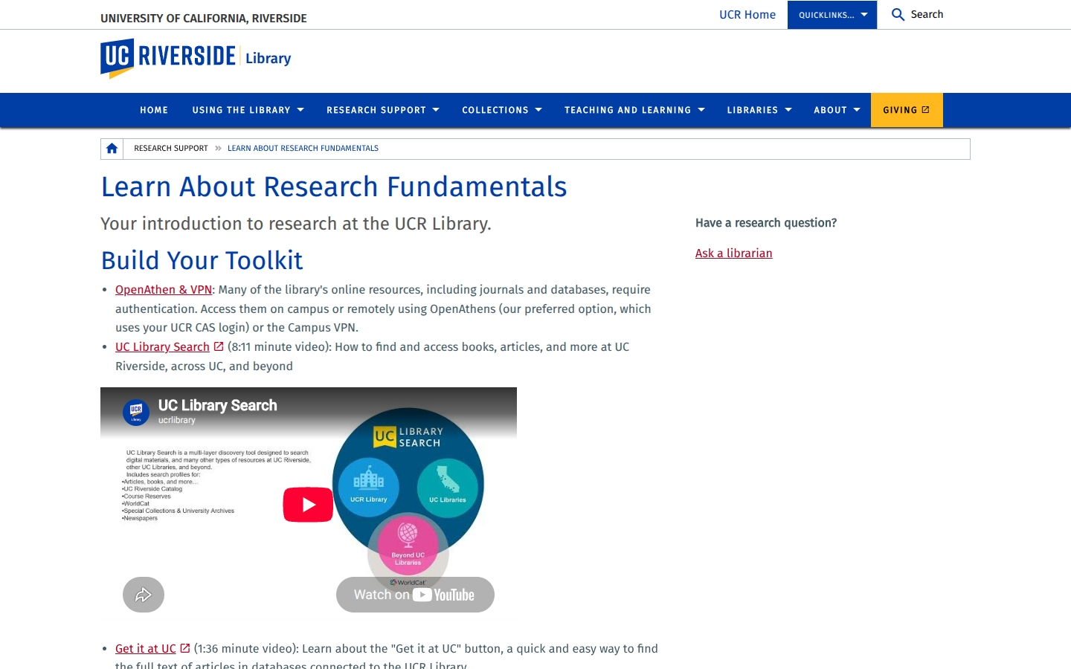

01 · FIND
Research Fundamentals and Poster Printing
Learn About Research Fundamentals
Research Poster Printing
Build your toolkit: OpenAthens & VPN, UC Library Search and Get It at UC videos, citation and literature-review help.
Walk-in Mon–Fri 9:00 am–4:45 pm (subject to staff availability); appointments through the Google Scheduling page.
Research Fundamentals page
guides.lib.ucr.edu/plotter
Research & Technology Services
11
Notes:
Suggested pacing: 0.6 min. Fundamentals is where citation management lives. Poster guide has sizes and prices. [Screenshots of the live pages, September 2026.]

Slide 52
TODAY
Roadmap for the Next 45 Minutes
“Research and Technology help at every stage — from the first search to the final digital publication online, policy brief or dataset.”
01
Find
Search, databases, evidence beyond articles, Ask Us, grad spaces
02
Consult
One-on-one expertise in data, AI, GIS, publishing and media
03
Research in Action
CISL autonomous-vehicle data, COVID border GIS and more
Everything here is free to UCR graduate students, and most of it is one email or one QR code away.
04
Learn
Fall 2026 workshops, meetups, certificates and events
05
Create
Makerspace, Robotics, 3DXP and the STAR Lab (local AI)
UCR Library · Research & Technology Services
2
Notes:
Five parts plus Q&A. Roughly: Find (8 min), Consult (8 min), Research in Action (7 min), Learn (10 min), Create (6 min), questions (5 min). Backup slides follow the Q&A slide if time allows or questions go there.

Slide 53

03 · RESEARCH IN ACTION
The Research Project and Document at the Center
AI and data
Making and robotics
Deeper inquiry, reproducible analysis and evidence
Prototypes, instruments and working demonstrations
Article · Thesis · Policy paper
Your research document
GIS
Digital scholarship
Spatial context, geographic comparison and maps
Research objects audiences can access and explore
Research & Technology Services
31
Notes:
Suggested pacing: 0.85 min. Adapted from the 2025 deck and UC Tech 2026. Invite students to picture one thesis, article or policy paper. Each service adds a method or an accompanying research output — possibilities, not mandatory stages.

Slide 54
04 · LEARN
Digital Scholarship Certificate — 2026–27 Curriculum
All sessions 11 a.m.–noon on Zoom. Choose any five (graduate track) and finish with a capstone.
FALL 2026
WINTER 2027
SPRING 2027
Sept. 28
Orientation
Jan. 13
Computational Methods in Text Analysis, Part 1
Mar. 31
Qualitative Data Analysis & Tools
Oct. 14
Building a Digital Research Portfolio Using No/Low-Code Tools
Feb. 3
Computational Methods in Text Analysis, Part 2
Apr. 21
Academic Publishing, Part 1: Academic Author Profiles
Nov. 4
Digital Scholarship Project Types & Best Practices
Feb. 17
Introduction to XR Design and 3D Experiences
May 12
Academic Publishing, Part 2: Publications
Nov. 18
Digital Storytelling: Building 2D Online Exhibits
Dec. 11
Deadline — interest form for the Experiential Learning Module
Text analysis and qualitative data analysis are especially useful for policy documents, public comments and interview data.
Research & Technology Services
43
Notes:
Suggested pacing: 0.85 min. From the 2026–27 certificate flyer. Winter/spring dates may shift — confirm with Jing Han.

Slide 55



SYNTHESIZE AND BRING IT TOGETHER
One Research Question Can Bring Several Services Together
Your question
AI & research data
GIS, making & Innovative media
Prototypes & Digital scholarship
Your output
A thesis chapter, article or policy paper
Inyoung Shin · Barbara Martinez Neda
Janet Reyes · Alvaro Alvarez · Brendon Wheeler
Jing Han: methods, publishing, communication,
Alvaro and Brendon
Dataset, map, prototype, video, publication, podcast or talk
Book Inyoung Shin
Book Janet Reyes
Book Jing Han
Start anywhere — a consultation, a workshop, a meetup or an event — and we route you to the right specialists.
Research & Technology Services
53
Notes:
Suggested pacing: 0.85 min. Recap through a student project rather than reporting lines. Ask: which service would help with your next research task?

Slide 56



02 · CONSULT
Deep Research with AI: A Working Method
01
02
03
04
A defined research question
An expanding evidence base
A verified synthesis
A documented process
Specify topic, scope, geography and the evidence you need.
Use AI to explore terminology, literature and connections.
Read primary sources; compare every claim with its evidence.
Keep sources, search decisions, uncertainties and AI disclosures.
Ask yourself: how would I verify a surprising AI-generated claim before it reaches a policy brief? Book an AI consultation
Research & Technology Services
24
Notes:
Suggested pacing: 0.85 min. A suggested workflow, not a claim about how COVID Borders or CooperScene were done. Draw on the deep-research workshops (Harnessing AI for Research, Deep Research AI Tools, 2025). Ask students how they would verify a surprising claim. Deep research is iterative search, reading and verification — not a guarantee of completeness.

