Slide 1
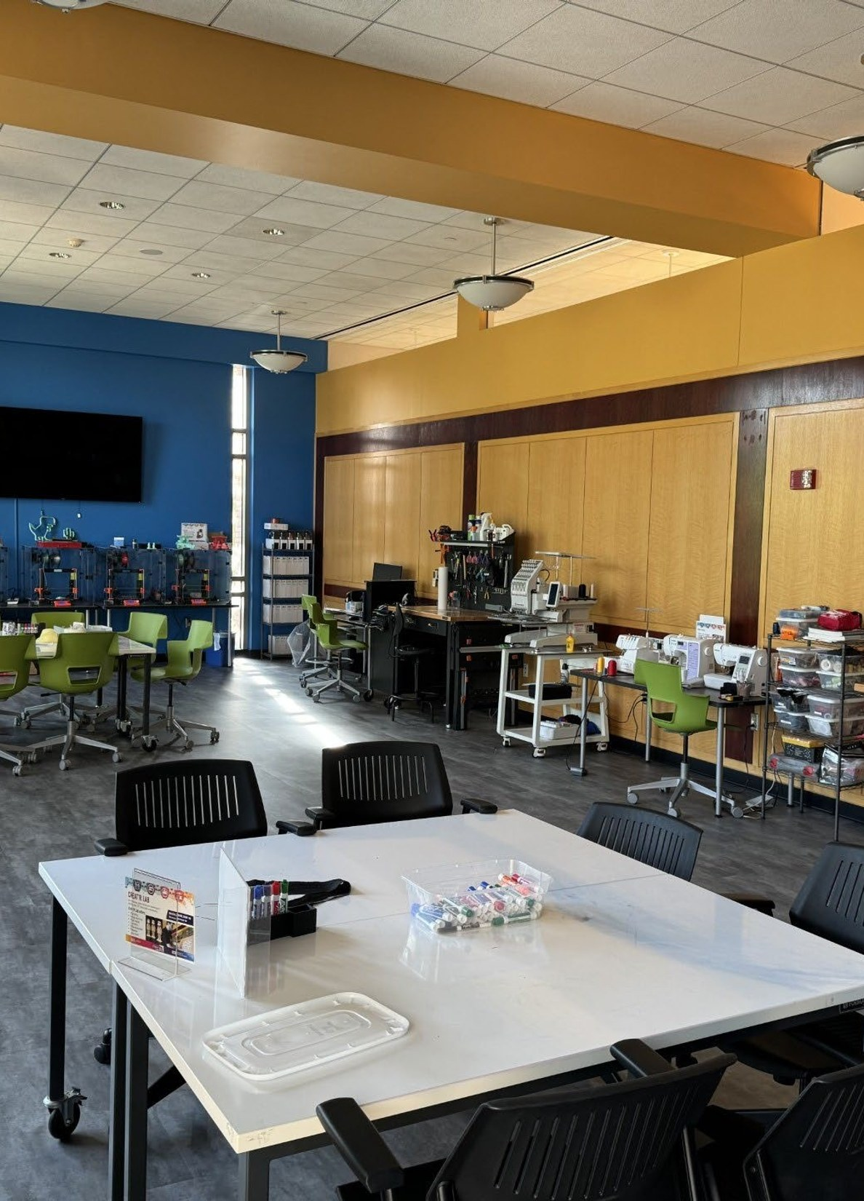

SPEAKS / FALL 2026
Library Research
Services
Expertise and technology for
science-to-policy research
Ray Uzwyshyn, Ph.D., MBA, MLIS
Acting AUL for Research and Technology
Director of Research Services
Notes:
Welcome the SPEAKS graduate cohort. Invite everyone to hold one current research question in mind. The session moves through evidence, specialist support, research collaborations, labs and fall opportunities. Suggested delivery: about 40 minutes plus discussion. The reference slides after questions hold the full schedules and contact list.
Sources:
SPEAKS_Library_Research_Services_2026ClaudeV2.pptx, slides 1
Library_Research_Services_Fall_2026OpenAIAstra.pptx, slides 1–3

Slide 2
RESEARCH AND ITS POSSIBILITIES
The research document at the center
AI and data
Article
Thesis
Policy paper
Analysis, evidence synthesis and reusable data
GIS
Spatial context and geographic comparisons
Making and robotics
Physical prototypes and working demonstrations
Digital scholarship
Interactive exhibits and accessible research outputs
02
Notes:
Ask students to think of a thesis, article or policy paper already underway. A map, dataset, prototype or digital exhibit can strengthen the work and become a research output in its own right. These services are options, not mandatory stages.
Sources:
Library_Research_Services_Fall_2026OpenAIAstra.pptx, slides 2
SPEAKS_Library_Research_Services_2026Claude.pptx, slides 3, 39

Slide 3

WORKING WITH THE LIBRARY
Four ways to work with us
Consultations
Workshops
Discuss a question, dataset or technical obstacle.
Develop a skill through guided practice.
Meetups
Events
Exchange methods and get feedback from peers.
Share your research and meet potential collaborators.
Longer research collaborations can develop from an initial conversation.
03
Notes:
A consultation can help scope a question and identify a next step. Workshops build a specific skill. Meetups and events help researchers exchange ideas. Some projects develop into longer collaborations after the team discusses scope and capacity.
Sources:
Library_Research_Services_Fall_2026OpenAIAstra.pptx, slides 3
SPEAKS_Library_Research_Services_2026Claude.pptx, slides 13
https://library.ucr.edu/research-support

Slide 4
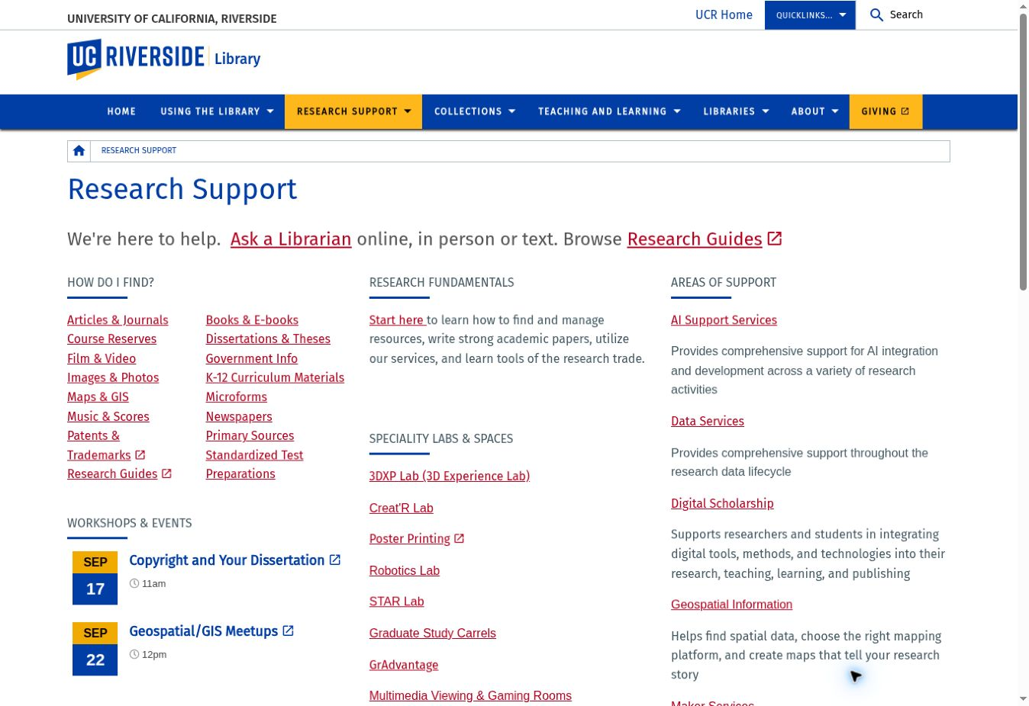
FIND
Research Support: the starting point
Find evidence
Search resources for your research question.
Find expertise
Choose a service or request a consultation.
Find a space
Explore specialty labs and equipment.
library.ucr.edu/research-support
04
Notes:
Use the Research Support hub to find resources by research task, locate a specialty lab or connect with a specialist. The image shows the actual service page supplied in the source presentation.
Sources:
Library_Research_Services_Fall_2026OpenAIAstra.pptx, slides 4
https://library.ucr.edu/research-support

Slide 5
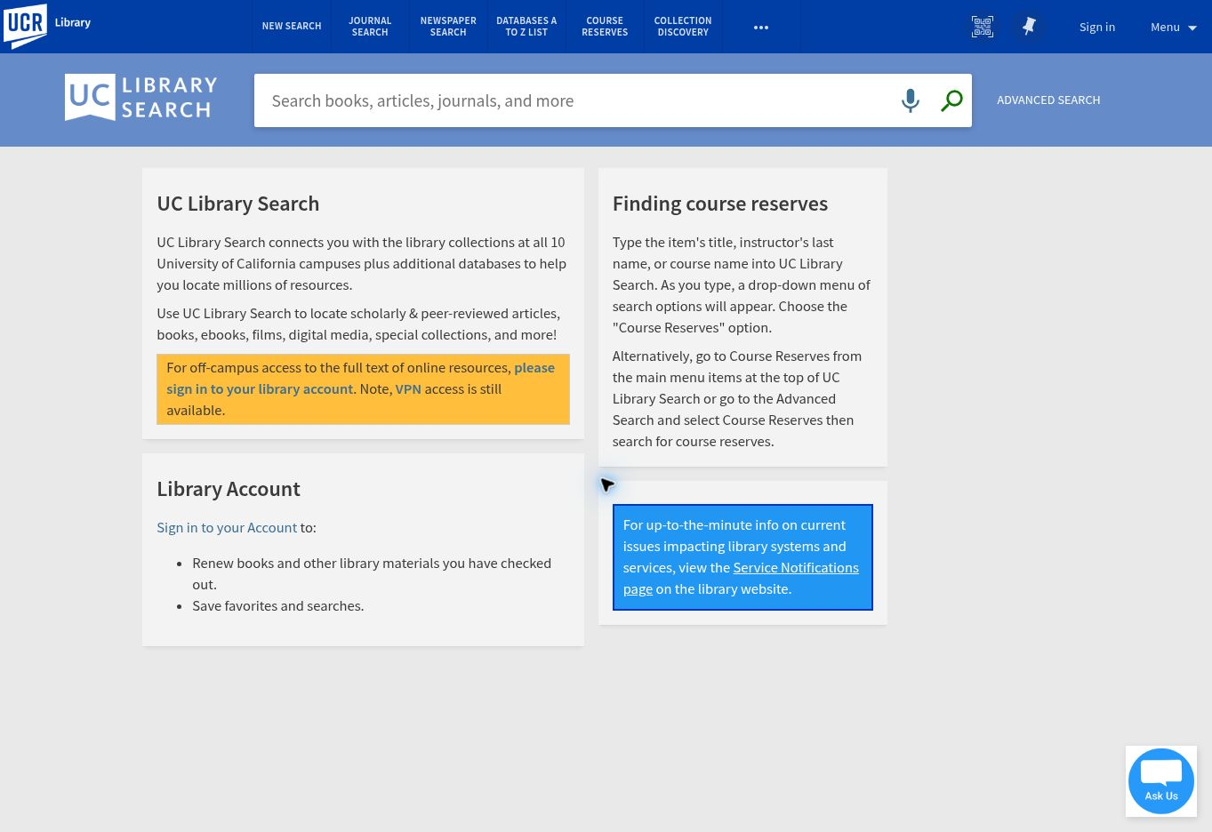
FIND
UC Library Search and subject databases
Broad discovery
Search books, articles, journals and media.
Disciplinary depth
Use A–Z Databases for subject-specific evidence.
Off-campus access
Sign in with OpenAthens through UC Library Search.
UC Library Search
A–Z Databases
Off-campus access
05
Notes:
Demonstrate a search such as zero-emission trucks and freight policy. Use UC Library Search for broad discovery, then consult disciplinary databases and citation trails. UCR currently recommends OpenAthens: sign in to the library account from UC Library Search. Cisco Secure AnyConnect remains an alternative for resources without OpenAthens access.
Sources:
Library_Research_Services_Fall_2026OpenAIAstra.pptx, slides 6–7
SPEAKS_Library_Research_Services_2026ClaudeV2.pptx, slides 3–6
https://search.library.ucr.edu/discovery/search?vid=01CDL_RIV_INST:UCR
https://guides.lib.ucr.edu/az/databases
https://library.ucr.edu/using-the-library/technology-equipment/connect-from-off-campus

Slide 6
FIND
Evidence beyond journal articles
Government information
Patents
Agency reports, statistics and policy documents
Prior art and the development of technologies
Dissertations and theses
Maps and imagery
Detailed methods and extended literature reviews
Spatial evidence and changes in land use
Newspapers
Primary sources
Public debate and historical context
Archives and the Water Resources Collections
Research resources and subject guides
06
Notes:
Policy questions often require evidence across source types. Government reports can establish regulatory context. Patents help with prior art. Dissertations expose detailed methods. Historical imagery and archives help explain how places changed. The selected sources depend on the research question.
Sources:
SPEAKS_Library_Research_Services_2026Claude.pptx, slides 8
SPEAKS_Library_Research_Services_2026ClaudeV2.pptx, slides 7
https://library.ucr.edu/research-support

Slide 7
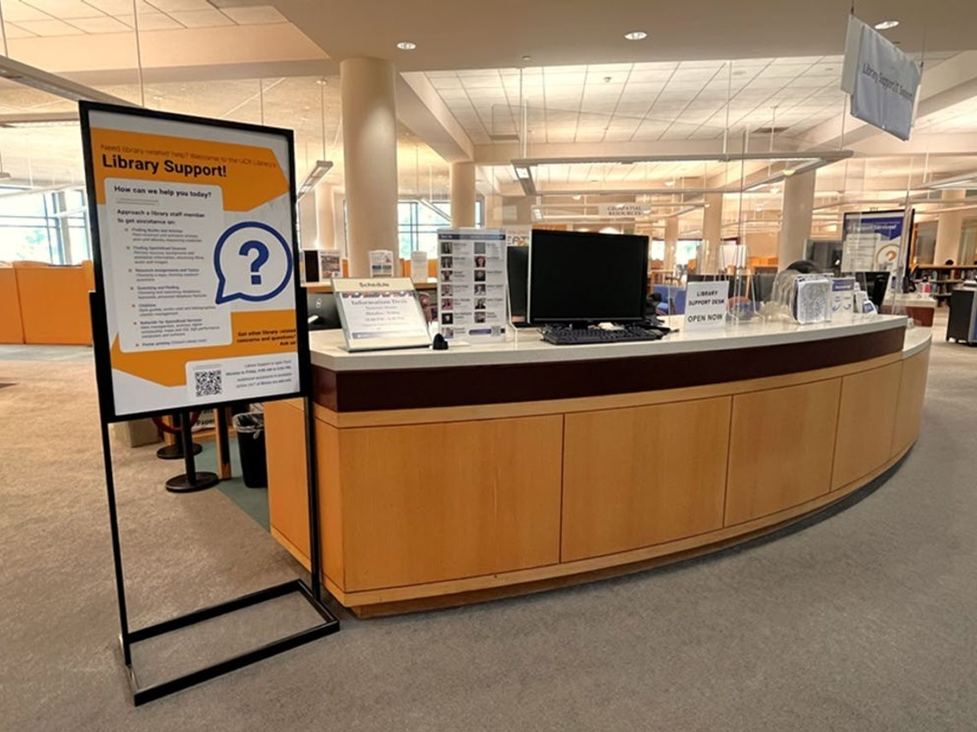
FIND
Access, citations and individual help
Interlibrary loan
Request books and articles beyond immediate access.
Reference management
Organize sources and build citations as you research.
Research consultations
Get help with search strategy or a difficult research question.
Ask Us
Interlibrary loan
Managing references
07
Notes:
When students cannot get a source, point them to interlibrary loan. Citation managers help organize material while a project develops. The Ask Us page offers chat, text, support desks and a consultation request. A student does not need to know the specialist in advance.
Sources:
Library_Research_Services_Fall_2026OpenAIAstra.pptx, slides 8
SPEAKS_Library_Research_Services_2026ClaudeV2.pptx, slides 8–12
https://library.ucr.edu/using-the-library/interlibrary-loan
https://guides.lib.ucr.edu/referencemanagement
https://library.ucr.edu/research-support/ask-a-librarian

Slide 8
CONSULT
Research expertise you can reach directly
Research need | Specialist
Data management, Python and machine learning | Barbara Martinez Neda
AI workflows, tools and custom systems | Inyoung Shin
GIS, imagery and spatial analysis | Janet Reyes
Digital methods and scholarly communication | Jing Han
3D, VR/XR and media production | Alvaro Alvarez
Making, fabrication and robotics | Brendon Wheeler
Not sure whom to contact? Request a consultation
08
Notes:
Introduce specialists through the work students need to do. The names link directly to booking or contact destinations. Subject and teaching librarians across the Library also take consultations. The general request form helps match a student with the appropriate person.
Sources:
SPEAKS_Library_Research_Services_2026Claude.pptx, slides 14
SPEAKS_Library_Research_Services_2026ClaudeV2.pptx, slides 14–18
https://library.ucr.edu/research-support/data-services
https://library.ucr.edu/research-support/geospatial-mapping
https://library.ucr.edu/research-support/digital-scholarship

Slide 9
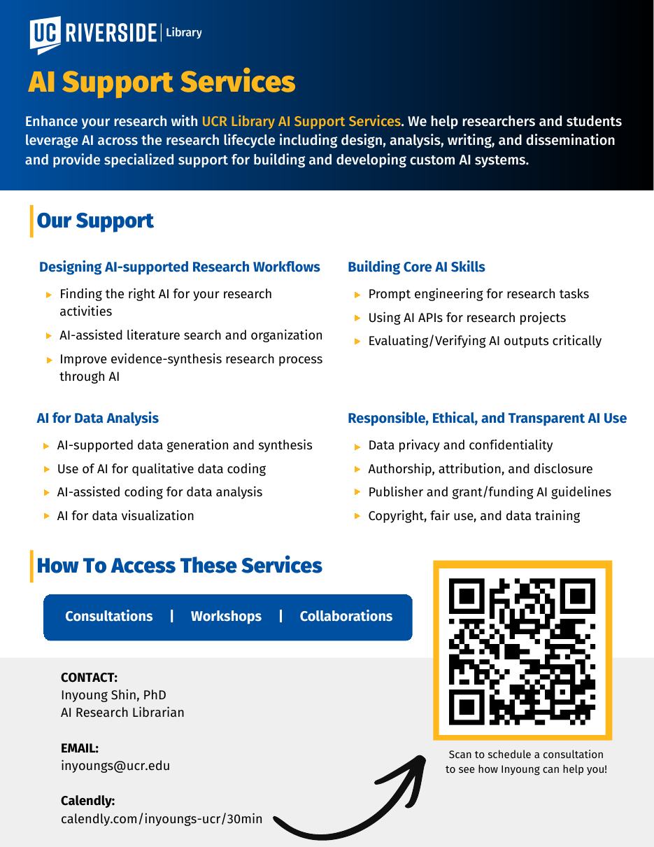
CONSULT
AI support across the research process
Research workflows
Literature discovery, organization and evidence synthesis
Analysis and development
Coding assistance, qualitative analysis and AI APIs
Critical evaluation
Source verification, privacy and transparent reporting
Book an AI consultation with Inyoung Shin
09
Notes:
Inyoung Shin helps researchers choose and evaluate AI approaches, work with AI APIs and develop research workflows. A consultation can also address coding, qualitative analysis and responsible use. Encourage students to bring a specific research task and explain the data involved.
Sources:
Library_Research_Services_Fall_2026OpenAIAstra.pptx, slides 9–10
SPEAKS_Library_Research_Services_2026ClaudeV2.pptx, slides 21–22
https://library.ucr.edu/research-support/ai-support-services

Slide 10
CONSULT
Deep research with AI
1 Define the question
2 Explore the evidence
Set the scope, geography and evidence needed.
Use AI to identify terminology and possible connections.
3 Verify the synthesis
4 Document the process
Read primary sources and compare claims with their evidence.
Retain sources, decisions, limitations and relevant disclosures.
A useful AI response still needs an accountable research process.
10
Notes:
This is a suggested research workflow. AI can help expand terminology and connections, but the researcher still needs to inspect the underlying sources, track decisions and identify uncertainty. Ask: what would you do if an AI-generated citation could not be located?
Sources:
Library_Research_Services_Fall_2026OpenAIAstra.pptx, slides 11
SPEAKS_Library_Research_Services_2026ClaudeV2.pptx, slides 21

Slide 11
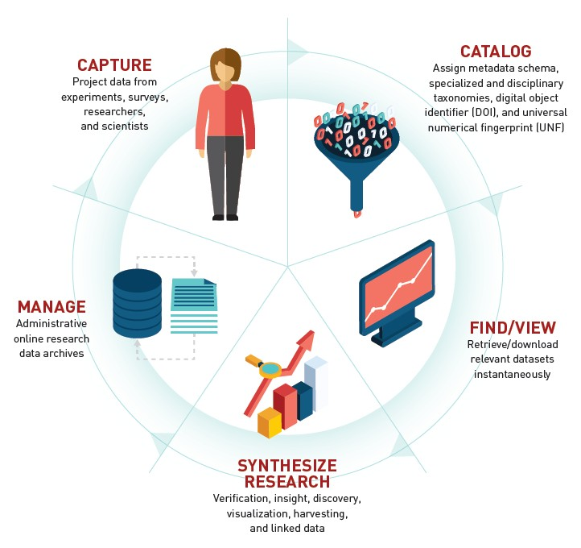
CONSULT
Research data across the lifecycle
Plan
Data management plans and project requirements
Organize
File structures, metadata and documentation
Analyze
Data cleaning, analysis and visualization
Share
Reusable datasets and appropriate repositories
Data consultation with Barbara Martinez Neda
11
Notes:
Barbara Martinez Neda supports researchers before, during and after analysis. The service includes data management planning, organization, cleaning and preparation for sharing. Begin early when data structure, documentation or a grant proposal will shape the rest of the project.
Sources:
Library_Research_Services_Fall_2026OpenAIAstra.pptx, slides 12
SPEAKS_Library_Research_Services_2026ClaudeV2.pptx, slides 19–20
https://library.ucr.edu/research-support/data-services

Slide 12
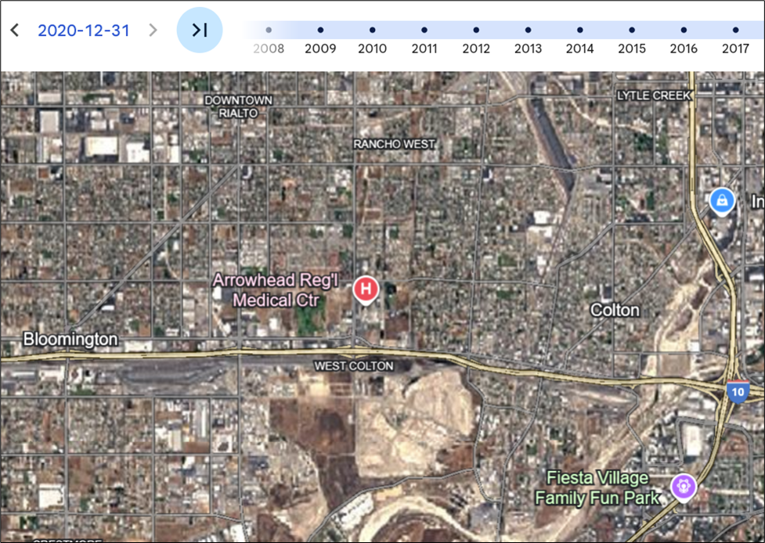
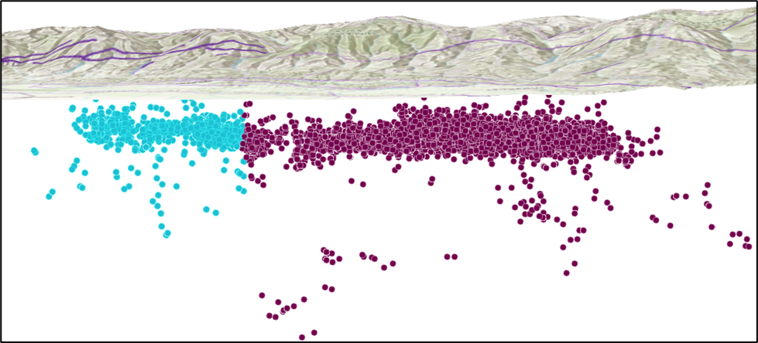
CONSULT
GIS adds spatial evidence
Patterns in three dimensions
Changes across time
Location can reveal relationships hidden in a table.
Historical imagery adds context to current conditions.
Geospatial Information Services
12
Notes:
Show the 3D earthquake view and historical aerial imagery as examples of what geographic tools reveal. For transportation and environmental policy, students might investigate infrastructure, land-use change or the distribution of exposure. The Library provides workshops, consultation and access to GIS software in the STAR Lab.
Sources:
Library_Research_Services_Fall_2026OpenAIAstra.pptx, slides 17
SPEAKS_Library_Research_Services_2026ClaudeV2.pptx, slides 23
https://library.ucr.edu/research-support/geospatial-mapping

Slide 13
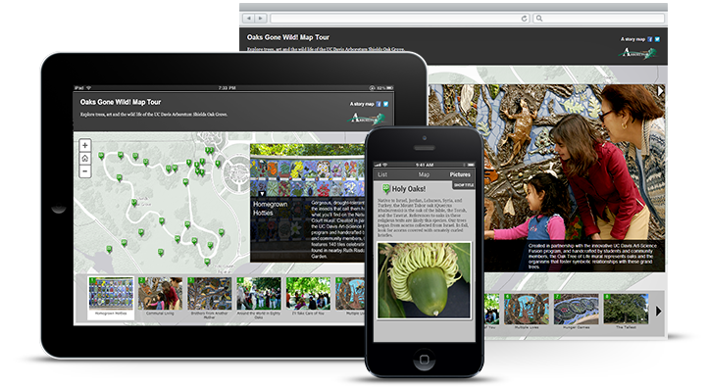
CONSULT
Digital scholarship extends the publication
Digital methods
Text analysis, visualization and digital collections
Research presentation
Portfolios, exhibits and interactive narratives
Project development
Tools, scope, preservation and research communication
Digital scholarship consultation with Jing Han
13
Notes:
Jing Han supports digital methods, project scoping and research communication. Policy documents, public comments or interview transcripts can support computational and qualitative analysis. StoryMaps and exhibits are possible outputs, depending on the material and audience.
Sources:
Library_Research_Services_Fall_2026OpenAIAstra.pptx, slides 23–24
SPEAKS_Library_Research_Services_2026ClaudeV2.pptx, slides 24, 26
https://library.ucr.edu/research-support/digital-scholarship

Slide 14
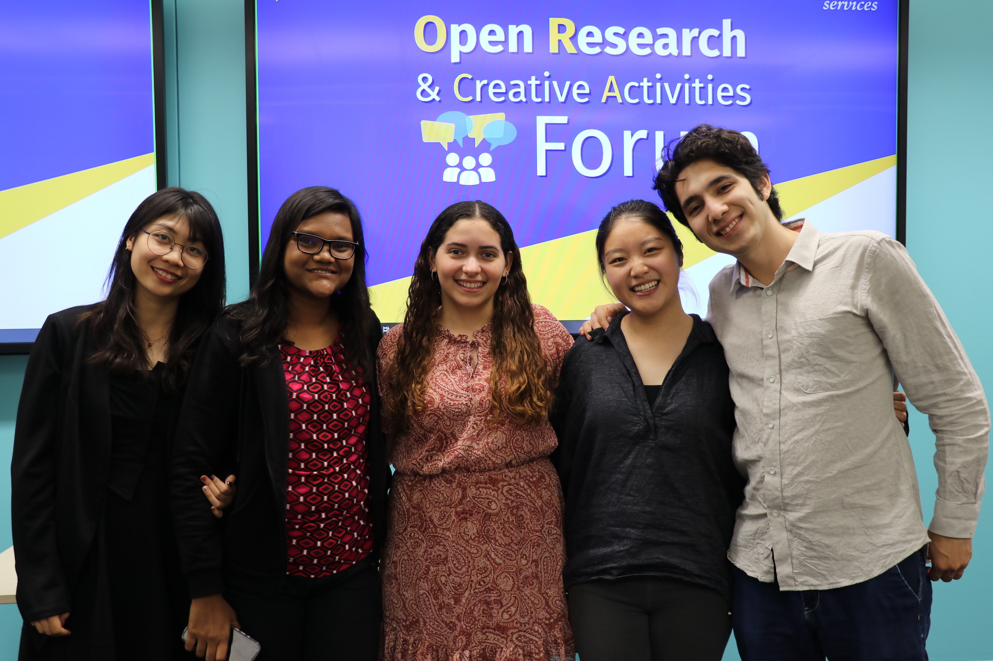
CONSULT
Publishing and public research
Open scholarship
Author rights, repositories and publishing support
ORCA Forum
A venue for student projects and open research
The Reference Desk
Conversations about researchers’ projects and methods
Scholarly Communication
ORCA and Digital Scholarship
Podcast
14
Notes:
Scholarly Communication Services can help with open access, author rights and publishing questions. ORCA showcases student work across disciplines. The Reference Desk podcast features conversations with UCR researchers. A research output needs a suitable audience and a route for long-term access.
Sources:
Library_Research_Services_Fall_2026OpenAIAstra.pptx, slides 30
SPEAKS_Library_Research_Services_2026ClaudeV2.pptx, slides 24–27
https://library.ucr.edu/research-support/scholarly-communication-services
https://library.ucr.edu/research-support/digital-scholarship

Slide 15
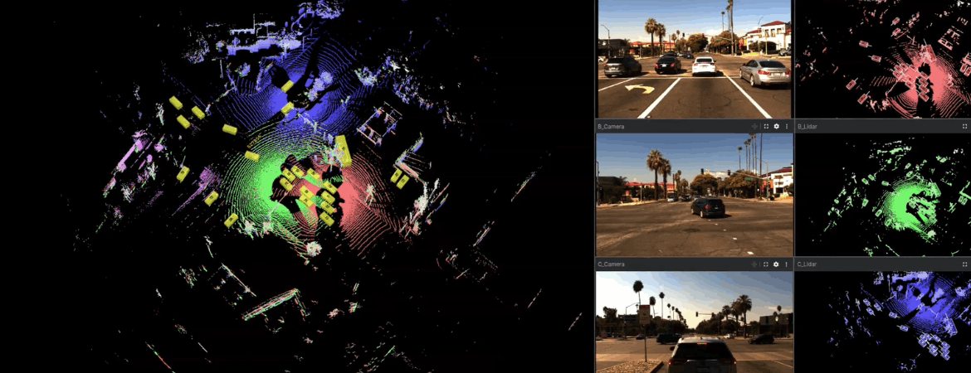
RESEARCH IN ACTION
CooperScene: autonomous-vehicle data
An interactive viewer makes complex sensor data explorable before download.
Explore the CooperScene viewer
15
Notes:
CISL, led by Hang Qiu, developed CooperScene. The Library built a data-processing pipeline and browser-based viewer. Researchers can explore the sensor data and play back driving sessions before downloading large files. This makes the dataset easier to inspect and use.
Sources:
Library_Research_Services_Fall_2026OpenAIAstra.pptx, slides 15–16
SPEAKS_Library_Research_Services_2026Claude.pptx, slides 20
https://library.ucr.edu/news/2026/09/09/ucr-library-research-and-technology-division-helps-cisl-lab-bring-autonomous

Slide 16
RESEARCH IN ACTION
The collaboration behind CooperScene
Research team
~60,000
Hang Qiu and the Collaborative Intelligence Systems Lab
synchronized LiDAR frames
Research Services
Barbara Martinez Neda, Research Data Scientist
344,000+
Cyberinfrastructure
3D bounding-box labels
Dan Szilagyi, Joel Valdez and Scott Metoyer
Read the Library collaboration story
16
Notes:
Credit both the research lab and the Library team. The example shows how a data problem can benefit from research consultation and software development working together. Dataset scale provides context, while the user-facing viewer is the Library’s visible contribution.
Sources:
Library_Research_Services_Fall_2026OpenAIAstra.pptx, slides 16
SPEAKS_Library_Research_Services_2026Claude.pptx, slides 20
https://library.ucr.edu/news/2026/09/09/ucr-library-research-and-technology-division-helps-cisl-lab-bring-autonomous

Slide 17
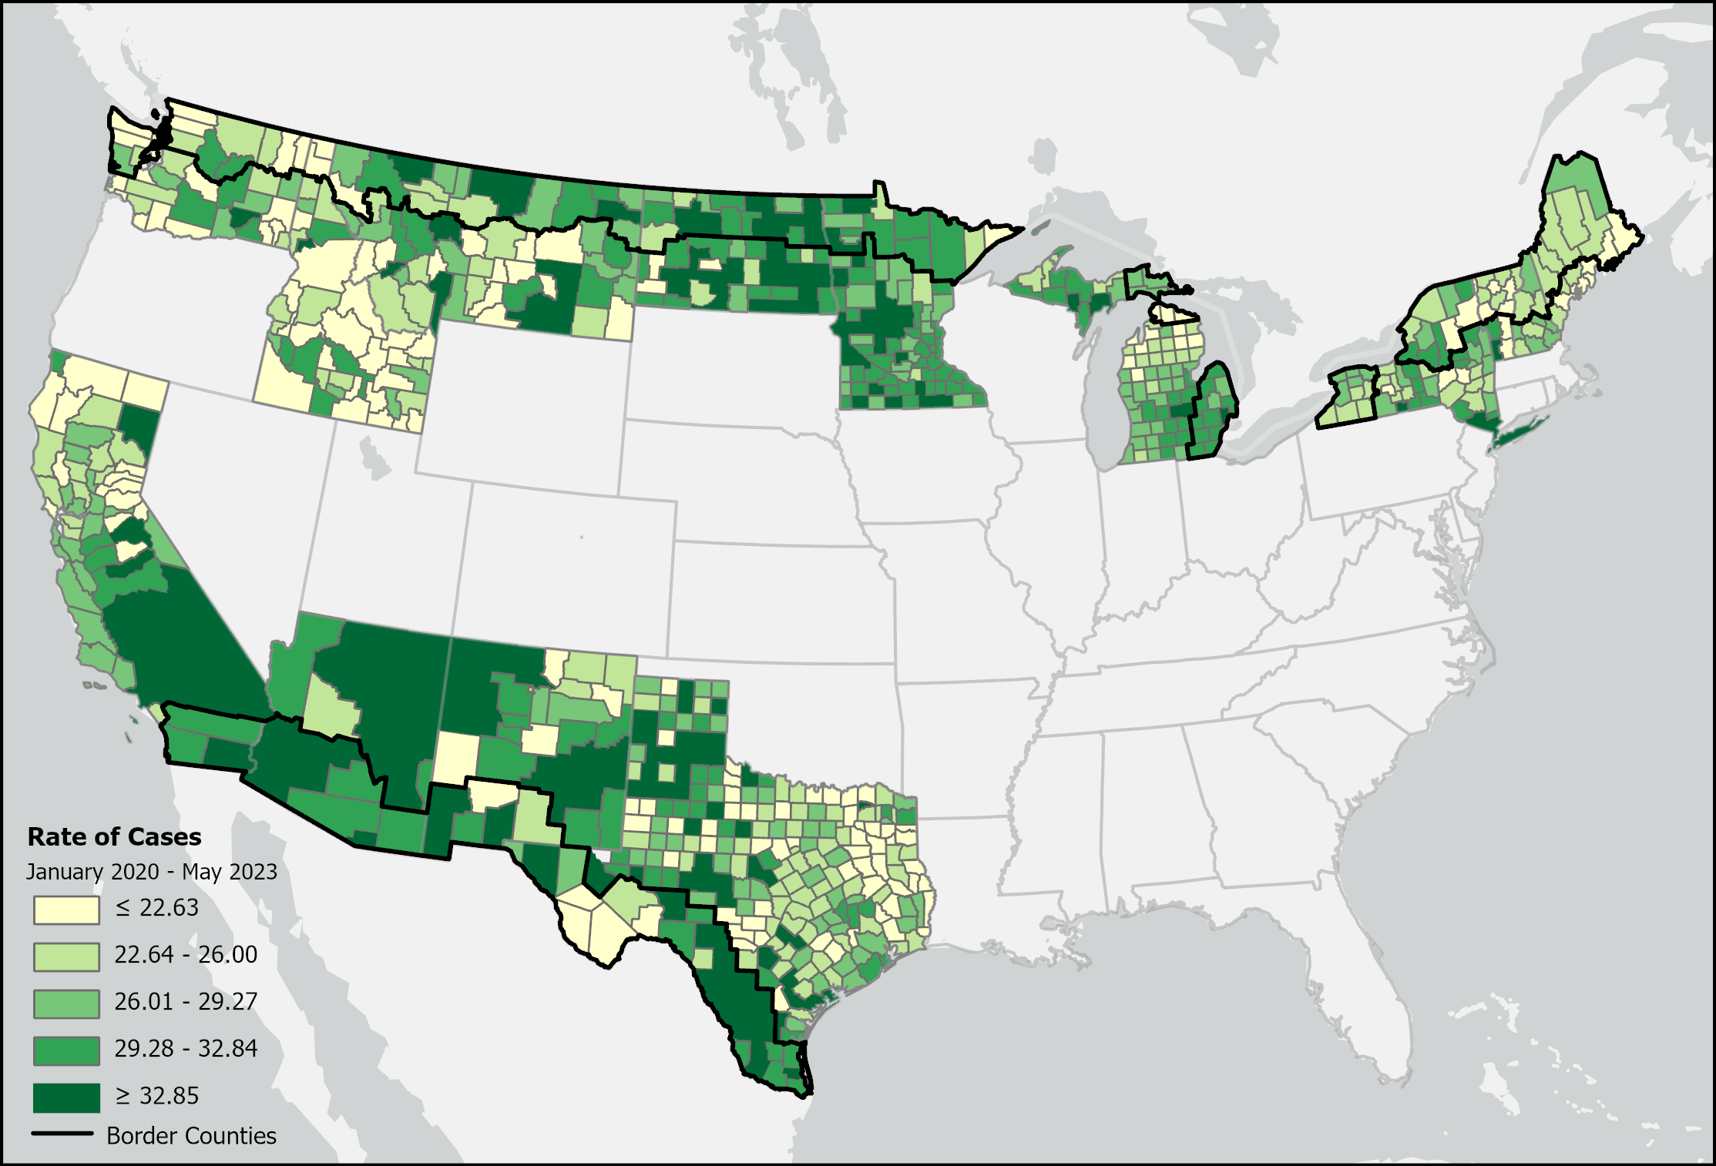
RESEARCH IN ACTION
COVID Borders: geographic context
Research question
How did outcomes vary across border regions?
Library contribution
Data preparation and geospatial mapping
Research value
Context for public health and preparedness
Project overview
17
Notes:
The School of Medicine project asked whether proximity to international land borders correlated with different COVID-19 outcomes. The displayed map shows case rates in border states for January 2020 through May 2023. Barbara Martinez Neda and Janet Reyes contributed data processing and mapping. This is a geographic association question, not a causal claim.
Sources:
Library_Research_Services_Fall_2026OpenAIAstra.pptx, slides 13
https://digitalinitiatives.ucr.edu/projects/covid-borders

Slide 18
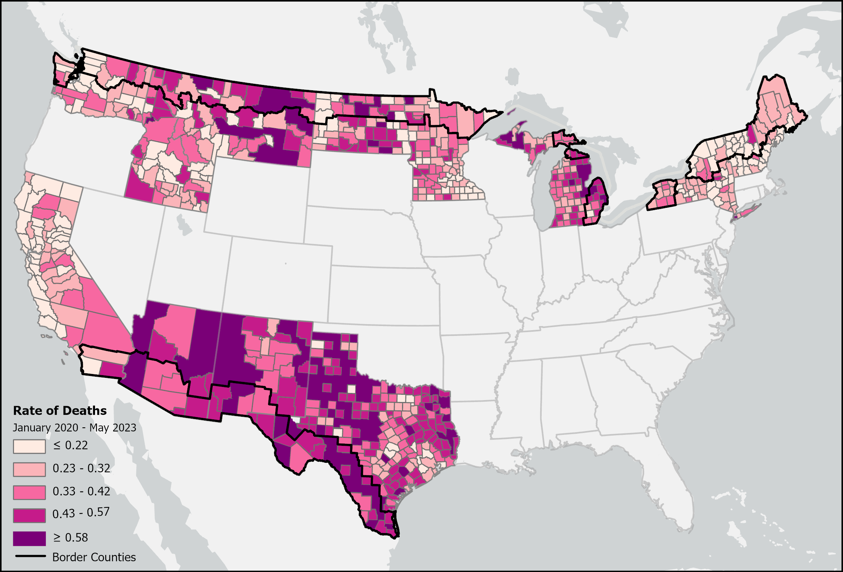
RESEARCH IN ACTION
The work behind the visualization
Prepare the data
Aggregate weekly records and validate measures.
Define proximity
Classify counties within 100 km of a land border.
Map the measures
Compare cases, deaths and case fatality rates.
Project methods and partners
18
Notes:
The team aggregated weekly records into quarterly totals and validated calculations. Counties within 100 km of an international land border defined proximity. ArcGIS Pro joined measures to geographic features. This image shows mortality rates. Its legend differs from the previous case-rate map, so the colors are not directly comparable.
Sources:
Library_Research_Services_Fall_2026OpenAIAstra.pptx, slides 14
https://digitalinitiatives.ucr.edu/projects/covid-borders

Slide 19
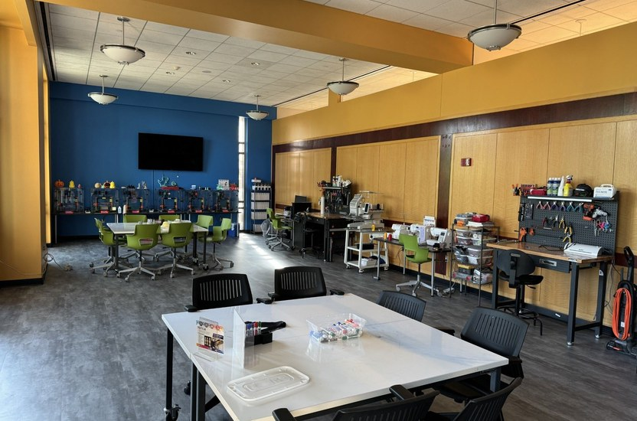
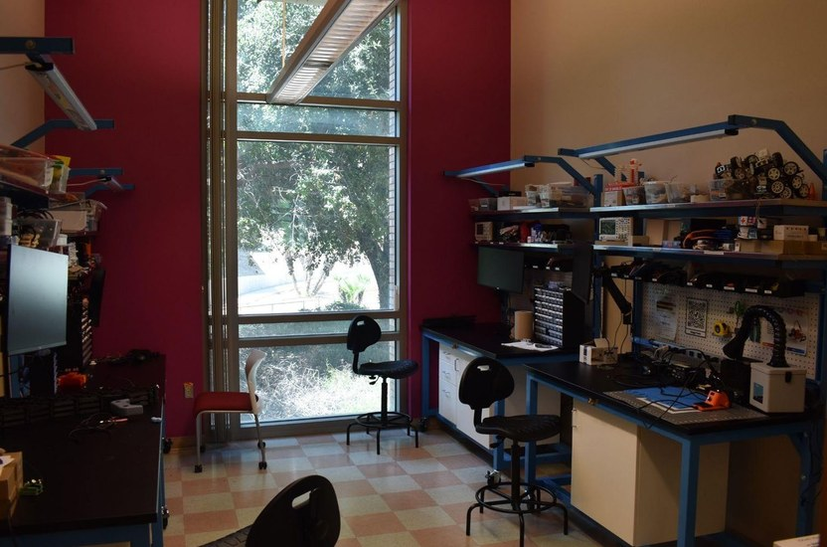
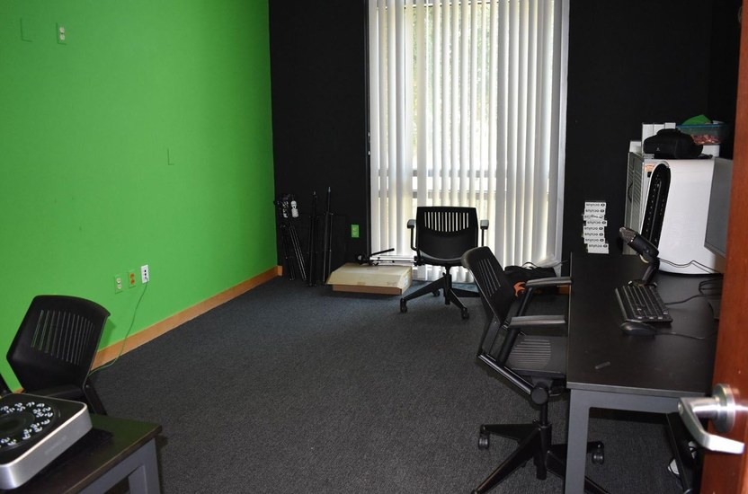
CREATE
Making, robotics and immersive media
Makerspace
Robotics Lab
3DXP Lab
Room 140
Room 146
Room 145
3D printing, laser engraving and fabrication
Sensors, microcontrollers and physical computing
VR/XR, scanning and media production
Fall access: check the reflooring service notice before visiting
19
Notes:
These are complementary spaces in Orbach Science Library. Maker Services supports fabrication and prototyping. Robotics connects code to sensors and physical devices. The 3DXP Lab supports immersive and media work. The current reflooring notice lists Robotics, Multimedia and STAR Lab closures through September 23, so direct students to the notice before a visit.
Sources:
Library_Research_Services_Fall_2026OpenAIAstra.pptx, slides 18–21
SPEAKS_Library_Research_Services_2026Claude.pptx, slides 33
SPEAKS_Library_Research_Services_2026ClaudeV2.pptx, slides 47
https://library.ucr.edu/news/2026/08/17/orbach-library-first-floor-reflooring-project-service-impacts

Slide 20
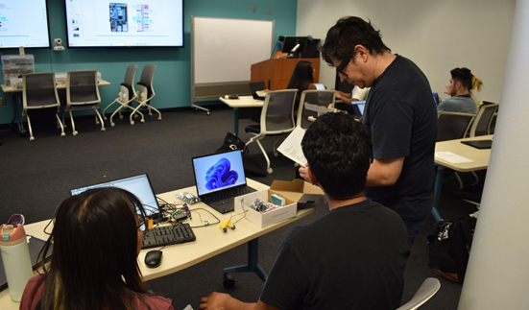
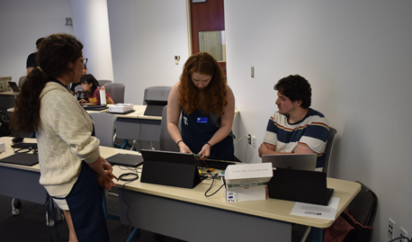
CREATE
Robotics connects code to a working system
Hardware and sensing
Software and AI
Microcontrollers, sensors and fabricated parts
Code and models that control a physical device
Robotics Lab
20
Notes:
The photographs show a robotics learning environment from the supplied decks. Students connect hardware, coding and machine-learning methods. An engineer might begin with a sensor, chassis or small control problem. Possible uses such as sensor housings or test rigs are examples for discussion, not claims about completed projects.
Sources:
Library_Research_Services_Fall_2026OpenAIAstra.pptx, slides 19–20
SPEAKS_Library_Research_Services_2026Claude.pptx, slides 40
https://library.ucr.edu/research-support/making-and-innovation/robotics-lab

Slide 21
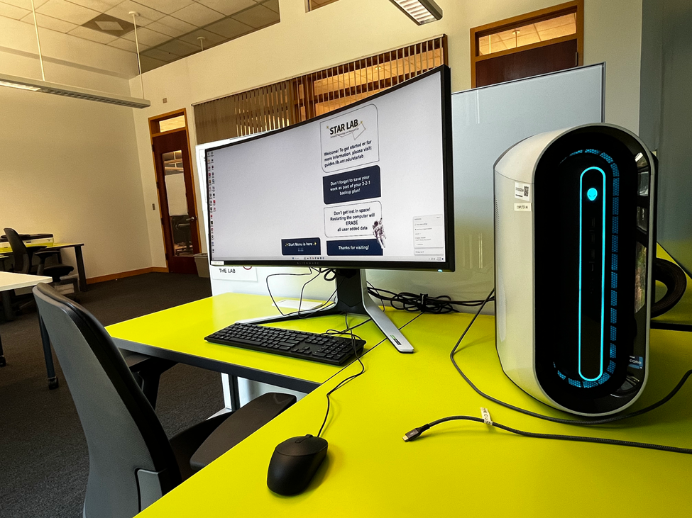
CREATE
STAR Lab: software and research computing
Specialized software
GIS, NVivo, Adobe Creative Cloud, CAD and data tools
Research equipment
High-performance Windows workstations and a photo scanner
Access
Orbach Room 147. Reserve through the STAR Lab guide.
STAR Lab software and reservations
21
Notes:
The STAR Lab combines specialized software and high-performance workstations in Orbach Room 147. The source guide describes online reservations and key pickup at Circulation. Lab access is affected by reflooring through September 23. The workstation photo documents the earlier installation.
Sources:
Library_Research_Services_Fall_2026OpenAIAstra.pptx, slides 22
SPEAKS_Library_Research_Services_2026ClaudeV2.pptx, slides 48
https://guides.lib.ucr.edu/starlab
https://library.ucr.edu/news/2026/08/17/orbach-library-first-floor-reflooring-project-service-impacts

Slide 22
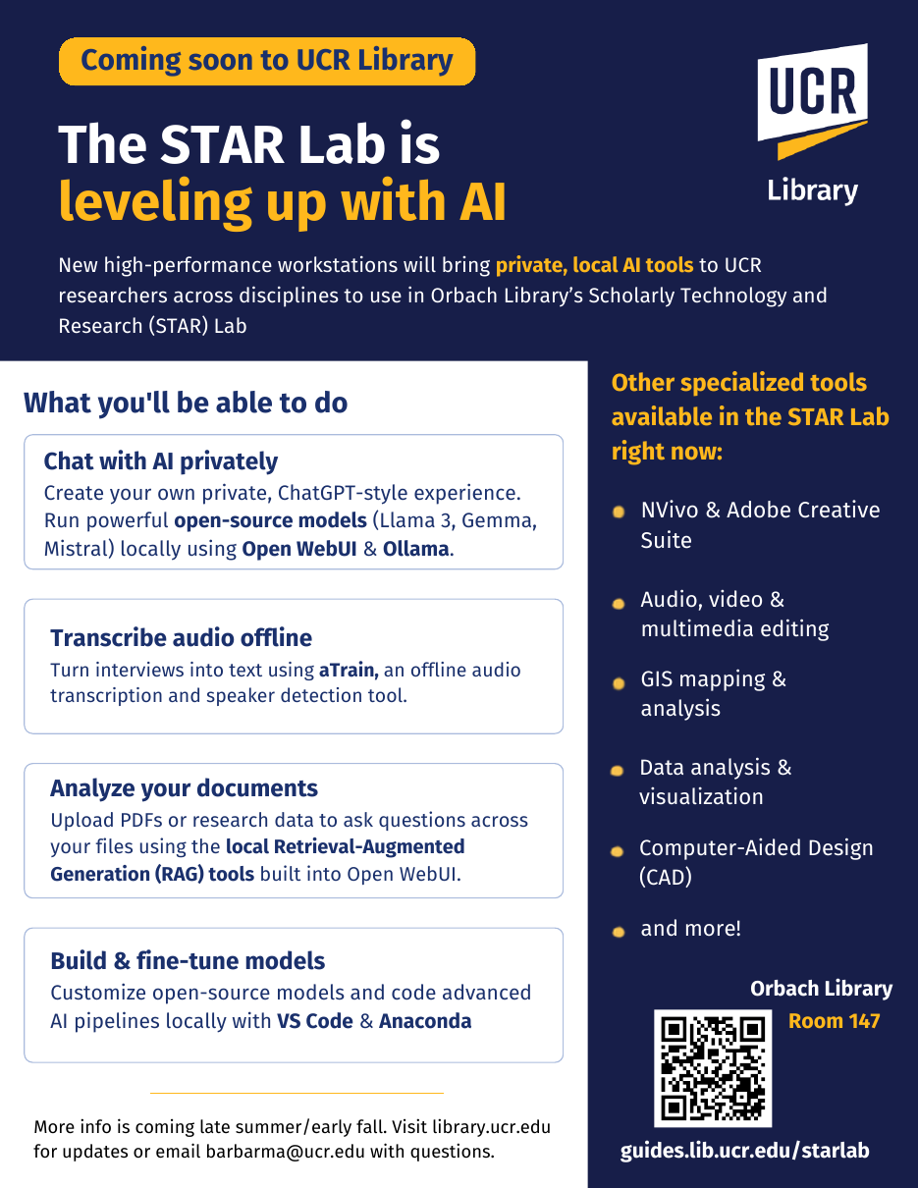
CREATE
Local AI capabilities planned for fall
Local chat and document exploration
Open WebUI and Ollama with open-weight models
Offline transcription
aTrain for audio and speaker detection
Development and reproducibility
Custom workflows with documented model versions
Availability and sensitive-data use depend on configuration and project requirements. Check with Library staff.
22
Notes:
The fall flyer describes Open WebUI and Ollama, aTrain, local document retrieval, and development tools such as VS Code and Anaconda. Local execution can reduce external data transfer and support version control. It does not by itself authorize restricted data use. Staff should confirm availability, configuration and project-specific requirements before researchers use sensitive data.
Sources:
Library_Research_Services_Fall_2026OpenAIAstra.pptx, slides 22
SPEAKS_Library_Research_Services_2026ClaudeV2.pptx, slides 49–50
https://guides.lib.ucr.edu/starlab

Slide 23
LEARN
A path toward deeper research
01
02
03
Explore
Experiment
Collaborate
Workshops and meetups introduce a method.
Lab work and consultations help test an approach.
Research teams and specialists develop a scoped project.
A question worth pursuing
A small, workable prototype
A shareable research output
23
Notes:
Use the progression as an invitation. Some students begin with a workshop, while others come with an existing technical project. Consultations and experimentation can help define a workable collaboration. The path is flexible and depends on the question, skills, scope and available support.
Sources:
SPEAKS_Library_Research_Services_2026Claude.pptx, slides 22
SPEAKS_Library_Research_Services_2026ClaudeV2.pptx, slides 29, 32

Slide 24
LEARN
Fall 2026: selected starting points
Date | Session | Research connection
Sep 24 | Introduction to Agentic AI | AI capabilities and personas
Oct 7 | Python for Beginners Using AI | Coding and data analysis
Oct 14 | Digital Research Portfolio | Presenting your work online
Oct 21 | Data Cleaning with Python, Pandas and AI | Preparing research datasets
Nov 4 | Introduction to Machine Learning | Exploring analytical methods
Nov 18 | The AI 3D Revolution | Creating 3D research assets
Registration, times and the full calendar
24
Notes:
Choose sessions that connect with students’ current work. The full schedules follow the discussion slides. Titles are shortened here. All times are Pacific. Students should use the current calendar for registration and changes.
Sources:
Library_Research_Services_Fall_2026OpenAIAstra.pptx, slides 27–29
SPEAKS_Library_Research_Services_2026Claude.pptx, slides 27–29
https://library.ucr.edu/about/workshops-events

Slide 25
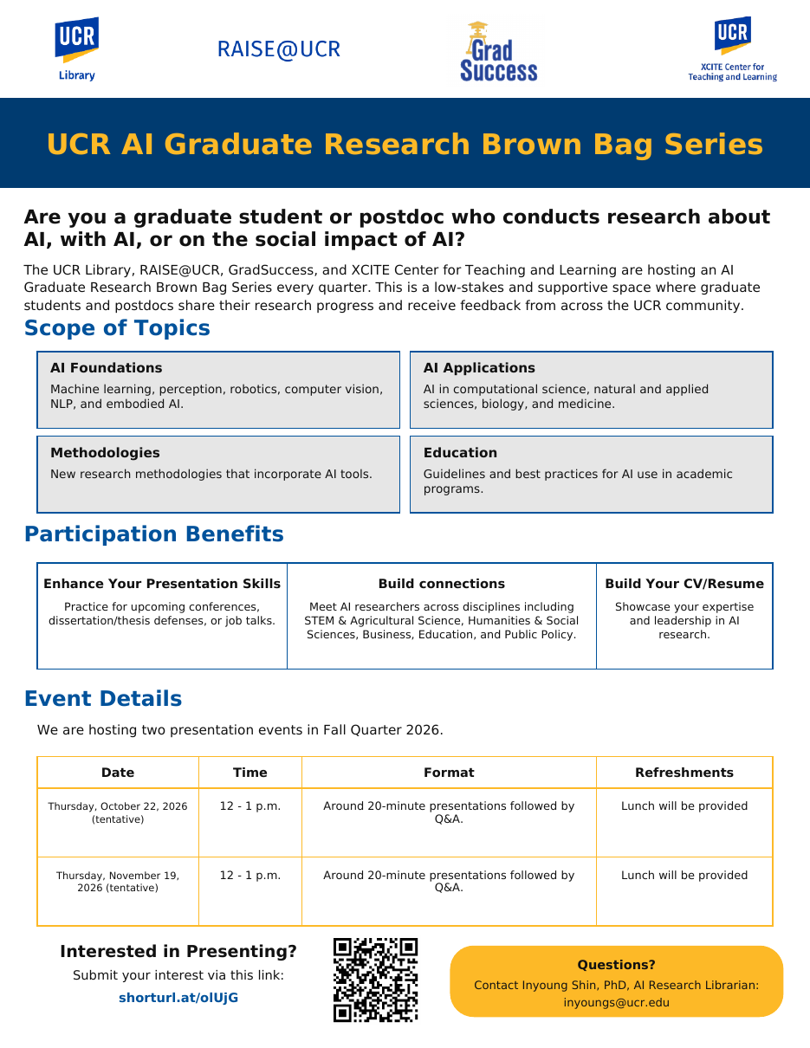
LEARN
AI Graduate Research Brown Bags
October 22 and November 19
Noon–1 p.m. Pacific
Research across disciplines
AI methods, applications and social impact
A setting for feedback
Short research talks, discussion and lunch
Present your work
25
Notes:
The series welcomes graduate students and postdocs doing research about AI, with AI or on AI’s social impact. The fall flyer names October 22 and November 19, noon to 1 pm. Talks run about 20 minutes followed by questions. Partners include UCR Library, RAISE@UCR, GradSuccess and XCITE.
Sources:
Library_Research_Services_Fall_2026OpenAIAstra.pptx, slides 26
SPEAKS_Library_Research_Services_2026ClaudeV2.pptx, slides 40
https://library.ucr.edu/about/workshops-events

Slide 26
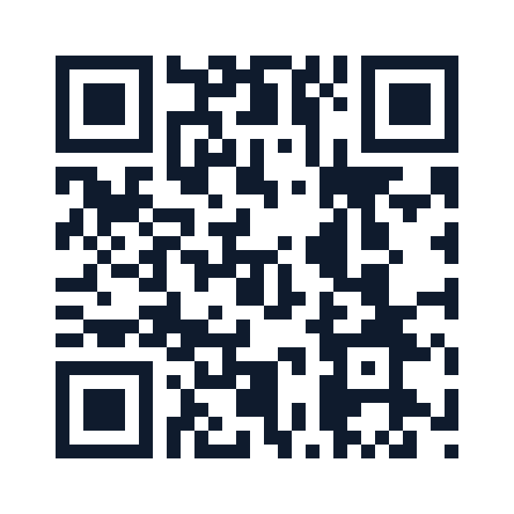
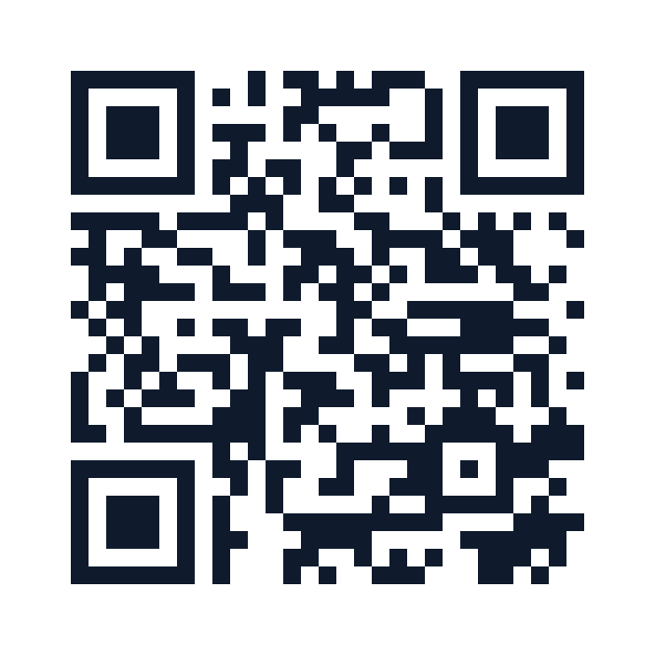
LEARN
Two credentials for graduate researchers
Digital Scholarship
Certificate
Graduate Research
Core Competencies Badge
At least five workshops
Applied project or experiential module
2026–27 sessions on Zoom
Asynchronous learning at your pace
Research foundations and applied work
Capstone and a digital badge
Enroll in the certificate
Enroll in the badge
Questions: Jing Han, jingh@ucr.edu
26
Notes:
These are distinct programs. The Digital Scholarship Certificate combines at least five workshops for graduate participants with an applied project or experiential module. The Graduate Research Core Competencies Badge is asynchronous and includes applied work and a capstone. Jing Han is the contact for both.
Sources:
Library_Research_Services_Fall_2026OpenAIAstra.pptx, slides 25
SPEAKS_Library_Research_Services_2026Claude.pptx, slides 30
SPEAKS_Library_Research_Services_2026ClaudeV2.pptx, slides 41–44

Slide 27

LEARN
Research community throughout the year
Fall
Open House, October 6–7. Open Access Week.
Winter
UC Love Data Week in February
Spring and summer
Maker Week and AI + Robotics Camp
Planet Imagery Day connected satellite imagery with sustainability research.
Ongoing
GIS meetups, ORCA and AI research exchange
Workshops and events
27
Notes:
The annual rhythm brings people together around shared methods and research interests. Open House and Open Access Week are fall opportunities. UC Love Data Week occurs in February. Maker Week and the AI and robotics camp extend hands-on learning across the year. GIS meetups and ORCA provide recurring opportunities to connect.
Sources:
SPEAKS_Library_Research_Services_2026Claude.pptx, slides 23, 31
SPEAKS_Library_Research_Services_2026ClaudeV2.pptx, slides 45
https://library.ucr.edu/about/workshops-events

Slide 28
PUTTING THE SUPPORT TOGETHER
One question can connect several services
Illustrative research question
How does freight traffic affect nearby communities?
Evidence
Methods
Outputs
Literature, agency data and community perspectives
Data cleaning, GIS and appropriate text analysis
A policy paper with a map, dataset or public exhibit
Discuss your research question with us
28
Notes:
This is an illustrative project, not a claim about a completed Library collaboration. Ask which support would help the students’ own next step. A consultation can help decide whether the evidence, analysis or communication challenge should come first.
Sources:
Library_Research_Services_Fall_2026OpenAIAstra.pptx, slides 31
SPEAKS_Library_Research_Services_2026Claude.pptx, slides 3, 13

Slide 29


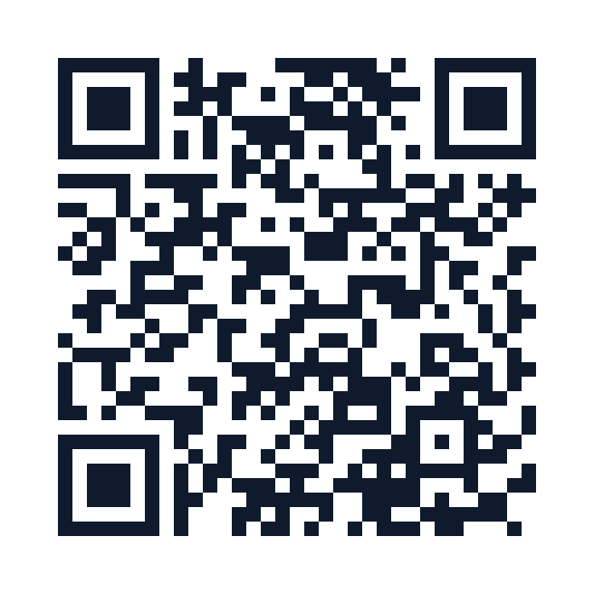
NEXT STEPS
Three links to keep
Research Support
Workshops & Events
Ask Us
Services and expertise
Registration and schedules
Help and consultations
library.ucr.edu/research-support
library.ucr.edu/about/workshops-events
library.ucr.edu/research-support/ask-a-librarian
29
Notes:
Pause to let students scan or photograph the links. Research Support connects resources, services and labs. Workshops and Events holds registration information. Ask Us routes general questions and consultation requests.
Sources:
SPEAKS_Library_Research_Services_2026Claude.pptx, slides 36
SPEAKS_Library_Research_Services_2026ClaudeV2.pptx, slides 51

Slide 30
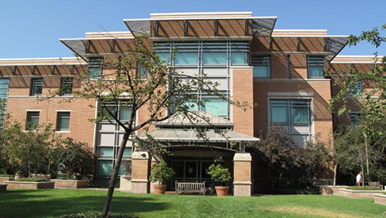
SPEAKS
Comments and questions
What would help your
research move forward?
A question, a technical obstacle
or an idea for a new research output.
Ray Uzwyshyn
raymondu@ucr.edu
rayuzwyshyn.net
30
Notes:
Invite students to describe a current question or obstacle. If an issue involves several methods, begin with a consultation and help connect the appropriate specialists. The reference slides that follow include schedules, contacts and additional resources.
Sources:
Library_Research_Services_Fall_2026OpenAIAstra.pptx, slides 32
SPEAKS_Library_Research_Services_2026ClaudeV2.pptx, slides 52

Slide 31
REFERENCE
Fall workshops: AI and research data
Date and time | Session | Lead
Sep 24, 9–10:30 a.m. | Introduction to Agentic AI | Ray Uzwyshyn
Sep 30, 1–2 p.m. | Studying with Gemini Notebook | Amiee Zou / Inyoung Shin
Oct 7, 2–3 p.m. | Python for Beginners Using AI | Barbara Martinez Neda
Oct 21, 3–4 p.m. | Data Cleaning with Python, Pandas and AI | Barbara Martinez Neda
Oct 28, Noon–1 p.m. | AI Literacy 101: Generative AI Through History | Inyoung Shin
Nov 4, 2–3:30 p.m. | Introduction to Machine Learning | Barbara Martinez Neda
Nov 5, 3–4 p.m. | Web Agent: AI Agent for Data Analysis | Inyoung Shin
Nov 23, 3–4 p.m. | Advanced ML: Neural Networks (PyTorch) | Inyoung Shin
All times Pacific. Calendar and registration
31
Notes:
All dates are in 2026. Times are Pacific. The supplied fall schedule is the source for these dates and times. Use the current event calendar for registration and changes.
Sources:
Library_Research_Services_Fall_2026OpenAIAstra.pptx, slides 27
SPEAKS_Library_Research_Services_2026Claude.pptx, slides 27
https://library.ucr.edu/about/workshops-events

Slide 32
REFERENCE
Fall workshops: making and robotics
Date and time | Session | Lead
Oct 7, 11 a.m.–Noon | Tinkering Research: Using the Makerspace | Brendon Wheeler
Oct 28, Noon–1:30 p.m. | Mini Maker: Pumpkin Carving | Brendon Wheeler
Nov 4, 11 a.m.–Noon | Tinkering Research: 3D Printing | Brendon Wheeler
Nov 5, 19 and 23* 2–3 p.m. | Brainy Bots: Arduino, ESP32 and LLMs | Alvaro Alvarez / Inyoung Shin
Nov 11, 2–3 p.m. | Maker Meetup: Sewing and Embroidery | Brendon Wheeler
*The November 23 Brainy Bots date requires confirmation.
All times Pacific. Calendar and registration
32
Notes:
All times are Pacific. The Brainy Bots line in the supplied schedule calls November 23 a Thursday, but November 23, 2026 is a Monday. The November 23 session remains to be confirmed. Keep that uncertainty visible until the organizer or current event listing resolves it.
Sources:
Library_Research_Services_Fall_2026OpenAIAstra.pptx, slides 28
SPEAKS_Library_Research_Services_2026Claude.pptx, slides 28
https://library.ucr.edu/about/workshops-events

Slide 33
REFERENCE
Fall workshops: fabrication and media
Date and time | Session | Lead
Nov 18, 11 a.m.–Noon | Tinkering Research: Laser Engraving | Brendon Wheeler
Nov 18, 2–3 p.m. | The AI 3D Revolution | Alvaro Alvarez
Nov 25, Noon–1:30 p.m. | Mini Maker: Thankful Origami | Brendon Wheeler
Dec 9, Noon–1:30 p.m. | Mini Maker: Silent Painting | Brendon Wheeler
Wednesdays, Oct 7–Dec 16 9:30 a.m.–1 p.m. | Makerspace Tabling at the Bell Tower | Brendon Wheeler
All times Pacific. Calendar and registration
33
Notes:
All dates are in 2026 and times are Pacific. Makerspace tabling is a recurring drop-in opportunity at the Bell Tower. The current event calendar is the place to confirm session logistics.
Sources:
Library_Research_Services_Fall_2026OpenAIAstra.pptx, slides 26, 28
SPEAKS_Library_Research_Services_2026Claude.pptx, slides 28
https://library.ucr.edu/about/workshops-events

Slide 34
REFERENCE
Digital scholarship: fall 2026
Workshops: 11 a.m.–Noon Pacific on Zoom
Date | Session or deadline
Sep 28 | Digital Scholarship Certificate orientation
Oct 14 | Digital Research Portfolio Using No/Low-Code Tools
Nov 4 | Digital Scholarship Project Types and Best Practices
Nov 18 | Digital Storytelling: Building 2D Online Exhibits
Dec 11 | Experiential Learning Module interest deadline
Certificate enrollment
Questions: jingh@ucr.edu
34
Notes:
The 2026–27 program flyer lists fall workshops on Zoom, 11 a.m. to noon Pacific, and the experiential module interest deadline on December 11. Jing Han is the program contact. Participants can attend individual sessions or work toward the certificate.
Sources:
Library_Research_Services_Fall_2026OpenAIAstra.pptx, slides 29
SPEAKS_Library_Research_Services_2026ClaudeV2.pptx, slides 41–42

Slide 35
REFERENCE
Digital scholarship: winter and spring 2027
Workshops: 11 a.m.–Noon Pacific on Zoom
Date | Session
Jan 13 | Computational Methods in Text Analysis, Part 1
Feb 3 | Computational Methods in Text Analysis, Part 2
Feb 17 | XR Design and 3D Experiences
Mar 31 | Qualitative Data Analysis and Tools
Apr 21 | Academic Publishing: Academic Author Profiles
May 12 | Academic Publishing: Publications
Program calendar and registration
35
Notes:
The 2026–27 certificate flyer lists these workshops. All times are 11 a.m. to noon Pacific on Zoom. Participants should check the current calendar for any changes.
Sources:
Library_Research_Services_Fall_2026OpenAIAstra.pptx, slides 29
SPEAKS_Library_Research_Services_2026ClaudeV2.pptx, slides 42

Slide 36
REFERENCE
Research Services contact directory
Specialist | Area | Contact or booking
Barbara Martinez Neda | Data science | Book a data consultation
Inyoung Shin | AI research support | Book an AI consultation
Janet Reyes | GIS and geospatial information | Book a GIS consultation
Jing Han | Digital scholarship and publishing | Book a digital scholarship consultation
Alvaro Alvarez | Innovative media | Book a media consultation
Brendon Wheeler | Making and robotics | brendon.wheeler@ucr.edu
Ray Uzwyshyn | Research partnerships | raymondu@ucr.edu
General consultation request
36
Notes:
The direct booking links come from the supplied decks and current service pages. For broader partnerships or cross-unit projects, contact Ray. Cyberinfrastructure staff may join scoped research-platform collaborations. Subject librarians across the Library provide additional consultation expertise.
Sources:
SPEAKS_Library_Research_Services_2026Claude.pptx, slides 5, 14
SPEAKS_Library_Research_Services_2026ClaudeV2.pptx, slides 14, 18
https://library.ucr.edu/research-support/data-services
https://library.ucr.edu/research-support/geospatial-mapping
https://library.ucr.edu/research-support/digital-scholarship

Slide 37
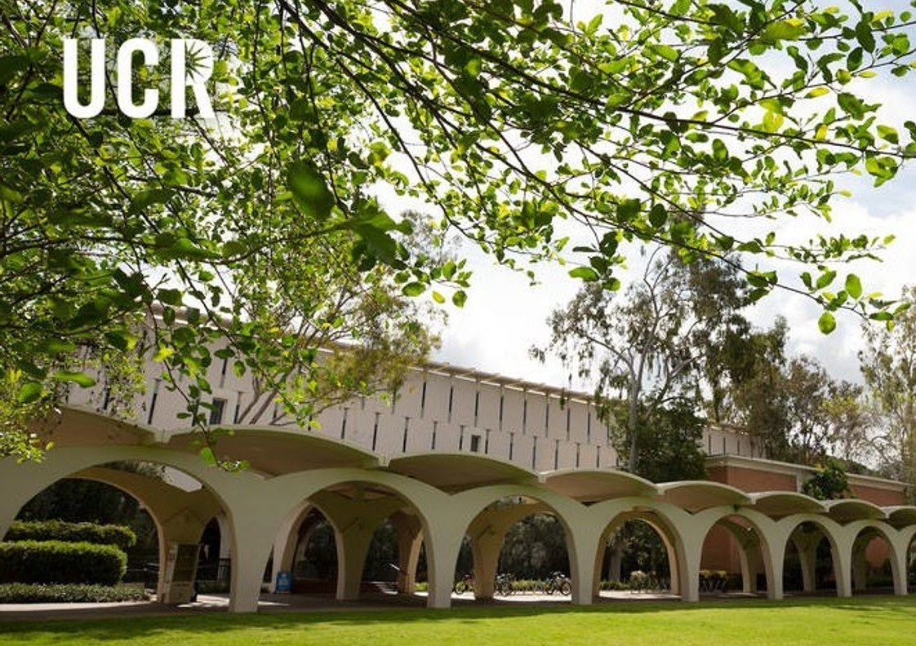
REFERENCE
Spaces, research foundations and poster printing
Graduate spaces
GrAdvantage, study wings, carrels and reservable rooms
Research foundations
Literature reviews, citations and research guides
Poster printing
Conference and research posters in Orbach Library
Poster guide
Study spaces
Research fundamentals
37
Notes:
GrAdvantage and graduate study spaces support focused work and graduate community. Students can use the current library website to check room booking, eligibility and access. Poster printing rates and instructions can change, so use the current guide. The Core Competencies Badge covers citation management, literature review strategies, data management, scholarly communication, and publishing and sharing.
Sources:
Library_Research_Services_Fall_2026OpenAIAstra.pptx, slides 33–34
SPEAKS_Library_Research_Services_2026ClaudeV2.pptx, slides 10–11, 44
https://library.ucr.edu/using-the-library/study-spaces
https://guides.lib.ucr.edu/plotter

Slide 38
REFERENCE
Further exploration
Digital Initiatives
Research collaborations and project examples
The Reference Desk
Conversations with UCR researchers
Graduate Research Core Competencies Badge
Self-paced research foundations
Ray Uzwyshyn: publications and presentations
AI, research infrastructure and digital scholarship
38
Notes:
These links offer deeper examples of library-supported projects and opportunities to continue learning. Ray’s website includes the AI infrastructure, agentic AI, and research and learning presentations referenced in the source materials. The podcast introduces the people and methods behind UCR research.
Sources:
Library_Research_Services_Fall_2026OpenAIAstra.pptx, slides 33
SPEAKS_Library_Research_Services_2026Claude.pptx, slides 41
SPEAKS_Library_Research_Services_2026ClaudeV2.pptx, slides 27
https://library.ucr.edu/research-support/digital-scholarship

