Slide 1
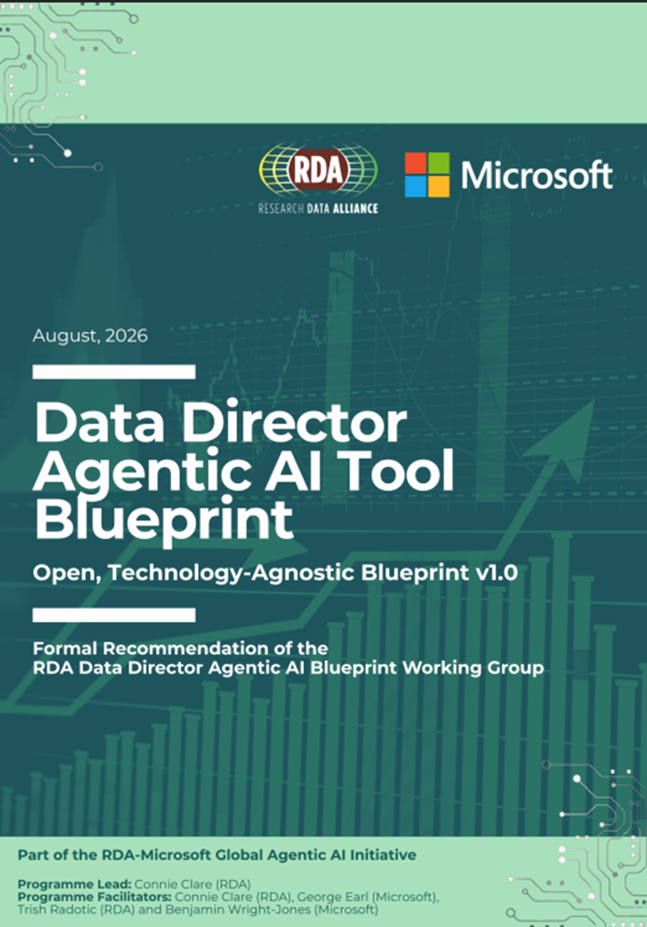

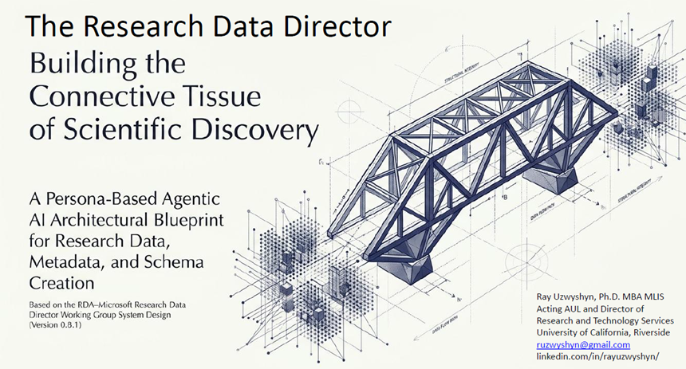
Research Data Alliance
US Cohort Participation
2026
Raymond Uzwyshyn Ph.D. MBA MLIS
Director, Research and Technology
University of California, Riverside
raymondu@ucr.edu, https://rayuzwyshyn.net

Slide 2
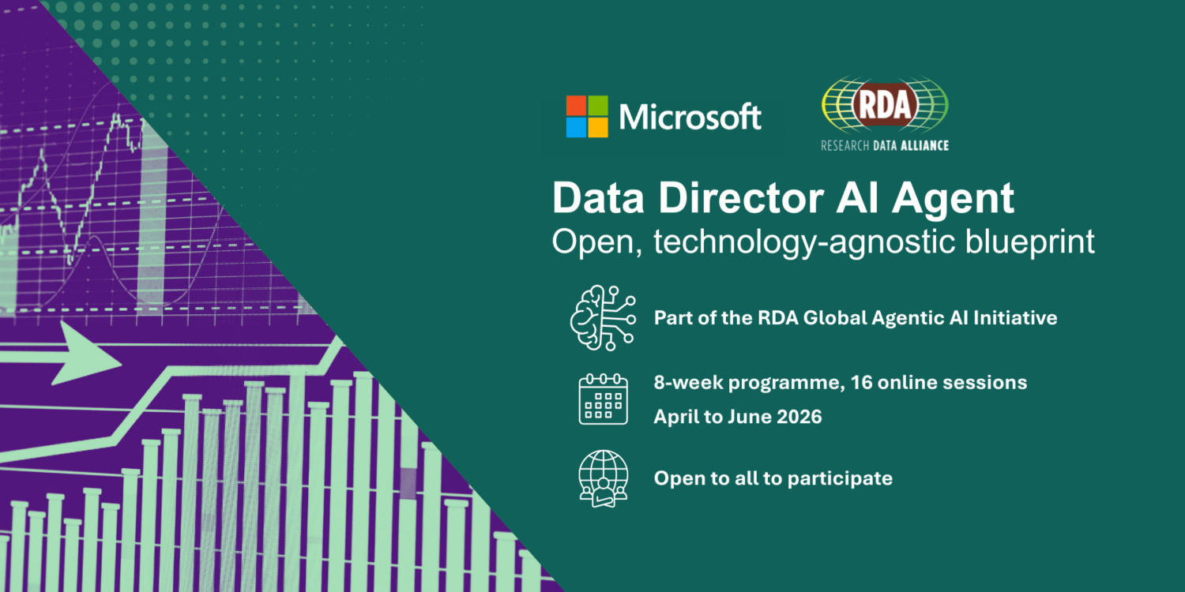
Joined RDA Global Agentic AI Initiative
March 2026
Data Director Agentic AI Blueprint
(Foundation for Application)
Intense 8 Week Program, Meetings Each Week, 90 participants began,
settled to two cohorts of ~16 participants,
two separate global regions working on the same blueprint,
2 Microsoft Engineers, & Dr. Connie Claire, RDA Coordinator

Slide 3
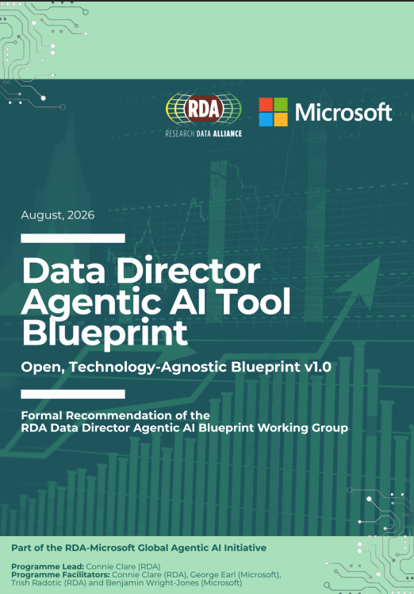
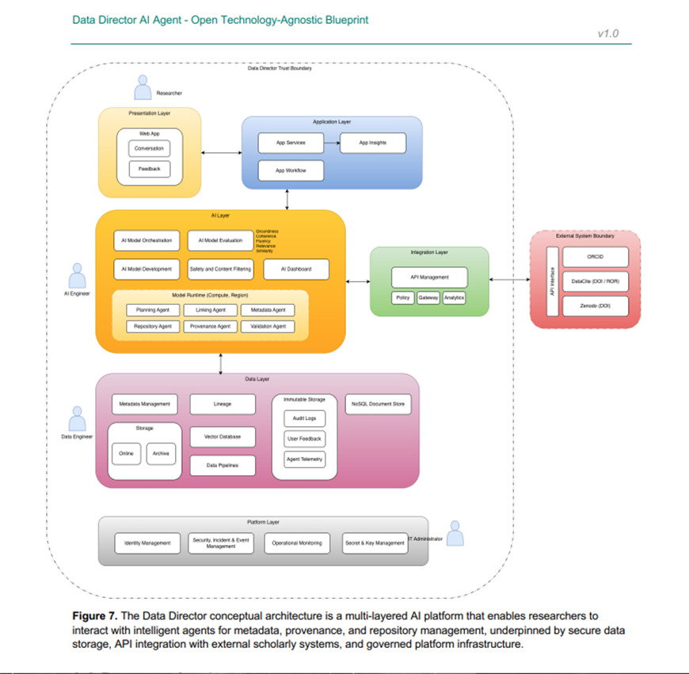
Blueprint
August 2026
Capabilities Based Model
Endorsed by RDA September 6th, 2026
Endorsed Final Version, September 6th, 2026
Working Group Site

Slide 4
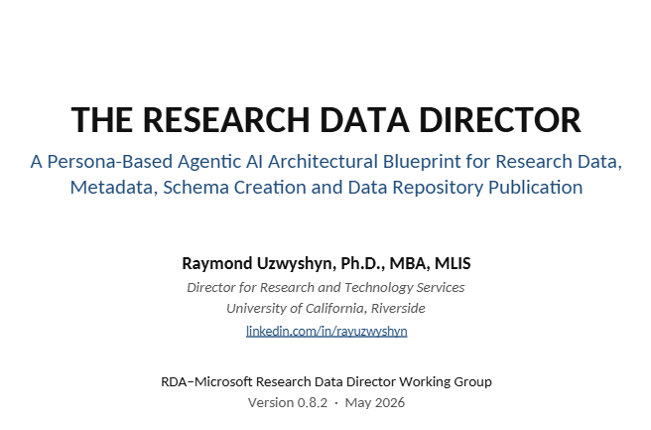
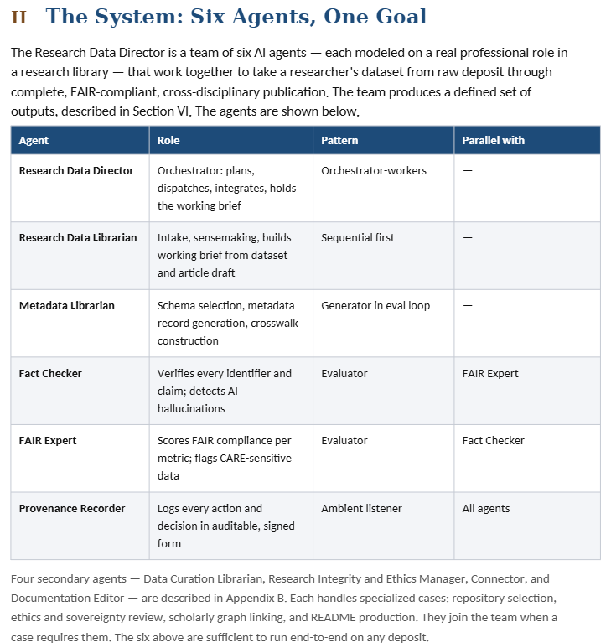
Persona Based Blueprint: Researchgate

Slide 5

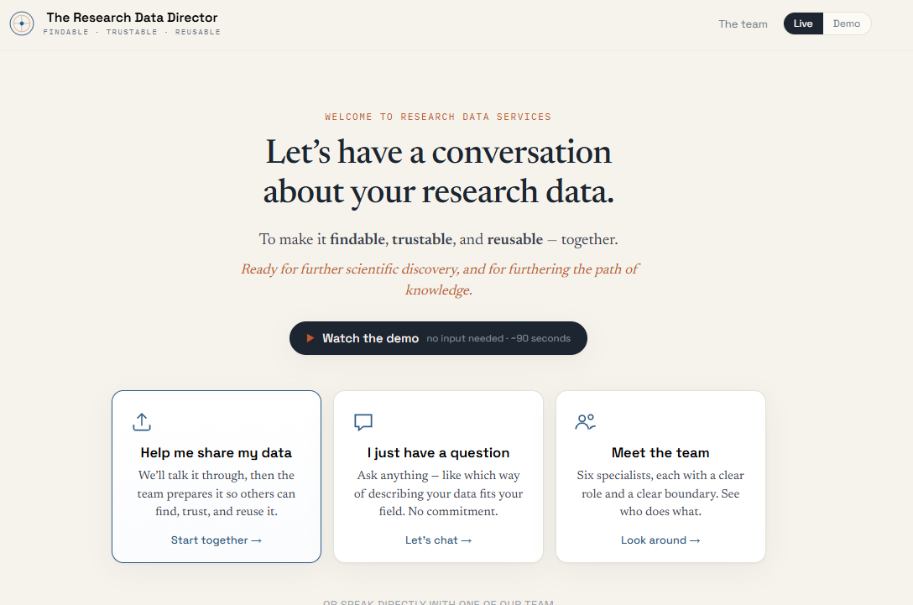
Person Based Agentic AI
Research Data Director
WG Presentations and Prototypes, July 2026
AI Data Visitation WG Presentation, July Meeting
AI VANTAGE WG : Proof of Concept Prototypes

Slide 6

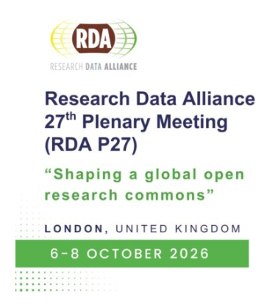
RDA Plenary 27
(London, Panel and Poster)
Breakout Session
October 6. 11:30-12:30 , John Major Room
From Governance to Deployment
Trust-Centered Strategies for Agentic AI
(Artificial Intelligence and Data Visitation
(AIDV Working Group)
Why Persona-based Agentic AI Systems Matter
for the Research Data Lifecycle
(Presentation and Prototype Demo)
Poster
October 6
17:00-18:30,
Jardin Suite
The Research Data Director:
A Persona-Based Agentic AI Blueprint for FAIR Research Data, Metadata Schema and Crosswalk Workflows

Slide 7
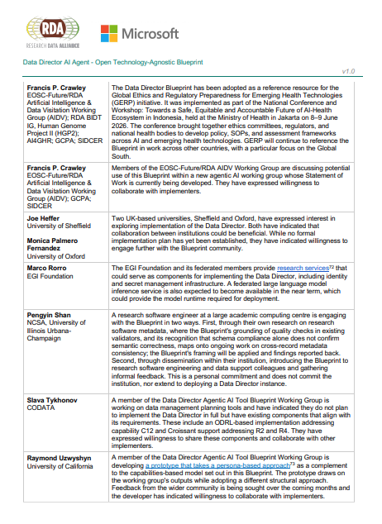
Next Steps 2026-2027
Potential Implementations and Implementors
Sensitive Data WG, Biomedical Apps,
Capabilities/Persona WG Model
July-September 2026
Invitations to Present Blueprint and Prototypes to Other RDA Groups
AIDV Working Group Blueprint Presentation July 2026
AI and Data Visitation: Ethical, Legal, Technical Challenges of AI in Scientific Research,
(secure processing environments)
VANTAGE WG Prototype Presentation, July
(Implementation of Medical/Biomedical Sensitive Data/Privacy with Agentic AI
(Paty Buendia, Seonyoung Kim, Francis Crawley)
RDA Data Director Implementation September - October
(Beginnings Group)

Slide 8
Related 2026 RDA Research
White Papers, Blueprints and Application Prototypes
Publications: White Papers, Background Research and Blueprints
The Data Director Agentic AI Tool Blueprint. (Open, Technology-Agnostic Blueprint v0.1, Capabilities Based Model). Final Draft PDF, Doc). Research Data Alliance Global Agentic AI Intiative (Microsoft/RDA Sponsored). July 2026. (Contributor).
Uzwyshyn, Raymond J. Diagnostic Synthesis: Biomedical Research Data, Metadata, and Discovery Through Imaging, Genomics, Sensors, and AI . RDA VANTAGE Working Group Background Document. ResearchGate, Preprint. August 2026.
Uzwyshyn, Raymond J. The Research Data Director — Biomedical Variant: A Persona-Based Agentic AI Architectural Blueprint for Biomedical Research Data, Metadata, Crosswalks, and Governed Publication . RDA VANTAGE Working Group Blueprint Document. (Prototype App Below). Preprint. August 2026. ResearchGate.
The Research Data Director: A Persona-Based Agentic AI Architectural Blueprint for Research Data, Metadata, Schema Creation and Data Repository Publication v08.2. (Build Specification PDF, Technical MD File , Personas Doc. Prototypes Below in Programming Section) Based on Work from the Research Data Alliance and Microsoft International Working Group. Research Data Alliance. April-June, 2026 (Author).
Spatial Synthesis: Research Data, Metadata and Discovery Through GIS, AI, Satellites and Drones. (White Paper). ResearchGate UCR AI/GIS/Drones/Planet Imagery Workshops. April 2026.
Presentations
The Research Data Director: A Persona-Based Agentic AI Blueprint for FAIR Research Data, Metadata, and Schema and Crosswalk Workflows (Poster Presentation). Research Data Alliance 27th Plenary Meeting (RDA P27) London, UK, Kia Oval, October 6 2026.
Building A Persona Based Agentic AI Research Data Director. (PPT). Artificial Intelligence and Data Visitation International Working Group (AIDV), Research Data Alliance (RDA). July 13, 2026.
The Data Director Agentic AI Tool Blueprint: Capabilities Based Model. Brief Presentation PPT and Overview Videos (MP4): Simplified and Advanced. Research Data Alliance/Microsoft Sponsored Agentic AI Initiative, Contributor. University of California, Riverside, Research Services Divisional Overview, July 2026.
Prototypes
The Research Data Director (Agentic AI Persona Based Model). Blueprint. Prototypes and Proof of Concept Beta Apps. V1 (HTML, Artifacts: Hard-Coded/Friendly UI v1-v4, V2 (HTML, Artifacts) V3 (HTML, Artifacts), V4 ((HTML, Artifacts). V5+ Anthropic API (HTML, Artifacts). V10+ Persona Based Models. V10 (HTML, Artifacts), w/Demo V11 (Artifacts, HTML), V12 Sound Experiment/Need Eleven Labs (Artifacts, HTML) (Opus 4.8 and Anthropic Fable). June 2026.
Medical Research Data Director (Variant): Biomedical Metadata & Crosswalk Studio . AI-assisted research-informatics prototype for multimodal biomedical research: dataset registration, metadata normalization, provenance and quality assessment, and human-reviewed crosswalks among DICOM, LOINC, SNOMED CT, RADLEX/PI-RADS, UCUM and FHIR. Includes an AI Crosswalk Assistant and FHIR Concept Map, metadata crosswalk and research-manifest exports. August 2026. ( Biomedical Blueprint, Research Background )

Slide 9
Thank you
Research Data Alliance
California Digital Library
Becky Grady, Maria Praetzellis and Connie Claire!

Slide 10
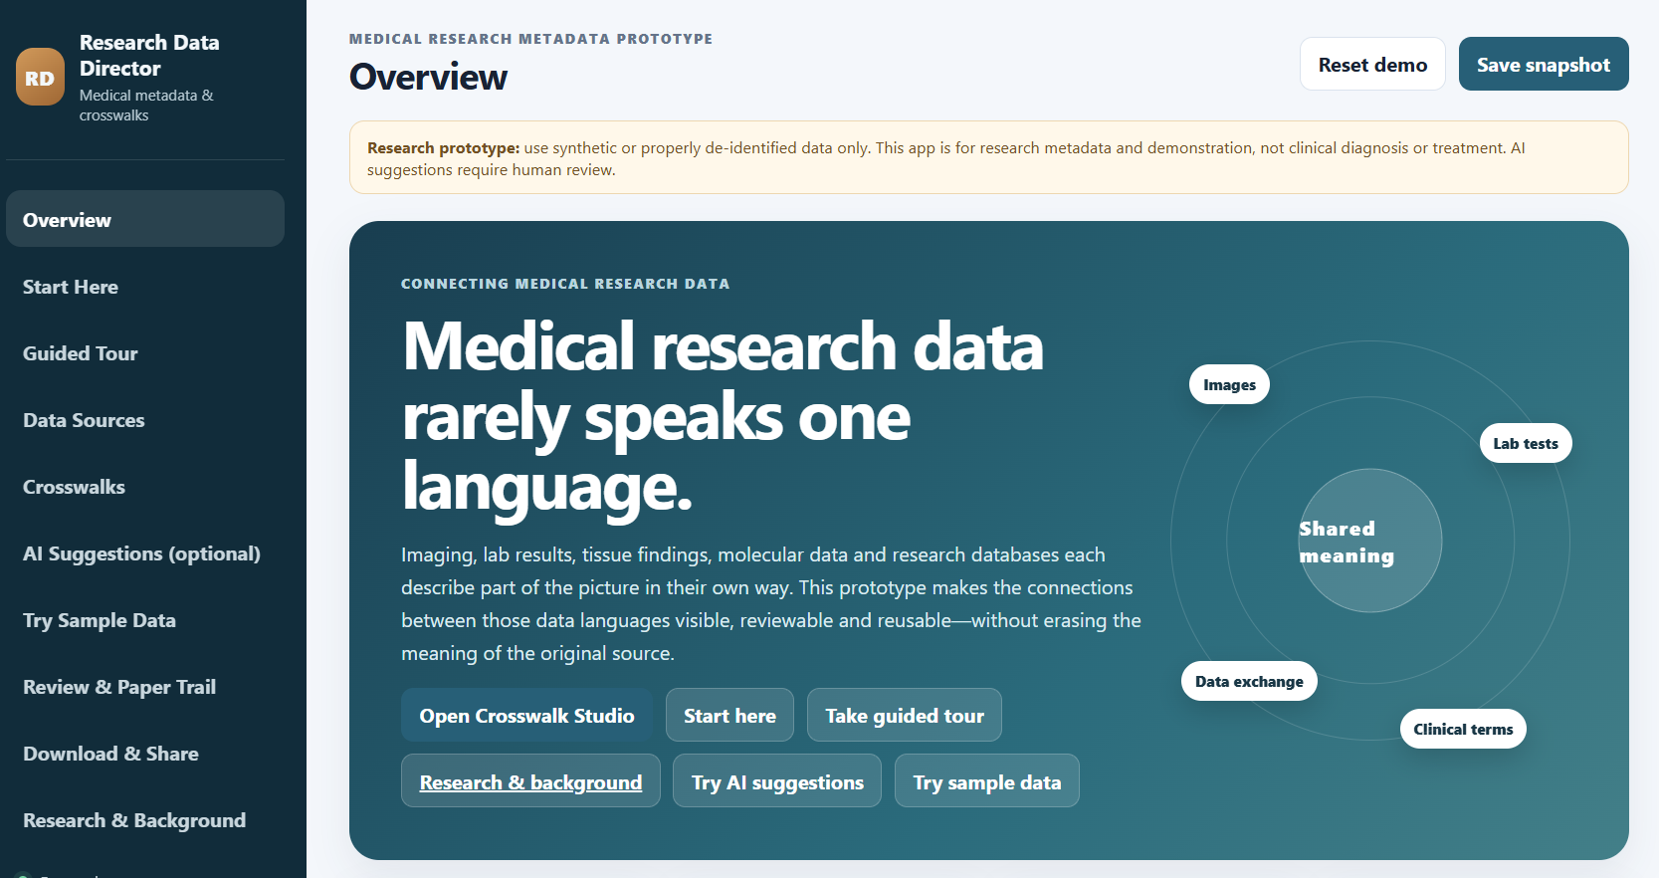
AIDV/Vantage: Sensitive Data, Privacy, Security Governance
Biomedical Focused Research Data Director, August, 2026
Biomedical Variant, Background Research, Blueprint and Prototype

Slide 11


