Slide 1
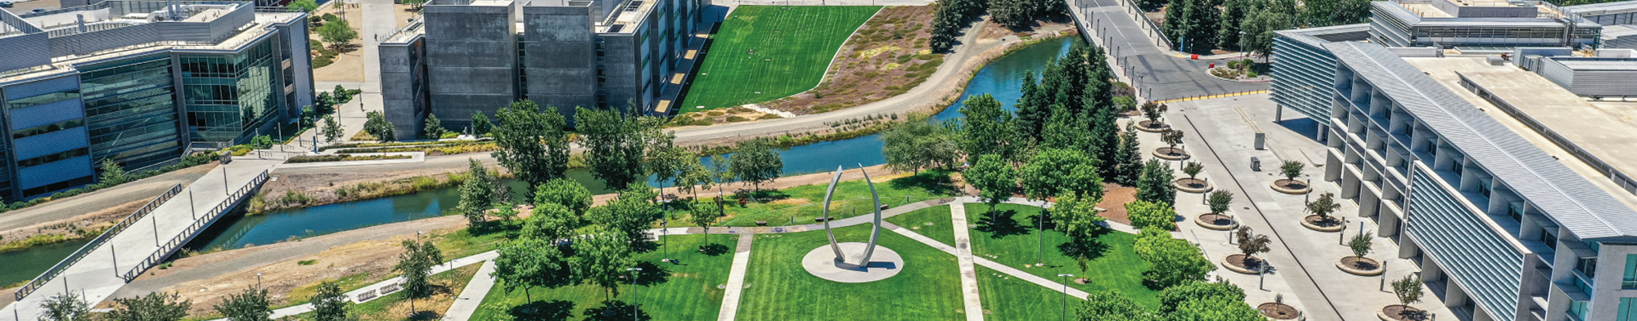
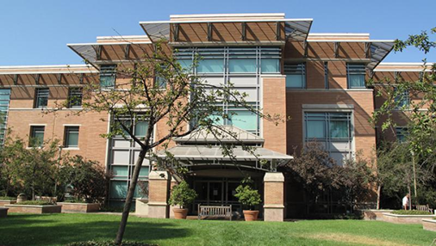



Building AI Literacy Infrastructures
UCR Libraries Multi-Unit AI Integration Model
(2024-2026)
Ray Uzwyshyn, Ph.D. MBA MLIS
Acting AUL for Research & Technology &
Director of Research Services
University of California Riverside Libraries, raymondu@ucr.edu ,https://rayuzwyshyn.net https://www.linkedin.com/in/rayuzwyshyn/

Slide 2
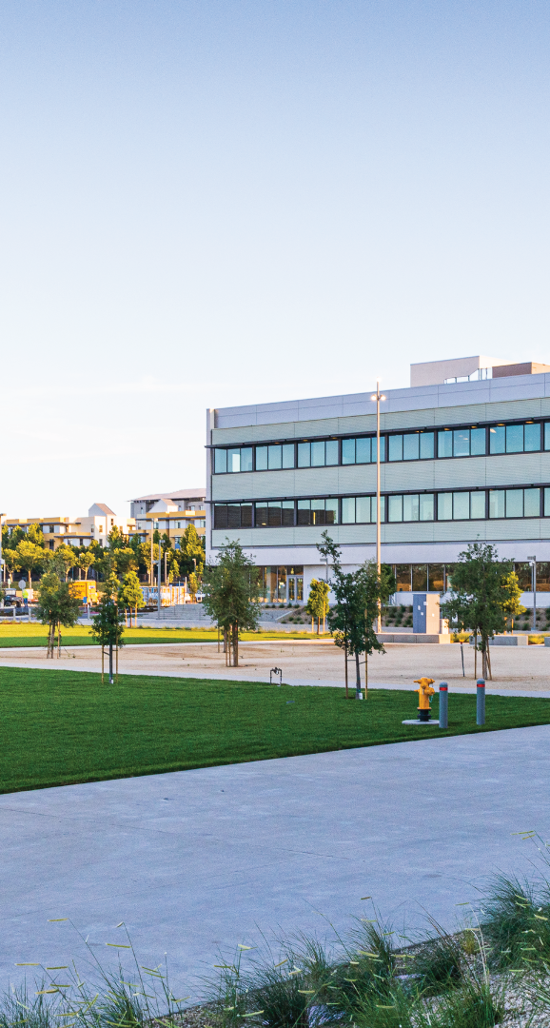
Agenda
Big Picture Introduction to AI Literacy Support at UCR
How is this divided , Focus UCR Libraries Division of Research and Technology Services
Rationale and Strategy Towards AI Literacy:
Onboarding, Cooperation, Collaboration, Research Services Emerging Technology, From Digital and Data Literacyto AI & Learning: Staircase Model: Vygotsky Zone of Proximal Development
Personnel and Case Study Examples
Data Research Scientist, AI Research Librarian
What is the Zero to Hero Pipeline?
Interdiciscplinarity, Emerging Technologies, Focus on Learning Format Examples Workshops, Digital Certificates, Consults, Meetups and Events
The Future: Local Open Source Lab, 2027
Rational, Hardware, Staffing, Proprietary and Open Source AI Primary goals
Summary, Comments and Questions
Building AI Literacy Infrastructures: A Multi Unit Integration Model

Slide 3
AI Literacy Infrastructure Support at UC Riverside
A Research Library
AI Integrated Model
Libraries,
Research & Technology Services
HPC &
Faculty Teaching Center
RAISE
Information
Technology
Services
AI Literacy, Faculty, Student &
Researcher Onboarding AI Support Other Campus 95-97 %
University System Wide AI Proprietary Licenses, Security
High Performance AI Research Compute
Top 2-5%, Cost Recovery

Slide 4
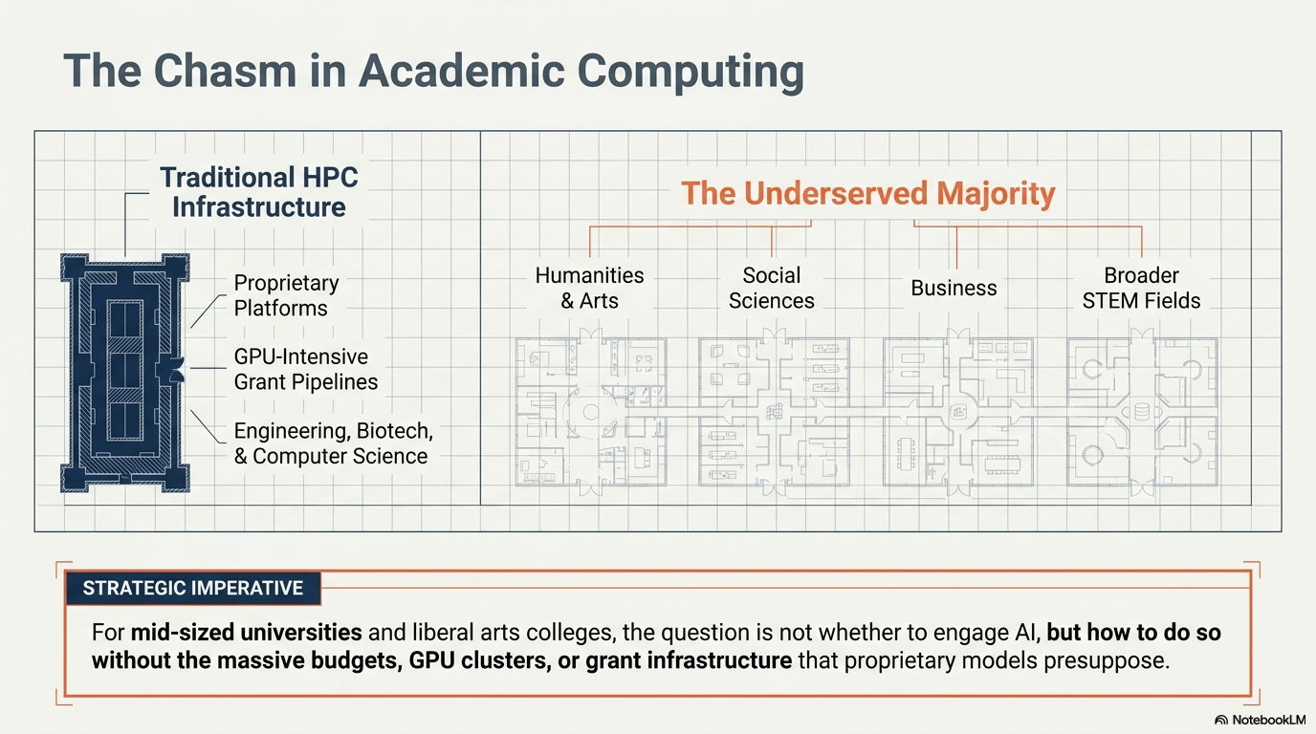
The Widening AI & Digital
Divides
Top
2-5%
The Other
95-97%
$$ Needs

Slide 5

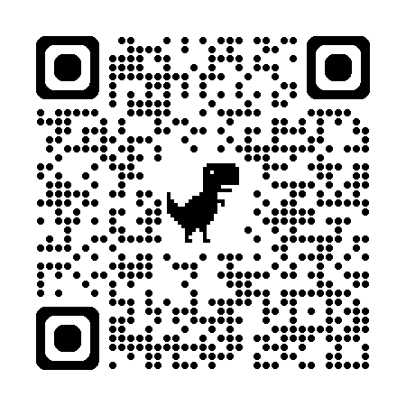
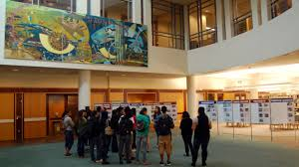
UCR Libraries Division of Research and Technology Services
Orbach Science Library
Research Services
(*Unique Emerging Technologies, Technologists & Labs
including Robotics, Makerspace, Innovative Media,
STAR Lab (Scholarly Technology and Upcoming AI Lab)
Cyberinfrastructure
(Core Libraries IT Infrastructure: Programming, Software/Database Support, IT Project Management, Desktop Support)
Research Services Staffing
Maker Space/Robotics Lab Services Coordinator
Innovative Media Librarian
Digital Scholarship Librarian
Geospatial Information Systems Librarian
Medical & Clinical Outreach Librarian
AI/Data Research Scientist (+1)
AI Research Librarian (+1)

Slide 6
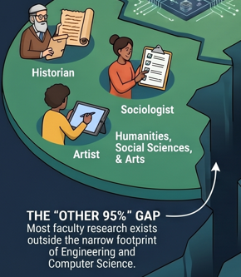
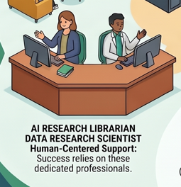
Library Research and Technology Services
AI Literacy Serving The Other 95% of University
Students, Graduate Students and Ph.D. Researchers
Information Literacy (1990’s)
Digital Literacy (2000’s)
Data Literacy (2010’s)
AI Literacy (2020’s)

Slide 7

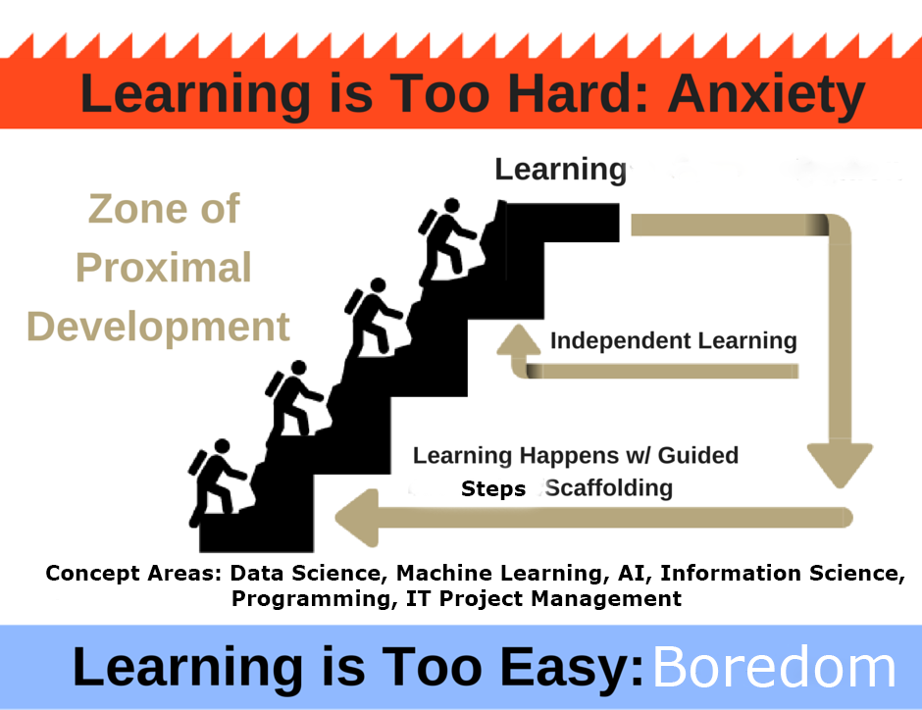

Steps and Scaffolding Towards Building
Library AI Infrastructures
Digital Literacy, Data Literacy
AI Literacy

Slide 8
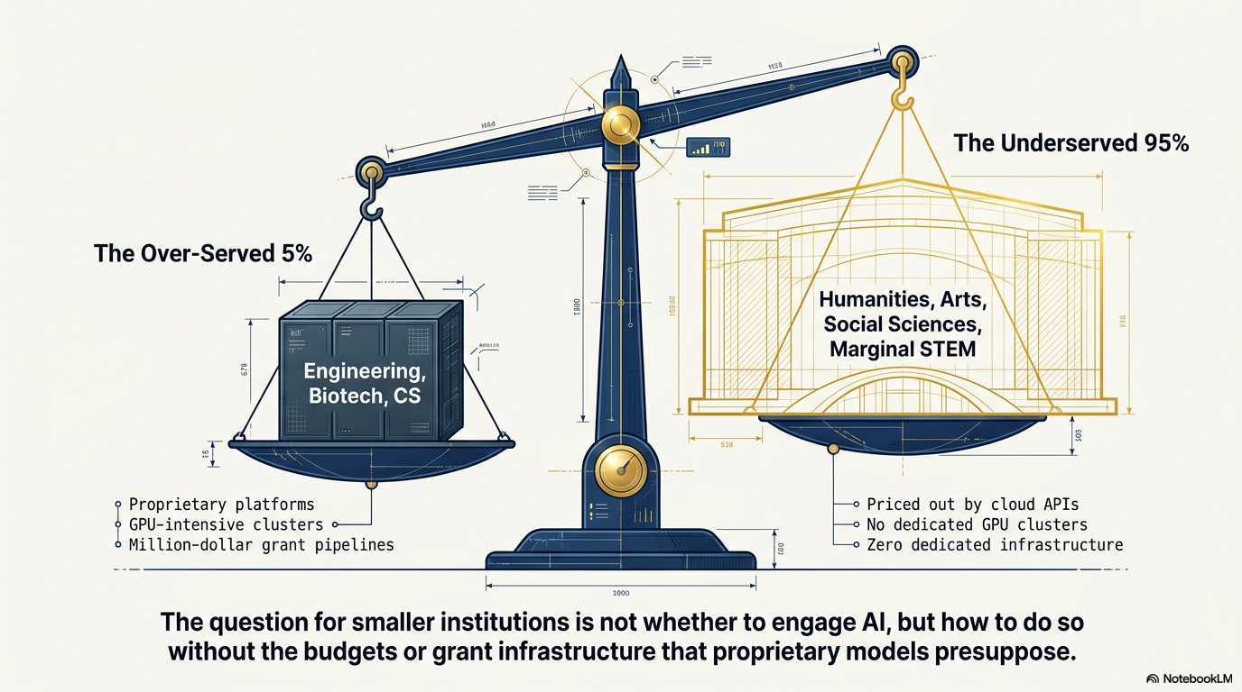
HPC Research Computing

Slide 9
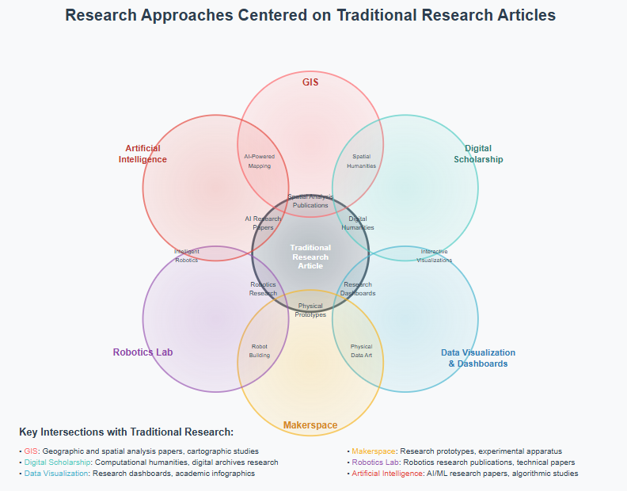
Enabling Research with Emerging Technology Possibilities
Digital Literacy
UCR Library
Research & Technology Services
Several Units
Several Technologies
Centered on Traditional Research Article, Monograph
(Increasingly Focused
on System wide AI Literacy
Information Literacy
AI Literacy
Data Literacy

Slide 10
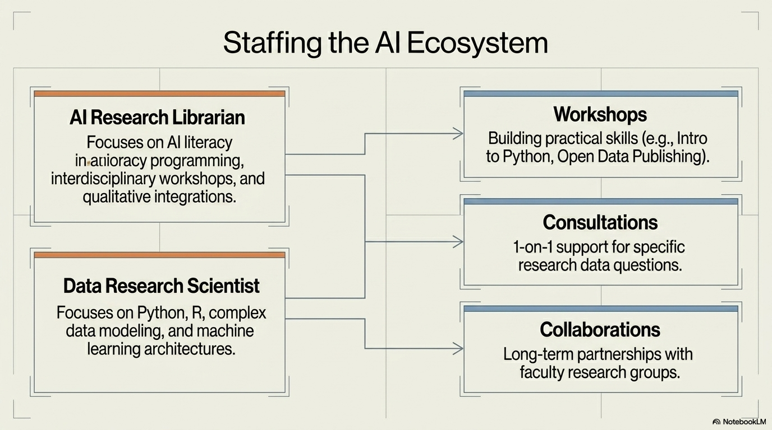

events
Currently 2 Staff, Planned Expansion (4) or (6), Possiblty Future Additions of
Teaching and Learning Dept.

Slide 11

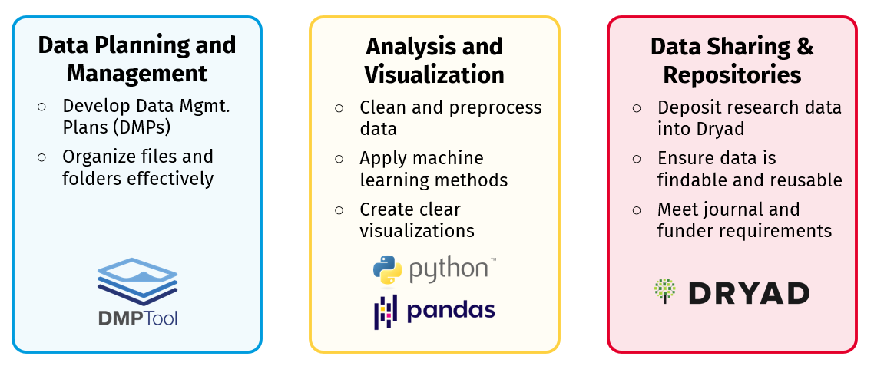

Research Scientist Supports The Research Data Lifecycle Scaffolding towards AI

Slide 12
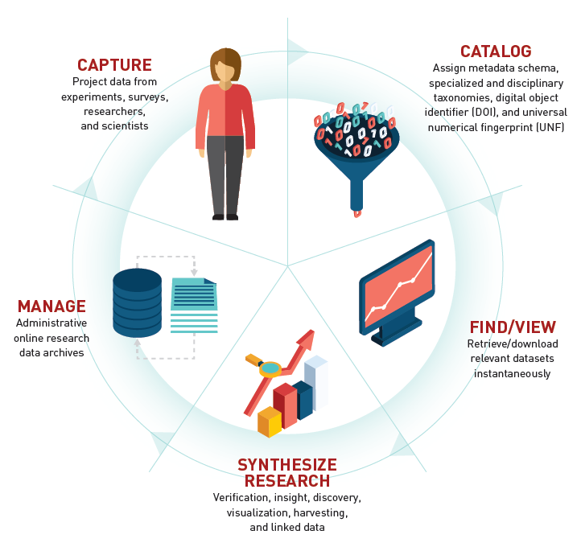



Research Data Lifecycle & Data Research Scientist
Support Toward Data Sharing, Visualization, Analytics, Insight
Onboarding Ramp towards AI (Workshops, Consults, Meetups Events)
Research Data Repository

Slide 13
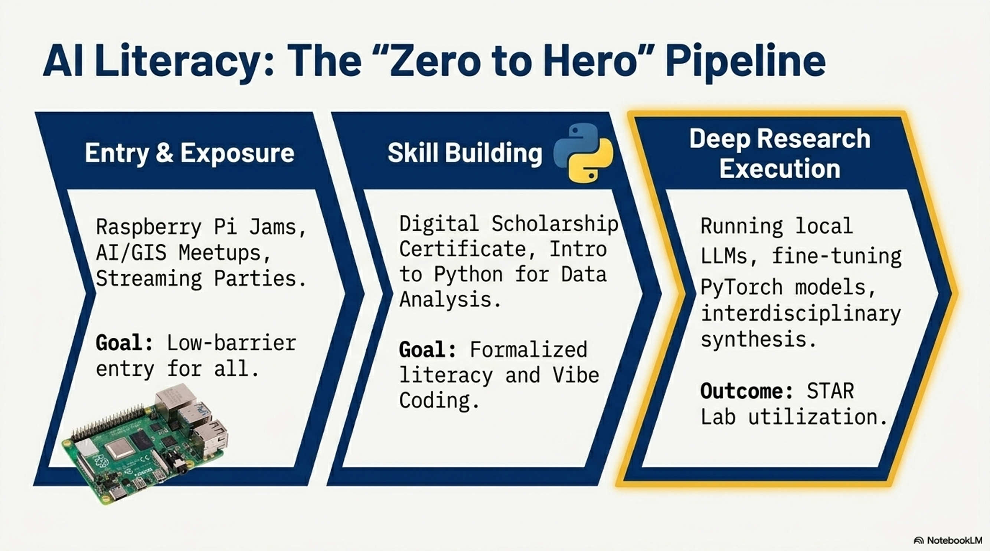

Slide 14
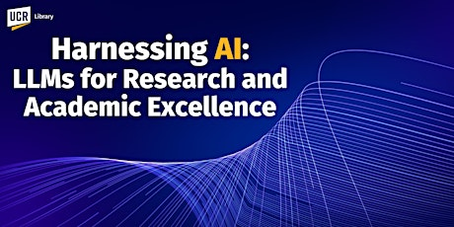
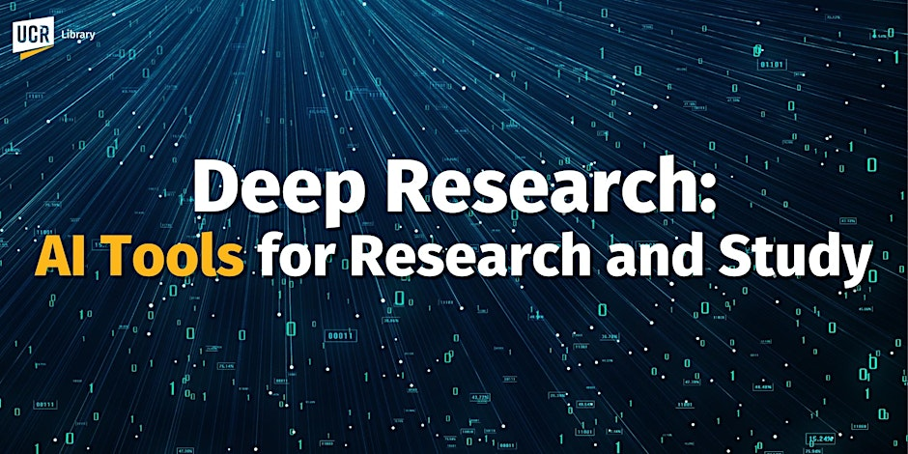
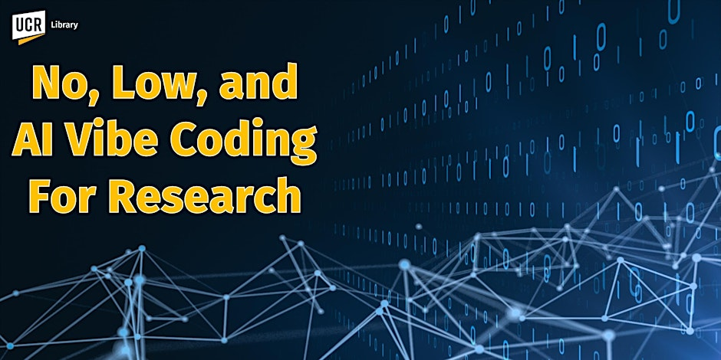
March 2025 UCR Orbach Science Library AI Literacy Sereries. https://www.researchgate.net/publication/389558789_Harnessing_AI_For_Research_2025_GenAI_Large_Language_Model_Introduction_AGI_and_Reasoning_Models_Multimodal_Models_and_Deep_Research_with_Autonomous_Agents
May 2025 Orbach Science Library AI Literacy Series. https://www.researchgate.net/publication/391739383_Deep_Research_AI_Tools_For_Research_and_Discovery
November 12, 2025. UCR AI Literacy Series
https://www.researchgate.net/publication/397584324_Vibe_Coding_For_AI-Driven_Development_An_Introduction_for_Research_and_Learning
March 2026, UCSF Generative AI Office Hours Colloquia Workshop Demos

Slide 15
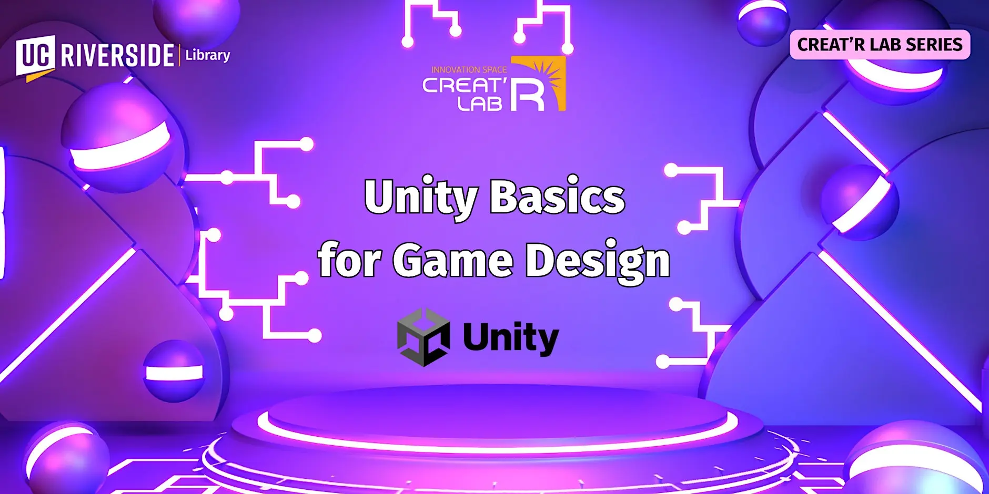
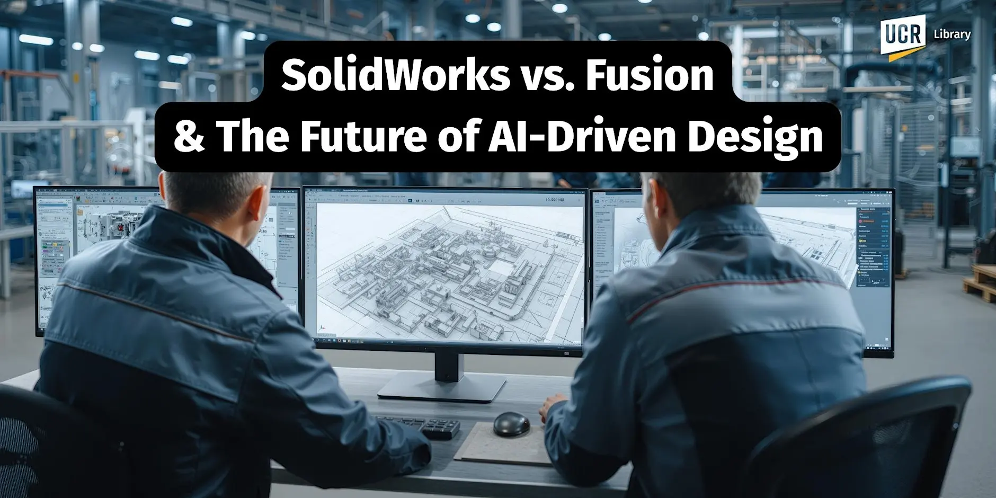
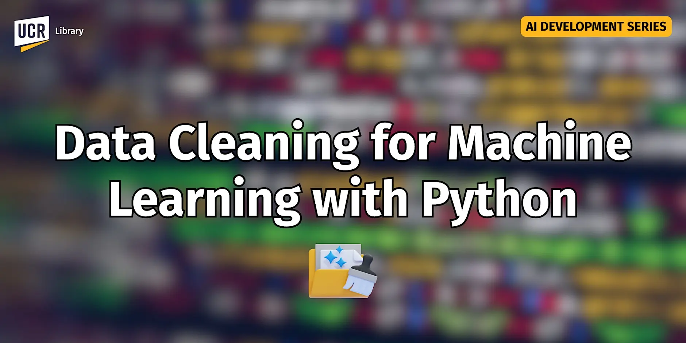
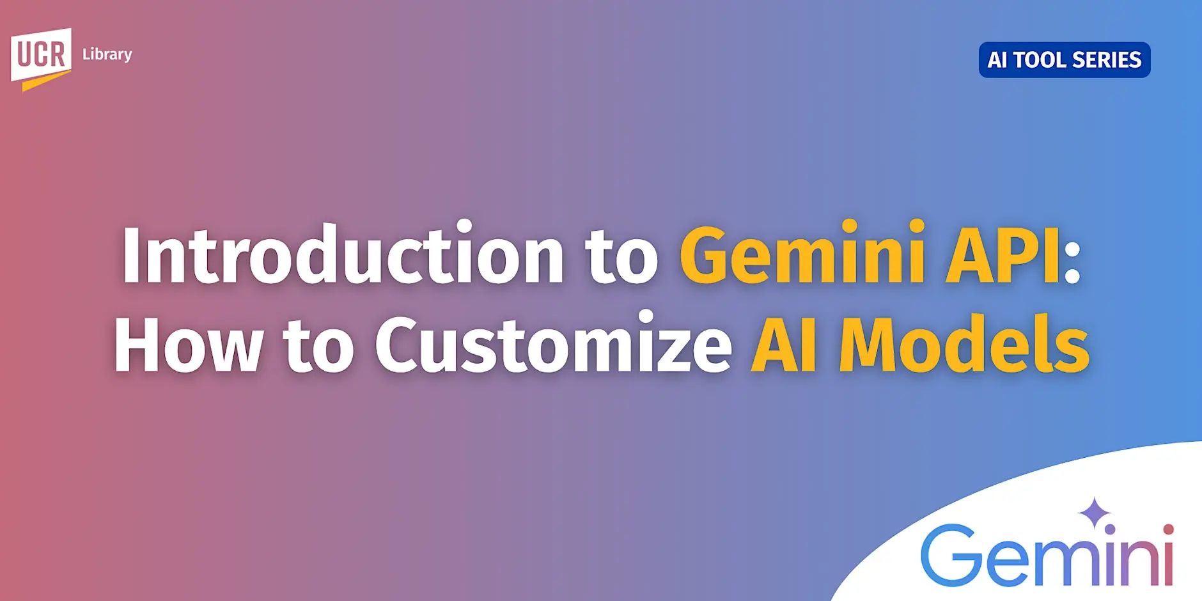
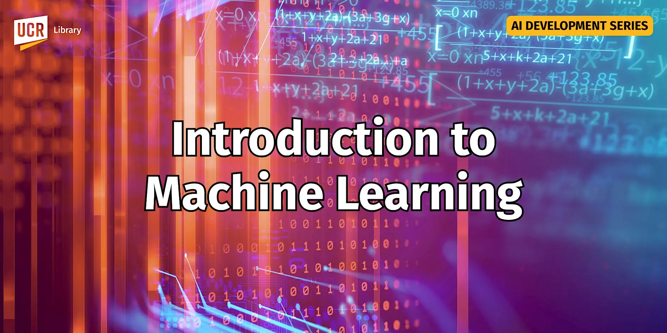
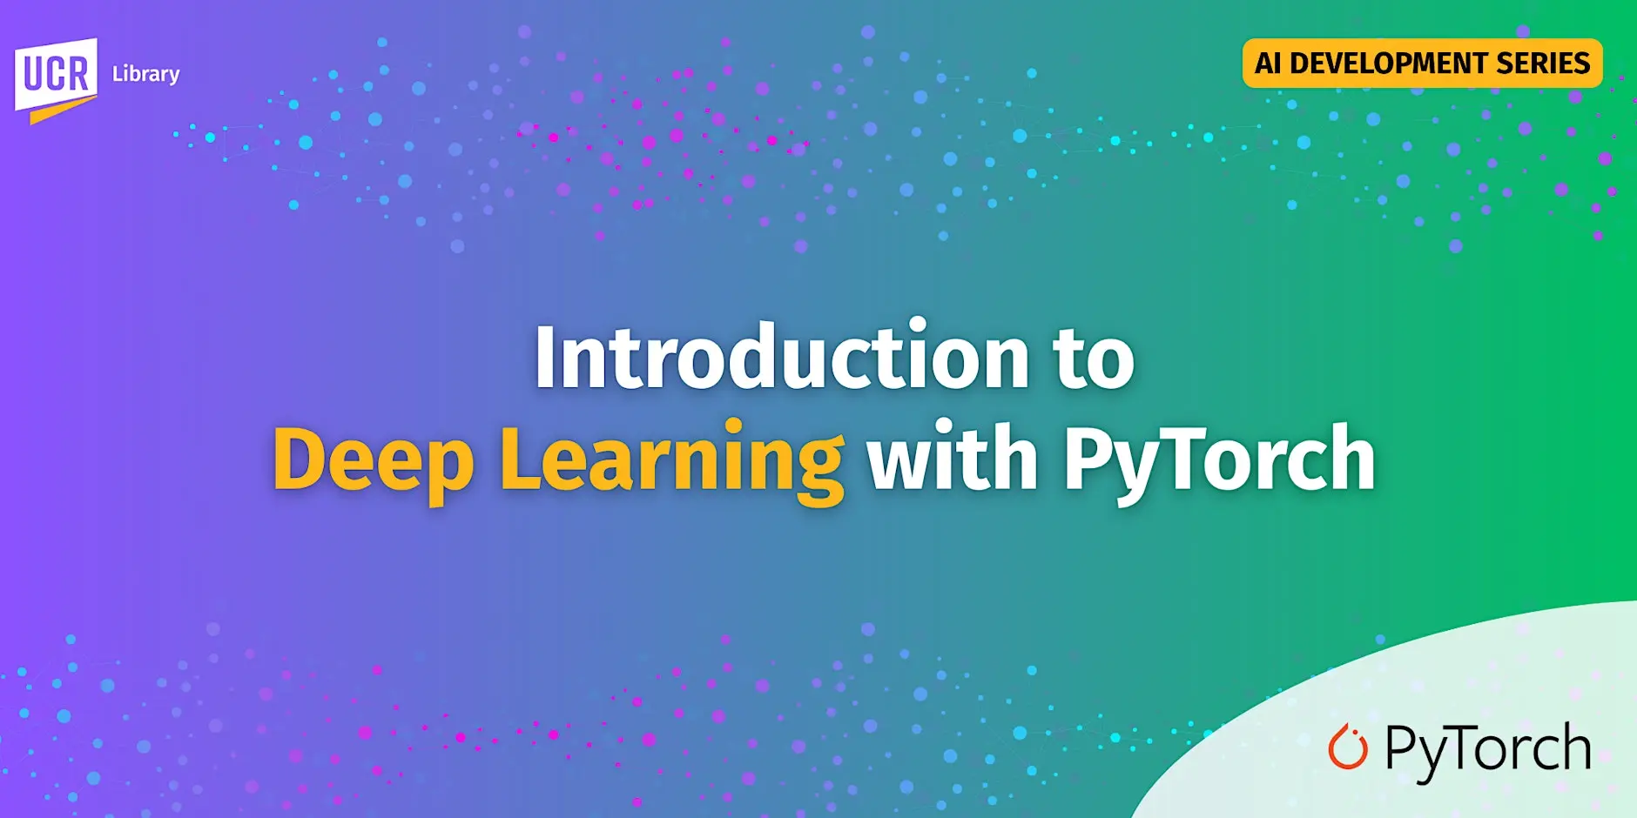
Interdisciplinarity & Skilll Building
AI Literacy
Digital Literacy
Faculty and Student
Introductory Workshops

Slide 16
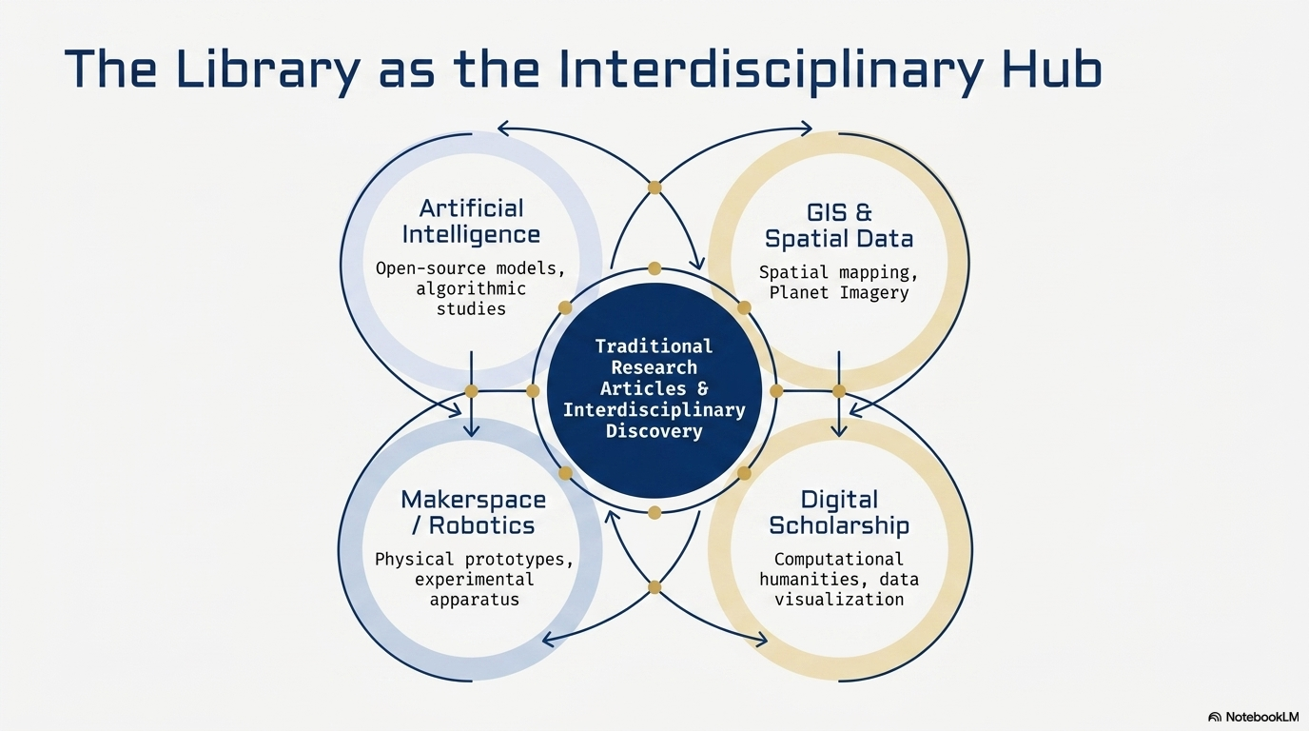
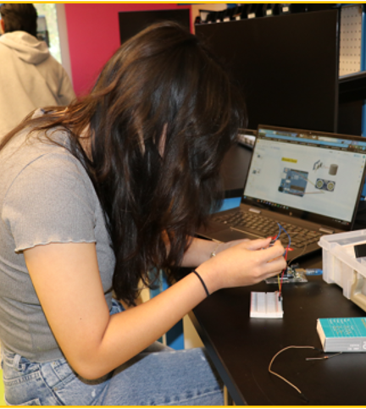
Experiential
Learning
Creat'R Lab Makerspace (Room 140)
Robotics Lab (Room 146)
3D XP Lab (Room 145) – virtual reality
Workshops:
  Maker Week (every April) with hands-on entrepreneurial prototyping workshops
  Robotics Camp (every summer)
    Free for any interested UCR students
    For beginners and for all disciplines (20 slots)
    Hardware skills (CAD modeling) to create an object
    Software skills (Python and C++ coding)
    AI + Robotics Incorporating AI into the robot
    UC Loves Data Week

Slide 17
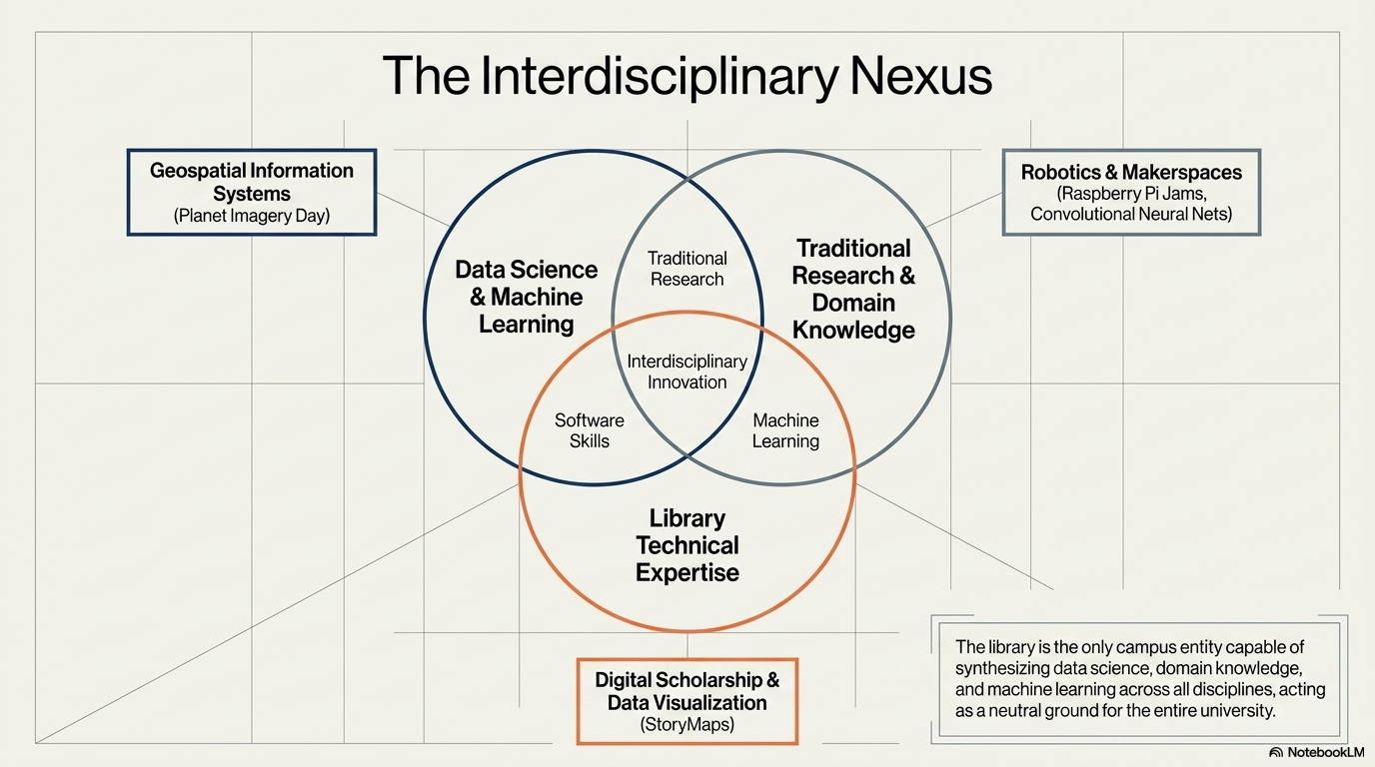
AI
Instrumentation
Data
Discovery
Scientific
Discovery

Slide 18
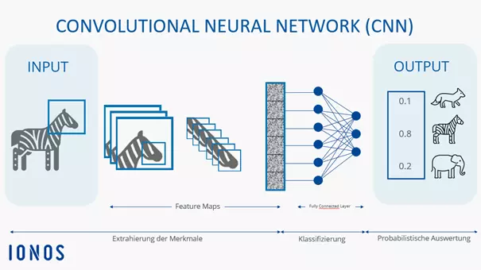
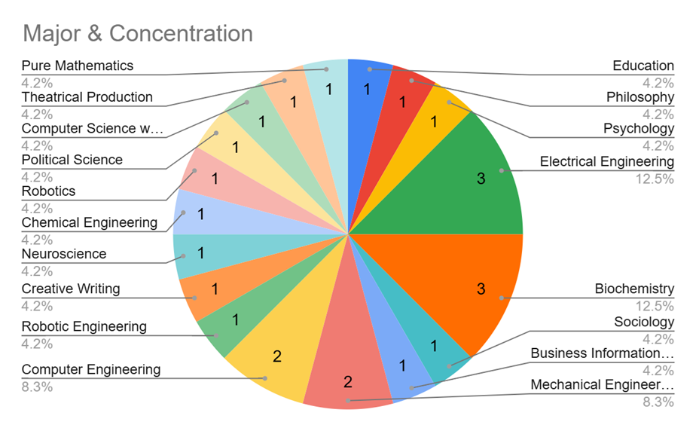
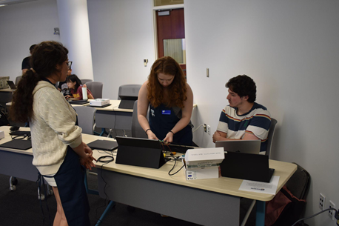
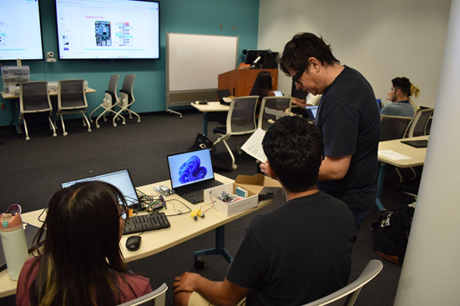
AI Enhanced Robotics Summer Camp
LAB Workshops: From Zero to Hero
An AI training method, which teaches the model to recognize items based on an image
Convolutional Neural Nets Integrated with Robotics
Students were taught how to train the model and how to use the model in a real application
75% Female
Attendees

Slide 19
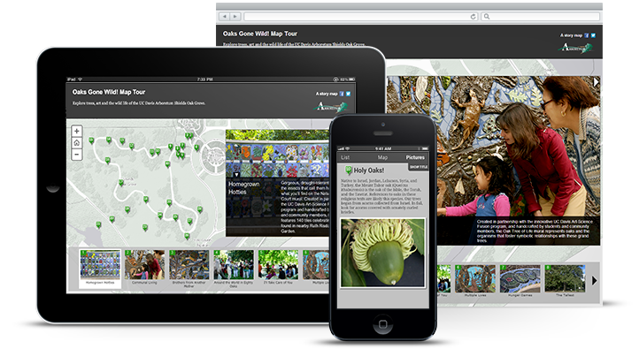
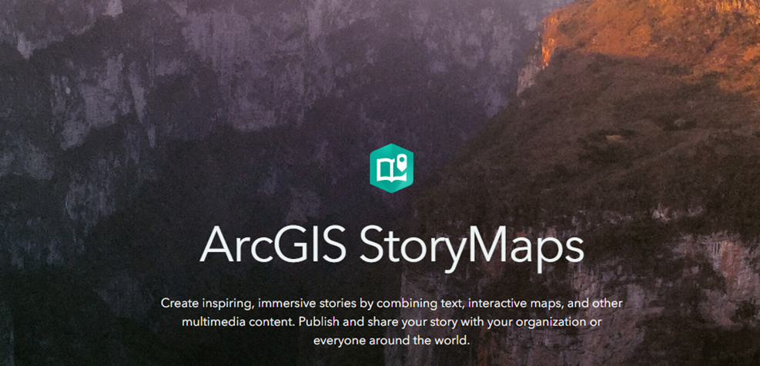


Geospatial Information Services
AI + GIS + Drones Planet Imagery + ESRI Day
Dr. Nan Li, UCR Environmental Sciences
Dr. Nicolas dos Santos, UCR Computer Science
Planet Imagery Day is supported by USDA-NIFA's Artificial Intelligence for Sustainable Agriculture project
In a collaboration with the Artificial Intelligence for Sustainable Agriculture (AI4SA) project, the library hosted Planet Imagery Day on May 2, 2025. The event featured presentations regarding using Planet imagery in Google Earth Engine and in ArcGIS products, given by staff from Planet and Esri respectively.

Slide 20
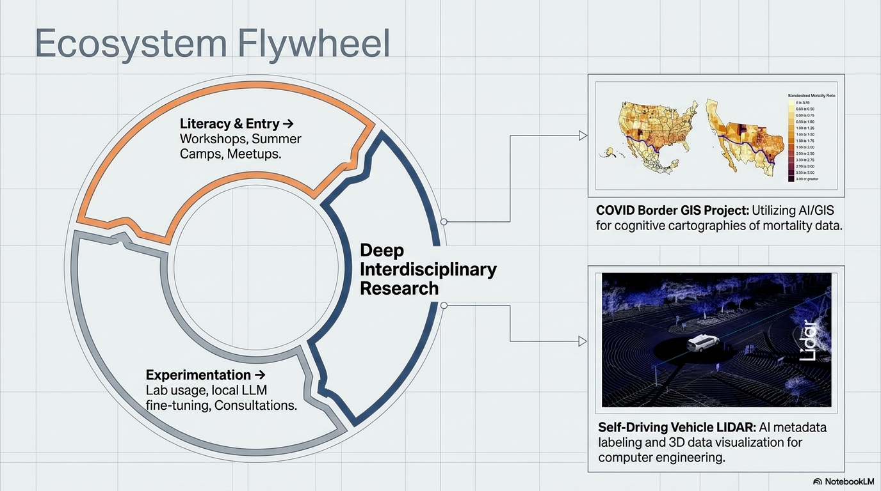
Creation

Slide 21

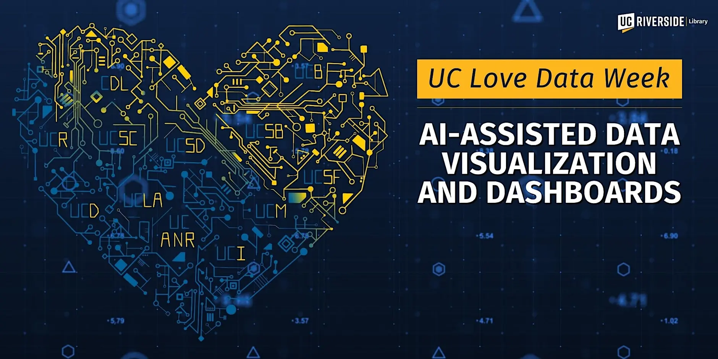
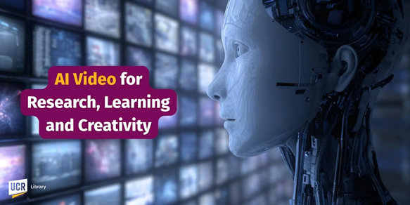
AI
Workshops
On UCR, State
And National
Levels

Slide 22
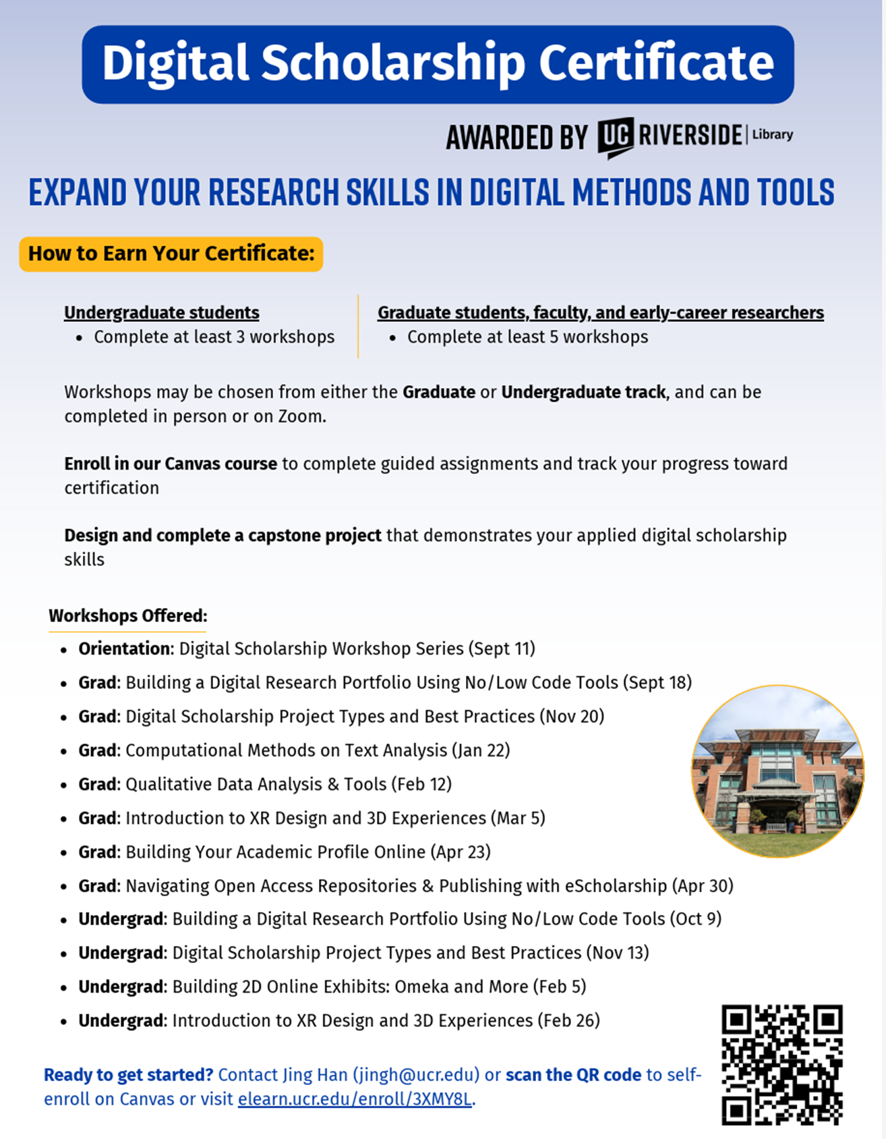
Digital Scholarship Certificates For Workforce Readiness
Literacy in the 21st Century means Information, Digital and AI Literacy

Slide 23
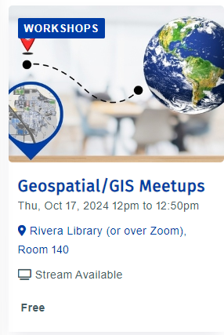
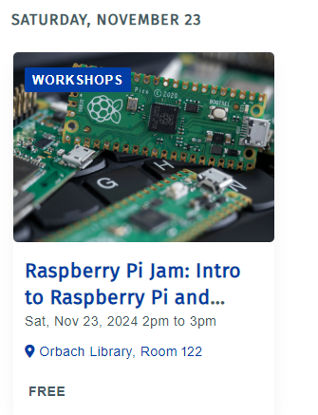
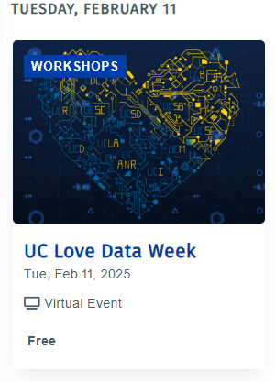

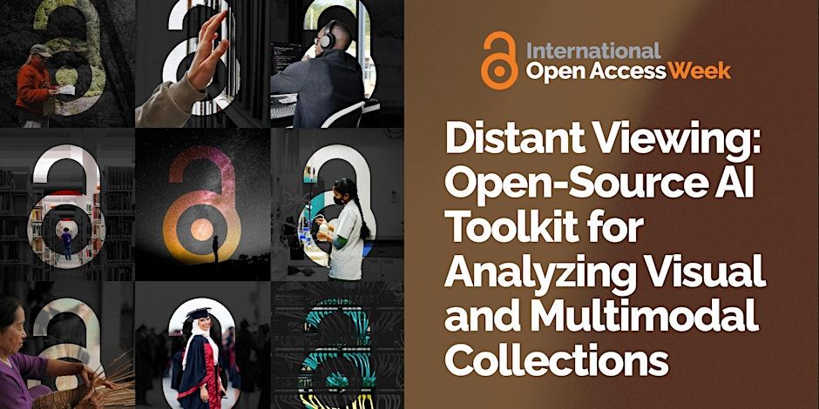
AI Research Orientation to Technology Workshops and Faculty, Student AI Related Research
Meetups, Thematic Weeks, Presentations
Data, AI,
Open Access
Global North and South Presentation
Streaming Party
For Faculty Students and Staff
AI Research Faculty
Presentations
AI/Robotics
Training Kits
Workshops

Slide 24
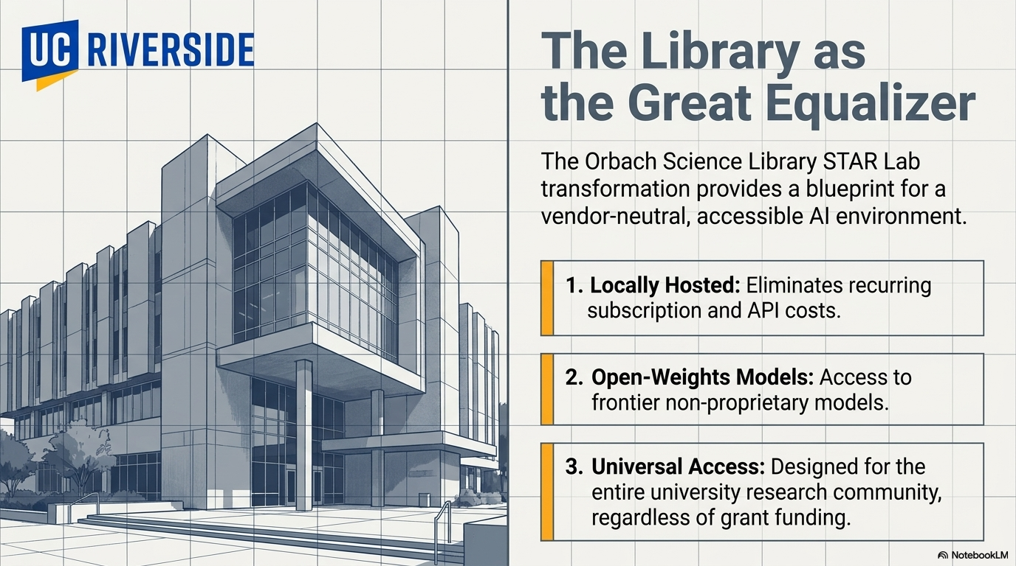
2027
Local Open Source AI Lab

Slide 25
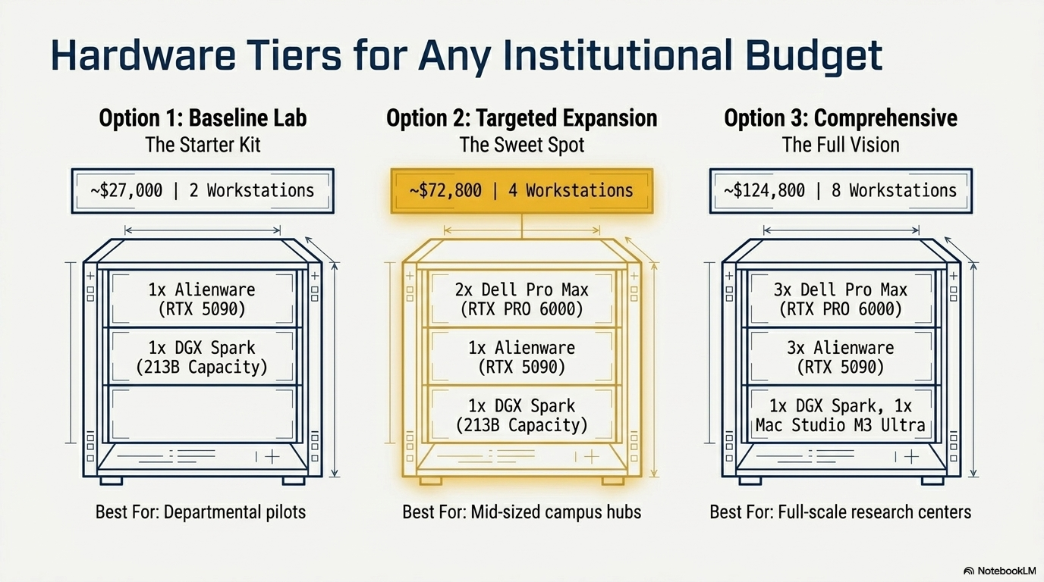
If a Bigger Lab Needed, Scale: (Option #3 x 2) = Double or Triple Size
Speed and/or Processing Power (Larger AI Models) Balance
Full Lab Project Specs

Slide 26
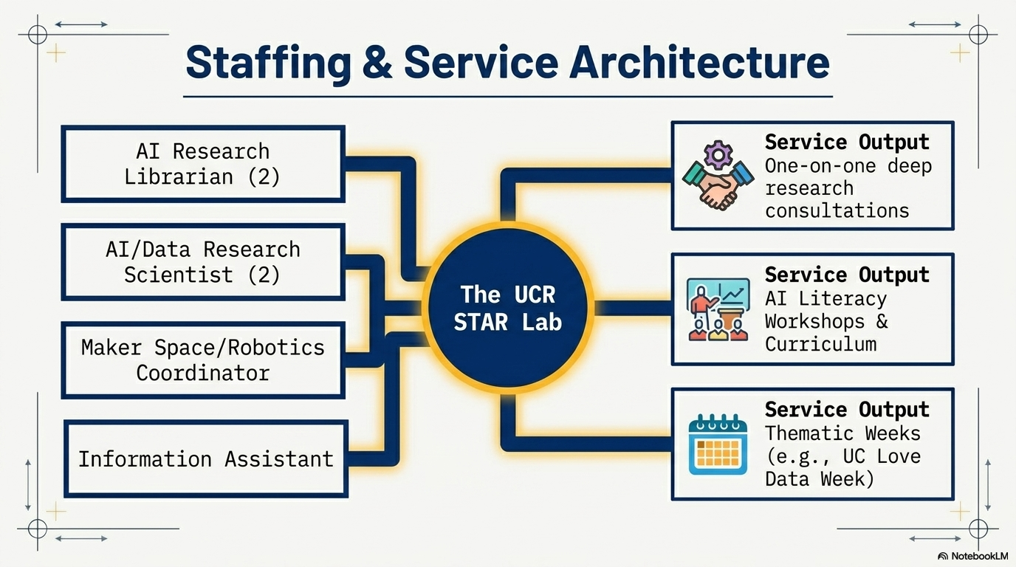

Cyberinfrastructure Staff
AI Lab Subcommittee

Slide 27
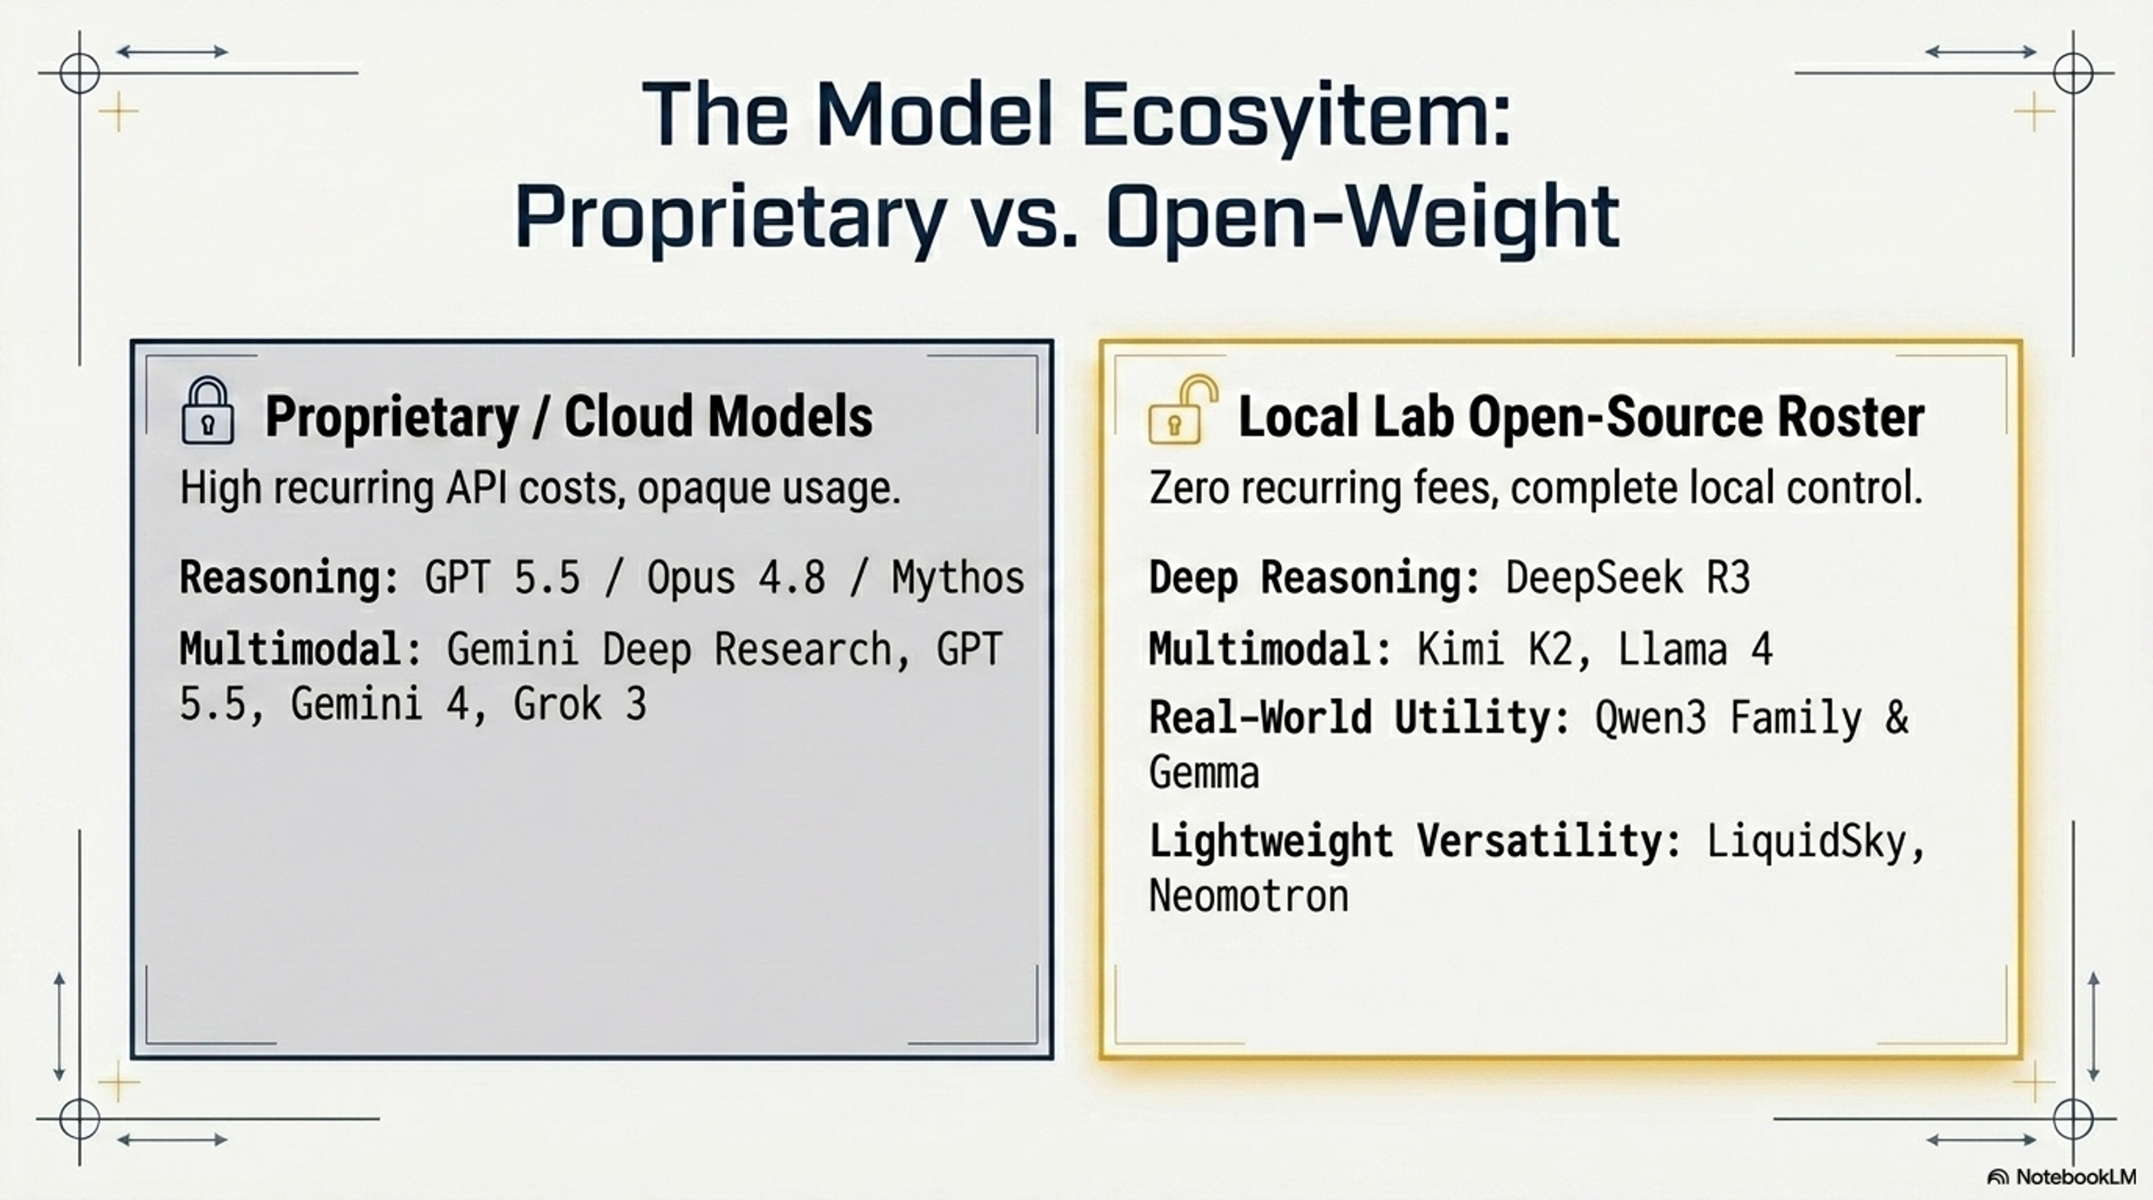
Ecosystem
&
&
Government Retraction /AI Corporate
Hobbling: Anthropic Fable 5, Mythos
Data Privacy/Campus IP: Data and IP
are off campus, model usage/data could be
retracted by various entities
Data Privacy/Campus IP: Data and IP
remain on Campus
Information Technology Services, Library Research and Technology Services and HPC Working Together

Slide 28
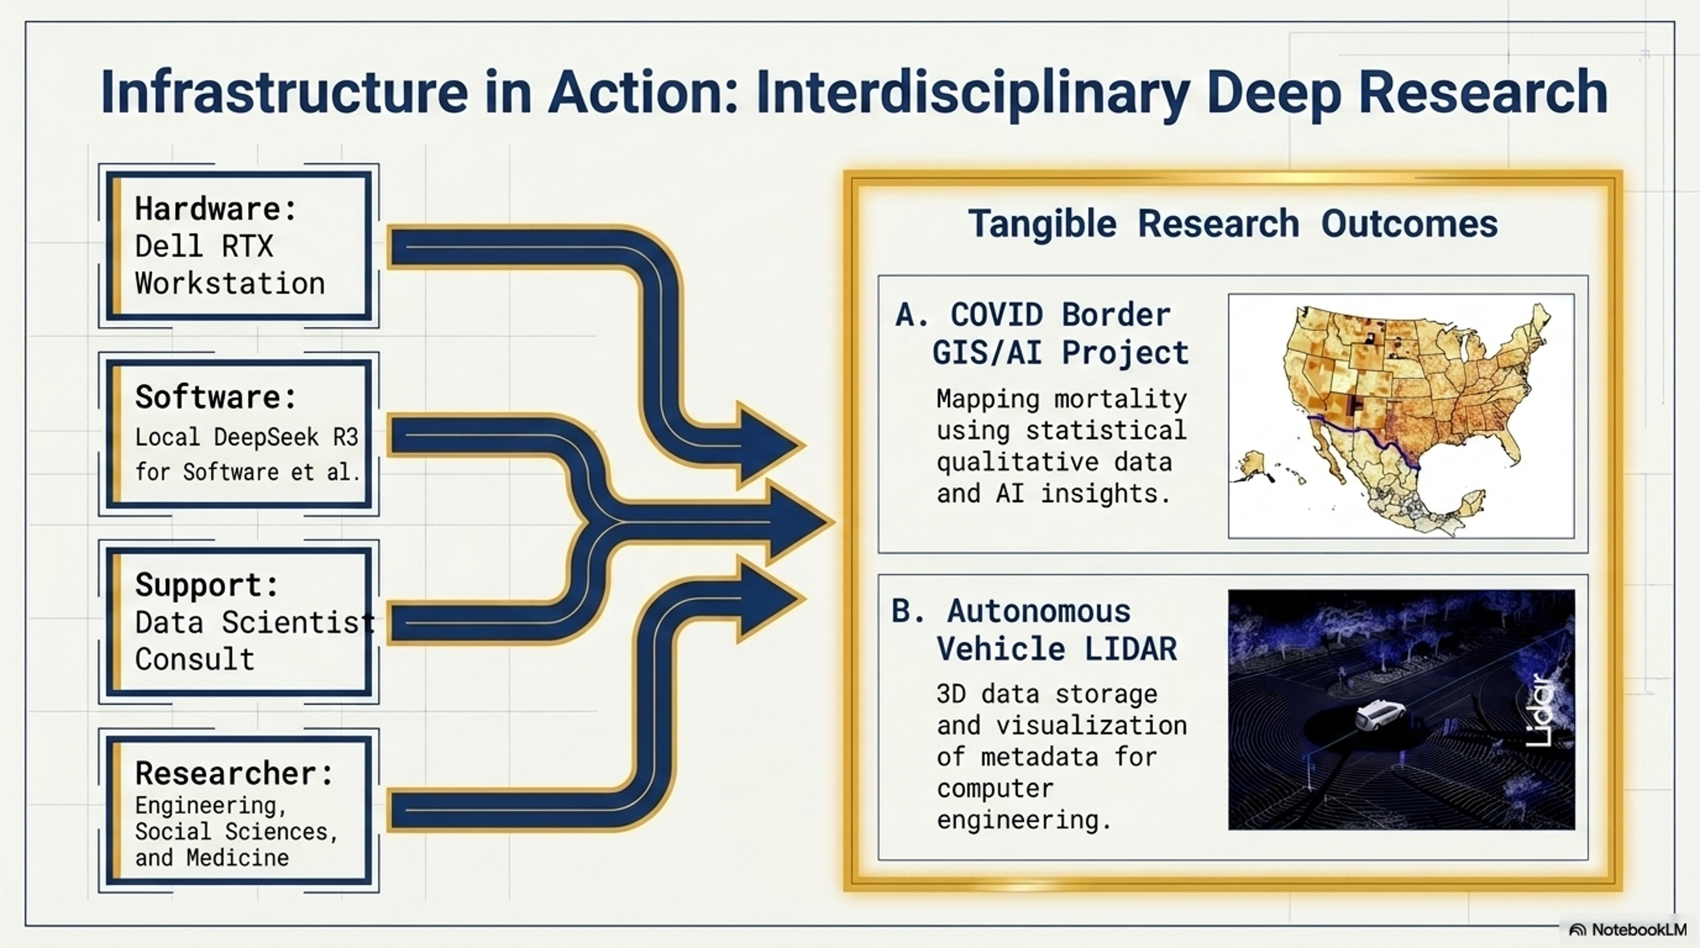

Slide 29
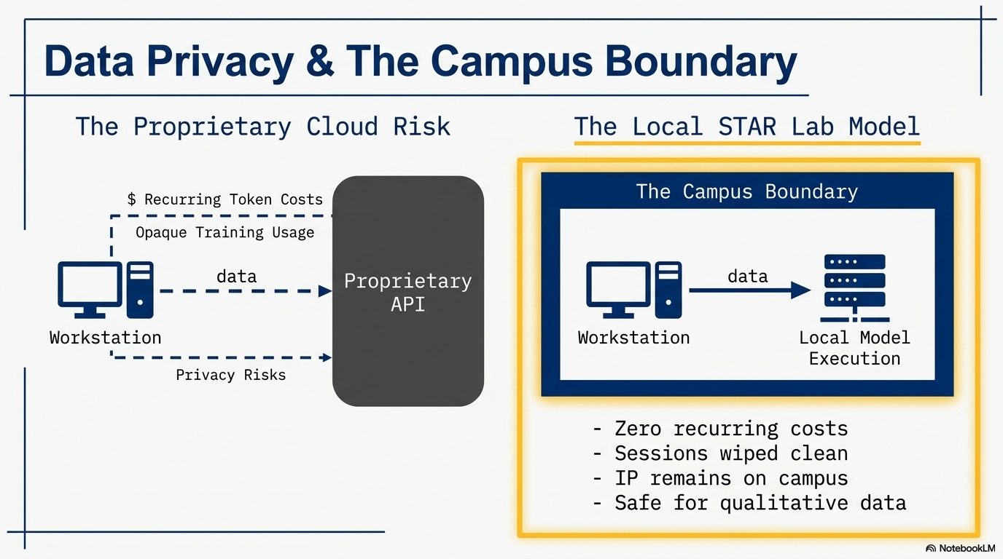

Slide 30
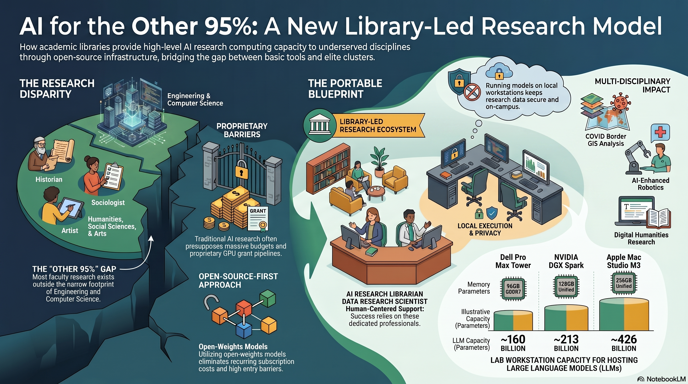
& Facilitated

Slide 31
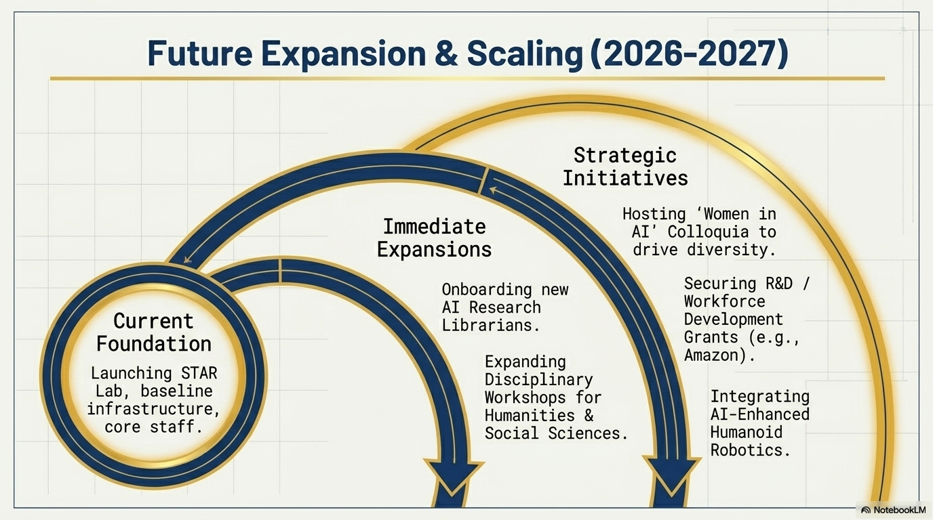
2-4

Slide 32



Comments and Questions
Thank you for Attending!
Ray Uzwyshyn, Ph.D. MBA MLIS
Acting AUL for Research & Technology Services
University of California, Riverside Libraries, raymondu@ucr.edu
https://www.linkedin.com/in/rayuzwyshyn/
https://rayuzwyshyn.net

Slide 33
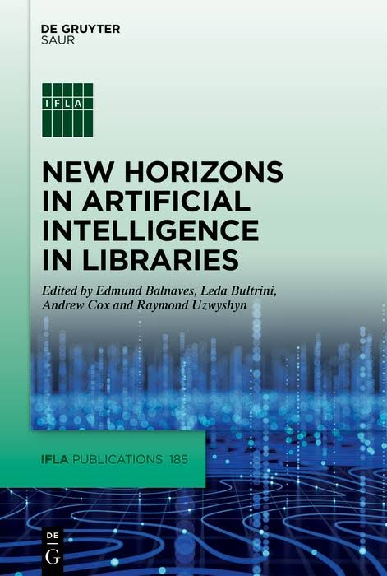
AI Literacy Related Library and Research Computing AI/Data Resources
Uzwyshyn, R. Deep Research Open-Source AI for the Other 95%:A Pragmatic Methodology for Academic Library AI Literacy Infrastructures . RCSI 2026: Research Computing for Small institutions Conference. Swarthmore College. National Science Foundation Sponsored. June 16-17, 2026.
UCR Library Research and Technology Services. Star Lab AI Lab Transformation Planning Document (Tech Specs.). June 2026.
Building Library AI Infrastructures: Research Data Repositories, Scholarly Ecosystems and AI Scaffolding (Draft). New Horizons in AI for Libraries. De Gruyter: Berlin, January 2025.
Uzwyshyn, R. Reimagining Education In the Age of AI: From Information Scarcity to Abundant Intelligence. (CXO Print Edition). Education Technology Insight. 2025.
Uzwyshyn, R et al. New Horizons in AI for Libraries (Editor). (Open Access Version). Intro: Projects in Machine Learning and Natural Language Processing in Libraries (Proof) .IFLA. Walter De Gruyter (GmbH): Berlin January 2025.
Uzwyshyn, R. From Open Science and Datasets to AI and Discovery. Trends and Issues in Library Technology: IFLA IT Section. January 2023.
Uzwyshyn, R. Online Research Data Repositories: The What, When, Why and How. Computers in Libraries. 36:3, April, 2016. pp. 18-21.
Presentations, Publications
https://rayuzwyshyn.net
https://www.linkedin.com/in/rayuzwyshyn/

Slide 34
Larger AI Infrastructure Support
University of California, Riverside
Three Main Areas
AI Literacy, Faculty, Student &
Researcher Onboarding AI Support
  Use of AI tools in research and teaching e.g., research design, data collection analysis
  ResearchData management
  AI Model onboarding, Training for regular size datasets, AI Applications
  Dedicated Staff Support
  and Integration
Libraries,
Research & Technology Services
High Performance Computing (HPC)
UCR RAISE
Information
Technology
Services
& Faculty Teaching Center
University System Wide AI Proprietary Licenses (Google Gemini, Limited OpenAI, Anthropic, Vertex)Broad general training
AI/Security
High Performance Computing GPU Clusters), Research Compute (Top 2-5%, Major Grant Support Costs Recovery Involved)
Instructor Development,

Slide 35
Library Workshops for Onboarding Researchers
(FY25/26 Samples)
Introduction to Machine Learning
Introduction to Gemini API: How to customize AI models
Exploring AI Literature Mapping Tools (Natural Language Processing)
Finding and Using Imagery in a GIS, Arc GIS and AI, Drones &GIS
Data Cleaning for Machine Learning with Python
AI Computational Methods with Text Analysis
AI Deep Research Models/AI Video
Introduction to Deep Learning with PyTorch
Open scholarship / open access publishing
Contact:
Raymond Uzwyshyn, Director of Research Services/Acting Assistant University Librarian for Research and Technology, UCR Library

Slide 36


Slide 37
Digital Scholarship & Scholarly Communication
AI Computational & Qualitative Text Analysis
Data Analysis & Visualization
Web Scraping & Digital Archiving
Open Access publishing support
Learn more about the UCR Library digital scholarship & scholarly communication services

Slide 38

(Cost recovery)

Slide 39

Thematic Weeks

Slide 40


