Slide 1
Vibe Coding
AI-Assisted Programming — The Live Demos
No coding experience required — just curiosity and a willingness to surf the waves!
Ray Uzwyshyn, Ph.D. MBA MLIS
Acting AUL for Research and Technology
& Director of Research Services
UCR Libraries | University of California, Riverside
https://rayuzwyshyn.net , https://www.linkedin.com/in/rayuzwyshyn
UCSF Generative Office Hours
1 / 21

Slide 2
What Is "Vibe Coding"?
Programming through natural language conversation with AI.
Not less rigor but a different focus: Paradigm shift towards clear language and evaluation, iteration & validation
Traditional Coding | Vibe Coding
Deterministic | Probabilistic
Syntax-first | Natural Language-ideation first
Debugging errors | Shaping emergence and rigor through iteration/conversations
Engineer as syntax and logic translator | Creator as conductor/orchestrator/project manager
Full-stack analytic software engineering background preferred | Fuzzy Logic orchestration (Probabilistic, Neuro-symbolic)
UCSF Generative Office Hours
2 / 21

Slide 3
Key Tips for Effective Vibe Coding
1
Start with Idea, Openness, Curiosity
4
Verify Everything at Least Twice
Develop your research question — AI responds to clear intent
Fluency ≠ factuality. Always cross-check outputs and sources against primary sources/links
2
Describe, Don't Prescribe
5
Use Deep Research as Basis as Needed (The AI Research Models)
Tell the AI what you want, not how to build it. Natural language and Voice > syntax
Let AI models research your topic deeply before building — synthesis drives quality
3
Iterate Conversationally
6
Ask the AI Questions
12–20 versions is normal. Treat AI as a collaborative partner, not a one-shot tool, Back and Forth, Call and Response
Invite the model to ask clarifying questions. Better input = better output “Feel Free To Ask Me Questions?
UCSF Generative Office Hours
3 / 21

Slide 4
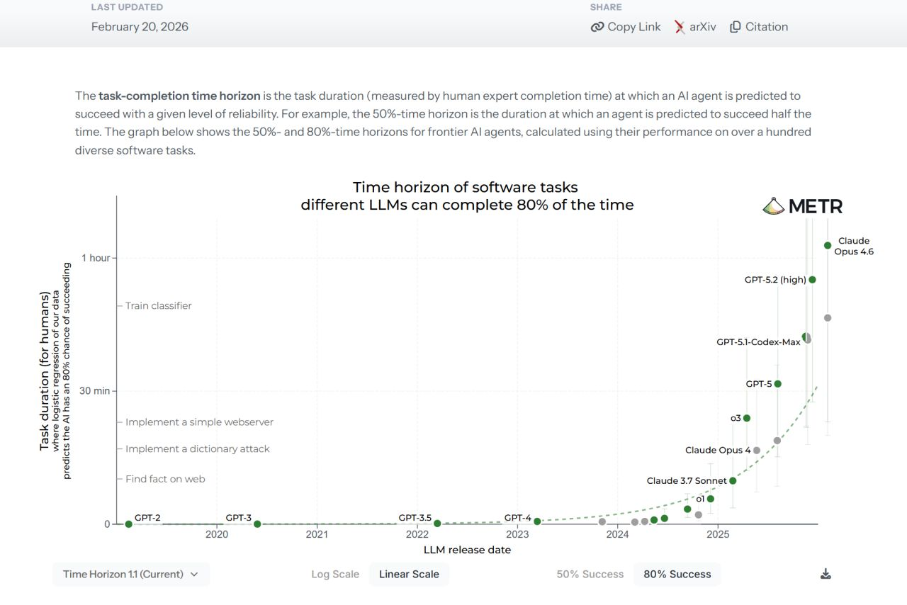
Our Current State, 2026 AI Coding Capability
METR Task-Completion Time Horizon Benchmark (February 2026)
Source: METR.org — Measuring AI task completion across 100+ software tasks
UCSF Generative Office Hours

Slide 5
The Iterative Workflow: Deep Research + Vibe Coding
1
Deep Research
Use AI deep research models to survey literature, find data sources, synthesize background
2
Frame Your Prompt
Define the task, audience, format, and data structure — be specific about what you want
3
Generate MVP
Produce a Minimal Viable Product through conversational co-creation with AI
4
Iterate & Refine
Converse, produce, review, edit, repeat. Version — 8–20 iterations is normal for excellent output
5
Validate & Publish
Cross-check sources, verify data, test accessibility, then deploy your final product. Publish to Artifacts or Web (Server)
UCSF Generative Office Hours
5 / 21

Slide 6
Today's Live Demos: From Simple To Complex
Demo 1
UC Research Starter
AI-powered brainstorming app for research faculty and graduate students — accessible, immediate, and practical
Demo 2
PRISMA Systematic Review Framework
Interdisciplinary systematic review with structured PRISMA methodology, literature mapping, and research synthesis
Demo 3
AI Literacy Curriculum Builder
Multi-literacy curriculum generator through critical lenses — building education tools accessible to all skill levels
Demo 4
The Boring Company Project
Complex infrastructure analysis with deep research synthesis — 10 global tunnel sites, ROI matrices, and data visualization
~20—25 min demos + 10–12 min discussion & Q&A
UCSF Generative Office Hours
6 / 21

Slide 7
Demo 1 UC Research Starter: The Prompt
PROMPT ENGINEERING 101: The Structured Simple Prompt
Create a University of California AI-powered research brainstorming application.
The app should:
- Help faculty and graduate students brainstorm research questions
- Suggest methodological approaches and theoretical frameworks
- Generate structured research outlines
- Connect ideas to relevant literature and datasets
- Work across all disciplines (STEM, humanities, social sciences)
Use the Anthropic Claude AI API for real-time brainstorming.
Design with UC branding (blue and gold) and professional styling.
Please ask me questions if you have about the features or audience.
The AI API The AI Model’s Trillion Parameter Brain (Hyperdimensional Neural Net)
UCSF Generative Office Hours
8 / 21

Slide 8
DEMO 1
UC Research Starter
AI-Powered Brainstorming for Research Faculty and Graduate Students
What It Does
Why Start Here
Helps researchers brainstorm and refine research questions through AI-guided conversation
Suggests methodological approaches, theoretical frameworks, and literature connections
Generates structured research outlines with key variables and hypotheses
Designed for UC faculty and students — accessible to all disciplines
Simples vibe coding example — everyone understands the research brainstorming pain point
Shows the core Prompt Engineering pattern: Describe what you want → AI generates a working app → Review, Verify, Iterate (Repeat as Necessary)
AI API integration: the app connects to Claude for real-time brainstorming at trillion-parameter scale
From prompt to working application in a single conversation
[UC Research Starter]
[New York Designer Remix]
UCSF Generative Office Hours
7 / 21

Slide 9
Demo 2: The Prompt: PRISMA Keep it Simple
PROMPT
Create an interdisciplinary systematic review framework using PRISMA guideline documents available here: https://www.prisma-statement.org/ .
Include:
- Structured search strategy builder (databases, keywords, Boolean logic)
- Screening criteria with inclusion/exclusion tracking
- PRISMA flow diagram generation
- Evidence synthesis tables with quality assessment
- Cross-disciplinary theme mapping
Design for researchers across health sciences, social sciences, and STEM.
Use professional academic styling.
Please ask me questions if you have about the data or research.
UCSF Generative Office Hours
10 / 21

Slide 10
DEMO 2
PRISMA Systematic Review Framework
Research Insights Architect: Interdisciplinary Systematic Review App
What It Does
Key Technique
Structures interdisciplinary literature reviews using the PRISMA framework
PRISMA stands for Preferred Reporting Items for Systematic Reviews and Meta-Analyses. 27 item checklist, four phase flow diagram for rigor
Automates search strategy, screening criteria, and inclusion/exclusion tracking
Generates synthesis tables and evidence maps
Produces publication-ready methodology sections
Deep research synthesis first — AI surveys the literature landscape before building the tool
Structured prompts define methodology, inclusion criteria, and output format upfront
AI API enables real-time analysis as new research is added
Iterative refinement through conversational editing
[PRISMA Review Framework V.1 Sonnet 3.5, 2025]
[PRISMA Review Framework V.2 Beta, Unverified, Opus 4.6]
UCSF Generative Office Hours
9 / 21

Slide 11
Demo 3: The AI Curriculum Builder
PROMPT
Build a multi-literacy AI curriculum builder that generates lesson plans through multiple critical lenses.
Critical frameworks to include:
- Bruno Latour (Science, Technology & Society)
- Donna Haraway (Situated Knowledge / Feminist Posthumanism)
- Karen Barad (New Materialism / Intra-action)
- Traditional Media Literacy (critical evaluation of sources)
For each lens, generate: learning objectives, activities, assessments.
Support customization by grade level and special needs.
Enable AI API to generate new curricula in real-time.
Please ask me questions about pedagogical approach or audience.
UCSF Generative Office Hours
12 / 21

Slide 12
DEMO 3
AI Literacy Curriculum Builder
Multi-Literacy Curriculum Builder: AI Literacy Through Multiple Critical Lenses
What It Does
Key Technique
Generates complete AI literacy curricula grounded in critical theory frameworks
Multiple lenses: Latour (STS), Haraway (feminist posthumanist), Barad (new materialist), media literacy
Customizable for grade levels, special needs, and curriculum standards
AI API-powered: generates activities, assessments, and lesson plans in real-time
Theoretical framework as scaffolding — critical lenses structure the AI's output, not just aesthetics
Anthropic Claude AI API integration enables real-time curriculum generation at the trillion-parameter scale
Version evolution: V.1 → V.2 with enhanced accessibility and standards alignment through iterative prompting
Original Version https://claude.ai/public/artifacts/1b85ff5b-069d-4ef4-872c-52195f86814a
[Bruno Latour Specialized Version]
UCSF Generative Office Hours
11 / 21

Slide 13
DEMO 4
The Boring Company Project
Unlocking the Invisible Mile: 10 Global Strategic Sub-Ground Tunnel Sites
What It Does
Deep Research + Vibe Coding
Identifies 10 highest-ROI global infrastructure bottlenecks solvable by a single 1-mile tunnel intervention
Full research reports, site maps atlas, ROI matrices, and operational metrics dashboards
Interactive data visualizations for each site with comparative analysis
Multimedia: podcasts, video overviews, presentation decks — all AI-assisted
Deep research Complex Interdisciplinary Research Project
Complex multi-format output: PDFs, HTML dashboards, presentations, audio/video — all from conversational prompts
Shows the full vibe coding pipeline: research → prompt → build → iterate → publish
[Tunnel Vision]
UCSF Generative Office Hours
13 / 21

Slide 14
Demo 4: Deep Research Synthesis + Prompt
STEP 1: UTILIZE DEEP RESEARCH MODELS : (Gemini 3.1, OpenAI 5.2, Opus 4.6, Kimi K2 2.5 Thinking, Deep Seek 3, Grok 4(
STEP 2: BUILD PROMPT
Research the top 10 global infrastructure bottlenecks that could be solved by a single 1-mile tunnel.
Consider:
- Airport connectivity gaps
- Urban transit dead zones
- Port-to-rail missing links
- Cross-border bottlenecks
Rank by ROI, feasibility, and economic multiplier effect.
Create an interactive project site using the Research Reports as a Base for top 10 tunnel ranking and analyses.
Include:
- ROI matrix with comparative scoring
- Operational metrics dashboard
- Site maps atlas (interactive)
- Full research report + addendum
- Audio/video overviews
Use professional styling with dark theme.
UCSF Generative Office Hours
14 / 21

Slide 15
Your AI Toolkit
Claude Artifacts
Custom interactive apps, dashboards, AI API integration
Building Prototypes, Iterating & deploying
Deep Research Models
Literature surveys, data discovery, ‘Deep Research’ Cross Model source verification and validation
Research foundation
Exploratory data analysis, Python notebooks, scientific verification
Analysis & validation
Opus 4.6, Sonnet 4.6 ChatGPT 5.2, Gemini 3.1. Grok Kimi K2 2.5 Thinking, Deep Seek 3, Qwen
NotebookLM
Research synthesis, audio podcasts, video overviews, infographics
Multimodal synthesis
The agentic future
The Future Autonomous Agents OpenClaw, CrewAI etc.
Autonomous personal AI agents, Teams, Crews, Groups and Swarms —full workflow management email, calendar, code, Social Media Connections, Human AI Collaboration
UCSF Generative Office Hours
16 / 21
All tools available now — start building today

Slide 16
Best Practices & Responsible Use
Do This
Avoid This
Start with clear research questions
Use deep research before building
Iterate incrementally (8–20 versions)
Validate and verify all outputs against source data
Document your prompts and iterations
Invite the AI to ask you questions
Cite AI tools and data sources, check sources
Embrace experimental discovery
Skipping verification and validation
Trusting complex calculations blindly
Feeding sensitive data to AI
Assuming first output is final
Over-complicating visualizations
Forgetting accessibility standards
Ignoring institutional compliance
Going for perfection in one shot
Fluency ≠ factuality | Plausibility ≠ verification | Coherence ≠ clinical safety
UCSF Generative Office Hours
17 / 21

Slide 17
The Future: Agentic AI
From vibe coding to AI agents that act autonomously on your behalf
Multi-agentic Architectures, OpenClaw, et Al.
Why It Matters
Beyond Cursor, Lovable, Claude Code
Vibe coding → Vibe working
AI doesn't just write code for you — it manages your entire digital workflow
The future professional is a cognitive supervisor or AI IT project manager of agentic systems
"2026 is the year of personal agents"
"The AI that actually does things."
Multi-agent orchestration: specialized sub-agents collaborate
OpenClaw Open-source personal AI agent by Peter Steinberger
Runs on your machine — Mac, Windows, or Linux with full privacy
Communicates via WhatsApp, Telegram, Discord, Slack, iMessage
Manages email, calendar, flights, code, files — autonomously
UCSF Generative Office Hours
15 / 21

Slide 18
Thank You!
Comments and Questions
UCSF Generative Office Hours
Ray Uzwyshyn, Ph.D. MBA MLIS
Acting AUL for Research & Technology | Director of Research Services
UCR Library | University of California, Riverside
LinkedIn: linkedin.com/in/rayuzwyshyn | Vita: rayuzwyshyn.net
21 / 21

Slide 19
Selected Works: AI Coding & Programming
Applications, AI API-Enabled Apps, React, Node, Anthropic Claude API • rayuzwyshyn.net
Move 37:The Art of Counterintuitive Discovery. Research Discovery Engine Modeled After Dennis Hassabis AlphaGo Creative AI Methodology. (AI API App) July 2025. AI Literacy Activities and Planning Curriculum Builder Multi-Literacy Curriculum Builder: AI Literacy Education Through Multiple Critical Lenses. (AI API Enabled) August 2025. Further Info
UC Research Starter: University of California AI Powered Brainstorming Application for Research Faculty and Graduate Students. (AI API App) July 2025.
Jungian Psychotherapeutic Therapy App: Individuation. Hillman, von Franz, Jung. (AI API App). July, 2025.
Symph Composer: Note Taking Creative Idea Brainstorming Scratch Pad (Experimental). July 2025.
Bruno Latour AI Literacy Builder: Based on Latour's Science, Technology and Society Framework. Version 2 (Enhanced, Special Needs, Curriculum Standards. (AI API Enabled) June 2025.
Spartan Amazonia: Mind-Body Training System: Integrating, Movement Mindfulness and Nutrition for Optimal Performance (AI API app). June 2025.
Athena Deep Learning: Computational Creativity for Strategic Business Intelligence. Business App v.11, V.52 Simplified (AI API app). June 2025.
Research Insights Architect: PRISMA Interdisciplinary Systematic Review Framework App. June 2025.
Urban Spartan: Men's Health App. May 2025. Market Derivative Sonic Screener. V.5, V.7, V.7.b, V.9) (AI API). Financial Derivative Experimental Prototypes Through Aural Analogues. (Background) 2025.
UCSF Generative Office Hours
18 / 21

Slide 20
Selected Works: Data Visualization & Dashboards
Complex Data-Driven Dashboards & Information Visualization Apps • rayuzwyshyn.net
The Graduate Employment Paradox: Interactive Data Visualization and Synthesis: New York Federal Reserve, Stats Canada and UK Universities Labor Market Sources et al. 2026 Collider Bias: The Elite Athlete Paradox. Multivariate Complex Statistics Explained through Interactive Visualization (Background).2025
NASDAQ Corporations Across Demis Hassabis Probability Landscape. (Business App Mapping Innovation Stages to Market Capitalization. June 2025.
AI's Impact on Knowledge Workers: Real-Time Analysis of Economic Transformation on Professional Work v.6 (Interactive Data Visualization). June 2025
AI Model Intelligence and Economics Dashboard , Version 14 Revision. (Price Performance, Ranking, Market Intelligence). June 2025.
Athena Capital Financial Derivatives Sell Side Puts Quant App . V. 2 FinTech. (AI API). May 2025.
AI Innovation in Academic Research Libraries. Advanced Data Analytics and Visualization Dashboard. May 2025.
NASDAQ Companies Mapped to Demis Hassabis Creativity Architecture. April 2025. Advanced Citation & LinkedIn Analysis Dashboard. Interactive Visualization so Citation Patterns, knowledge flows and LinkedIn Post Performance. April 2025.
Complex Treasury Bond ETF Yield Relationships (TLT). Interactive Visualization of TLT Price relationship vs Treasury Yields and Federal Reserve Fund Rate. 2025
Enhanced Socio-Economic Analysis of LinkedIn User Profile Interest Networks. Interactive Visualization. 2025
UCSF Generative Office Hours
19 / 21

Slide 21
Selected Works: AI-Human Collaboration & Research
Scholarly Articles, Social Media Publications & AI Research Program, https://www.linkedin.com/in/rayuzwyshyn/recent-activity/articles/ ,
Formal Publications
Human-AI Collaboration
Beyond Traditional AI IQ Metrics: Metacognition & Benchmarking for LLMs, AGI, and ASI. J. Human Behavior & Emerging Tech., 2026.
Reimagining Education in the Age of AI: From Information Scarcity to Abundant Intelligence. Education Technology Insight, 2025.
New Horizons in AI for Libraries (Editor). IFLA Publication Series, De Gruyter, 2025.
Building Library AI Infrastructures: Research Data Repositories & AI Scaffolding. De Gruyter, 2025.
A Blueprint for AI/Human Ph.D. Level Research Collaboration (2025–2035). LinkedIn AI Feature, 2025.
Human–AI Ph.D. Level Co-Intelligence 2025–2035: Roadmaps, Reflections & Recommendations. 2025.
Co-Intelligence, Entangled Partnerships & New Models for Human-AI Collaboration. 2025.
Meeting the Algorithm Halfway: Karen Barad's Quantum Entanglement as Human/AI Model. 2025.
AI Literacy & Critical Theory
AI Coding, Creativity & Discovery
Mapping AI Networks: Bruno Latour, STS and AI Literacy in 2025. LinkedIn AI Feature, 2025.
Donna Haraway's Cyborg Vision: A Framework for Understanding AI Literacy in 2025. 2025.
Women of AI Series: How Four California Academic Theorists Wrote the Book on AI Ethics. 2025.
Karen Barad's Physics Frameworks Applied for AI Literacy (10 Concepts). 2025.
Move 37: Paths for AI Creativity in Discovery & Academic Research for 2025. 2025.
Staying With the Trouble: Programming's Symbiotic AI Vibe Turn. 2025.
AI Coding Tools Quick Comparison & Quick Beginners Guide 2025. 2025.
The Architecture of Probabilities: Inside Demis Hassabis' Framework for AI Creativity. 2025.
115+ AI scholarly and social media articles across 9 interdisciplinary domains • Research: ResearchGate Social Media: linkedin.com/in/rayuzwyshyn/recent-activity/articles/
UCSF Generative Office Hours
20 / 21

